Slide 1
Team 1

Slide 2


Slide 3
Fore Head

Slide 4













Slide 5
Water -fall

Slide 6


Slide 7
Tu nafish

Slide 8


Slide 9
TeaBag

Slide 10


Slide 11
Rob in hood

Slide 12



Slide 13
Broken Heart

Slide 15
Team 2

Slide 16
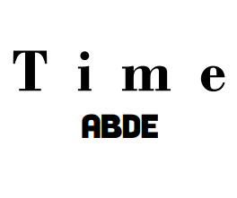

Slide 17
Long Time No SEE

Slide 18


Slide 19
Sea Horse

Slide 20


Slide 21
Middle Aged

Slide 22


Slide 23
Sea-Saw

Slide 24


Slide 25
Foreign Language

Slide 26
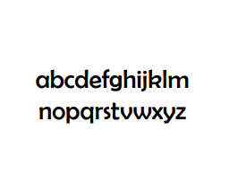

Slide 27
Missing You

Slide 29
Team 3

Slide 30
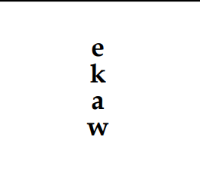

Slide 31
Wake Up

Slide 32


Slide 33
Design

Slide 34


Slide 35
3 D movie

Slide 36


Slide 37
Once Upon a Time

Slide 38


Slide 39
Top Secret

Slide 40


Slide 41
After Noon tea

Slide 44
TEAM 4

Slide 45


Slide 46
Camping OverNight

Slide 47
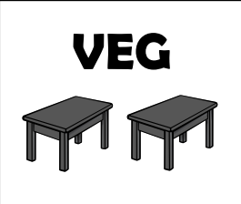

Slide 48
Veg e tables

Slide 49


Slide 50
Travel Under Seass

Slide 51
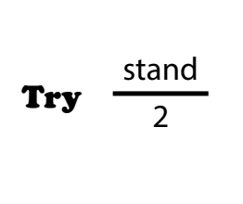

Slide 52
Try to Understand

Slide 53


Slide 54
Up to you

Slide 55


Slide 56
Time to go

