Slide 1


https://youtube.com/shorts/_MWlYGdIS_I?feature=share
Department Of Mechanical Engineering
FINAL Review
Guided by:
Mr.s.saravaNAkumar
Presented by Srikrishna.s(927622BME088)
Vikas.v(927622BME101)
Mugunthan.u(927622BME312)

Slide 2
Drum Relocation Equipment

Slide 3
ABSTRACT:
The Drum Relocator is a specially designed equipment for safe and efficient handling of drums containing hazardous materials.
This innovative solution aims to minimize the risk of accidents, spills, and environmental contamination associated with manual drum handling.
The Drum Relocator features a robust and ergonomic design, allowing for easy maneuverability and precise control. Its advanced safety features, including automatic braking and secure drum gripping, ensure a secure and stable transportation process.

Slide 4
METHODLOGY:
Pre-Relocation Steps
1. Assessment: Evaluate the drum's condition, size, weight, and material.
2. Planning: Determine the relocation route, considering obstacles and clearances.
3. Safety precautions: Wear personal protective equipment (PPE) and ensure the area is clear.

Slide 5
COST ESTIMATION:
Factors Influencing Cost:
1. Drum size and weight
2. Relocation distance
3. Equipment requirements
4. Labor expertise
5. Regulatory compliance
6. Site-specific challenges

Slide 6
OBJECTIVE
The objective of this project is to identify and recommend drum relocation equipment that enhances safety, operational efficiency, and regulatory compliance while accommodating various drum sizes and types.
The goal is to ensure that organizations can select equipment that meets their specific needs, fits within their space constraints, and provides cost-effective solutions for handling hazardous or sensitive materials.

Slide 7
PROJECT OVERVIEW:
Organizations managing drums with hazardous or sensitive materials face challenges in ensuring:
Safety: Preventing accidents and spills during drum relocation.
Efficiency: Streamlining operations and reducing labor costs.
Compatibility: Choosing equipment that fits various drum sizes and types.
Space: Selecting equipment suitable for limited facility space.
Compliance: Meeting safety and regulatory standards.

Slide 8
KEY COMPONENTS:
FRAMES
CHASSIS
PLATFORM
WHEELS OR CASTERS
BREAKING SYSTEM
DRUM HANDLERS
DRUM GRIPPERS

Slide 9
MATERIALS USED:
HANDLE BARS
STEEL WHEELS
STAINLESS STEEL
RUBBER BUSHES

Slide 10
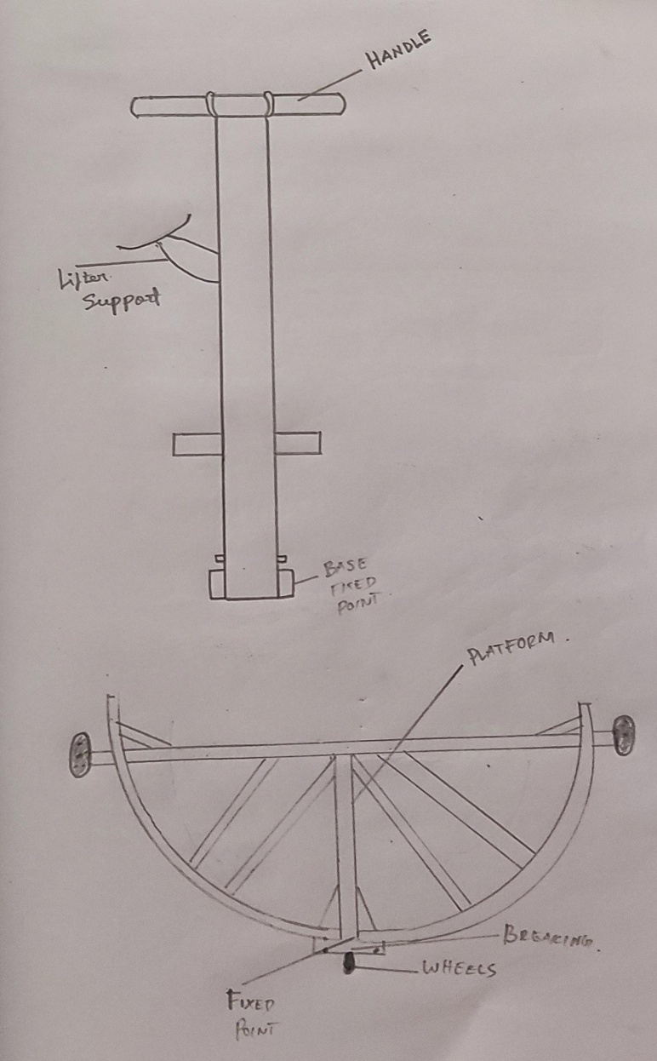
BLOCK DAIGRAM:

Slide 11
CONSIDERATION
Load Capacity and Weight: Ensuring the equipment can handle the drum's weight.
Drum Size and Type: Steel, plastic, and fiber drums have different requirements.
Material Handling Needs: Consider whether the contents are hazardous or flammable.
Safety Regulations: Compliance with safety standards for hazardous materials

Slide 12
Advantage and application:
Advantages:
1. Improved Safety: Reduces manual handling risks, minimizing injuries and accidents.
2. Increased Efficiency: Streamlines drum movement, saving time and labor.
3. Reduced Damage: Protects drums and contents from damage during relocation
.4. Space Optimization: Enables efficient storage and organization.
5. Cost Savings: Decreases labor costs, equipment damage, and spill cleanup expenses.
6. Enhanced Productivity: Allows personnel to focus on higher-value tasks.
7.Flexibility: Suitable for various drum sizes, weights, and materials.

Slide 13
Industrial Applications:
1. Chemical Plants: Handling hazardous materials and chemicals.
2. Oil and Gas: Managing drum storage and transportation.
3. Manufacturing: Relocating drums within production facilities.
4. Warehousing: Organizing and storing drums efficiently.
5. Construction: Moving drums on-site.

Slide 14
CONCLUSION
In conclusion, drum relocation equipment ensures the safe and efficient movement of drums, especially when handling hazardous materials. The right tools like dollies, lifters, and forklift attachments make drum handling easier and safer, while safety features like spill containment and straps help prevent accidents. This equipment is essential for smooth operations and worker safety.

Slide 15


