Slide 1

LAPTOP SHOP MANAGEMENT SYSTEM USING SPRING BOOT
Guided By
Prof. Indrakka Mali

Slide 2
Project Member
Saraswathi L
Andiappan R
Keerthana R
Shivani Mugu
Avaneesh Kumar Pandey

Slide 3
Contents
Introduction
Objective
ER Diagram
Working of Back-End
Annotations
API’s
Software Requirement
Features Of System
Conclusion

Slide 4
Introduction
Laptop shop System application is used to store all type of laptops data.
The Laptop Shop without facing any issues of maintaining records of a shop manually.
To help run a business smoothly having an online system to manage it would not prove to be a bad decision for your business.

Slide 5
Objective
To provide a bug-free application to the admin.
The main objective is to build a secured, robust Laptop Shop System.
It maintains the record of purchases, availability of laptops, and so on.

Slide 6
ER Diagram
Laptop
lid
lname
Lprocess
lRAM
lOS
lweight
lprice
lStorage
Customer
Brand
cid
cname
caddress
cmobileno
cemailid
cPayAmount
bid
bname
Many To Many
Many To One

Slide 7
Working Of Back-End
There are mainly three stages –
Client
RestController
Service
Repository
Database

Slide 8
Work Flow
Client send a request to server for different options like inserting ,fetching ,update and delete a data.
When client hit on request .Request goes to the Contoller Class and use respective URL to take data .
Then control of URL goes to the service Class And Conditions get Executed.
For returning response to client use same sequence. Service To Controll Class.
Here Repository class is used to interact with database using Hibernate Technology.

Slide 9
Annotations ( @)
Annotations are used to provide supplemental information about a program.
Annotations start with ‘@’.
@Id: This id annotation is used to declare attribute as primary.
@GeneratedValue: Used to generate value automatically when use insert new record
@Column: When user want to add constraint on column that time this @ is used.
@JsonIgnore: Is used to ignore the logical property used in serialization and deserialization.

Slide 10
Annotations ( @)
@Email: used to compare email format
@size: Used in collection
@NotNull: This gives manadatory filed to enter data.
@ManyToOne: To create the many-to-one relationship between the Laptop and Customer entities.
@OneToMany: is used to create the one-to-many relationship between the Customer and Lpatop entities
@JoinColumn: helps us specify the column we'll use for joining.

Slide 11
Annotations ( @)
@ManyToMany: is used to create the many-to-many relationship between the Brand and Laptop entities
@Entity: is used is used to mark this class as an Entity bean.
Cascadetype.All: ensure that all persistence events such as persist, refresh, merge and remove that occur on the parent, will be passed to the child.
@Override: Informs the compiler that the element is meant to override an element declared in a superclass.
@RestController: This annotation is used at the class level and allows the class to handle the requests made by the client.

Slide 12
Annotations ( @)
@Autowired: Enables you to inject the object dependency implicitly.
@ControllerAdvice: Allows to handle exceptions across the whole application in one global handling component.
@ResponseStatus: To mark a method or an exception class with a status code and reason that should be returned.
@ExceptionHandler : Used to handle the specific exceptions and sending the custom responses to the client.
@Service:It is used to mark the class as a service provider.

Slide 13
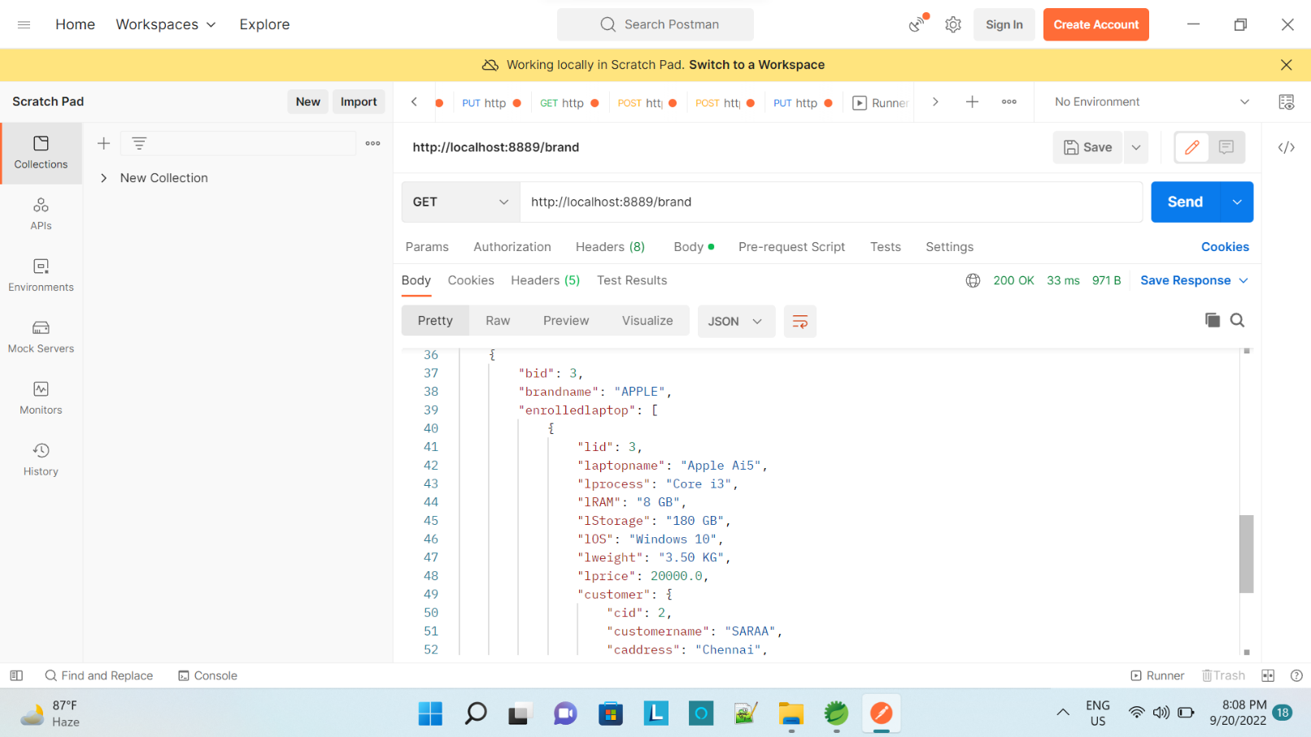
Application Programming Interface(APIs)
APIS Under Brand To Do :
“brand” : Brand can access all laptops details using this Url.

Slide 14
Application Programming Interface(APIs)
For Brand Class:
/brand- (@PostMapping) using this url brand can add their details.
/brand- (@GetMapping) using this url user can see all brands details
/brandId/{bid}- (@GetMapping) using this url user can see particular brand details.
/brandname/{bname}-(@/GetMapping)- using this url user can see particular brand by entering the brand name.
/deletebrand/{bid}- (@DeleteMapping) using this url admin can delete particular brand details.

Slide 15
Application Programming Interface(APIs)
/brand/{bid}-(@PutMapping) - using this url user can see particular brand by entering the brand id.
/brand/{bid}/laptop/{lid}-(@PutMapping) using this url user can assign particular brand to particular laptop.
For Laptop Class:
/laptop-(@PostMapping) using this url admin can add Laptop
/laptop-(@GetMapping) using this url user can see all the Laptop list
/laptop/{lid}-(@DeleteMapping) using this url admin can delete particular laptop details.

Slide 16
Application Programming Interface(APIs)
/laptop/{lid}-(@GetMapping) using this url user can see particular laptop by entering the laptop id.
/laptopname/{lname}-(@GetMapping) using this url user can see particular laptop by entering the laptop name.
/customer/{cid}/laptop/{lid}-(@PutMapping) using this url admin can assign particular laptop to particular customer.
/laptop/{lid}-(@PutMapping) using this url admin can edit particular laptop.

Slide 17
Application Programming Interface(APIs)
For Customer Class
/customer-(@PostMapping) using this url admin can add customer.
/customer/{cid}-(@PutMapping) using this url user can edit particular customer.
/customer/{cid}-(@GetMapping) using this url user can see particular customer by entering the customer id.
/customername/{cname}-(@GetMapping) using this url user can see particular customer by entering the customer name.

Slide 18
Application Programming Interface(APIs)
/customer-(@GetMapping) using this url admin can see all the customer list
/customer/{cid}-(@DeleteMapping)using this url user can delete the customer.
/laptoptotalprice - (@GetMapping) using this url admin can see all the laptop total price.
/customertotalpayamount- (@GetMapping) using this url admin can see all the customer total payment
/profitandloss – (@GetMapping) using this url admin can check total payment is profit and less.

Slide 19
Software & hardware used
Software Requirements
- Operating System : Windows 11
- Language : Java
- IDE : Spring Tool Suite
- Client : Postman
- Backend : MySQL
Hardware Requirements
- CPU : Intel 5i processor
- RAM : 4 GB or above
- Hard Disk : 1TB hard disk space or minimum

Slide 20
Features of system
To store laptop details, customer details data under brand wise.
This application which is hit the URL on post man and working on different task.

Slide 21
Conclusion
Performing CRUD operations on the database.
Creating Rest APIs.
Implementing Spring Security.
Handle Exceptions.
Create association between entities.

Slide 22


