Slide 1


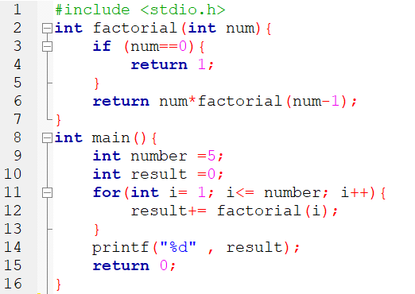
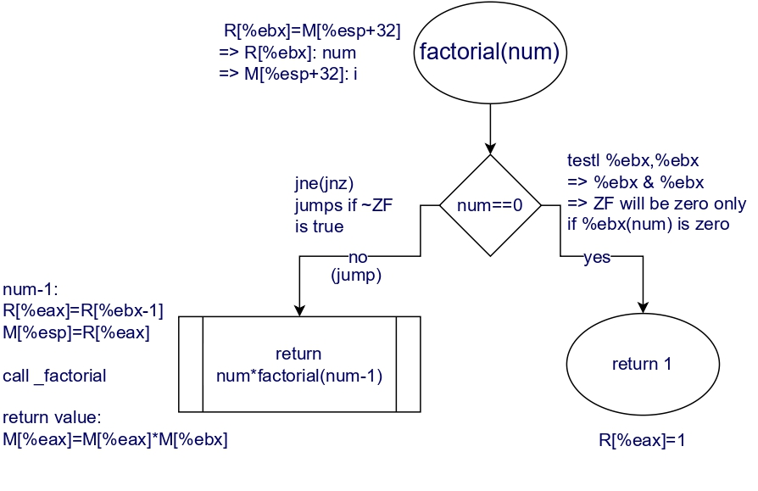
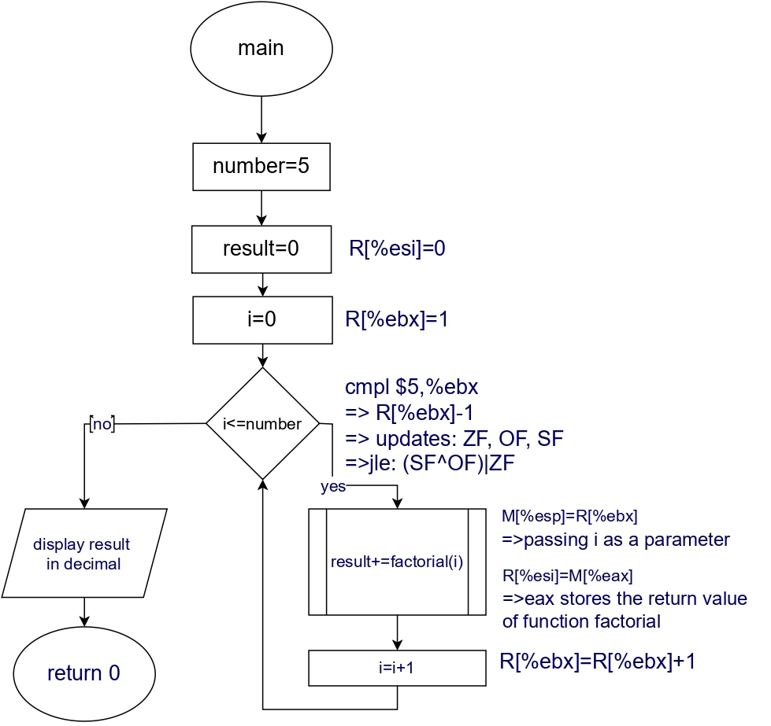
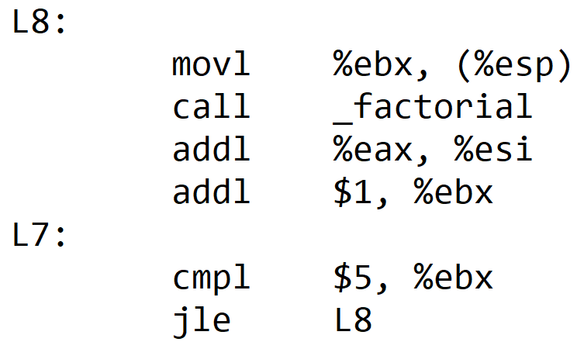
C to Assembly Translation
Laila Khaled – Nour Hany – Yasmine Elqorashy – Shady Ali- Ahmed Sameh
22-101078 22-101068 22-101174 22-101195 22-101198
Our Program
In Main Function
Factorial Function
Applications on Computer Architecture
Simple C program that calculates the sum of factories from 1 to 5 to using recursion.
Initializes %ebx and %esi to 1 and 0, which are the registers for variables i and result, then it compares the variable i with 5.
If it’s less than 5 then it goes to L8 which is the for loop.
After finishing the loop, it moves what’s in $LC0 in %esp (which has the format string “%d”) and calls the print function to print the result and pops all values and returns.
movl $1, %ebx
movl $0, %esi
jmp L7
L7:
cmpl $5, %ebx
jle L8
movl %esi, 4(%esp)
movl $LC0, (%esp)
call _printf
movl $0, %eax
leal -8(%ebp), %esp
popl %ebx
popl %esi
popl %ebp
ret
L5 handles the recursive case by computing the factorial for a decremented value and multiplying it back with the original value.
L1 represents the base case, ensuring termination of the recursion when %ebx becomes zero.
1- Mariner 1
America's first attempt to explore Venus up close was lost to a software glitch due to the omission of an overbar for the symbol R for radius (R instead of R̅) in an equation.
2-Von Neumann Architecture:
Also known as the Princeton architecture, is a computer architecture based on a 1945 description by John von Neumann, and by others, in the First Draft of a Report on the EDVAC.
3-Harvard Architecture:
It is a computer architecture with separate storage and signal pathways for instructions and data. It is mostly used in ARM based processors.
4-Computer Architecture and Machine Learning
The end of Moore's Law and Dennard scaling hinders general-purpose program improvement. Machine learning, rooted in low-precision linear algebra, provides an alternative, transforming fields like vision and language understanding.
Collaborative efforts between ML experts and computer architects are essential to meet the growing demand for ML computing.
5-The Pentium FDIV bug
The Pentium FDIV bug in early Intel Pentium processors caused rare but significant inaccuracies in binary floating-point division results. Intel faced heavy criticism for the flaw and recalled the processors in December 1994, incurring a $475 million pre-tax charge in January 1995 for replacements.
_factorial:
LFB12:
pushl %ebx
subl $24, %esp
movl 32(%esp), %ebx
testl %ebx, %ebx
jne L5
movl $1, %eax
L1:
addl $24, %esp
popl %ebx
ret
L5:
leal -1(%ebx), %eax
movl %eax, (%esp)
call _factorial
imull %ebx, %eax
jmp L1
What does the program do before starting?
For Loop (L8)
O
Flowchart of The Program
Before the program starts, this sets up a new stack frame, saves the values of %esi and %ebx registers, aligns the stack, allocates space for local variables and then calls the main function
First it moves the value of %ebx to the memory location of the stack pointer then it calls the factorial function.
After returning from the function is adds the return value (%eax) to %esi (result) then increments %ebx by 1 then go back to L7 to check
pushl %ebp
movl %esp,%ebp
pushl %esi
pushl %ebx
andl $-16, %esp
subl &16, %esp
call ___main
Mariner 1
References
https://stackoverflow.com/questions/23309863/why-does-gcc-produce-andl-16
https://community.st.com/t5/stm32-mcus-products/main-in-startup-assembly/td-p/391658
https://stackoverflow.com/questions/17794533/what-does-this-assembly-language-code-mean
https://science.nasa.gov/mission/mariner-1/
https://nssdc.gsfc.nasa.gov/nmc/spacecraft/display.action?id=MARIN1
https://www.sciencedirect.com/topics/computer-science/von-neumann-architecture
https://www.sciencedirect.com/topics/engineering/harvard-architecture
https://doi.org/10.1109/MM.2018.112130030
https://superfri.susu.ru/index.php/superfri/article/view/165
https://handwiki.org/wiki/Software:Pentium_FDIV_bug
Variable | Register
result | %esi
i | %ebx

