Slide 1
Algoritma dan Struktur Data
Program Studi Teknologi Informasi, Fakultas Teknik
Universitas Muhammadiyah Yogyakarta
Dosen: Muhammad Abdul Haq, S.Tr.T., M.Eng.

Slide 2
Data Structures and Algorithm
Objective
Queue

Slide 3
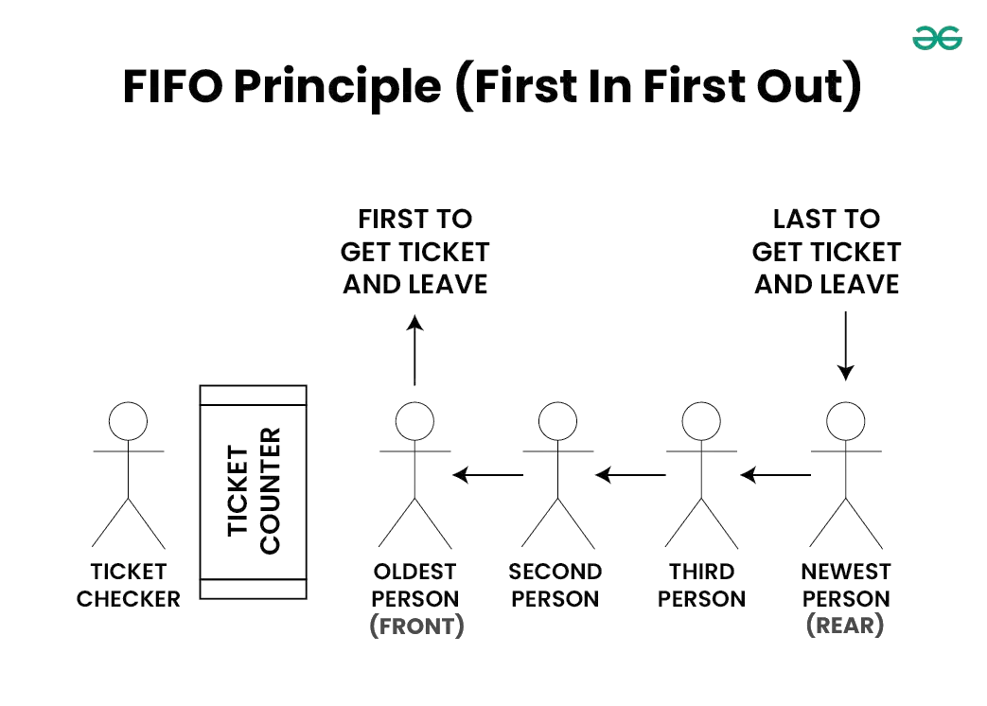
Data Structures and Algorithm
Queue
Queue is a linear data structure that follows FIFO (First In First Out) Principle, so the first element inserted is the first to be popped out.

Slide 4
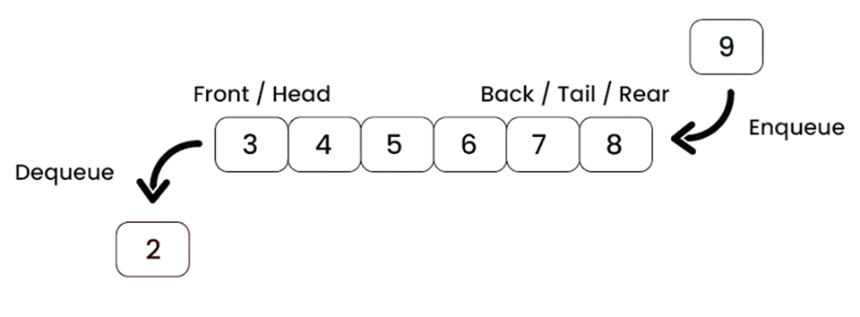
Data Structures and Algorithm
Queue
Operations on Queue:
Enqueue/Insert: Adds an element to the end (rear) of the queue. If the queue is full, an overflow error occurs.
Dequeue/Delete: Removes the element from the front of the queue. If the queue is empty, an underflow error occurs.
Front: Returns the element at the front without removing it.
Rear: Returns the number of elements in the queue.
isEmpty: Returns true if the queue is empty, otherwise false.
isFull: Returns true if the queue is full, otherwise false.

Slide 5
Data Structures and Algorithm
Queue (Array)
Insert Operation
If the queue is empty:
Set FRONT = 0.
Increment REAR by 1.
Store the element at index position REAR in the array.

Slide 6
Data Structures and Algorithm
Queue (Array)
Delete Operation
Retrieve the element at index FRONT.
Increment FRONT by 1.

Slide 7
Data Structures and Algorithm
Queue (Circular Array)
Insert Operation
If the queue is empty (If FRONT= –1):
Set FRONT = 0
Set REAR = 0
Go to step 4
If REAR is at the last index position:
Set REAR = 0
Go to step 4
Increment REAR by 1
Queue[REAR] = element

Slide 8
Data Structures and Algorithm
Queue (Circular Array)
Delete Operation
If there is only one element in the queue:
Set FRONT = –1
Set REAR = –1
Exit
If FRONT is at the last index position:
Set FRONT = 0
Exit
Increment FRONT by 1

Slide 9
Data Structures and Algorithm
References
https://www.geeksforgeeks.org/
https://www.tutorialspoint.com/

Slide 10
Any Question ?

