Slide 1
Algoritma dan Struktur Data
Program Studi Teknologi Informasi, Fakultas Teknik
Universitas Muhammadiyah Yogyakarta
Dosen: Muhammad Abdul Haq, S.Tr.T., M.Eng.

Slide 2
“You are the detective of your own body and I'm just here to help you find the map.” — Lindsey Vestal

Slide 3
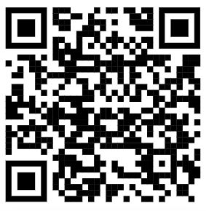
Contact
https://muhabdulhaq.github.io/

Slide 4
Any Question ?

