Slide 1
Algoritma dan Struktur Data
Program Studi Teknologi Informasi, Fakultas Teknik
Universitas Muhammadiyah Yogyakarta
Dosen: Muhammad Abdul Haq, S.Tr.T., M.Eng.

Slide 2
Data Structures and Algorithm
Objective
In this session, you will learn to:
Identify the algorithms that can be used to sort data
Sort data by using bubble sort
Sort data by using selection sort
Sort data by using insertion sort
Sort data by using shell sort

Slide 3
Data Structures and Algorithm
Sorting Data
Suppose, you have to invite your friends and relatives for your birthday party. For this, you need to give them a call.
You are looking for the telephone number of a friend named Steve in a telephone directory with 10,000 records.
However, the records are stored randomly and not in any particular order.

Slide 4
Data Structures and Algorithm
Sorting Data
To search for the telephone number of your friend in such a directory, you would need to scan each entry in the directory in a sequential manner.
This would be very time consuming.
How can you solve this problem?

Slide 5
Data Structures and Algorithm
Sorting Data
A simple solution to save time, and search records efficiently is sorting.
Sorting is the process of arranging data in some pre-defined order or sequence. The order can be either ascending or descending.
If the data is ordered, you can directly go to the section that stores the names starting with ‘S’, thereby reducing the number of records to be traversed.

Slide 6
Data Structures and Algorithm
Selecting a Sorting Algorithm
Sorting is implemented in a program by using an algorithm.
Some sorting algorithms are:
Bubble sort
Selection sort
Insertion sort
Shell sort
Merge sort
Quick sort
Heap sort
To select an appropriate algorithm, you need to consider the following:
Execution time
Storage space
Programming effort

Slide 7
Data Structures and Algorithm
Sorting Data by Using Bubble Sort
Bubble sort algorithm:
Is one of the simplest sorting algorithms
Has a quadratic order of growth and is therefore suitable for sorting small lists only
Works by repeatedly scanning through the list, comparing adjacent elements, and swapping them if they are in the wrong order

Slide 8
Data Structures and Algorithm
Sorting Data by Using Selection Sort
Selection sort algorithm:
Has a quadratic order of growth and is therefore suitable for sorting small lists only
Scans through the list iteratively, selects one item in each scan, and moves the item to its correct position in the list

Slide 9
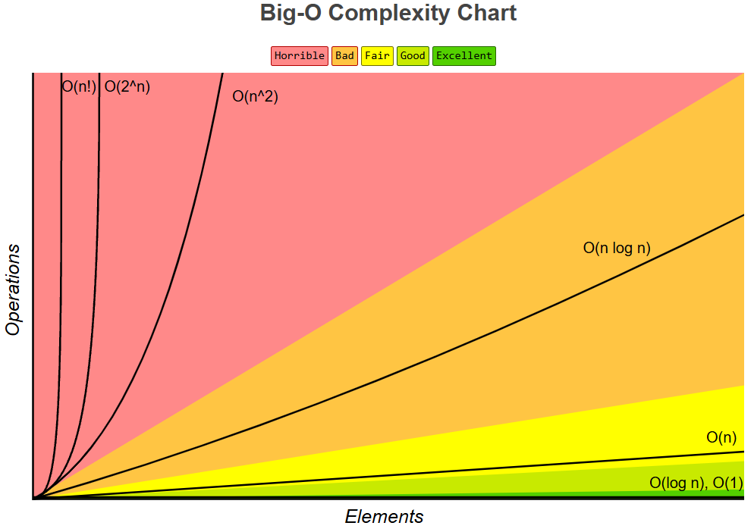
Data Structures and Algorithm
Big-O
https://www.bigocheatsheet.com/

Slide 10
Any Question ?

