Slide 1
APPLICATION OF GEOSPATIAL TECHNIQUES IN REVISING AND UPDATING STREET NAMES IN BUNKORO DISTRICT, CADASTRAL ZONE C18, F.C.T ABUJA, NIGERIA
A.M. Bello¹, A.B. Hassan¹
¹Department of Geography, Federal University of Technology, Minna, Nigeria
Corresponding Address: muhammadbello62@gmail.com , adamu.muhammad3@st.futminna.edu.ng ,+2348166607566

Slide 2
Introduction
A map is a symbolic representation of selected characteristics of a place, usually drawn on a flat surface. Maps present information about the world in a simple, visual way. They teach about the world by showing sizes and shapes of countries, locations of features, and distances between places. Maps can show distributions of things over Earth, such as settlement patterns. They can show exact locations of houses and streets in a city neighborhood (National Geographic Society)
Maps have played vital roles in the world through aiding decision making and policy formulation processes as well as aiding tourism and general navigation (Longley et al. 2007).
Ezra and Kantiok (2007) argued that street guide are not only important for aiding navigation within the city, but are also useful in planning enumeration areas by demographers, and are equally useful to tourists, salesman, firemen, police, security agents, tax collectors, postal services etc.
Street map stands as a basic datum that can also help researchers conduct good research such as emergency response studies, proximity and accessibility studies (Idowu et al 2016).

Slide 3
Introduction
The importance of Remote sensing and Geographic Information System in map making cannot be overemphasized because of its ability to integrate spatial data with non-spatial data and also communicate the resulting information in a way that everyone would understand. Several works have taken advantage of the abilities of these technologies to produce street maps using High resolution images (Idowu, et.al 2016).
As a scientific tool, GIS is used to capture, store, create interactive queries, analyze and manage spatial information and edit spatial data and associated attributes. It provides a computer-implemented spatially oriented database for evaluating remote sensing data in conjunction with other spatially formatted data and information acquired from different sources (Udoh, and Igbokwe, 2014).
Digital mapping has now become an indispensable tool in solving many environment-based problems. The method used for producing digital maps are many, depending on the level of detail required, the use to which the map will be put and the source of data (Musa, and Tukur, 2006)

Slide 4
Statement of Research Problem
Several countries in the world most especially the 3rd world countries (Nigeria Included) face problems in relation to outdated streets maps.
Maps produced some years back lack details of recent development.
The use of streets maps in developing countries is relatively low compared to what is obtainable in the developed countries.
Davis and Fairburn (1998) did a comparative study on the state of street guide mapping in developing countries (DCs) and more developed countries (MDCs) for urban and rural areas at different scales respectively. The outcome of the result showed that there was an average digital mapping coverage of 60 percent for the (MDCs) and 20 percent for the (DCs).
This is strongly linked to the lack of accurate and up-to-date maps, which could be linked to the non-adoption and application of recent advances in map making process.
As far back as 1986, it was pointed out that digital approach to street map making would play a vital role in developing countries (Taylor, 1986).
However, the earlier expectation that the new wave of advancements in computer technology would speed up the map making process in Nigeria has not necessary been met.
Therefore, there is an utmost need for regular street map revision in Nigeria

Slide 5
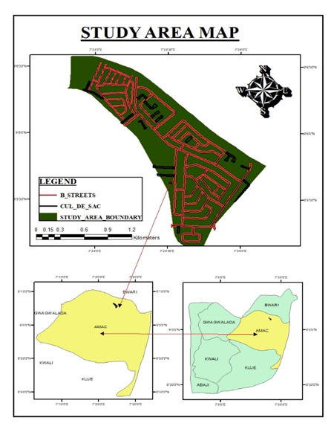
Study Area
The study area the study area is located between:
LONGITUDE: 7º 23’ 30” E and 7º 25’ 30” E;
LATITUDE: 9º 07’ 00” N and 9º 05’ 00” N.
It covers an approximate size of 241 hectares. It is also bounded to the North-East by Jahi district cadastral zone B08, to the South-East by Kado district cadastral zone B09, to the North-West by Wupa district cadastral zone C15. It is within the UTM National Grid of Zone 32N.

Slide 6
Materials and Methodology
Data
The data used consisted of:
Abuja Geographical Information Systems (AGIS) acquired Aerial Imagery with less than 0.5m resolution of the study area.
Survey data layout of the study area from the Department of survey and mapping, Federal Capital Development Authority (FCDA).
Old Street names from Abuja Geographical Information Systems (AGIS) database.
1. Equipment
The equipment consists of:
• HP Laptop
• GPS (handheld Garmin Etrex10)
• Hewlet Packard Jet 130 colored printer, scanner and photocopier
• Camera

Slide 7
Materials and Methodology
2. Software
The software consists of:
• AutoCAD 2007
• ArcGIS 10.2
• Microsoft office 2010 packages

Slide 8
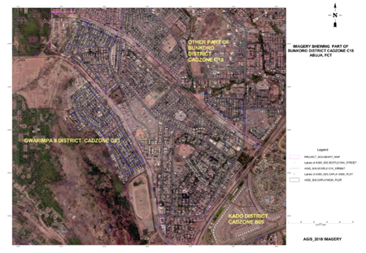
Georeferencing and resampling
Having acquired the aerial imagery of the study area and pyramids been created on ArcGIS 10.2, the imagery was brought into harmony with the true ground coordinates by using four control points on ArcGIS.

Slide 9
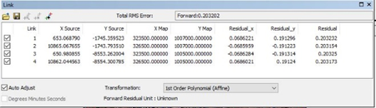
Root Mean Square Error (RMSE) Of The Geo-Referencing
The residual of Root Mean Square error (RMSE) during geo-referencing of the acquired aerial imagery is “0.2”
“0.2” indicates a very minimal Root Mean Square Error (RMSE) and is within the acceptable range value of Root Mean Square Error (RMSE) as values greater than 0.5 reflects a relatively poor accuracy of data or model (Hanan, 2019).

Slide 10
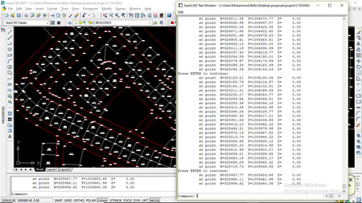
Extracting the Street Beacon Coordinates from the Survey Data Layout
The on-screen digitizing process was used in vectorising the data to bring out details from the image that will form part of the new map information. It was carried out using the AutoCAD 2007 software.

Slide 11
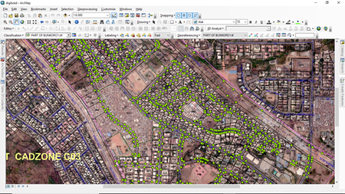
Overlay of the Extracted Street Beacon Coordinates
The extracted point coordinates of street beacons were imported into ArcGIS 10.2 and overlaid on the aerial imagery.

Slide 12
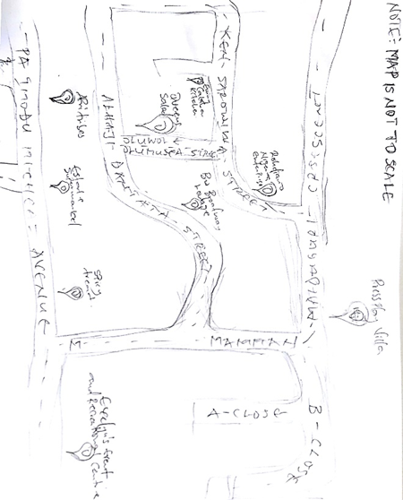
Revising and Naming the streets
The names of the streets were obtained by field work. The names of the streets were written on the streets with the aid of a field reconnaissance sketch made and images of street sign posts taken during the field work which made it possible to place appropriate names on appropriate streets.

Slide 13
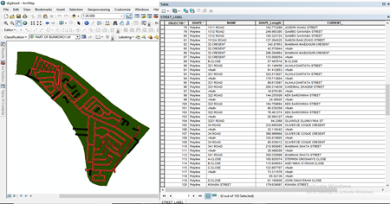
Digitizing and Compilation of the Street’s Name
The road network of the study area consists of different categories of road such as the highway, arterial road, sub-arterial road, street, close (cul_de_sac) and crescent.

Slide 14
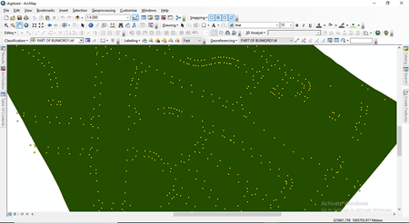
Digitizing and Compilation of the Street’s Name

Slide 15
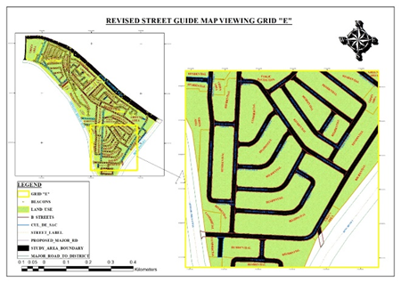
Digitizing and Compilation of the Street’s Name

Slide 16
Ground-Truthing
Final ground-truthing and identification of features on the map was carried out using hand held Garmin Etrex 10 GPS receiver to navigate to the positions on ground of the identified ground control points (GCP’s) on the map.
GROUND-TRUTH POINTS AND THEIR X,Y COORDINATES
 |  | GEOGRAPHICAL COORDINATES (degree) |  | UNIVERSAL TRANVERSE MERCATOR (meter)
S/N | NAME | LAT | LONG | E | N
1 | DOMINO’S PIZZA | 9º 06’5”N | 7º 24’22”E | 324855 | 1006450
2 | THE LINGERIE CITY | 9º 06’11”N | 7º 24’17”E | 324696 | 1006643
3 | FOWLCHASE EATERY | 9º 05’57”N | 7º 24’39”E | 325379 | 1006224
4 | POLARIS BANK | 9º 05’51”N | 7º 24’36”E | 325288 | 1006022
5 | ZENITH BANK | 9º 05’34”N | 7º 24’37”E | 325307 | 1005495
6 | CHRISTIANA AJAYI OKUNUGA STREET | 9º 05’34”N | 7º 24’36”E | 325285 | 1005503
7 | E.C. AKINWUMI STREET | 9º 05’33”N | 7º 24’48”E | 325651 | 1005468
8 | PA IMODU MICHEAL AVENUE | 9º 06’17”N | 7º 24’16”E | 324676 | 1006819
9 | JOSEPH WAKU STREET | 9º 05’32”N | 7º 24’48”E | 325653 | 1005454
10 | RESIDENTIAL BUILDING | 9º 06’22”N | 7º 24’14”E | 324604 | 1006998

Slide 17
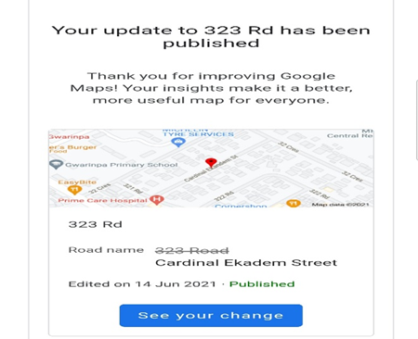
Updating Google Map
The current street names were however uploaded on google map for review and update.

Slide 18
Results and Discussion
A revised digital street guide map of Bunkoro, Gwarimpa District Cadastral Zone C18 was produced.
The map contains a comprehensive list of the locations and names of important features in the area.
Moreover, the geo-referenced map produced from this project could serve as a Street image map when the need arises.
A comprehensive list of all the streets and relevant attributes of features were compiled and produced from this project and is expected to serve as an important database for future related projects within Bunkoro, Gwarimpa district in particular and Federal Capital Territory (FCT) in general.
Geo-spatial science and technology have given us the opportunity to present an up-to-date map of any place of interest in the world. It can also provide opportunity for updating of any map that interests us.

Slide 19
Conclusion and Recommendation
People in developing countries like Nigeria are been negatively affected from the effects of obsolete maps which is highly essential in a digital 21st century era.
While Geographic Information System (GIS) have been used to a great extent in mapping in Nigeria, its full potential has not been reached.
The study was able to generate location-based information as regards to current street names on some parts of the F.C.T cadastral zone C18 which shows that our maps lack recent information as a result of lack of regular map review and revision after initial creation.
The employment of regular road mapping review results in better navigational details and more embracement of map usage by individuals as its tends to solve day to day navigational issues.
An important problem which needs to be addressed urgently is the need for policy makers in Nigeria to be highly aware, understand and recognize the relevance and impressiveness of using GIS and remote sensing technology
Such awareness leads to an intensive increase in professional consultation on contents and relevance for high-technology adaptation in sustainable development in Nigeria.

Slide 20
THANK YOU

