Slide 1

-------------
SOFTWARE PROJECT LAB-1

Slide 2
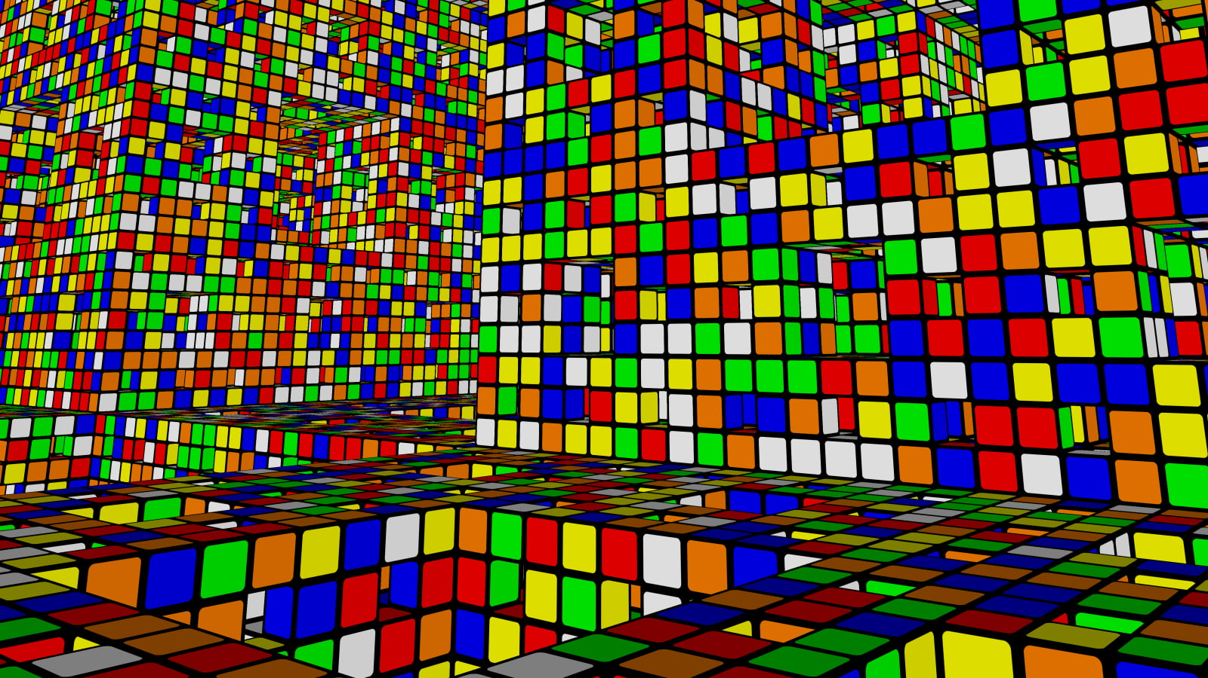
PixelCube
By Abb Muhaimeen
Roll: 1423
Supervised by:
Kishan Kumar Ganguly Assistant Professor,
IIT,DU

Slide 3
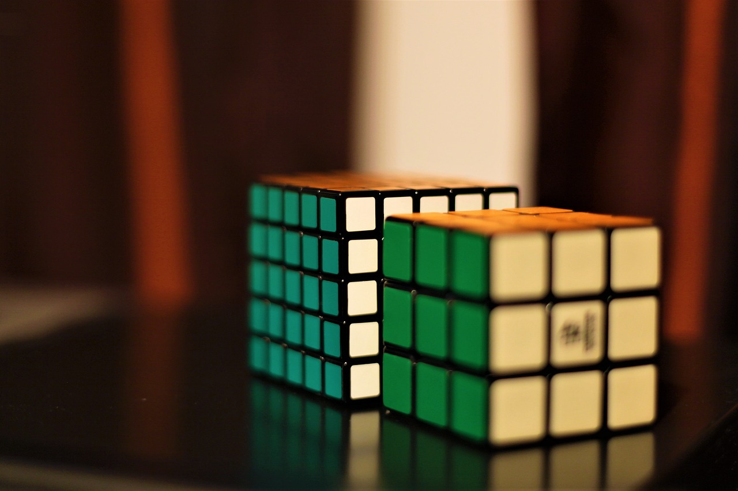
Project Overview
Input a Rubik’s Cube via 2D representation.
Solve it using Layer by Layer method.
Print out the move sets so that user can also solve it in real life.

Slide 4
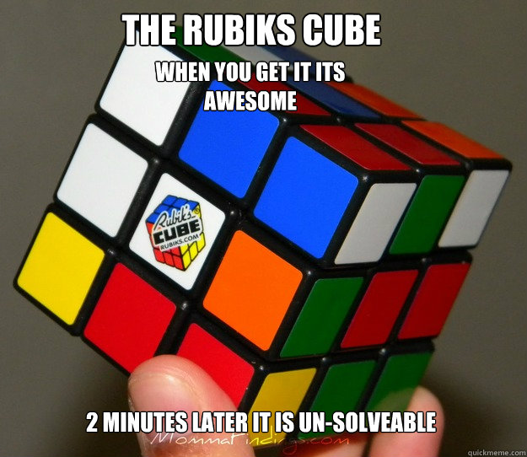
Project Motivations
Anyone can solve a Rubik’s Cube
Easy to understand move sets
Solve any type of scrambled cubes
Learn algorithms related to Rubik’s Cube

Slide 5
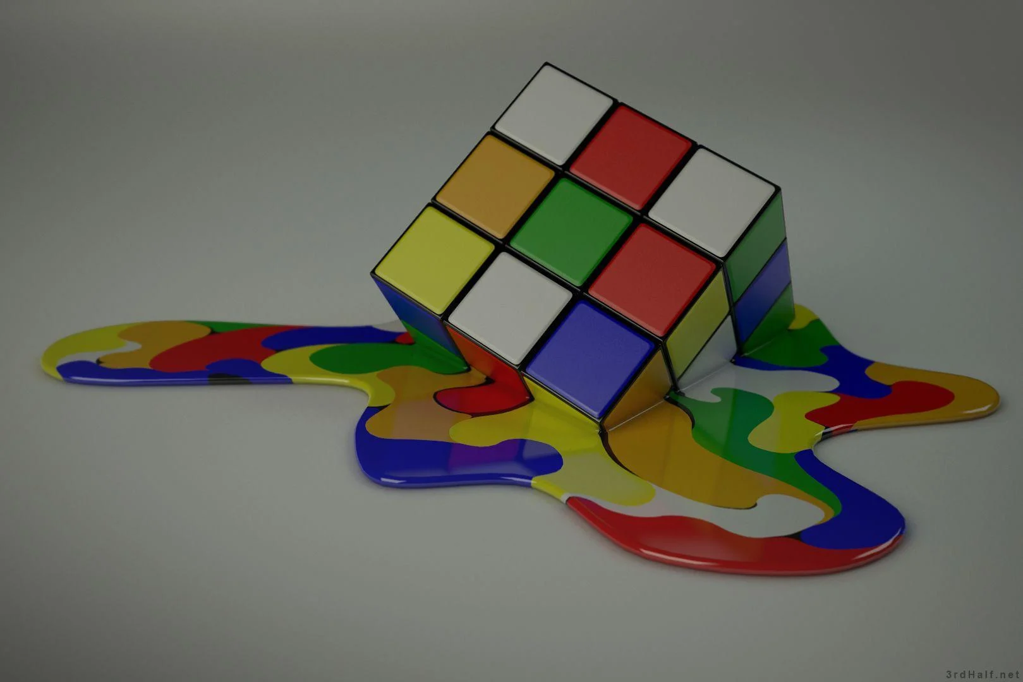
Project Complexity
Accessing and manipulating a 3D Rubik’s Cube
Complex Algorithms to implement in a computer program
Smartly use cube operations
Solid background knowledge
Implementing GUI for visually better output

Slide 6
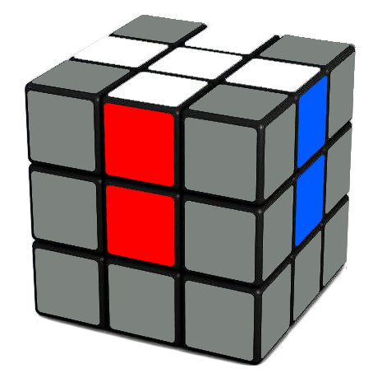
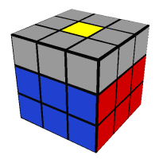
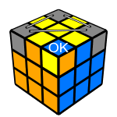
Project Workflow
Initialize Cube operations
Get a white cross on white side.
Follow algorithm to solve F2L(First Two Layer).
Reorganize the corner pieces to solve the last layer.

Slide 7
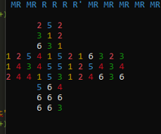
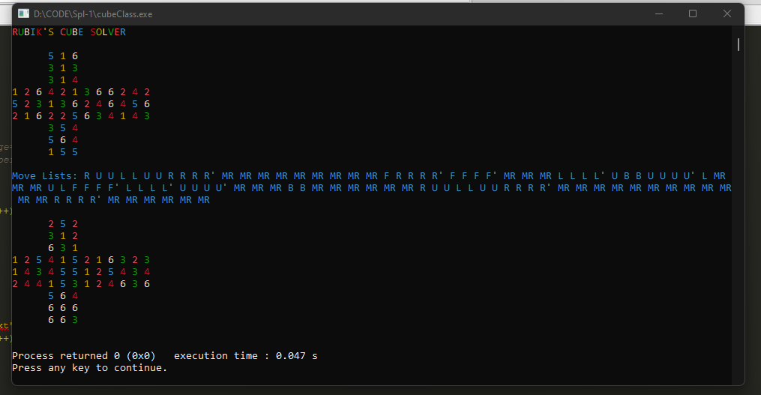
Before Mid Presentation
Output till now:
White Cross ✓
Second Layer ✗
Full Cube Solved ✗

Slide 8
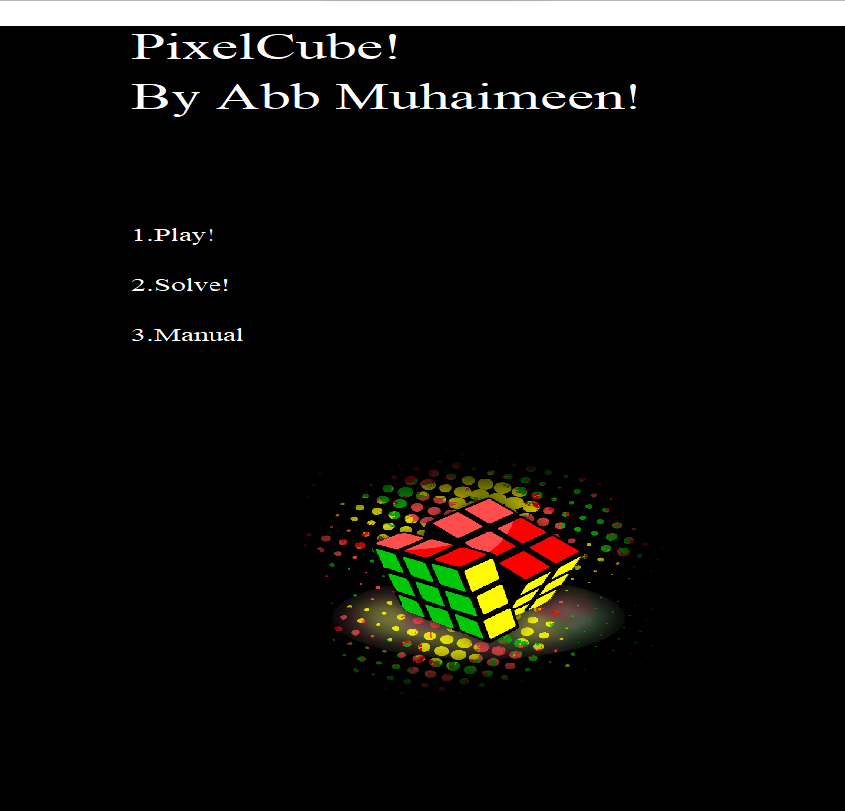
Final Output
Main Menu:

Slide 9
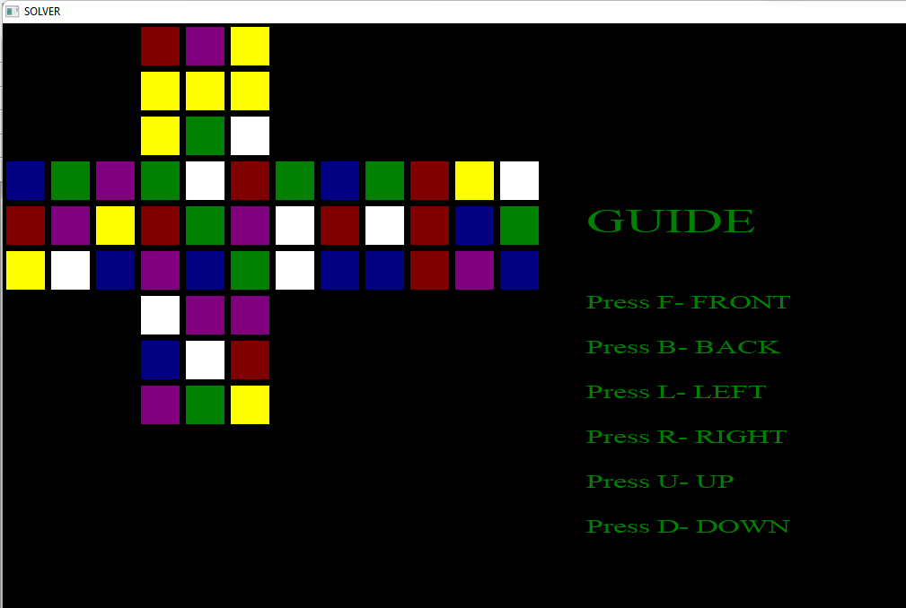
GAMEPLAY

Slide 10
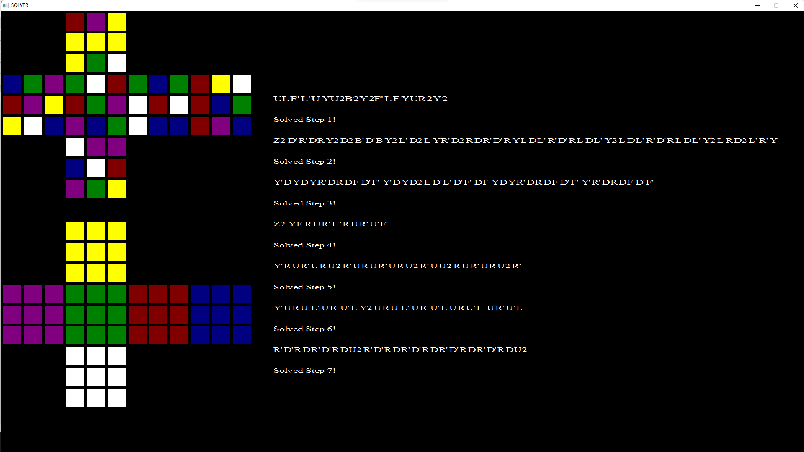
Solution Step by Step

Slide 11
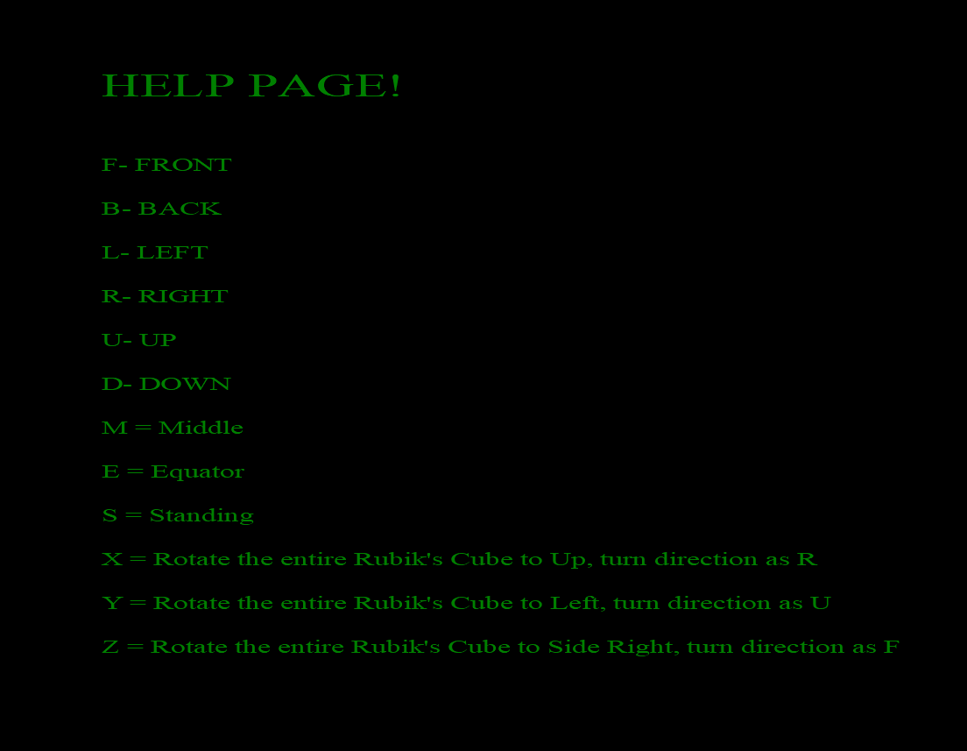
Help Page

Slide 12
Why PixelCube?
Introducing variety of intuitive moves which are absent in other solvers. Those moves will help in learning the cube much more faster.
Keeping balance between efficiency and simplicity.
Easy to access Graphical User Interface keeping both enthusiasts and beginners in mind.

Slide 13
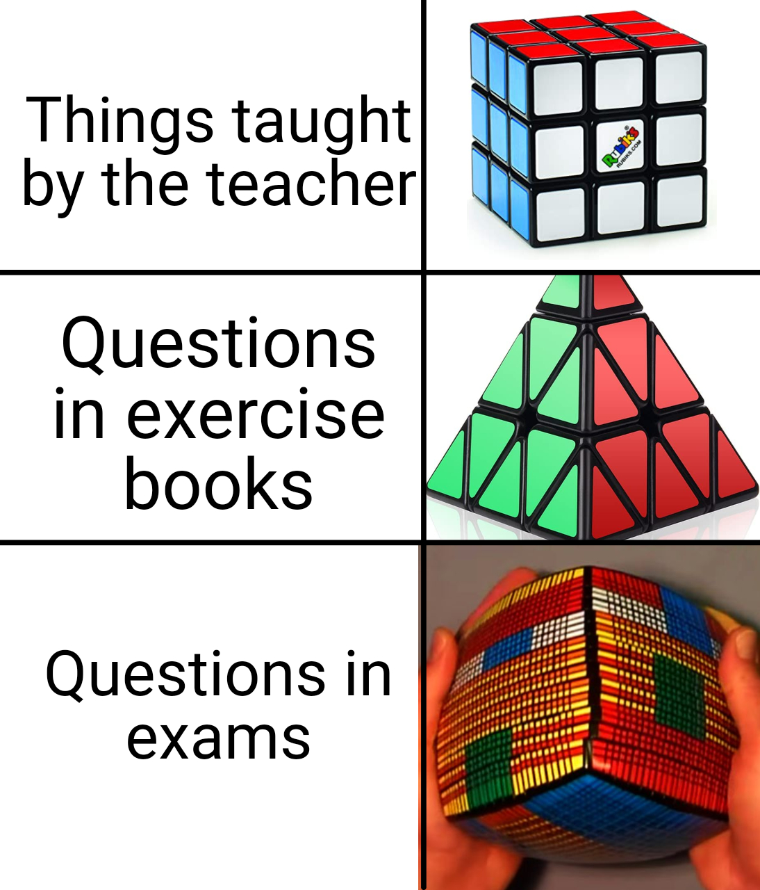
How it can be extended
Support cubes of any dimension
Explore further complex algorithms to reduce moves
Train a machine learning model to learn solving strategies

Slide 14


Tools Used
Lines of Code
2700++

Slide 15
Thank you !

