Slide 1

-------------
SOFTWARE PROJECT LAB-1

Slide 2
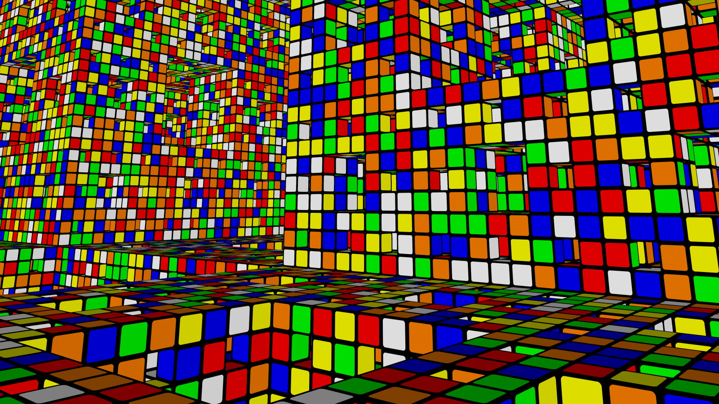
PixelCube
By Abb Muhaimeen
Roll: 1423
Supervised by:
Kishan Kumar Ganguly Assistant Professor,
IIT,DU

Slide 3
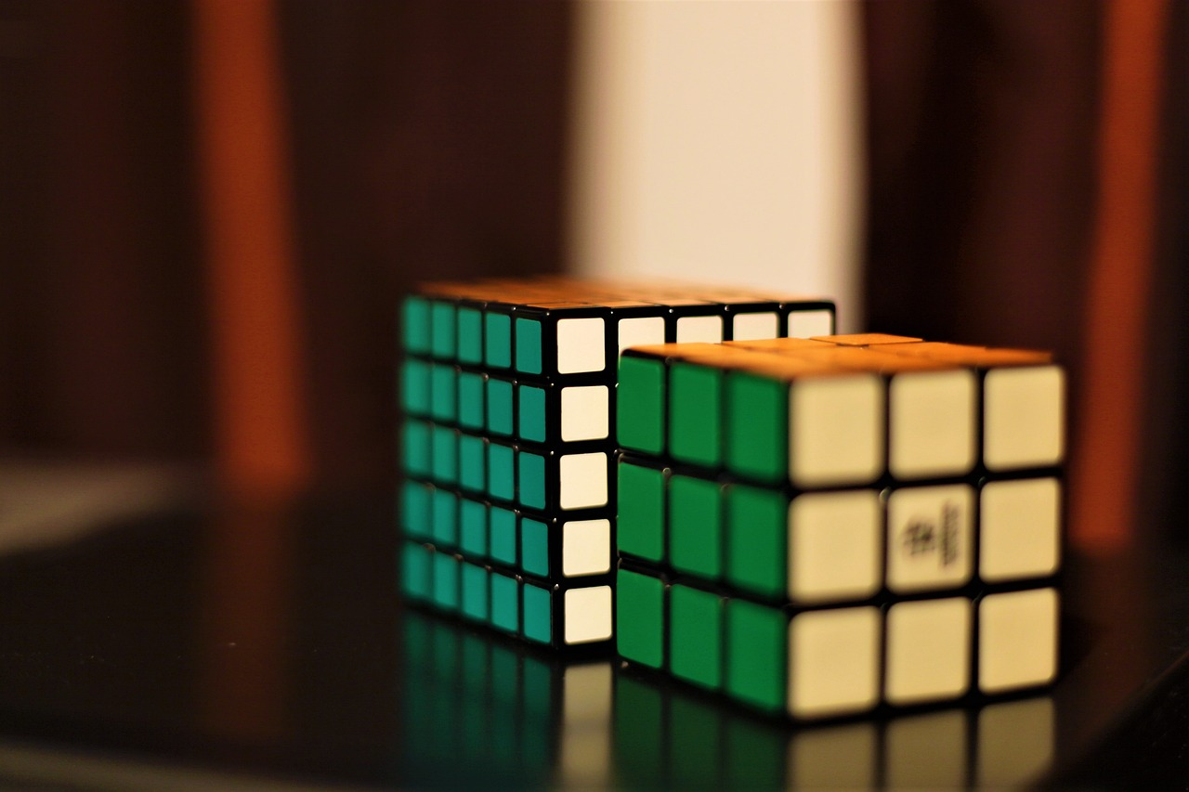
Project Overview
Input a Rubik’s Cube via 2D representation.
Solve it using Layer by Layer method.
Print out the move sets so that user can also solve it in real life.

Slide 4
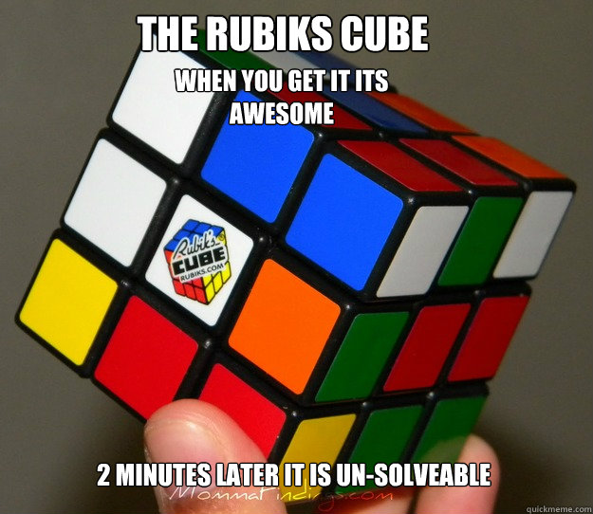
Project Motivations
Anyone can solve a Rubik’s Cube
Easy to understand move sets
Solve any type of scrambled cubes
Learn algorithms related to Rubik’s Cube

Slide 5
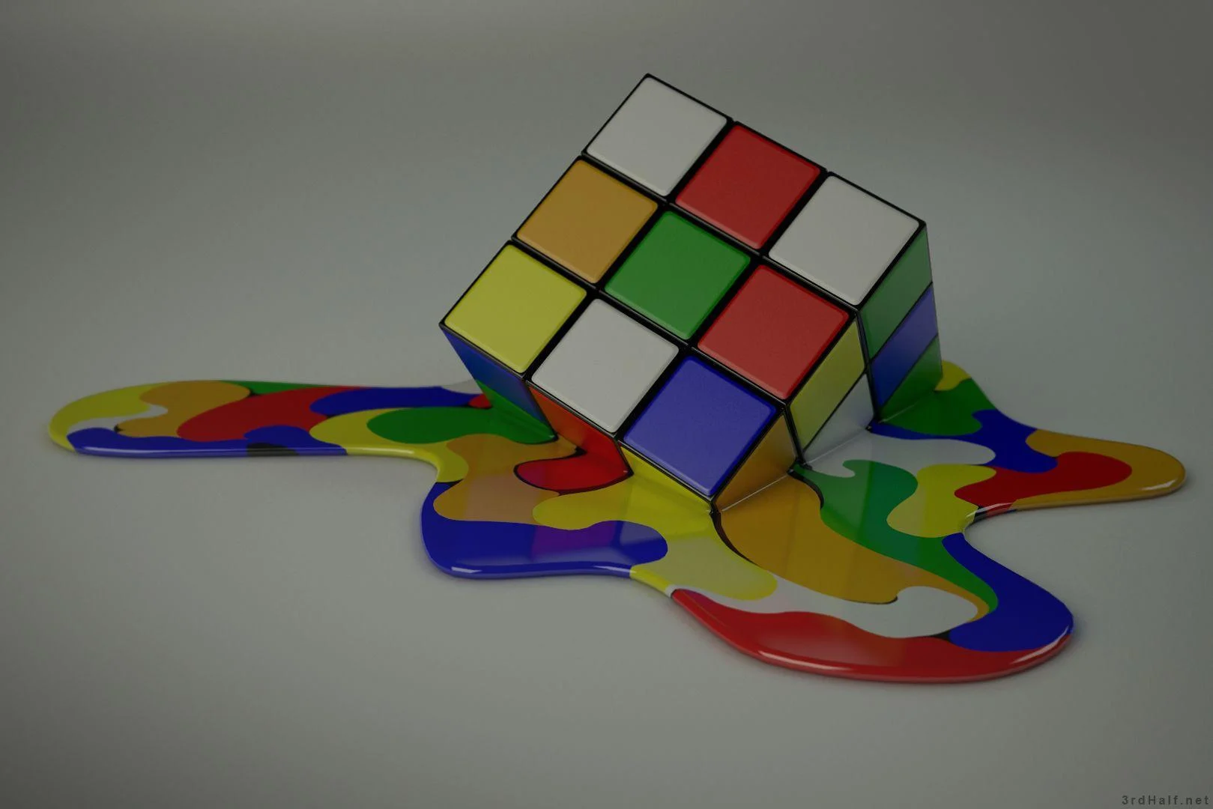
Project Complexity
Accessing and manipulating a 3D Rubik’s Cube
Complex Algorithms to implement in a computer program
Smartly use cube operations
Solid background knowledge
Implementing GUI for visually better output

Slide 6
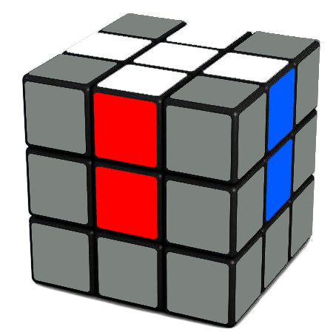
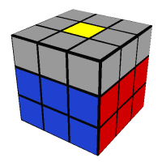
Project Workflow
Initialize Cube operations
Get a white cross on white side.
Follow algorithm to solve F2L(First Two Layer).
Reorganize the corner pieces to solve the last layer.

Slide 7
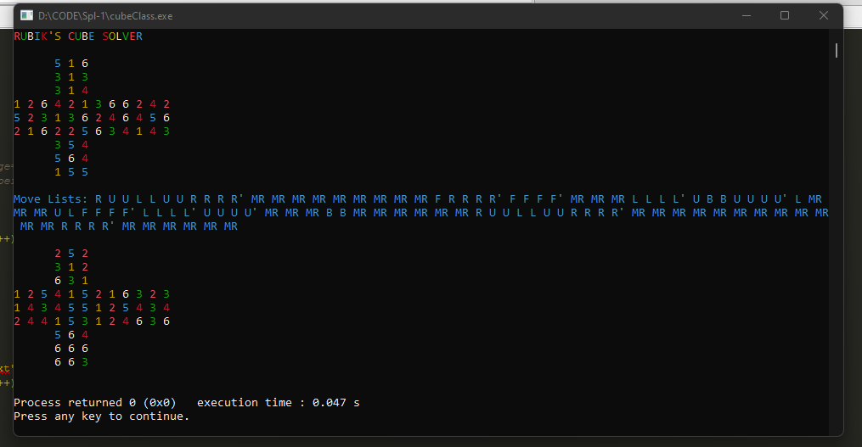
Project Progress
Output till now:
White Cross ✓
Second Layer ✗
Full Cube Solved ✗

Slide 8


Tools Used

Slide 9
Thank you !

Slide 10
