Slide 1

-------------
SOFTWARE PROJECT LAB-1

Slide 2
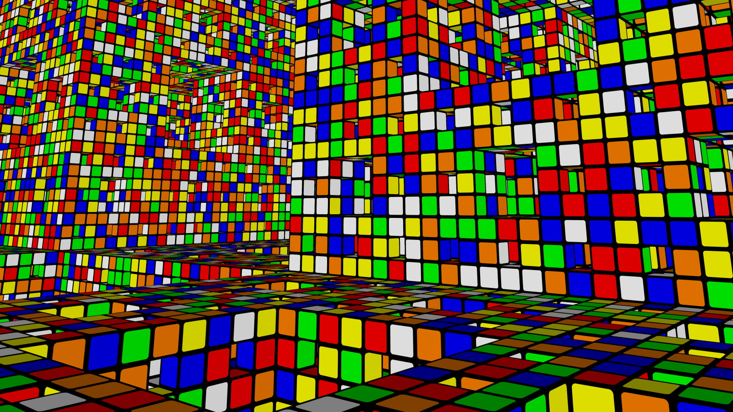
PixelCube
By Abb Muhaimeen
Roll: 1423
Supervised by:
Kishan Kumar Ganguly Assistant Professor,
IIT,DU

Slide 3
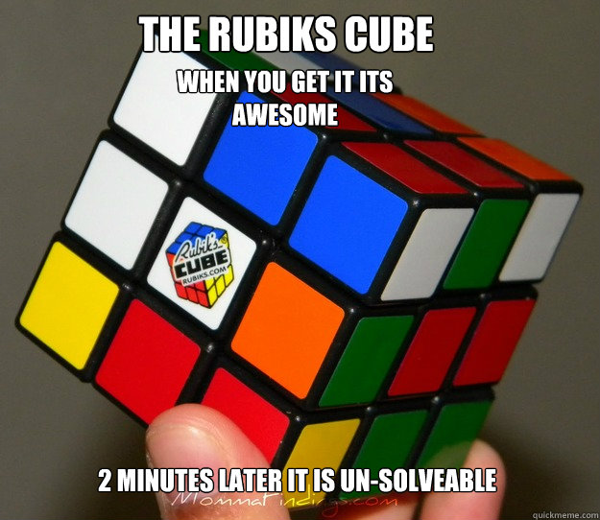
Project Objectives
Anyone can solve a Rubik’s Cube
Easy to understand move sets
Solve any type of scrambled cubes
Learn algorithms related to Rubik’s Cube

Slide 4
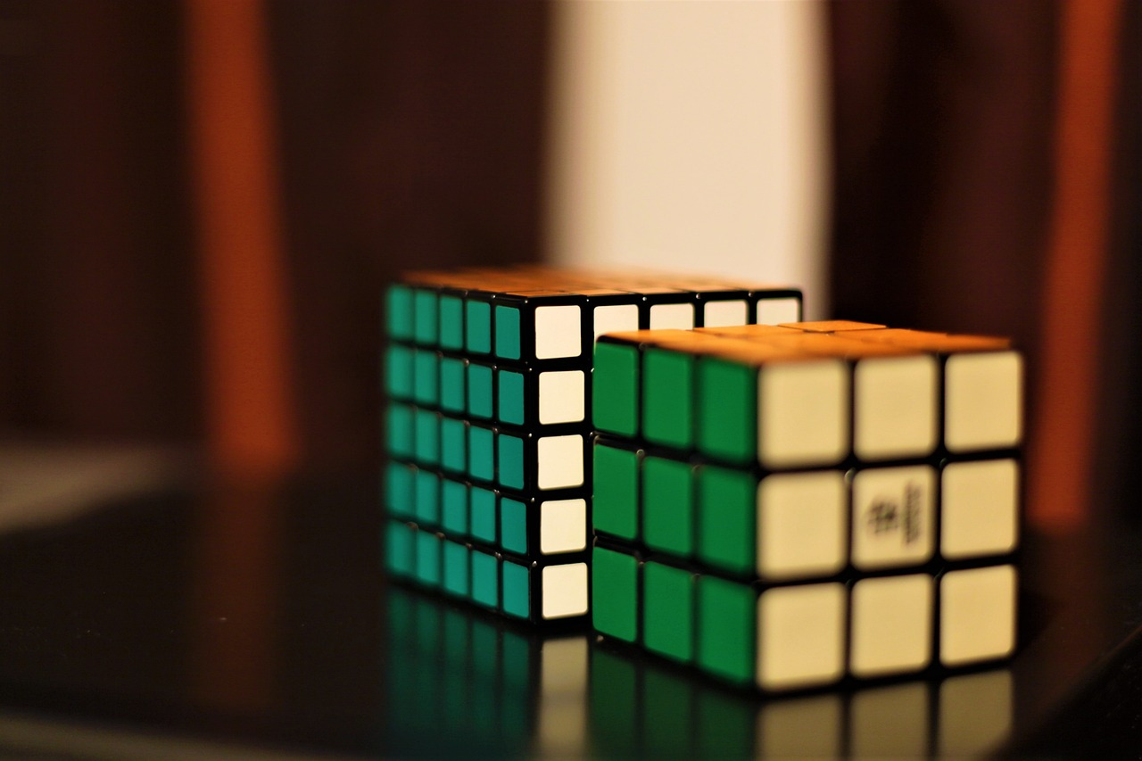
Project Overview

Slide 5
Project Workflow

Slide 6
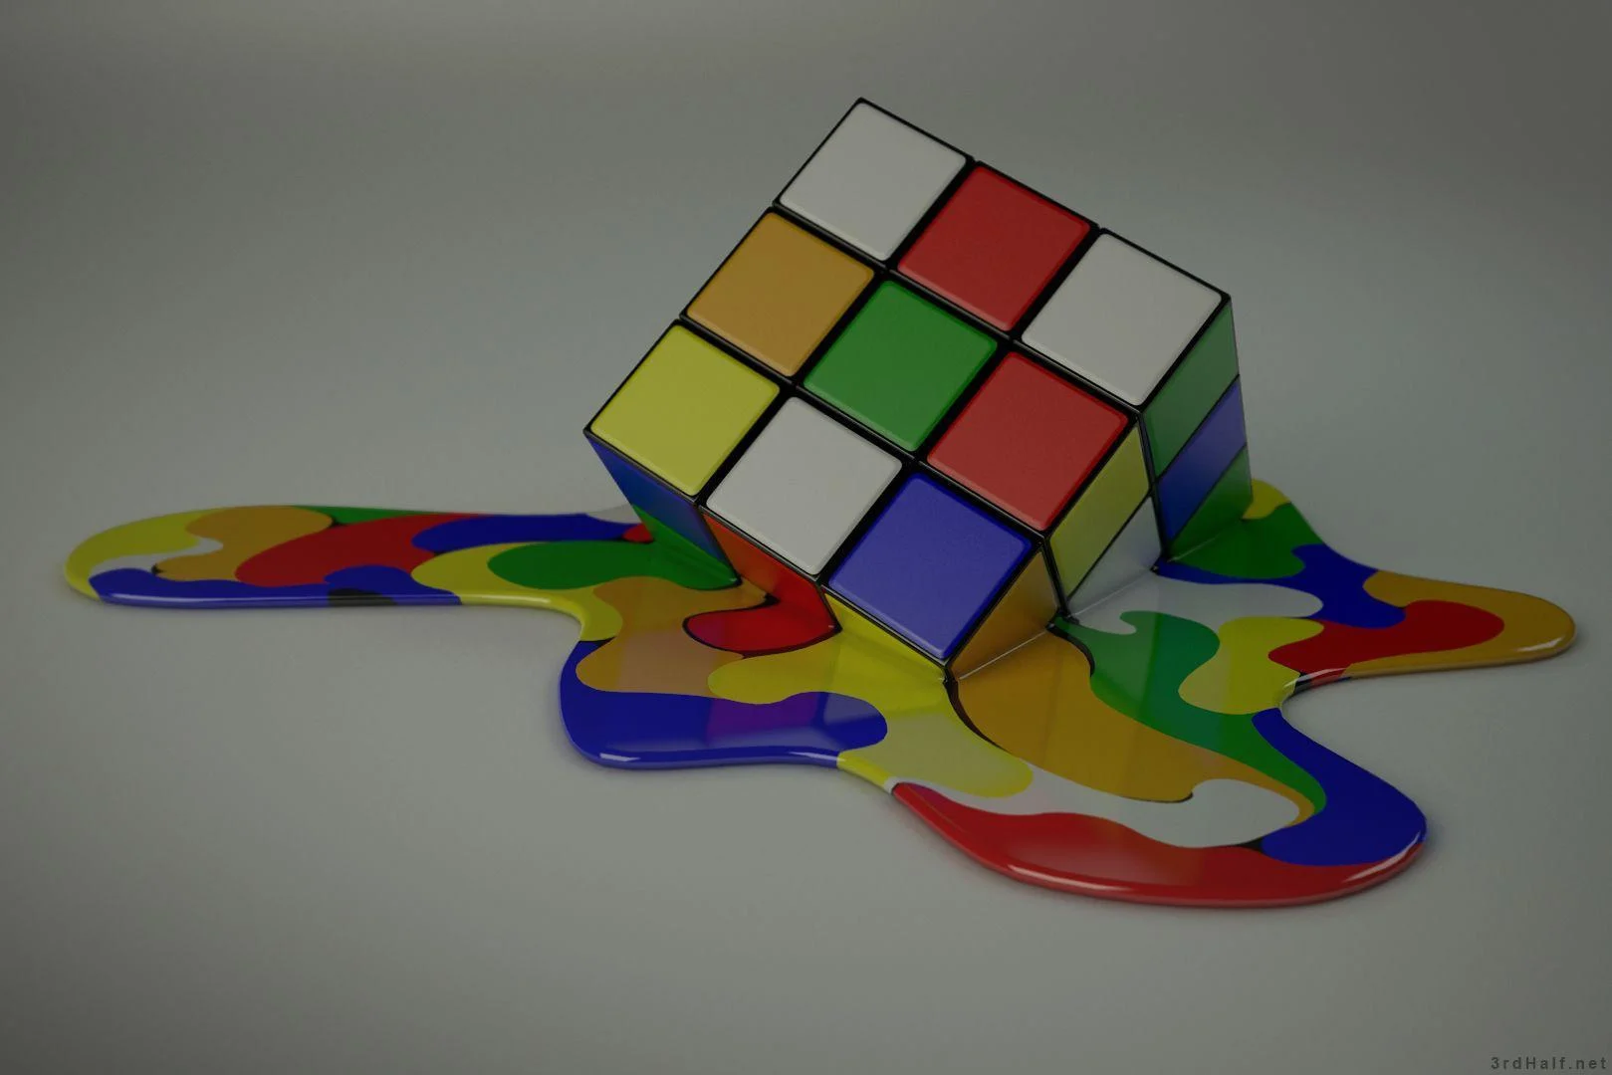
Project Complexity
Accessing and manipulating a 3D Rubik’s Cube
Complex Algorithms to implement in a computer program
Smartly use cube operations to effect
Solid background knowledge
Implementing GUI for visually better output

Slide 7
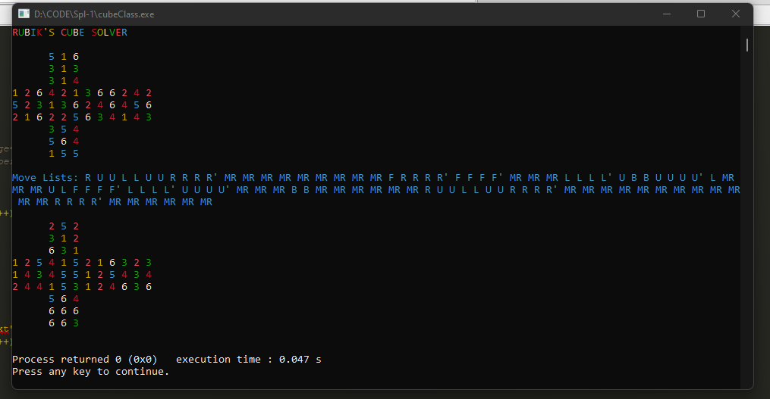
Project Progress
Output till now:
White Cross ✓
Second Layer ✗
Full Cube Solved ✗

Slide 8
Thank you !

Slide 9
