Slide 1
Chapter 1: Introduction
Lecture 1
Week 1
Ms. Nazia Shahzadi

Slide 2
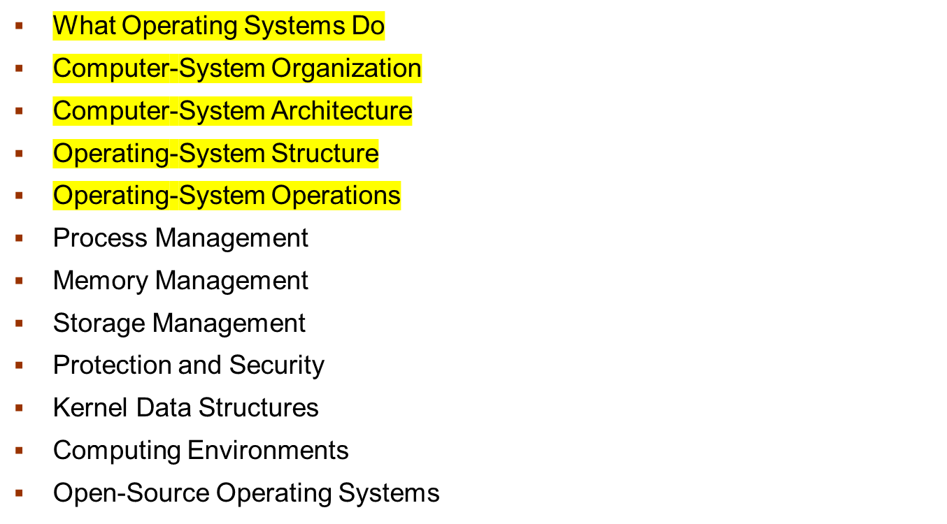
Chapter 1: Introduction

Slide 3
Objectives
To describe the basic organization of computer systems
To provide a grand tour of the major components of operating systems
To give an overview of the many types of computing environments
To explore several open-source operating systems

Slide 4
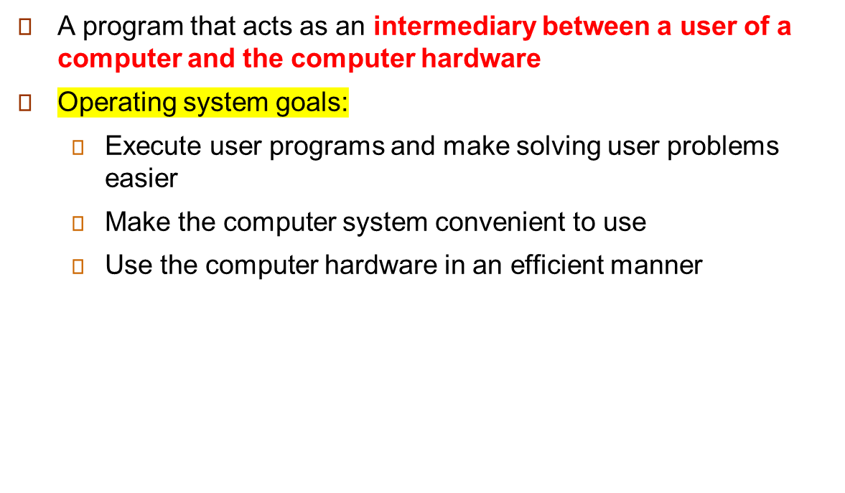
What is an Operating System?

Slide 5
Computer System Structure
The computer system can be divided into four components:
  Hardware – provides basic computing resources
    CPU, memory, I/O devices
  Operating system
    Controls and coordinates the use of the hardware among various applications and users
  Application programs – define the ways in which the system resources are used to solve the computing problems of the users
    Word processors, compilers, web browsers, database systems, video games
  Users
    People, machines, other computers

Slide 6

Four Components of a Computer System

Slide 7
What Operating Systems Do
Depends on the point of view
Users want convenience, ease of use and good performance
  Don’t care about resource utilization
But shared computer such as mainframe or minicomputer must keep all users happy
Users of dedicate systems such as workstations have dedicated resources but frequently use shared resources from servers
Handheld computers are resource poor, optimized for usability and battery life
Some computers have little or no user interface, such as embedded computers in devices and automobiles

Slide 8
Operating System Definition
OS is a resource allocator
  Manages all resources
  Decides between conflicting requests for efficient and fair resource use
OS is a control program
  Controls execution of programs to prevent errors and improper use of the computer
“The one program running at all times on the computer” is the kernel.

Slide 9
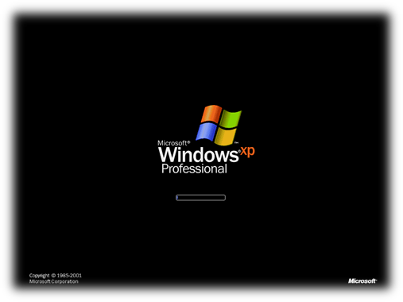
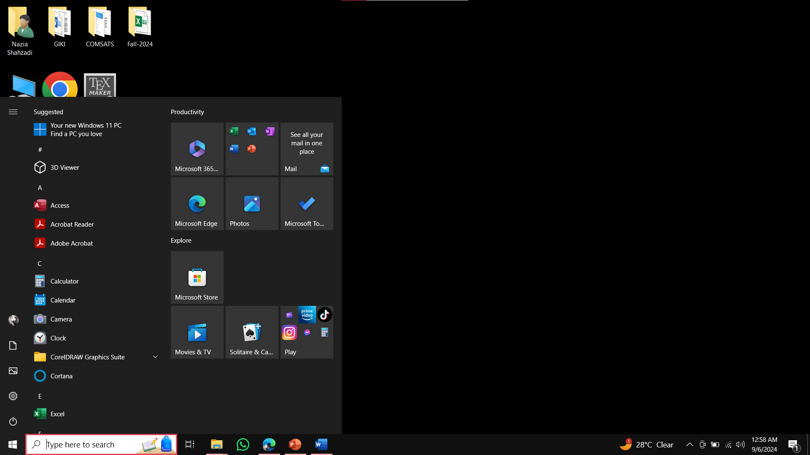
Computer Startup [1/3]
bootstrap program is loaded at power-up or reboot
  Typically stored in ROM or EPROM, generally known as firmware
  Initializes all aspects of system
  Loads operating system kernel and starts execution

Slide 10
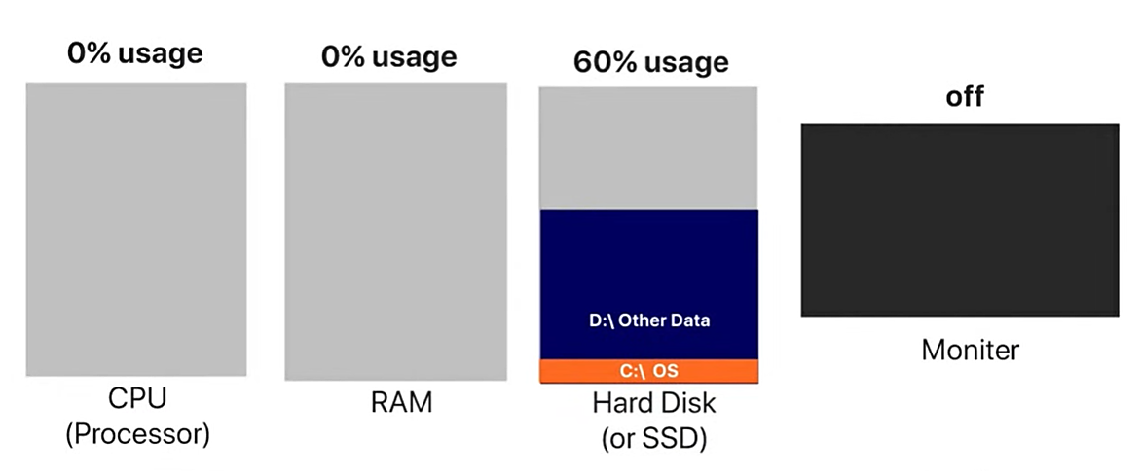
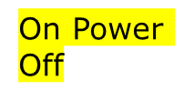
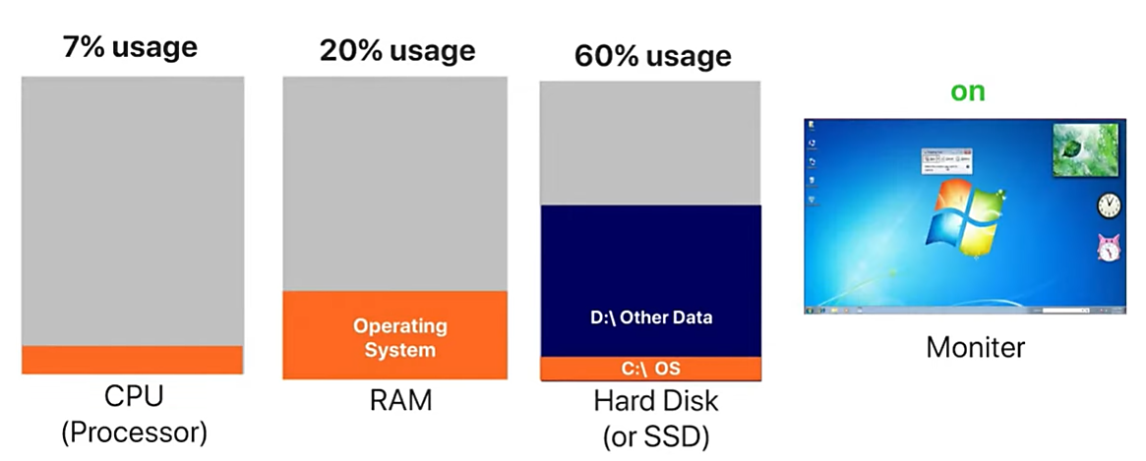
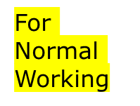
Computer Startup [2/3]

Slide 11
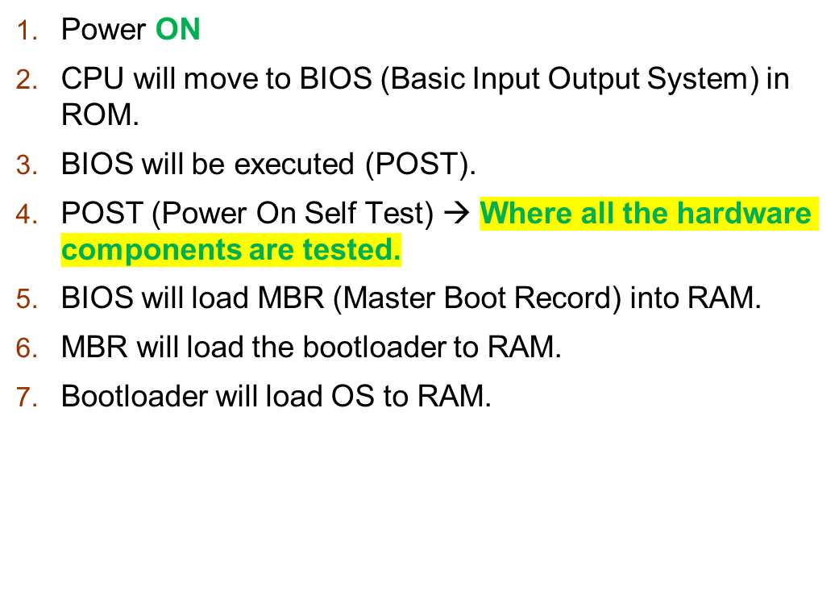
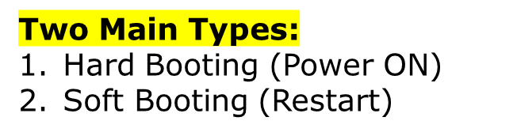
Computer Startup [3/3]

Slide 12

Computer System Organization
Computer-system operation
  One or more CPUs, device controllers connect through common bus providing access to shared memory
  Concurrent execution of CPUs and devices competing for memory cycles

Slide 13
End of Lecture 1
#Page 31 of Textbook

