Slide 1
Scheduling Algorithms
Lecture#22
Week 8

Slide 2
Outline
Shortest Remaining Time First (SRTF)
Round Robin (RR)

Slide 3



Shortest Remaining Time First (SRTF)
Simply a pre-emptive version of SJF
Pre-empt current process if a new one arrives with a shorter burst length than the remaining time of the current process
Distinguish arrival time and burst length, e.g.,
Gives chart
Process | Arrival Time | Burst Length
P₁ | 0 | 8
P₂ | 1 | 4
P₃ | 2 | 9
P₄ | 3 | 5
Average waiting time now
(10 − 1) + (1 − 1) + (17 − 2) + (5 − 3) 26 1
₄ = = 6
4
2

Slide 4
SRTF Example#2
Consider the set of 5 processes whose arrival time and burst time are given below-
Process Id | Arrival time | Burst time
P1 | 3 | 1
P2 | 1 | 4
P3 | 4 | 2
P4 | 0 | 6
P5 | 2 | 3
If the CPU scheduling policy is SRTF preemptive, calculate the average waiting time and average turn around time.

Slide 5
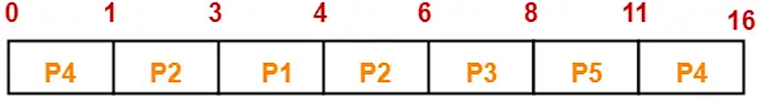
SRTF Example#2 (Cont.…)
Solution:
Now, we know-
Turn Around time = Exit time – Arrival time
Waiting time = Turn Around time – Burst time
Process Id | Exit time | Turn Around time | Waiting time
P1 | 4 | 4 – 3 = 1 | 1 – 1 = 0
P2 | 6 | 6 – 1 = 5 | 5 – 4 = 1
P3 | 8 | 8 – 4 = 4 | 4 – 2 = 2
P4 | 16 | 16 – 0 = 16 | 16 – 6 = 10
P5 | 11 | 11 – 2 = 9 | 9 – 3 = 6
Now,
Average Turn Around time = (1 + 5 + 4 + 16 + 9) / 5 = 35 / 5 = 7 unit
Average waiting time = (0 + 1 + 2 + 10 + 6) / 5 = 19 / 5 = 3.8 unit

Slide 6
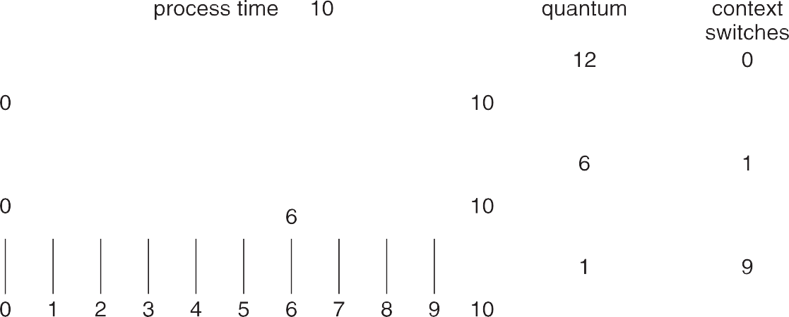
Round Robin
A pre-emptive scheduling scheme for time-sharing systems
Give each process a quantum (or time-slice) of CPU time e.g., 10—100 milliseconds
Once quantum elapsed, process is pre-empted and appended to the ready queue
Timer interrupts every quantum to schedule next process
Can be tricky to choose correctly
q too large degenerates into a FIFO queue (~ FCFS)
q too small makes the context switch overhead too great
q usually 10ms to 100ms, while context switch < 10 μsec
=

Slide 7
RR Example#1
Consider the set of 5 processes whose arrival time and burst time are given below-
Process Id | Arrival time | Burst time
P1 | 0 | 5
P2 | 1 | 3
P3 | 2 | 1
P4 | 3 | 2
P5 | 4 | 3
If the CPU scheduling policy is Round Robin with time quantum = 2 unit, calculate the average waiting time and average turn around time

Slide 8
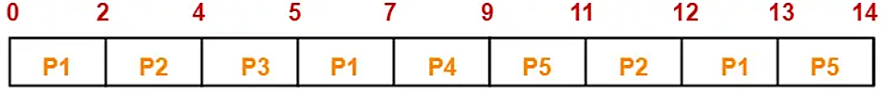
RR Example#1 (Cont.…)
Ready Queue-
P5, P1, P2, P5, P4, P1, P3, P2, P1
Now, we know-
Turn Around time = Exit time – Arrival time
Waiting time = Turn Around time – Burst time

Slide 9
RR Example#1 (Cont.…)
Process Id | Exit time | Turn Around time | Waiting time
P1 | 13 | 13 – 0 = 13 | 13 – 5 = 8
P2 | 12 | 12 – 1 = 11 | 11 – 3 = 8
P3 | 5 | 5 – 2 = 3 | 3 – 1 = 2
P4 | 9 | 9 – 3 = 6 | 6 – 2 = 4
P5 | 14 | 14 – 4 = 10 | 10 – 3 = 7
Now,
Average Turn Around time = (13 + 11 + 3 + 6 + 10) / 5 = 43 / 5 = 8.6 unit
Average waiting time = (8 + 8 + 2 + 4 + 7) / 5 = 29 / 5 = 5.8 unit

Slide 10
Any Questions???

