Slide 1
Priority Scheduling
Lecture 23
Week8

Slide 2
Consider the set of 5 processes whose arrival time and burst time are given below-
Process Id | Arrival time | Burst time | Priority
P1 | 0 | 4 | 2
P2 | 1 | 3 | 3
P3 | 2 | 1 | 4
P4 | 3 | 5 | 5
P5 | 4 | 2 | 5
Non-Preemptive
If the CPU scheduling policy is priority non-preemptive, calculate the average waiting time and average turn around time. (Higher number represents higher priority)

Slide 3
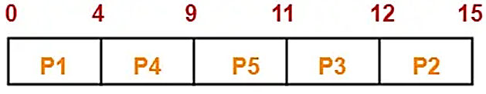
Solution-
Chart-
Turn Around time = Exit time – Arrival time
Waiting time = Turn Around time – Burst time
Process Id | Exit time | Turn Around time | Waiting time
P1 | 4 | 4 – 0 = 4 | 4 – 4 = 0
P2 | 15 | 15 – 1 = 14 | 14 – 3 = 11
P3 | 12 | 12 – 2 = 10 | 10 – 1 = 9
P4 | 9 | 9 – 3 = 6 | 6 – 5 = 1
P5 | 11 | 11 – 4 = 7 | 7 – 2 = 5
Average Turn Around time = (4 + 14 + 10 + 6 + 7) / 5 = 41 / 5 = 8.2 unit
Average waiting time = (0 + 11 + 9 + 1 + 5) / 5 = 26 / 5 = 5.2 unit

Slide 4




Priority scheduling
Associate integer priority with process, and schedule the highest priority (~ lowest number) process, e.g.,
Process | Priority | Burst Length
P₁ | 3 | 10
P₂ | 1 | 1
P₃ | 4 | 2
P₄ | 5 | 1
P₅ | 2 | 5
Average waiting time now
(1+5) + 0 + (1+5+10) + (1+5+10+2) + 1 ₌ 41 ₌ ₈ 1
5 5 5
Consider: SJF as priority scheduling using inverse of predicted burst length

Slide 5
Consider the set of 5 processes whose arrival time and burst time are given below-
Process Id | Arrival time | Burst time | Priority
P1 | 0 | 4 | 2
P2 | 1 | 3 | 3
P3 | 2 | 1 | 4
P4 | 3 | 5 | 5
P5 | 4 | 2 | 5
Preemptive
If the CPU scheduling policy is priority preemptive, calculate the average waiting time and average turn around time. (Higher number represents higher priority)

Slide 6
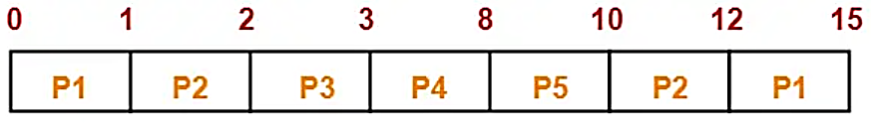
Solution-
Chart-
Turn Around time = Exit time – Arrival time
Waiting time = Turn Around time – Burst time
Process Id | Exit time | Turn Around time | Waiting time
P1 | 15 | 15 – 0 = 15 | 15 – 4 = 11
P2 | 12 | 12 – 1 = 11 | 11 – 3 = 8
P3 | 3 | 3 – 2 = 1 | 1 – 1 = 0
P4 | 8 | 8 – 3 = 5 | 5 – 5 = 0
P5 | 10 | 10 – 4 = 6 | 6 – 2 = 4
Average Turn Around time = (15 + 11 + 1 + 5 + 6) / 5 = 38 / 5 = 7.6 unit
Average waiting time = (11 + 8 + 0 + 0 + 4) / 5 = 23 / 5 = 4.6 unit

Slide 7
Outline
First-Come First-Served (FCFS)
Shortest Job First (SJF)
Shortest Remaining Time First (SRTF)
Round Robin (RR)
Priority scheduling
Multilevel queues
Multilevel queues
Multilevel feedback queues

Slide 8
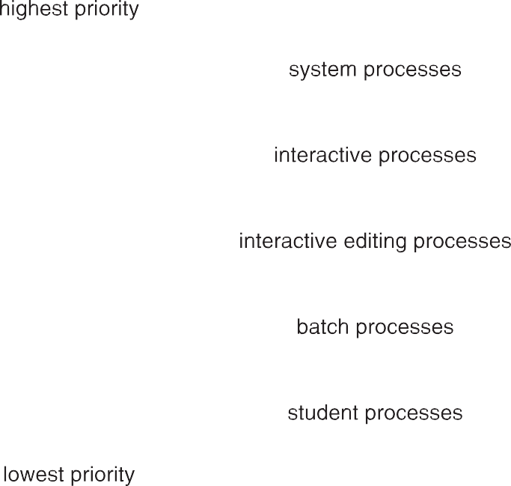
Multilevel Queues
Partition Ready queue into many queues for different types of process, e.g.,
Foreground/interactive processes
Background/batch processes
Each process is permanently assigned a given queue
Each queue runs its own scheduling algorithm, e.g.,
Foreground runs Round Robin
Background runs First-Come First-Served

