Slide 1
Processes
Lecture 14
Week 5
10/01/2024

Slide 2
Operations on Processes
System must provide mechanisms for:
  process creation,
  process termination,
  and so, on as detailed next

Slide 3
Process Creation
Parent process create children processes, which, in turn create other processes, forming a tree of processes
Generally, process identified and managed via a process identifier (pid)
Resource sharing options
  Parent and children share all resources
  Children share subset of parent’s resources
  Parent and child share no resources
Execution options
  Parent and children execute concurrently
  Parent waits until children terminate

Slide 4

A Tree of Processes in Linux

Slide 5

Process Creation (Cont.)
Address space
  Child duplicate of parent
  Child has a program loaded into it
UNIX examples
  fork() system call creates new process
  exec() system call used after a fork() to replace the process’ memory space with a new program

Slide 6
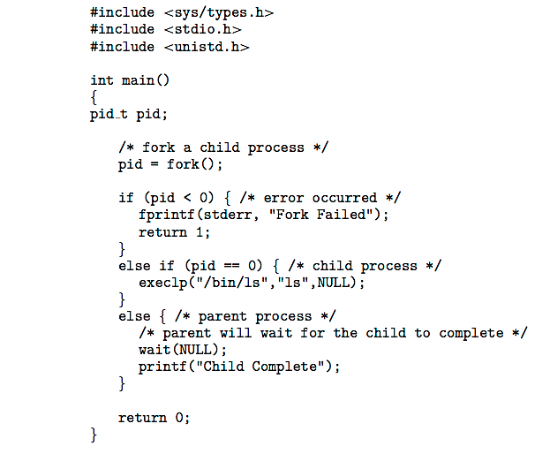
C Program Forking Separate Process

Slide 7
Process Termination
Process executes last statement and then asks the operating system to delete it using the exit() system call.
  Returns status data from child to parent (via wait())
  Process’ resources are deallocated by operating system
Parent may terminate the execution of children processes using the abort() system call. Some reasons for doing so:
  Child has exceeded allocated resources
  Task assigned to child is no longer required
  The parent is exiting, and the operating systems does not allow a child to continue if its parent terminates

Slide 8
Process Termination
Some operating systems do not allow child to exists if its parent has terminated. If a process terminates, then all its children must also be terminated.
  cascading termination. All children, grandchildren, etc. are terminated.
  The termination is initiated by the operating system.
The parent process may wait for termination of a child process by using the wait()system call. The call returns status information and the pid of the terminated process
pid = wait(&status);
If no parent waiting (did not invoke wait()) process is a zombie
If parent terminated without invoking wait , process is an orphan

Slide 9
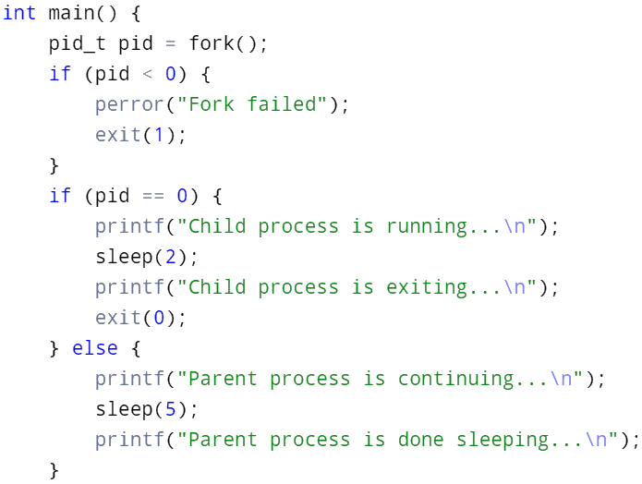
C Program Showing a Zombie Process

Slide 10
Interprocess Communication
Processes within a system may be independent or cooperating
Cooperating process can affect or be affected by other processes, including sharing data
Reasons for cooperating processes:
  Information sharing
  Computation speedup
  Modularity
  Convenience
Cooperating processes need interprocess communication (IPC)
Two models of IPC
  Shared memory
  Message passing

Slide 11

Communications Models
(a) Message passing. (b) shared memory.

Slide 12
Cooperating Processes
Independent process cannot affect or be affected by the execution of another process
Cooperating process can affect or be affected by the execution of another process
Advantages of process cooperation
  Information sharing
  Computation speed-up
  Modularity
  Convenience

Slide 13
Any Questions?

