Slide 1
Chapter 3: Processes
Week4
Lecture 11

Slide 2
Chapter 3: Processes
Process Concept
Process Scheduling
Operations on Processes
Interprocess Communication
Examples of IPC Systems
Communication in Client-Server Systems

Slide 3
Objectives
To introduce the notion of a process -- a program in execution, which forms the basis of all computation
To describe the various features of processes, including scheduling, creation and termination, and communication
To explore interprocess communication using shared memory and message passing
To describe communication in client-server systems

Slide 4
Process Concept
Program is passive entity stored on disk (executable file), process is active
  Program becomes process when executable file loaded into memory
Execution of program started via GUI mouse clicks, command line entry of its name, etc
One program can be several processes
  Consider multiple users executing the same program

Slide 5
Process Concept (Cont.)
An operating system executes a variety of programs:
  Batch system – jobs
  Time-shared systems – user programs or tasks
Textbook uses the terms job and process almost interchangeably
Process – a program in execution; process execution must progress in sequential fashion
Multiple parts
  Current activity including program counter, processor registers
  Stack containing temporary data
    Function parameters, return addresses, local variables
  Data section containing global variables
  Heap containing memory dynamically allocated during run time

Slide 6

Process in Memory

Slide 7
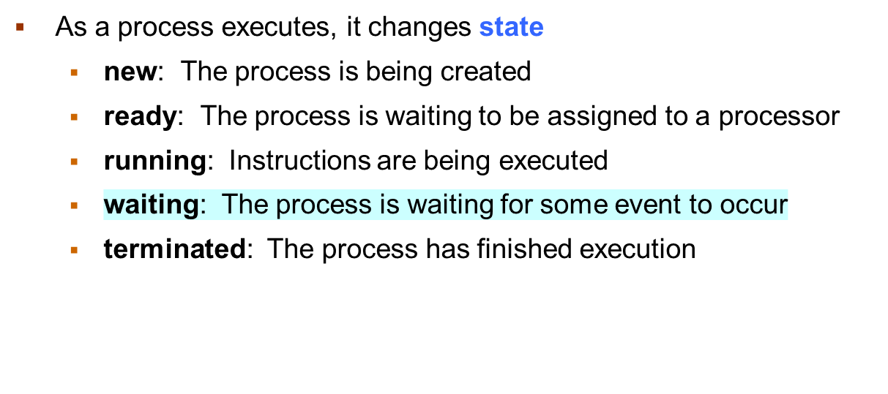
Process State

Slide 8

Diagram of Process State

Slide 9
Thank You

