Slide 1
Chapter 3: Processes
Week4
Lecture 12

Slide 2
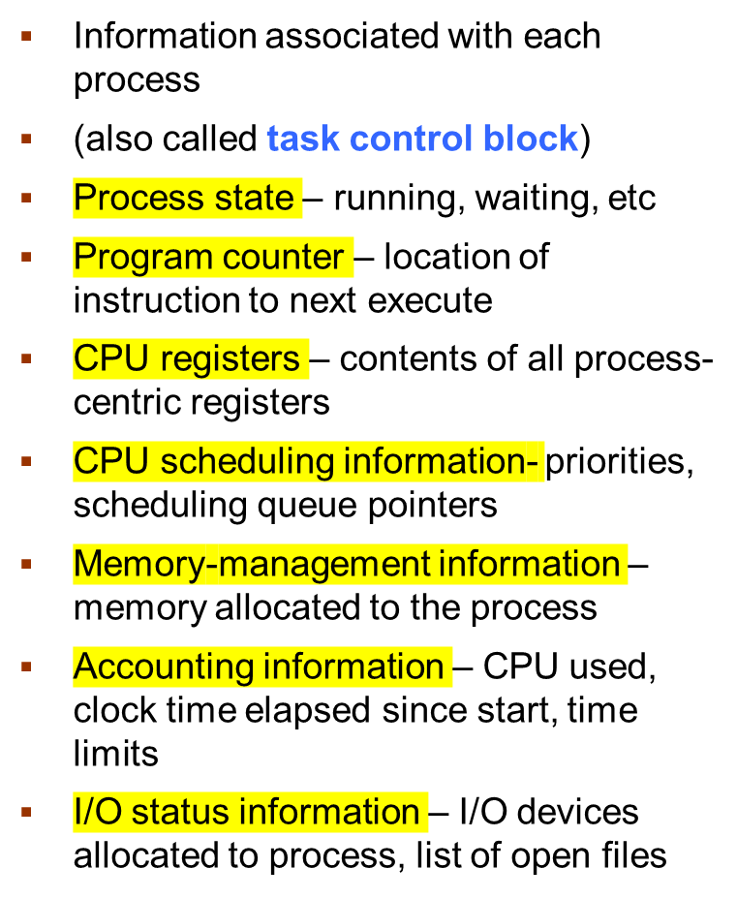

Process Control Block (PCB)

Slide 3
Context Switch
When CPU switches to another process, the system must save the state of the old process and load the saved state for the new process via a context switch
Context of a process represented in the PCB
Context-switch time is overhead; the system does no useful work while switching
  The more complex the OS and the PCB ➔ the longer the context switch
Time dependent on hardware support
  Some hardware provides multiple sets of registers per CPU ➔ multiple contexts loaded at once

Slide 4

CPU Switch From Process to Process

Slide 5
Threads
So far, process has a single thread of execution
Consider having multiple program counters per process
  Multiple locations can execute at once
    Multiple threads of control -> threads
Must then have storage for thread details, multiple program counters in PCB
See next chapter

Slide 6

Process Representation in Linux
Represented by the C structure task_struct
pid t_pid; /* process identifier */
long state; /* state of the process */
unsigned int time_slice /* scheduling information */
struct task_struct *parent; /* this process’s parent */
struct list_head children; /* this process’s children */
struct files_struct *files; /* list of open files */
struct mm_struct *mm; /* address space of this process */

Slide 7
Process Scheduling
Maximize CPU use, quickly switch processes onto CPU for time sharing
Process scheduler selects among available processes for next execution on CPU
Maintains scheduling queues of processes
  Job queue – set of all processes in the system
  Ready queue – set of all processes residing in main memory, ready and waiting to execute
  Device queues – set of processes waiting for an I/O device
  Processes migrate among the various queues

Slide 8

Representation of Process Scheduling
Queueing diagram represents queues, resources, flows

Slide 9
Schedulers
Long-term scheduler (or job scheduler) – selects which processes should be brought into the ready queue
  Long-term scheduler is invoked infrequently (seconds, minutes) ⇒ (may be slow)
  The long-term scheduler controls the degree of multiprogramming
Short-term scheduler (or CPU scheduler) – selects which process should be executed next and allocates CPU
  Sometimes the only scheduler in a system
  Short-term scheduler is invoked frequently (milliseconds) ⇒ (must be fast)
Processes can be described as either:
  I/O-bound process – spends more time doing I/O than computations, many short CPU bursts
  CPU-bound process – spends more time doing computations; few very long CPU bursts

Slide 10
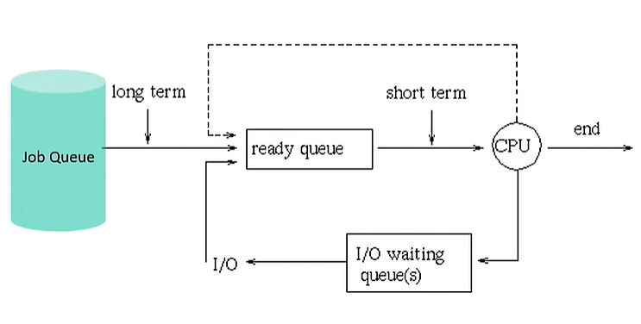
Schedulers

Slide 11

Addition of Medium-Term Scheduling
Medium-term scheduler can be added if degree of multiple programming needs to decrease
  Remove process from memory, store on disk, bring back in from disk to continue execution: swapping

Slide 12
Multitasking in Mobile Systems
Some mobile systems (e.g., early version of iOS) allow only one process to run, others suspended
Due to screen real estate, user interface limits iOS provides for a
  Single foreground process- controlled via user interface
  Multiple background processes– in memory, running, but not on the display, and with limits
  Limits include single, short task, receiving notification of events, specific long-running tasks like audio playback
Android runs foreground and background, with fewer limits
  Background process uses a service to perform tasks
  Service can keep running even if background process is suspended
  Service has no user interface, small memory use

Slide 13

Multiprocess Architecture – Chrome Browser
Many web browsers ran as single process (some still do)
  If one web site causes trouble, entire browser can hang or crash
Google Chrome Browser is multiprocess with 3 different types of processes:
  Browser process manages user interface, disk and network I/O
  Renderer process renders web pages, deals with HTML, Javascript. A new renderer created for each website opened
    Runs in sandbox restricting disk and network I/O, minimizing effect of security exploits
  Plug-in process for each type of plug-in

Slide 14
Thank You!!!

