Slide 1
Processes
Lecture 15
Week 5
10/02/2024

Slide 2

Local Procedure Calls (LPC)
Local Procedure Calls (LPCs) are a mechanism for interprocess communication (IPC) that allows processes running on the same machine to exchange data and messages efficiently.

Slide 3
Communications in Client-Server Systems
Sockets
Remote Procedure Calls
Pipes
Remote Method Invocation (Java)

Slide 4
Sockets
A socket is defined as an endpoint for communication
Concatenation of IP address and port – a number included at start of message packet to differentiate network services on a host
The socket 161.25.19.8:1625 refers to port 1625 on host 161.25.19.8
Communication consists between a pair of sockets
All ports below 1024 are well known, used for standard services
Special IP address 127.0.0.1 (loopback) to refer to system on which process is running

Slide 5

Socket Communication

Slide 6
Remote Procedure Calls
Remote procedure call (RPC) abstracts procedure calls between processes on networked systems
  Again uses ports for service differentiation
Stubs – client-side proxy for the actual procedure on the server
The client-side stub locates the server and marshalls the parameters
The server-side stub receives this message, unpacks the marshalled parameters, and performs the procedure on the server
On Windows, stub code compile from specification written in Microsoft Interface Definition Language (MIDL)

Slide 7
Remote Procedure Calls (Cont.)
Data representation handled via External Data Representation (XDL) format to account for different architectures
  Big-endian and little-endian
Remote communication has more failure scenarios than local
  Messages can be delivered exactly once rather than at most once
OS typically provides a rendezvous (or matchmaker) service to connect client and server

Slide 8

Execution of RPC

Slide 9
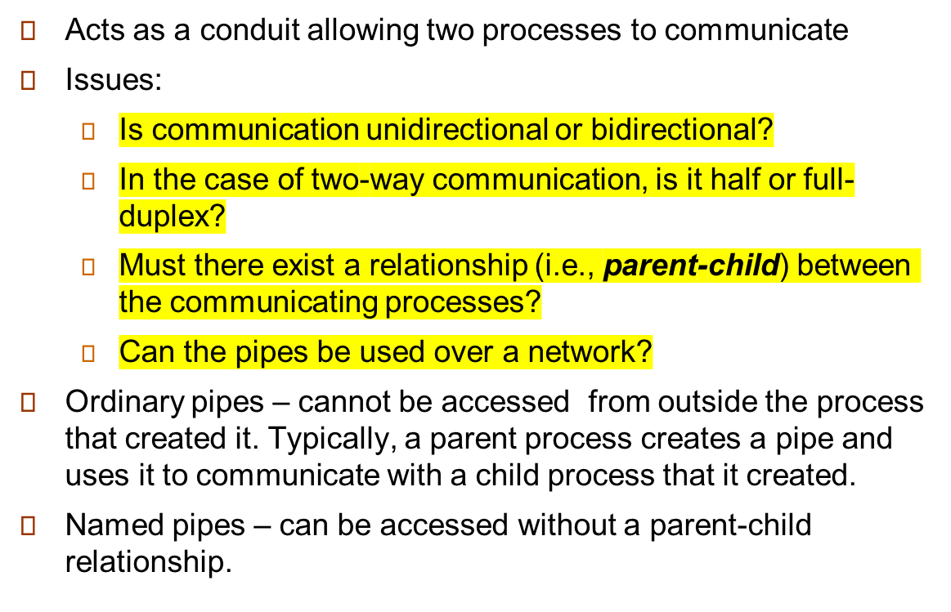
Pipes
Reading
Assignment

Slide 10
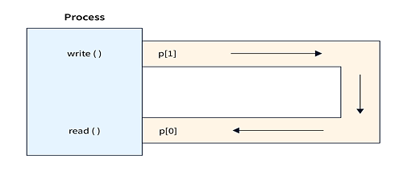
Ordinary Pipes
Ordinary Pipes allow communication in standard producer-consumer style
Producer writes to one end (the write-end of the pipe)
Consumer reads from the other end (the read-end of the pipe)
Ordinary pipes are therefore unidirectional
Require parent-child relationship between communicating processes

Slide 11
Named Pipes
Named Pipes are more powerful than ordinary pipes
Communication is bidirectional
No parent-child relationship is necessary between the communicating processes
Several processes can use the named pipe for communication
Provided on both UNIX and Windows systems

Slide 12
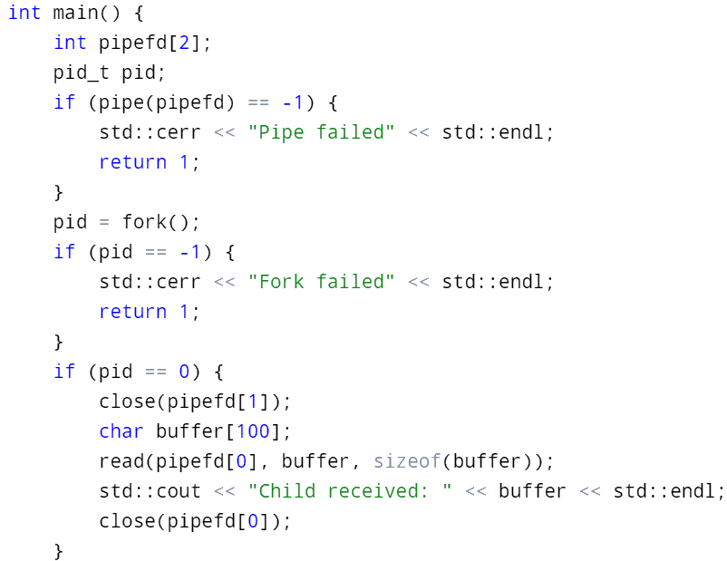
Pipe Implementation

Slide 13
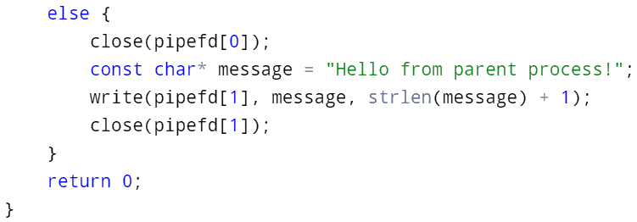
Pipes Implementation

Slide 14
End of Chapter 3

