Slide 1
Chapter 4: Threads
Lecture#16
10/07/2024

Slide 2
Chapter 4: Threads
Overview
Multicore Programming
Multithreading Models
Thread Libraries
Implicit Threading
Threading Issues
Operating System Examples

Slide 3
Objectives
To introduce the notion of a thread—a fundamental unit of CPU utilization that forms the basis of multithreaded computer systems
To discuss the APIs for the Pthreads, Windows, and Java thread libraries
To explore several strategies that provide implicit threading
To examine issues related to multithreaded programming
To cover operating system support for threads in Windows and Linux

Slide 4
Threads in OS
Most modern applications are multithreaded
Threads run within application
Multiple tasks with the application can be implemented by separate threads
  Update display
  Fetch data
  Spell checking
  Answer a network request
Process creation is heavy-weight while thread creation is light-weight
Can simplify code, increase efficiency
Kernels are generally multithreaded

Slide 5
Example
#include <iostream>
#include <thread>
void printNumbers( ) {
for (int i = 1; i <= 5; ++i) {
std::cout << "Thread 1 - Number: " << i << std::endl;
}
}
void printLetters() {
for (char c = 'A'; c <= 'E'; ++c) {
std::cout << "Thread 2 - Letter: " << c << std::endl;
}
}

Slide 6
Example
int main() {
std::thread t1(printNumbers);
std::thread t2(printLetters);
t1.join();
t2.join();
std::cout << "Both threads finished!" << std::endl;
return 0;
}
Output
Thread 1 - Number: 1
Thread 2 - Letter: A
Thread 1 - Number: 2
Thread 2 - Letter: B
Thread 1 - Number: 3
Thread 2 - Letter: C
Thread 1 - Number: 4
Thread 2 - Letter: D
Thread 1 - Number: 5
Thread 2 - Letter: E
Both threads finished!

Slide 7

Multithreaded Server Architecture

Slide 8
Benefits
Responsiveness – may allow continued execution if part of process is blocked, especially important for user interfaces
Resource Sharing – threads share resources of process, easier than shared memory or message passing
Economy – cheaper than process creation, thread switching lower overhead than context switching
Scalability – process can take advantage of multiprocessor architectures

Slide 9
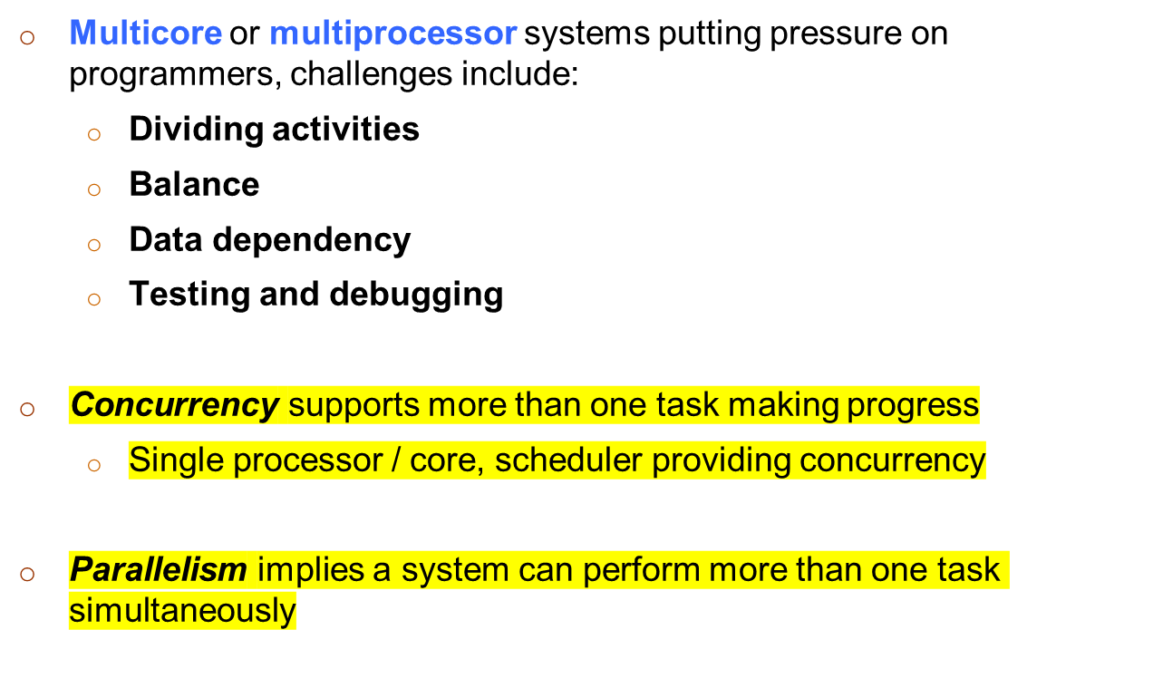
Multicore Programming

Slide 10
Multicore Programming
for i=1, 100
Read V(i)
for i=1, 100
Read V(i)
For i=1, 100
X(i) = V(i)*a
Y(i) = V(i)+b
for I = 1, 100
Print X(i)
Print Y(i)
for i=1, 10
X(i) = V(i)*a
Y(i) = V(i)+b
for i = 1, 10
Print X(i)
Print Y(i)
for i=11, 20
X(i) = V(i)*a
Y(i) = V(i)+b
for i = 11, 20
Print X(i)
Print Y(i)
for i=91, 100
X(i) = V(i)*a
Y(i) = V(i)+b
for i = 91, 100
Print X(i)
Print Y(i)
………

Slide 11


Concurrency vs. Parallelism
Concurrent execution on single-core system:
Parallelism on a multi-core system:

Slide 12
Multicore Programming (Cont.)
Types of parallelism
  Data parallelism – distributes subsets of the same data across multiple cores, same operation on each
  Task parallelism – distributing threads across cores, each thread performing unique operation
As # of threads grows, so does architectural support for threading
  Consider Oracle SPARC T4 with 8 cores, and 8 hardware threads per core

Slide 13

Single and Multithreaded Processes

Slide 14

Amdahl’s Law
Identifies performance gains from adding additional cores to an application that has both serial and parallel components
S is serial portion
N processing cores
That is, if application is 75% parallel / 25% serial, moving from 1 to 2 cores results in speedup of 1.6 times
As N approaches infinity, speedup approaches 1 / S
Serial portion of an application has disproportionate effect on performance gained by adding additional cores

Slide 15
User Threads and Kernel Threads
User threads - management done by user-level threads library
Three primary thread libraries:
  POSIX Pthreads
  Windows threads
  Java threads
Kernel threads - Supported by the Kernel
Examples – virtually all general purpose operating systems, including:
  Windows
  Solaris
  Linux
  Tru64 UNIX
  Mac OS X

Slide 16
Any Questions???

