Slide 1
Chapter 4: Threads
Lecture#17
10/08/2024

Slide 2
User Threads and Kernel Threads
User threads - management done by user-level threads library
Three primary thread libraries:
  POSIX Pthreads
  Windows threads
  Java threads
Kernel threads - Supported by the Kernel
Examples – virtually all general-purpose operating systems, including:
  Windows
  Solaris
  Linux
  Tru64 UNIX
  Mac OS X

Slide 3
User Threads Example
import threading
import time
def task(name):
print(f"{name} is starting.")
time.sleep(2)
print(f"{name} is done.")
thread1 = threading.Thread(target=task, args=("Thread 1",))
thread2 = threading.Thread(target=task, args=("Thread 2",))
thread1.start()
thread2.start()
thread1.join()
thread2.join()
print("Both threads finished.")

Slide 4
Multithreading Models
Many-to-One
One-to-One
Many-to-Many

Slide 5

Many-to-One
Many user-level threads mapped to single kernel thread
One thread blocking causes all to block
Multiple threads may not run in parallel on muticore system because only one may be in kernel at a time
Few systems currently use this model
Examples:
  Solaris Green Threads
  GNU Portable Threads

Slide 6

One-to-One
Each user-level thread maps to kernel thread
Creating a user-level thread creates a kernel thread
More concurrency than many-to-one
Number of threads per process sometimes restricted due to overhead
Examples
  Windows
  Linux
  Solaris 9 and later

Slide 7

Many-to-Many Model
Allows many user level threads to be mapped to many kernel threads
Allows the operating system to create a sufficient number of kernel threads
Solaris prior to version 9
Windows with the ThreadFiber package

Slide 8

Two-level Model
Similar to M:M, except that it allows a user thread to be bound to kernel thread
Examples
  IRIX
  HP-UX
  Tru64 UNIX
  Solaris 8 and earlier

Slide 9
Thread Libraries
Thread library provides programmer with API for creating and managing threads
Two primary ways of implementing
  Library entirely in user space
  Kernel-level library supported by the OS

Slide 10
Pthreads
May be provided either as user-level or kernel-level
A POSIX API for thread creation and synchronization
Specification, not implementation
API specifies behavior of the thread library, implementation is up to development of the library
Common in UNIX operating systems (Solaris, Linux, Mac OS X)

Slide 11
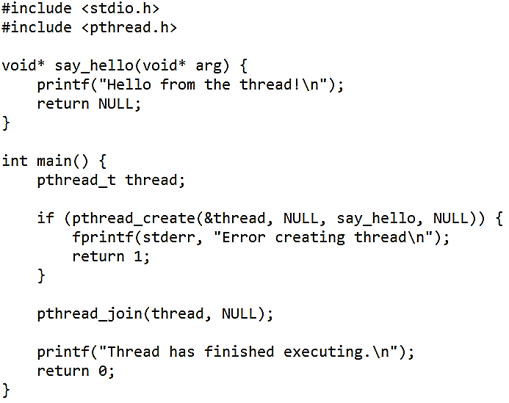
Pthreads Example

Slide 12
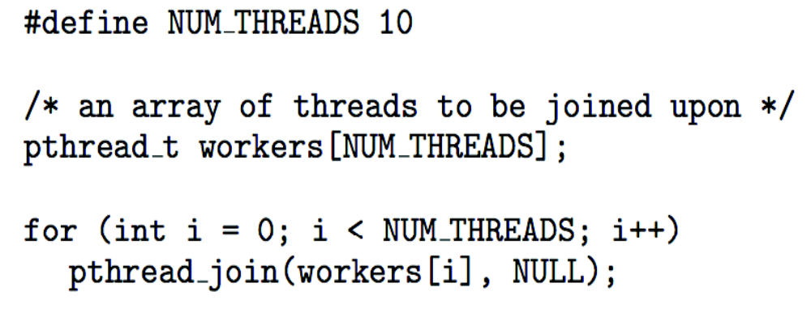
Pthreads Code for Joining 10 Threads

Slide 13
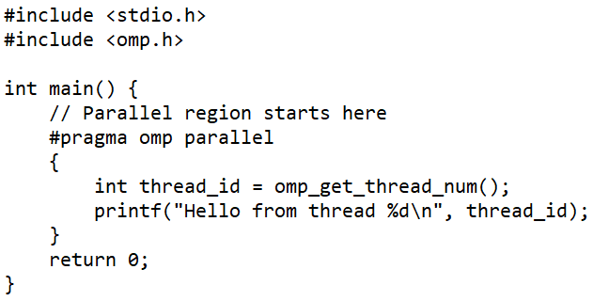
OpenMP
Set of compiler directives and an API for C, C++, FORTRAN
Provides support for parallel programming in shared-memory environments
Identifies parallel regions – blocks of code that can run in parallel
#pragma omp parallel
Create as many threads as there are cores
#pragma omp parallel for for(i=0;i<N;i++) {
c[i] = a[i] + b[i];
}
Run for loop in parallel

Slide 14
Signal Handling
Signals are used in UNIX systems to notify a process that a particular event has occurred.
A signal handler is used to process signals
  Signal is generated by particular event
  Signal is delivered to a process
  Signal is handled by one of two signal handlers:
    default
    user-defined
Every signal has default handler that kernel runs when handling signal
  User-defined signal handler can override default
  For single-threaded, signal delivered to process

Slide 15
Signal Handling (Cont.)
Where should a signal be delivered for multi-threaded?
  Deliver the signal to the thread to which the signal applies
  Deliver the signal to every thread in the process
  Deliver the signal to certain threads in the process
  Assign a specific thread to receive all signals for the process

Slide 16
End of Chapter 4

