Slide 1
CPU Scheduling
Lecture 19
10/15/2024

Slide 2
CPU Scheduling
Basic Concepts
Scheduling Criteria
Scheduling Algorithms
Thread Scheduling
Multiple-Processor Scheduling
Real-Time CPU Scheduling
Operating Systems Examples
Algorithm Evaluation

Slide 3
Objectives
To introduce CPU scheduling, which is the basis for multiprogrammed operating systems
To describe various CPU-scheduling algorithms
To discuss evaluation criteria for selecting a CPU-scheduling algorithm for a particular system
To examine the scheduling algorithms of several operating systems

Slide 4

Basic Concepts
Maximum CPU utilization obtained with multiprogramming
CPU–I/O Burst Cycle – Process execution consists of a cycle of CPU execution and I/O wait
CPU burst followed by I/O burst
CPU burst distribution is of main concern

Slide 5
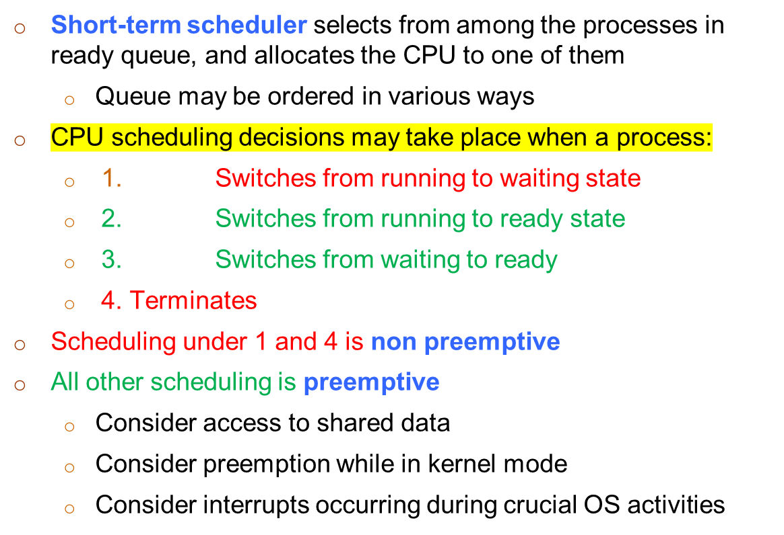
CPU Scheduler

Slide 6
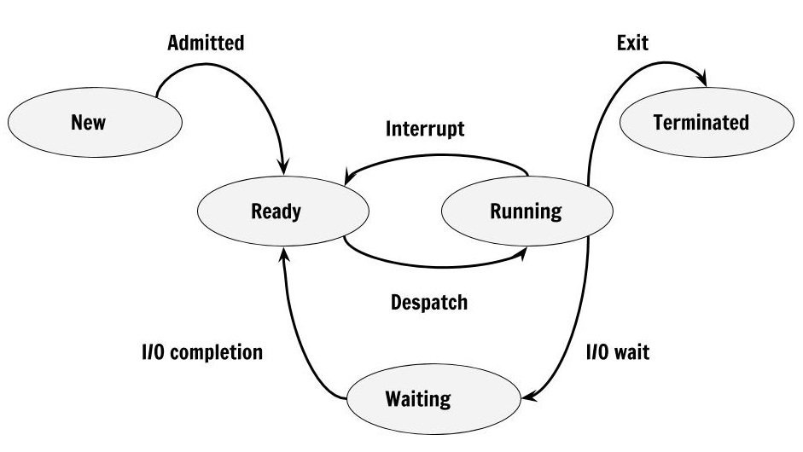
Process States (Previous)

Slide 7
Dispatcher
Dispatcher module gives control of the CPU to the process selected by the short-term scheduler; this involves:
  switching context
  switching to user mode
  jumping to the proper location in the user program to restart that program
Dispatch latency – time it takes for the dispatcher to stop one process and start another running

Slide 8
Scheduling Criteria
CPU utilization – keep the CPU as busy as possible
Throughput – # of processes that complete their execution per time unit
Turnaround time – amount of time to execute a particular process
Waiting time – amount of time a process has been waiting in the ready queue
Response time – amount of time it takes from when a request was submitted until the first response is produced, not output.

Slide 9
Scheduling Algorithm Optimization Criteria
Max CPU utilization
Max throughput
Min turnaround time
Min waiting time
Min response time

Slide 10

First- Come, First-Served (FCFS) Scheduling
(Nonpreemptive)
Process Burst Time
P₁ 24
P₂ 3
P₃ 3
Suppose that the processes arrive in the order: P₁ , P₂ , P₃
The Chart for the schedule is:
Waiting time for P₁ = 0; P₂ = 24; P₃ = 27
Average waiting time: (0 + 24 + 27)/3 = 17

Slide 11

FCFS Scheduling (Cont.)
Suppose that the processes arrive in the order:
P₂ , P₃ , P₁
The chart for the schedule is:
Waiting time for P₁ = 6; P₂ = 0; P₃ = 3
Average waiting time: (6 + 0 + 3)/3 = 3
Much better than previous case
Convoy effect is a situation where many processes, who need to use a resource for short time are blocked by one process holding that resource for a long time.
This essentially leads to poor utilization of resources and hence poor performance.

Slide 12
FCFS Scheduling Exm#1
Consider the set of 5 processes whose arrival time and burst time are given below
Process Id | Arrival time | Burst time
P1 | 3 | 4
P2 | 5 | 3
P3 | 0 | 2
P4 | 5 | 1
P5 | 4 | 3
If the CPU scheduling policy is FCFS, calculate the average waiting time and average turn around time.

Slide 13
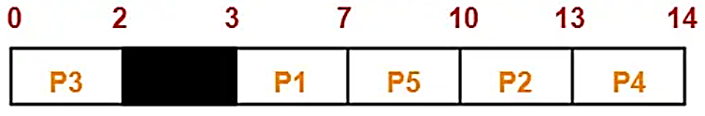
FCFS Scheduling Exm#1
Process Id | Arrival time | Burst time
P1 | 3 | 4
P2 | 5 | 3
P3 | 0 | 2
P4 | 5 | 1
P5 | 4 | 3
Here, black box represents the idle time of CPU.
Now, we know-
Turn Around time = Exit time – Arrival time
Waiting time = Turn Around time – Burst time

Slide 14
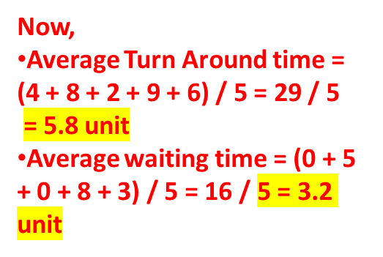
FCFS Scheduling Exm#1
Process Id | Arrival time | Burst time
P1 | 3 | 4
P2 | 5 | 3
P3 | 0 | 2
P4 | 5 | 1
P5 | 4 | 3
Process Id | Exit time | Turn Around time | Waiting time
P1 | 7 | 7 – 3 = 4 | 4 – 4 = 0
P2 | 13 | 13 – 5 = 8 | 8 – 3 = 5
P3 | 2 | 2 – 0 = 2 | 2 – 2 = 0
P4 | 14 | 14 – 5 = 9 | 9 – 1 = 8
P5 | 10 | 10 – 4 = 6 | 6 – 3 = 3

Slide 15
FCFS Scheduling Exm#2
Solve it !!!
Consider the set of 3 processes whose arrival time and burst time are given below-
Process Id | Arrival time | Burst time
P1 | 0 | 2
P2 | 3 | 1
P3 | 5 | 6
If the CPU scheduling policy is FCFS, calculate the average waiting time and average turn around time.

Slide 16
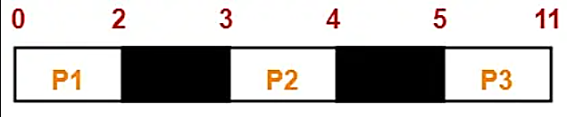
FCFS Scheduling Exm#2
Solve it !!!
Process Id | Arrival time | Burst time
P1 | 0 | 2
P2 | 3 | 1
P3 | 5 | 6
Now, we know-
Turn Around time = Exit time – Arrival time
Waiting time = Turn Around time – Burst time

Slide 17
FCFS Scheduling Exm#2
Solve it !!!
Process Id | Arrival time | Burst time
P1 | 0 | 2
P2 | 3 | 1
P3 | 5 | 6
Process Id | Exit time | Turn Around time | Waiting time
P1 | 2 | 2 – 0 = 2 | 2 – 2 = 0
P2 | 4 | 4 – 3 = 1 | 1 – 1 = 0
P3 | 11 | 11- 5 = 6 | 6 – 6 = 0
Now,
Average Turn Around time = (2 + 1 + 6) / 3 = 9 / 3 = 3 unit
Average waiting time = (0 + 0 + 0) / 3 = 0 / 3 = 0 unit

Slide 18
Any Questions???

