Slide 1
Chapter 2: Operating-System Structures
Lecture 7
Week 3
9/16/2024

Slide 2
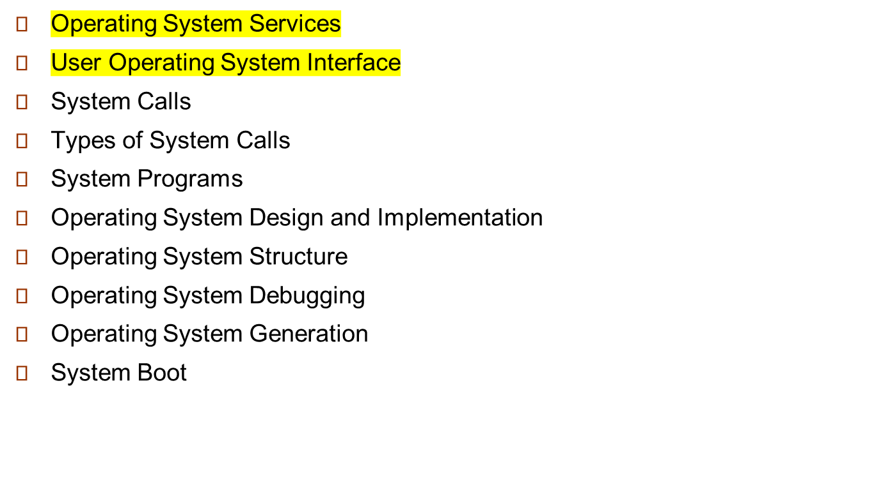
Chapter 2: Operating-System Structures

Slide 3
Objectives
To describe the services an operating system provides to users, processes, and other systems
To discuss the various ways of structuring an operating system
To explain how operating systems are installed and customized and how they boot

Slide 4
Operating System Services
Operating systems provide an environment for execution of programs and services to programs and users
One set of operating-system services provides functions that are helpful to the user:
  User interface - Almost all operating systems have a user interface (UI).
    Varies between Command-Line (CLI), Graphics User Interface (GUI), Batch
  Program execution - The system must be able to load a program into memory and to run that program, end execution, either normally or abnormally (indicating error)
  I/O operations - A running program may require I/O, which may involve a file or an I/O device

Slide 5
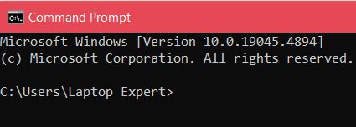
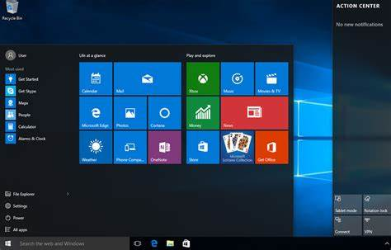
UI
Command Line Interface
Graphical User Interface

Slide 6
Operating System Services (Cont.)
One set of operating-system services provides functions that are helpful to the user (Cont.):
  File-system manipulation - The file system is of particular interest. Programs need to read and write files and directories, create and delete them, search them, list file Information, permission management.
  Communications – Processes may exchange information, on the same computer or between computers over a network
    Communications may be via shared memory or through message passing (packets moved by the OS)
  Error detection – OS needs to be constantly aware of possible errors
    May occur in the CPU and memory hardware, in I/O devices, in user program
    For each type of error, OS should take the appropriate action to ensure correct and consistent computing
    Debugging facilities can greatly enhance the user’s and programmer’s abilities to efficiently use the system

Slide 7
Operating System Services (Cont.)
Another set of OS functions exists for ensuring the efficient operation of the system itself via resource sharing
  Resource allocation - When multiple users or multiple jobs running concurrently, resources must be allocated to each of them
    Many types of resources - CPU cycles, main memory, file storage, I/O devices.
  Accounting - To keep track of which users use how much and what kinds of computer resources
  Protection and security - The owners of information stored in a multiuser or networked computer system may want to control use of that information, concurrent processes should not interfere with each other
    Protection involves ensuring that all access to system resources is controlled
    Security of the system from outsiders requires user authentication, extends to defending external I/O devices from invalid access attempts

Slide 8

A View of Operating System Services

Slide 9
User Operating System Interface - CLI
CLI or command interpreter allows direct command entry
  Sometimes implemented in kernel, sometimes by systems program
  Sometimes multiple flavors implemented – shells
  Primarily fetches a command from user and executes it
  Sometimes commands built-in, sometimes just names of programs
    If the latter, adding new features doesn’t require shell modification

Slide 10
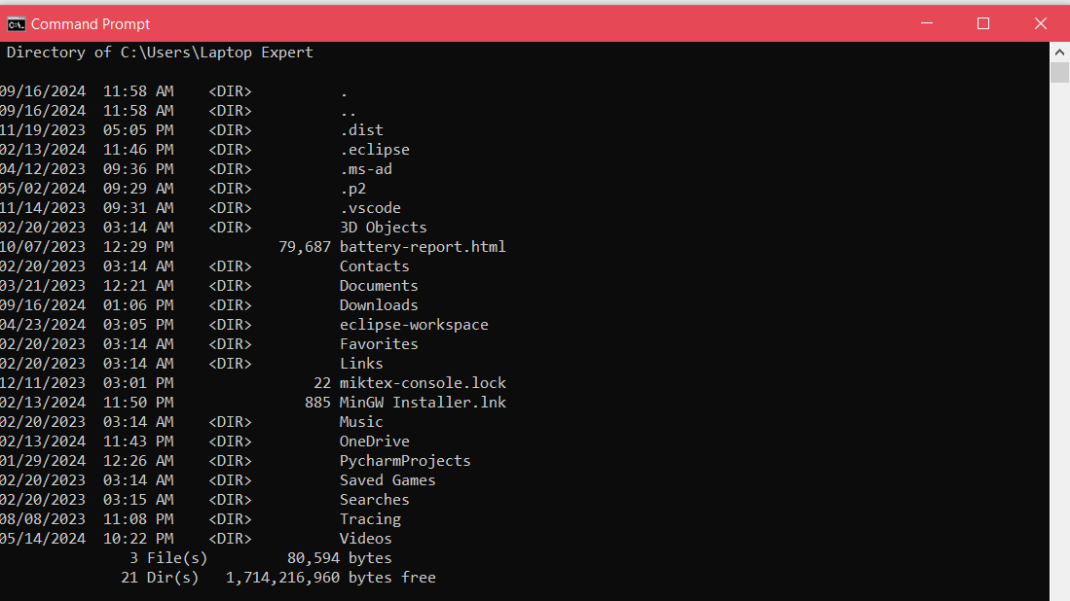
Windows Command Prompt

Slide 11
User Operating System Interface - GUI
User-friendly desktop interface
  Usually mouse, keyboard, and monitor
  Icons represent files, programs, actions, etc
  Various mouse buttons over objects in the interface cause various actions (provide information, options, execute function, open directory (known as a folder)
  Invented at Xerox PARC
Many systems now include both CLI and GUI interfaces
  Microsoft Windows is GUI with CLI “command” shell
  Apple Mac OS X is “Aqua” GUI interface with UNIX kernel underneath and shells available
  Unix and Linux have CLI with optional GUI interfaces (CDE, KDE, GNOME)

Slide 12
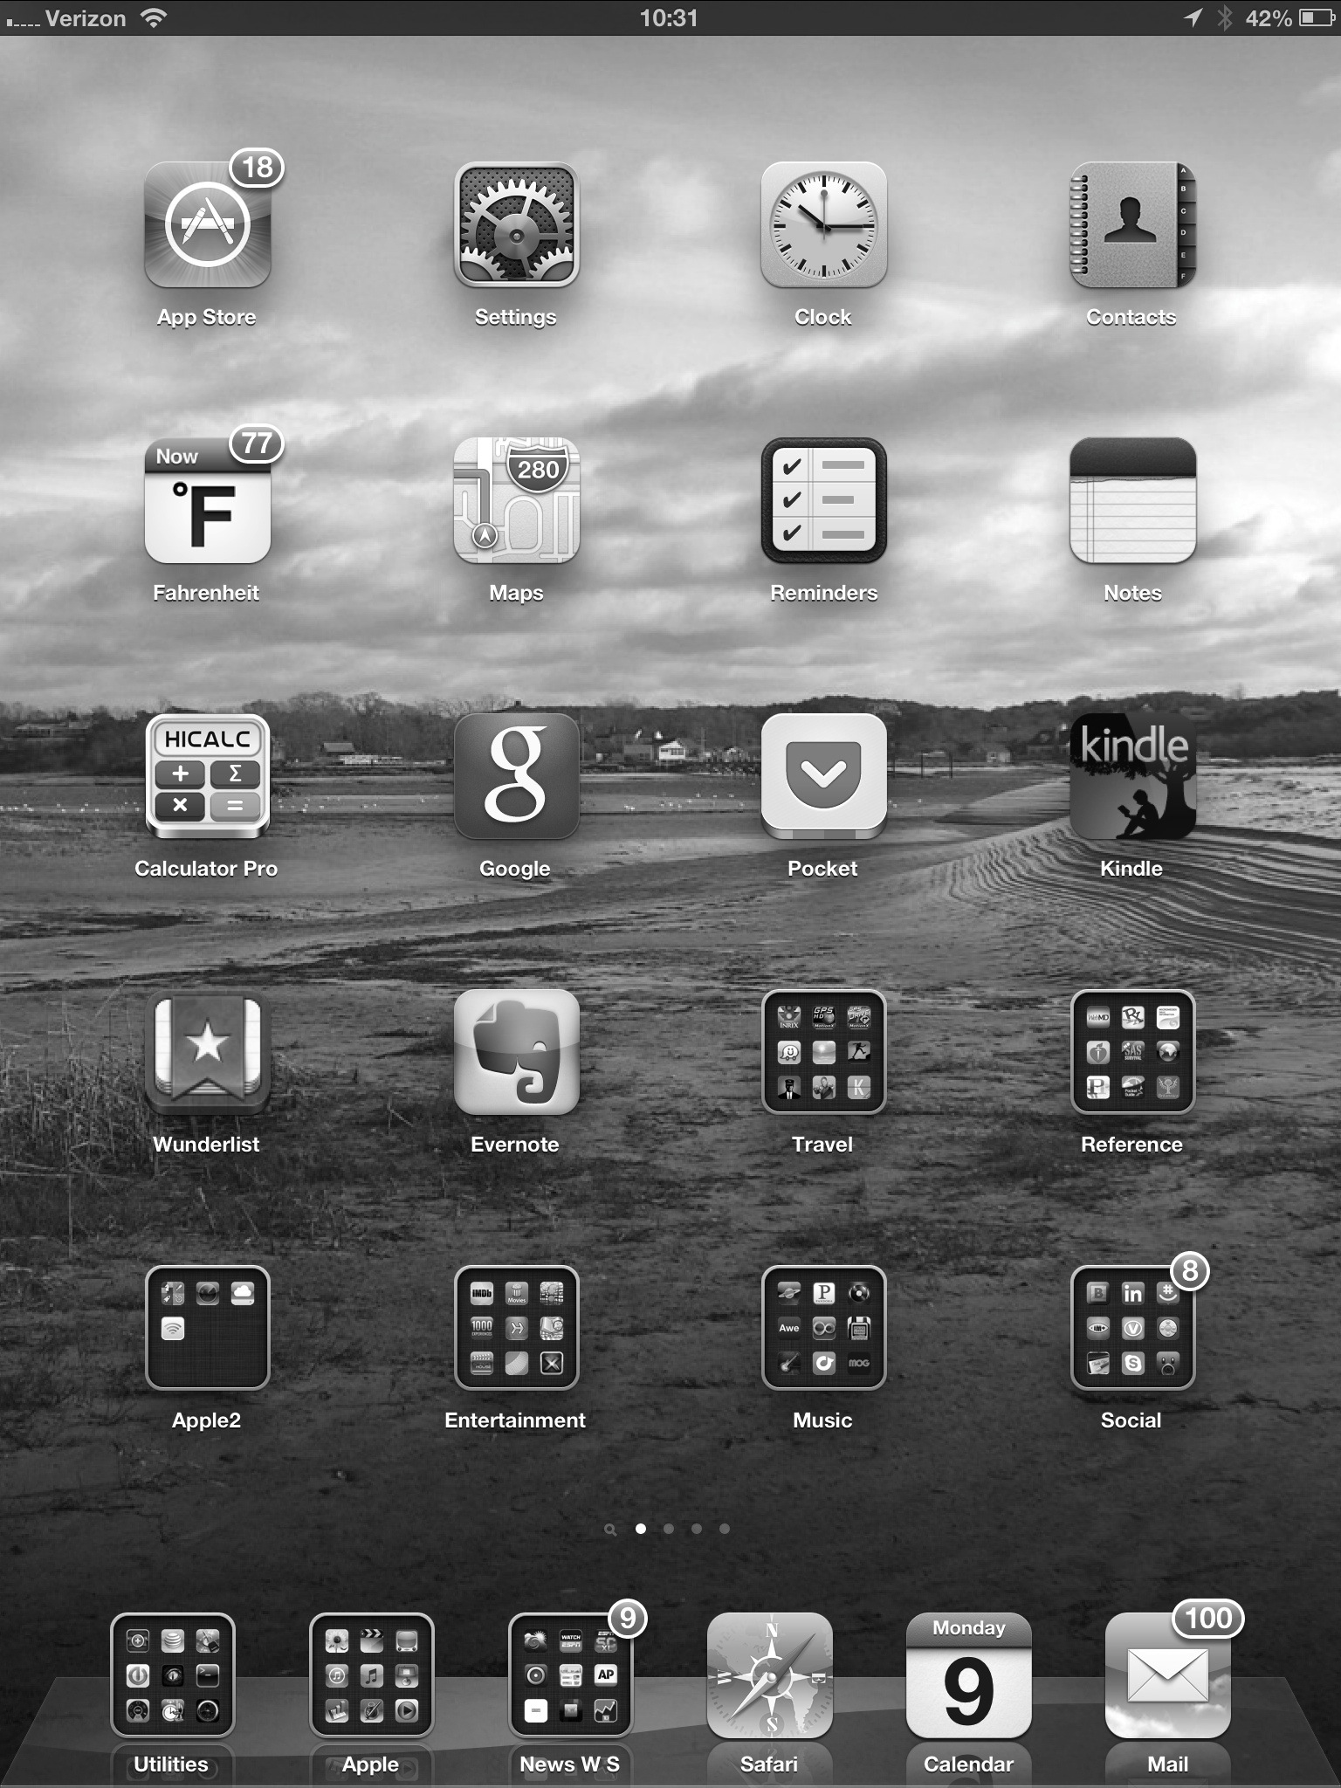
Touchscreen Interfaces
Touchscreen devices require new interfaces
  Mouse not possible or not desired
  Actions and selection based on gestures
  Virtual keyboard for text entry
Voice commands.

Slide 13

The Mac OS X GUI

Slide 14
End of Lecture 7

