Slide 1
Chapter 2: Operating-System Structures
Lecture 9+10
Week 4
9/23/2024

Slide 2
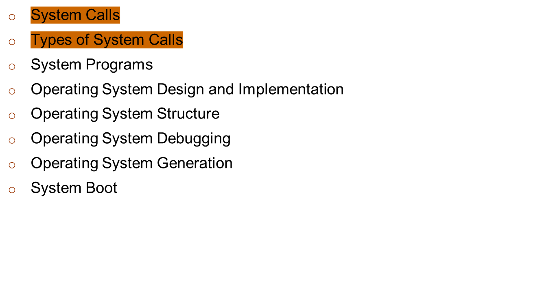
Chapter 2: Operating-System Structures

Slide 3
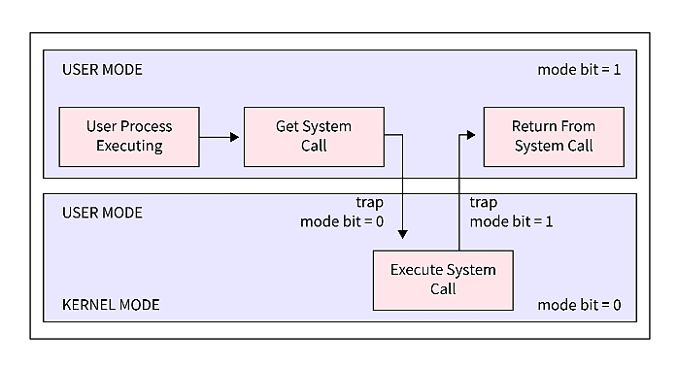
System Calls
Programming interface to the services provided by the OS
Typically written in a high-level language (C or C++)
Mostly accessed by programs via a high-level Application Programming Interface (API) rather than direct system call use
Three most common APIs are Win32 API for Windows, POSIX API for POSIX-based systems (including virtually all versions of UNIX, Linux, and Mac OS X), and Java API for the Java virtual machine (JVM)

Slide 4

Example of System Calls
System call sequence to copy the contents of one file to another file

Slide 5
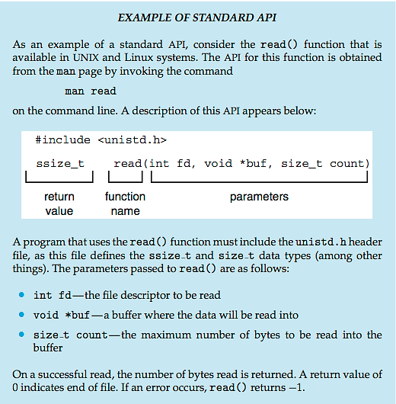
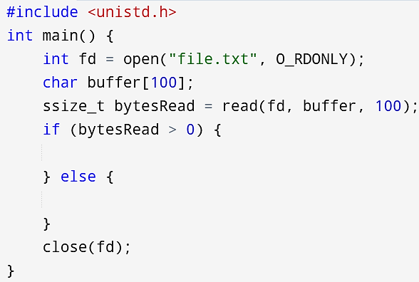
Example of Standard API

Slide 6
System Call Implementation
Typically, a number associated with each system call
  System-call interface maintains a table indexed according to these numbers
The system call interface invokes the intended system call in OS kernel and returns status of the system call and any return values
The caller need know nothing about how the system call is implemented
  Just needs to obey API and understand what OS will do as a result call
  Most details of OS interface hidden from programmer by API
    Managed by run-time support library (set of functions built into libraries included with compiler)

Slide 7

API – System Call – OS Relationship

Slide 8
System Call Parameter Passing
Often, more information is required than simply identity of desired system call
  Exact type and amount of information vary according to OS and call
Three general methods used to pass parameters to the OS
  Simplest: pass the parameters in registers
    In some cases, may be more parameters than registers
  Parameters stored in a block, or table, in memory, and address of block passed as a parameter in a register
    This approach taken by Linux and Solaris
  Parameters placed, or pushed, onto the stack by the program and popped off the stack by the operating system
  Block and stack methods do not limit the number or length of parameters being passed

Slide 9

Parameter Passing via Table

Slide 10
Types of System Calls
Process control
  create process, terminate process
  end, abort
  load, execute
  get process attributes, set process attributes
  wait for time
  wait event, signal event
  allocate and free memory
  Dump memory if error
  Debugger for determining bugs, single step execution
  Locks for managing access to shared data between processes

Slide 11
Types of System Calls
File management
  create file, delete file
  open, close file
  read, write, reposition
  get and set file attributes
Device management
  request device, release device
  read, write, reposition
  get device attributes, set device attributes
  logically attach or detach devices

Slide 12
Types of System Calls (Cont.)
Information maintenance
  get time or date, set time or date
  get system data, set system data
  get and set process, file, or device attributes
Communications
  create, delete communication connection
  send, receive messages if message passing model to host name or process name
    From client to server
  Shared-memory model create and gain access to memory regions
  transfer status information
  attach and detach remote devices

Slide 13
Types of System Calls (Cont.)
Protection
  Control access to resources
  Get and set permissions
  Allow and deny user access

Slide 14

Examples of Windows and Unix System Calls

Slide 15

Standard C Library Example
C program invoking printf() library call, which calls write() system call

Slide 16
End of Lecture 9-10

