Slide 1
Process
Synchronization
Lecture#26
12/Nov/2024

Slide 2
Process Synchronization
Background
The Critical-Section Problem
Peterson’s Solution
Synchronization Hardware
Mutex Locks
Semaphores
Classic Problems of Synchronization
Monitors
Synchronization Examples
Alternative Approaches

Slide 3
Objectives
To present the concept of process synchronization.
To introduce the critical-section problem, whose solutions can be used to ensure the consistency of shared data
To present both software and hardware solutions of the critical-section problem
To examine several classical process-synchronization problems
To explore several tools that are used to solve process synchronization problems

Slide 4
Background
Processes can execute concurrently
  May be interrupted at any time, partially completing execution
Concurrent access to shared data may result in data inconsistency
Maintaining data consistency requires mechanisms to ensure the orderly execution of cooperating processes
Illustration of the problem:
Suppose that we wanted to provide a solution to the consumer-producer problem that fills all the buffers. We can do so by having an integer counter that keeps track of the number of full buffers. Initially, counter is set to 0. It is incremented by the producer after it produces a new buffer and is decremented by the consumer after it consumes a buffer.
-Serial Execution
-Parallel Execution
  Cooperative
  Independent

Slide 5
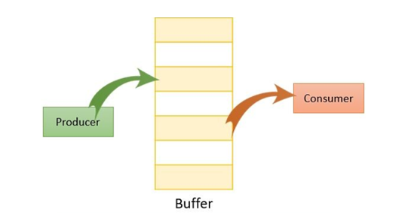
Producer
int counter=0;
while (true) {
/* produce an item in next produced */
while (counter == BUFFER_SIZE) ;
/* do nothing */
buffer[in] = next_produced;
in = (in + 1) % BUFFER_SIZE;
counter++;
}

Slide 6

Consumer
while (true) {
while (counter == 0); /* do nothing */
next_consumed = buffer[out];
out = (out + 1) % BUFFER_SIZE;
counter--;
/* consume the item in next consumed */
}

Slide 7

Producer
int counter = 0;
while (true) {
while (counter == BUFFER_SIZE);
buffer[in] = next_produced;
int temp = counter;
sleep(1);
counter = temp + 1;
in = (in + 1) % BUFFER_SIZE;
}

Slide 8

Consumer
while (true) {
while (counter == 0);
int temp = counter;
next_consumed = buffer[out];
sleep(1);
counter = temp - 1;
out = (out + 1) % BUFFER_SIZE;
}

Slide 9
Race Condition
counter++ could be implemented as
register1 = counter
register1 = register1 + 1
counter = register1
counter-- could be implemented as
register2 = counter
register2 = register2 - 1
counter = register2
Consider this execution interleaving with “count = 5” initially:
  S0: producer execute register1 = counter {register1 = 5}
  S1: producer execute register1 = register1 + 1 {register1 = 6}
  S2: consumer execute register2 = counter {register2 = 5}
  S3: consumer execute register2 = register2 – 1 {register2 = 4}
  S4: producer execute counter = register1 {counter = 6 }
  S5: consumer execute counter = register2 {counter = 4}

Slide 10
Critical Section Problem
Consider system of n processes {p₀, p₁, … p_{n-1}}
Each process has critical section segment of code
  Process may be changing common variables, updating table, writing file, etc
  When one process in critical section, no other may be in its critical section
Critical section problem is to design protocol to solve this
Each process must ask permission to enter critical section in entry section, may follow critical section with exit section, then remainder section

Slide 11

Critical Section
General structure of process P_{i}

Slide 12
Conditions for Critical-Section Problem
1. Mutual Exclusion - If process P_{i} is executing in its critical section, then no other processes can be executing in their critical sections
2. Progress - If no process is executing in its critical section and there exist some processes that wish to enter their critical section, then the selection of the processes that will enter the critical section next cannot be postponed indefinitely
3. Bounded Waiting - A bound must exist on the number of times that other processes are allowed to enter their critical sections after a process has made a request to enter its critical section and before that request is granted
  Assume that each process executes at a nonzero speed
  No assumption concerning relative speed of the n processes

Slide 13
Critical-Section Handling in OS
Two approaches depending on if kernel is preemptive or non- preemptive
  Preemptive – allows preemption of process when running in kernel mode
  Non-preemptive – runs until exits kernel mode, blocks, or voluntarily yields CPU
    Essentially free of race conditions in kernel mode

