Slide 1
Lecture 27
13/Nov/2024

Slide 2
Peterson’s Solution for Critical Section
Good algorithmic description of solving the problem
Two process solution
Assume that the load and store machine-language instructions are atomic; that is, cannot be interrupted
The two processes share two variables:
  int turn;
  Boolean flag[2]
The variable turn indicates whose turn it is to enter the critical section
The flag array is used to indicate if a process is ready to enter the critical section. flag[i] = true implies that process P_{i} is ready!

Slide 3
Algorithm for Process P_{i}
do {
flag[i] = true;
turn = j;
while (flag[j] && turn = = j);
critical section
flag[i] = false;
remainder section
} while (true);

Slide 4
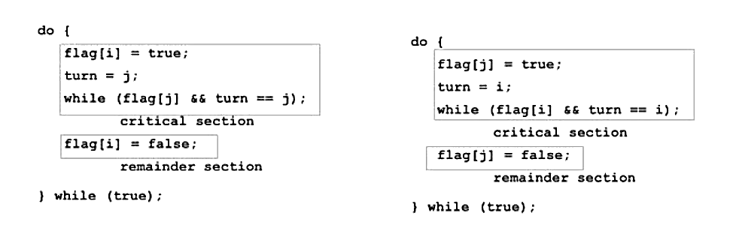
Algorithms for Processes P_{i and} P_{j}
P_{i}
P_{j}

Slide 5
Peterson’s Solution (Cont.)
Provable that the three CS requirement are met:
1. Mutual exclusion is preserved
P_{i} enters CS only if:
either flag[j] = false or turn = i
2. Progress requirement is satisfied
3. Bounded-waiting requirement is met

Slide 6
Synchronization Hardware
Many systems provide hardware support for implementing the critical section code.
All solutions below based on idea of locking
  Protecting critical regions via locks
Uniprocessors – could disable interrupts
  Currently running code would execute without preemption
  Generally too inefficient on multiprocessor systems
    Operating systems using this not broadly scalable
Modern machines provide special atomic hardware instructions
    Atomic = non-interruptible
  Either test memory word and set value
  Or swap contents of two memory words

Slide 7
Solution to Critical-section Problem Using Locks
do {
acquire lock
critical section
release lock
remainder section
} while (TRUE);

Slide 8
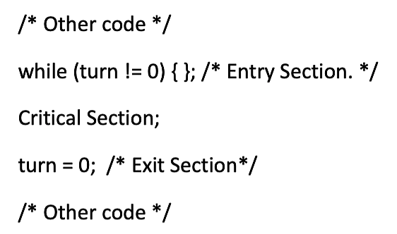
Pseudocode for Locks
do {
acquire lock
critical section
release lock
remainder section
} while (TRUE);

Slide 9
Home Assignment
-Prove that either Mutual Exclusion, Progress, and Bounded wait are fulfilled using “LOCKS” or Not. Justify with Examples.

Slide 10
Any Questions???

