Slide 1
Process Synchronization
Lectures 28-31
Week 10+11

Slide 2
Why we need Synchronization?
a=10;
P ( )
{
R(a);
a=a+1;
W(a);
}
P1 P2
P1 → 11
P2 → 12
P1 P2
P1 → 11
P2 → 11
In a Systematic Way
If P1 is Preempted

Slide 3
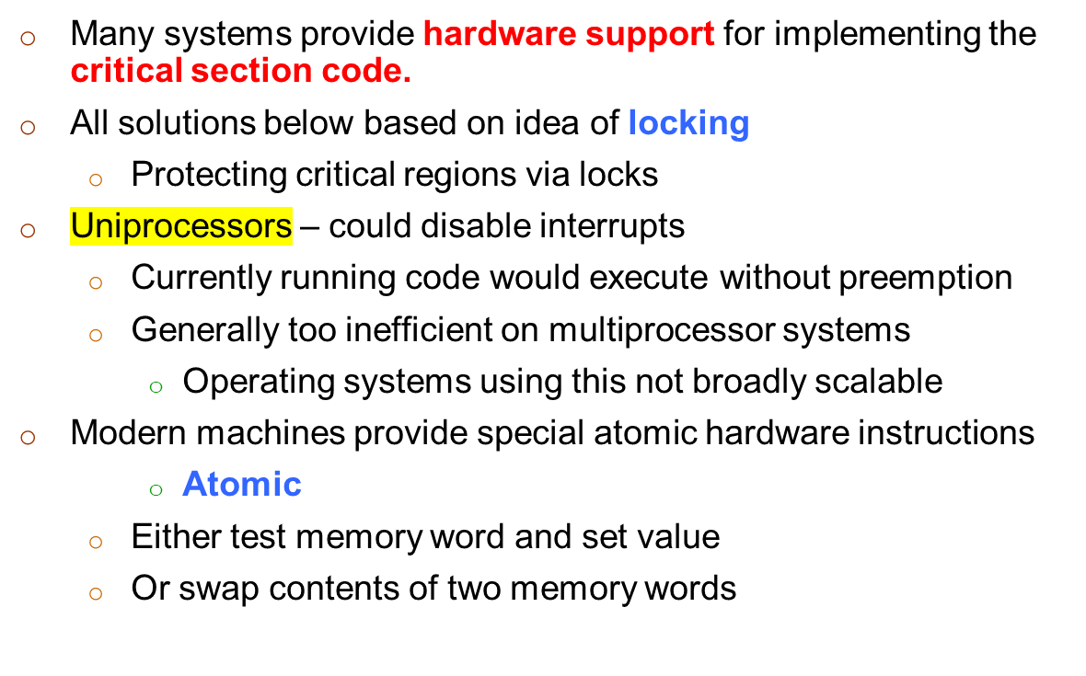
Synchronization Hardware

Slide 4
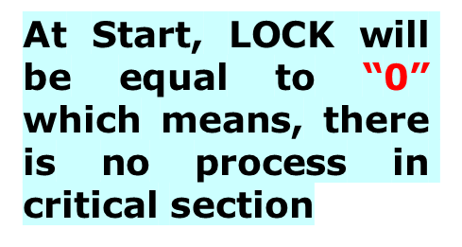
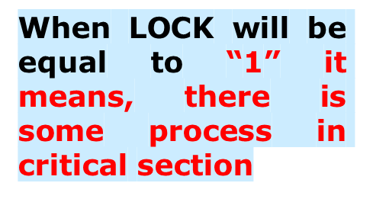
Solution to Critical-section Problem Using Lock Variable
do {
acquire lock
critical section
release lock
remainder section
} while (TRUE);
while (lock==1);
Lock = 1
Critical Section
Lock = 0

Slide 5

Does there’s Mutual Exclusion in
Case of Preemption?
do {
acquire lock
critical section
release lock
remainder section
} while (TRUE);
while (lock==1);
Lock = 1
Critical Section
Lock = 0

Slide 6
test_and_set Instruction
Definition:
boolean test_and_set (boolean *target)
{
boolean rv = *target;
*target = TRUE;
return rv:
}
Executed atomically
Returns the original value of passed parameter
Set the new value of passed parameter to “TRUE”.

Slide 7
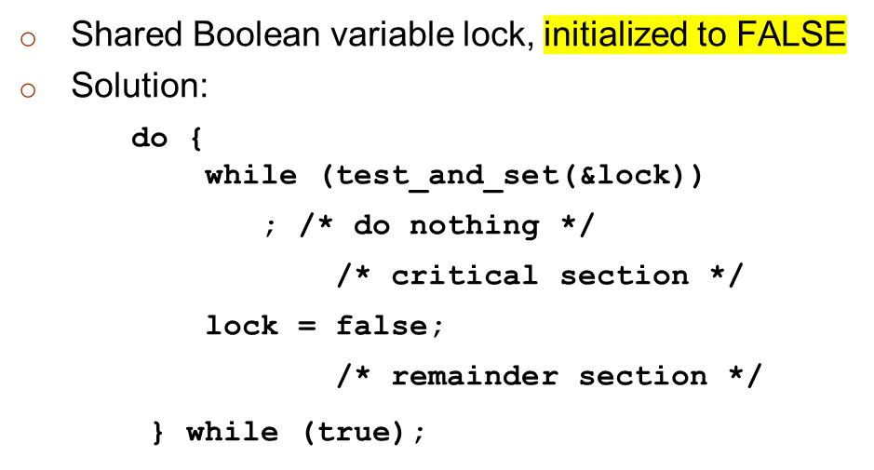

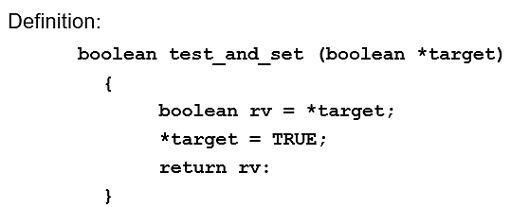
Solution using test_and_set()
Lock
Target
rv
False
200
False
200

Slide 8
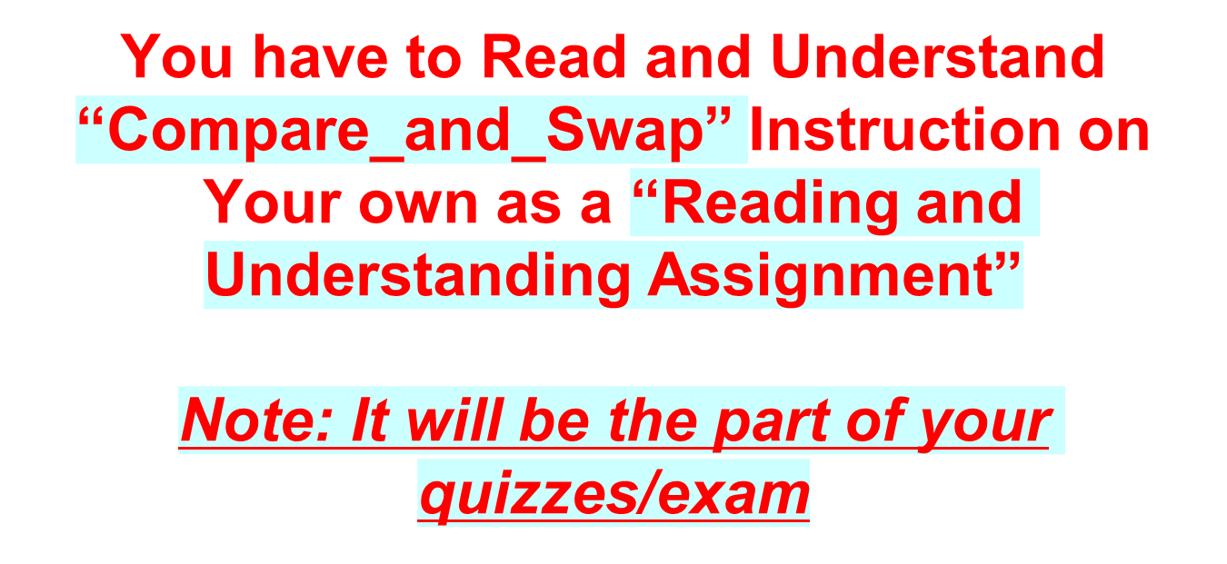

Slide 9
compare_and_swap Instruction
Definition:
int compare _and_swap(int *value, int expected, int new_value) {
int temp = *value;
if (*value == expected)
*value = new_value;
return temp;
}
Executed atomically
Returns the original value of passed parameter “value”
Set the variable “value” the value of the passed parameter “new_value” but only if “value” ==“expected”. That is, the swap takes place only under this condition.

Slide 10
Solution using compare_and_swap
Shared integer “lock” initialized to 0;
Solution:
do {
while (compare_and_swap(&lock, 0, 1) != 0)
; /* do nothing */
/* critical section */
lock = 0;
/* remainder section */
} while (true);

Slide 11
Mutex Locks
Previous solutions are complicated and generally inaccessible to application programmers
OS designers build software tools to solve critical section problem
Simplest is mutex lock
Protect a critical section by first acquire() a lock then release() the lock
  Boolean variable indicating if lock is available or not
Calls to acquire() and release() must be atomic
  Usually implemented via hardware atomic instructions

Slide 12
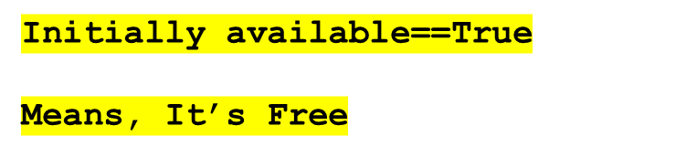
acquire() and release()
acquire() {
while (!available); /* busy wait */
available = false;
}
release() {
available = true;
}
do {
acquire lock
critical section
release lock
remainder section
} while (true);

Slide 13
Semaphore
Synchronization tool that provides more sophisticated ways (than Mutex locks) for process to synchronize their activities.
Semaphore S – integer variable → Initially ==1
Can only be accessed via two indivisible (atomic) operations
  wait() and signal()
    Originally called P() and V()
Definition of the wait() operation
  wait(S) {
  while (S == 0);
  // busy wait
  S--;
  }
Definition of the signal() operation
  signal(S) {
  S++;
  }

Slide 14
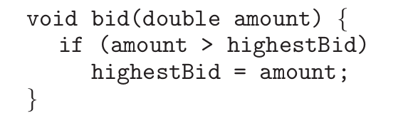
Exercise Questions
Race conditions are possible in many computer systems. Consider an online auction system where the current highest bid for each item must be maintained. A person who wishes to bid on an item calls the bid(amount) function, which compares the amount being bid to the current highest bid. If the amount exceeds the current highest bid, the highest bid is set to the new amount. This is illustrated below:
  Describe how a race condition is possible in this situation and what might be done to prevent the race condition from occurring.
2. Illustrate how a binary semaphore can be used to implement mutual exclusion among n processes.

Slide 15
Exercise Questions
3. Explain why implementing synchronization primitives by disabling interrupts is not appropriate in a single-processor system if the synchronization primitives are to be used in user-level programs.

Slide 16
Any Questions???

