Slide 1
DEADLOCKS
Chapter#7
Week 12
Lectures 33-35

Slide 2
OPERATING SYSTEM
Deadlocks
What Is In This Chapter?
What is a deadlock?
Staying Safe: Preventing and Avoiding Deadlocks
Living Dangerously: Let the deadlock happen, then detect it and recover from it.

Slide 3
DEADLOCKS
EXAMPLES:
You can't get a job without experience; you can't get experience without a job.
BACKGROUND:
The cause of deadlocks: Each process needing what another process has. results from sharing resources such as memory, devices, links.
This
Under normal operation, a resource allocations proceed like this::
Request a resource (suspend until available if necessary ).
Use the resource.
Release the resource.

Slide 4

Bridge Crossing Example
DEADLOCKS
Traffic only in one direction.
Each section of a bridge can be viewed as a resource.
If a deadlock occurs, it can be resolved if one car backs up (preempt resources and rollback).
Several cars may have to be backed up if a deadlock occurs.

Slide 5
DEADLOCK CHARACTERISATION
DEADLOCKS
NECESSARY CONDITIONS
ALL of these four must happen simultaneously for a deadlock to occur:
Mutual exclusion
One or more than one resource must be held by a process in a non-sharable (exclusive) mode.
No Preemption
There is only voluntary release of a resource - nobody else can make a process give up a resource.
Hold and Wait
A process holds a resource while waiting for another resource.
Circular Wait
Process A waits for Process B waits for Process C .... waits for Process A.

Slide 6
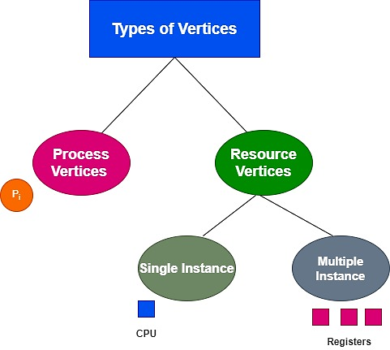
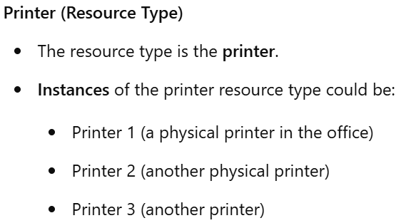
Resource-Allocation Graph
A set of vertices V and a set of edges E.
V is partitioned into two types:
P = {P₁, P₂, …, P_{n}}, the set consisting of all the processes in the system
R = {R₁, R₂, …, R_{m}}, the set consisting of all resource types in the system

Slide 7
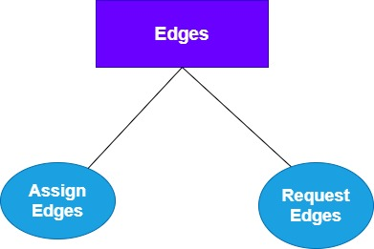


Resource-Allocation Graph (Edges)
1. Assign Edges
2. Request Edges

Slide 8
Resource-Allocation Graph (Cont.)
Process
Resource Type with 4 instances
P_{i} requests instance of R_{j}
P_{i} is holding an instance of R_{j}
P_{i}
R_{j}
P_{i}
R_{j}

Slide 9
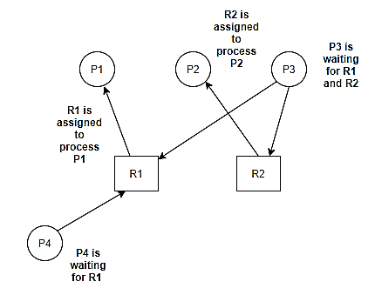
Single Instance RAG Example
Suppose there are Four Processes P1, P2, P3, P4, and two resources R1 and R2, where P1 is holding R1 and P2 is holding R2, P3 is waiting for R1 and R2 while P4 is waiting for resource R1.

Slide 10
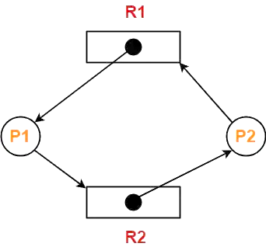
PRACTICE PROBLEMS BASED ON DETECTING DEADLOCK USING RAG-
Consider the resource allocation graph in the figure-
Find if the system is in a deadlock state or not?

Slide 11
Method-01:
The given resource allocation graph is single instance with a cycle contained in it.
Thus, the system is definitely in a deadlock state.

Slide 12
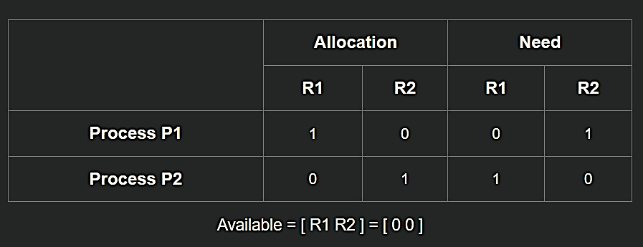
Method-02:
Using the given resource allocation graph, we have-

Slide 13
Consider the resource allocation graph in the figure-
P1
P2
P3
.
.
R1
R2
Find if the system is in a deadlock state or not?

Slide 14
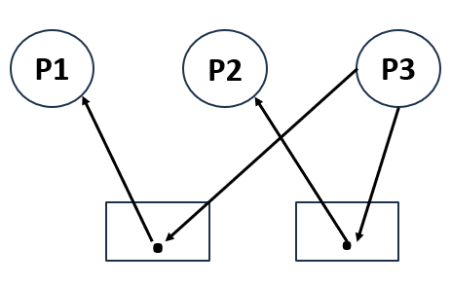
NO DEADLOCK
R1
R2
Processes | Resources Allocated R1 R2 | Request for Resources R1 R2
P1 | 1 0 | 0 0
P2 | 0 1 | 0 0
P3 | 0 0 | 1 1
Availability
R1 | R2
0 | 0
1 | 0
0 | 1
1 | 1
0
0 1
They will be +

Slide 15
Any Questions???

