Slide 1
Lecture 36
12/3/2024

Slide 2
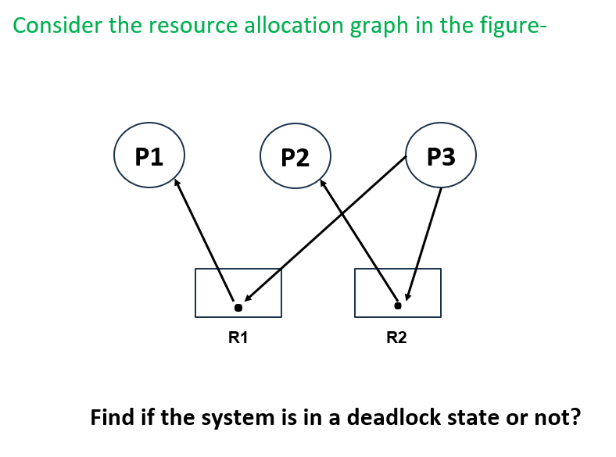

Slide 3
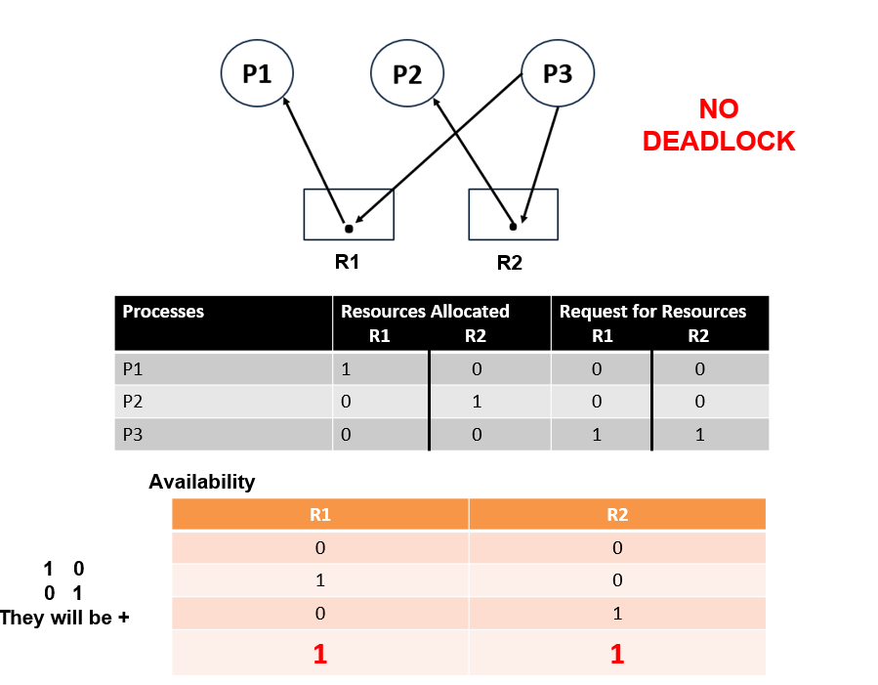

Slide 4

Multiple RAG With A Deadlock

Slide 5
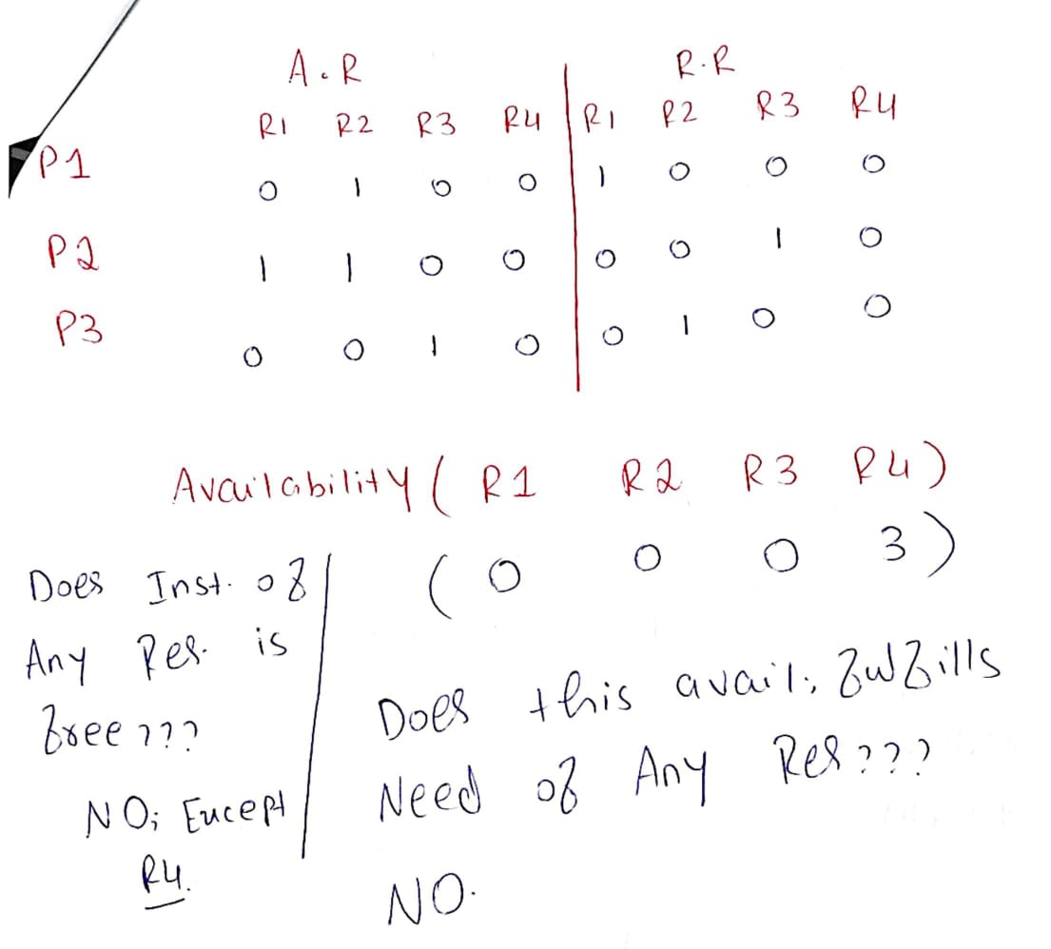
Solution

Slide 6

Find the Deadlock!!!

Slide 7
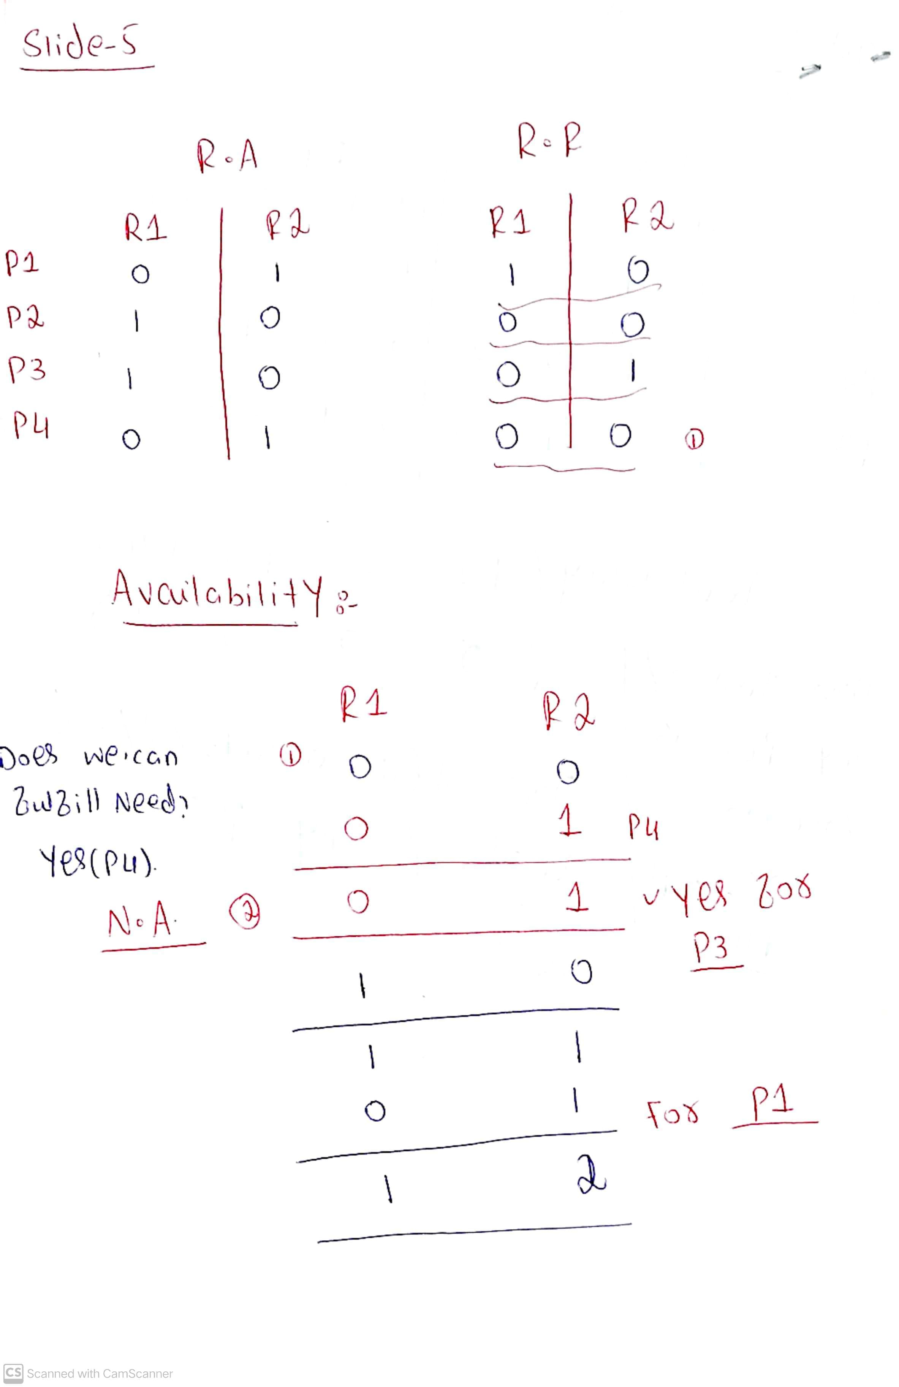
No Deadlock-
Solution

Slide 8
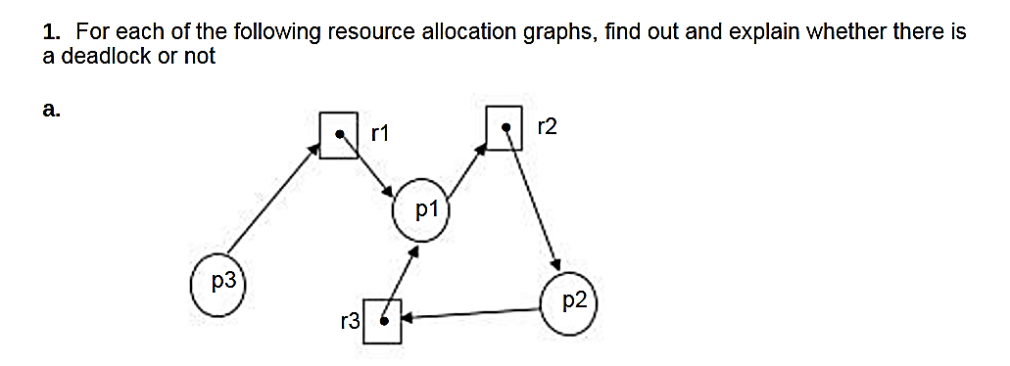
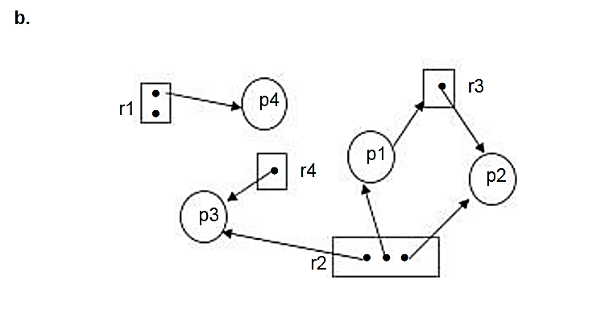
Practice Questions [1/2]

Slide 9
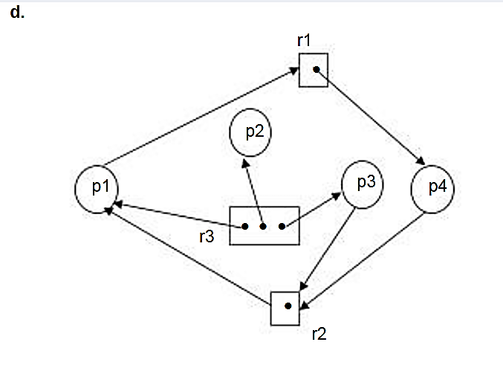
Practice Questions [2/2]

Slide 10
Basic Facts
If graph contains no cycles ⇒ no deadlock
If graph contains a cycle ⇒
  if only one instance per resource type, then deadlock
  if several instances per resource type, possibility of deadlock

Slide 11
Any Qs???

