Slide 1
Lectures 37+38
Week 13

Slide 2
Methods for Handling Deadlocks
Ensure that the system will never enter a deadlock state:
  Deadlock prevention
  Deadlock avoidance
Allow the system to enter a deadlock state and then recover
Ignore the problem and pretend that deadlocks never occur in the system; used by most operating systems, including UNIX

Slide 3
Deadlock Prevention
Restrain the ways request can be made
Mutual Exclusion – not required for sharable resources (e.g., read-only files); must hold for non-sharable resources
No Preemption –
  If a process that is holding some resources requests another resource that cannot be immediately allocated to it, then all resources currently being held are released
  Preempted resources are added to the list of resources for which the process is waiting
  Process will be restarted only when it can regain its old resources, as well as the new ones that it is requesting

Slide 4
Deadlock Prevention (Cont.)
Circular Wait – impose a total ordering of all resource types, and require that each process requests resources in an increasing order of enumeration.
Hold and Wait – must guarantee that whenever a process requests a resource, it does not hold any other resources
  Require process to request and be allocated all its resources before it begins execution, or allow process to request resources only when the process has none allocated to it.
  Low resource utilization; starvation possible

Slide 5
Deadlock Example
/* thread one runs in this function */
void *do_work_one(void *param)
{
pthread_mutex_lock(&first_mutex);
pthread_mutex_lock(&second_mutex);
/** * Do some work */
pthread_mutex_unlock(&second_mutex);
pthread_mutex_unlock(&first_mutex);
pthread_exit(0); }
/* thread two runs in this function */
void *do_work_two(void *param)
{
pthread_mutex_lock(&second_mutex);
pthread_mutex_lock(&first_mutex);
/** * Do some work */
pthread_mutex_unlock(&first_mutex);
pthread_mutex_unlock(&second_mutex);
pthread_exit(0); }
Suppose, there are two threads and they are working in “Parallel”.

Slide 6
Deadlock Avoidance
Requires that the system has some additional a priori information
available
Simplest and most useful model requires that each process declare the maximum number of resources of each type that it may need
The deadlock-avoidance algorithm dynamically examines the resource-allocation state to ensure that there can never be a circular-wait condition
Resource-allocation state is defined by the number of available and allocated resources, and the maximum demands of the processes

Slide 7
Avoidance Algorithms
Single instance of a resource type
  Use a resource-allocation graph
Multiple instances of a resource type
  Use the banker’s algorithm

Slide 8
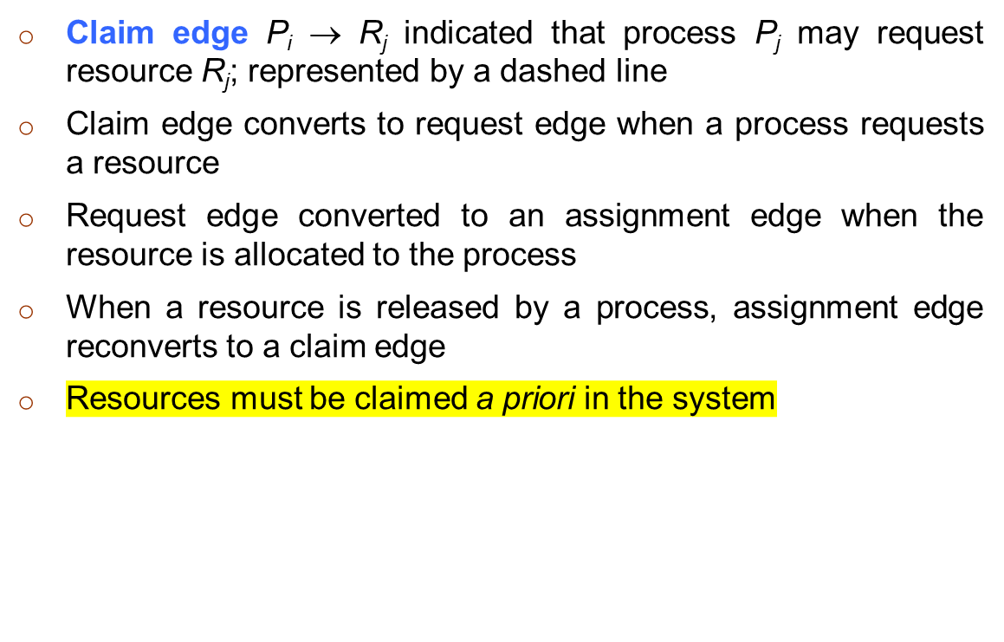
Resource-Allocation Graph Scheme

Slide 9

Resource-Allocation Graph

Slide 10
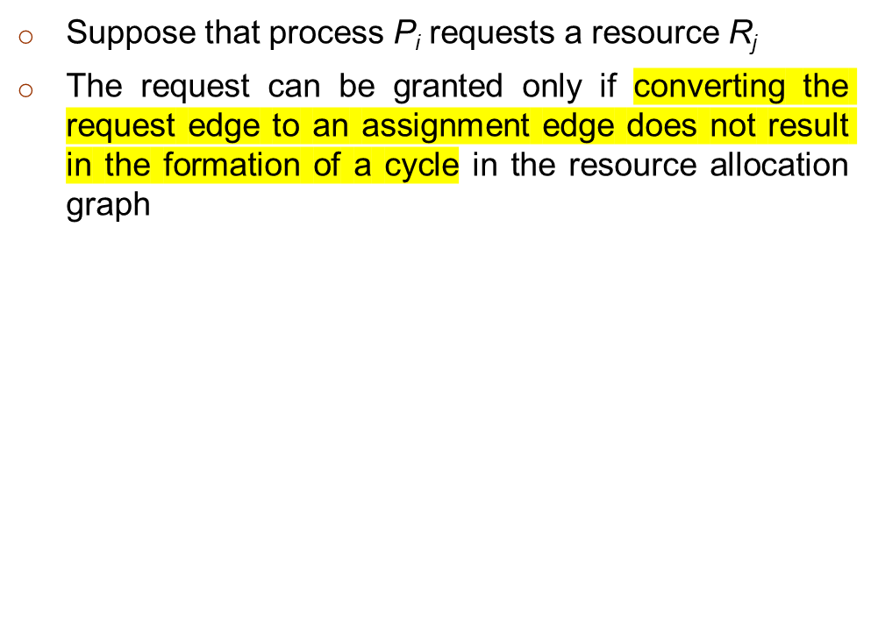
Resource-Allocation Graph Algorithm

Slide 11

Resource will never be
allocated because it’s
resulting in a deadlock
state.

Slide 12
Any Questions?

