Slide 1
Memory Management and Allocation for Processes in OS

Slide 2

Memory Management
Memory Storage
Access Time
Per Unit Cost
Memory???
Memory management is the functionality of an operating system which handles or manages primary memory and moves processes back and forth between main memory and disk during execution.
Memory management keeps track of each and every memory location, regardless of either it is allocated to some process or it is free.

Slide 3
Memory Allocation and It’s Methods
Memory allocation means, how we store our programs in the Main Memory
There are two main types of memory allocation
Contiguous Memory Allocation
Fixed Size Partitioning
Variable Size Partitioning
Non-Contiguous Memory Allocation
Segmentation
Paging

Slide 4
Contiguous Memory Allocation
Contiguous memory allocation is one of these memory allocation strategies. We use this strategy to allocate contiguous blocks of memory to each process, as the name suggests.
There are two ways to allocate this:
Fix-size Partitioning Method
Variable Partitioning Method

Slide 5
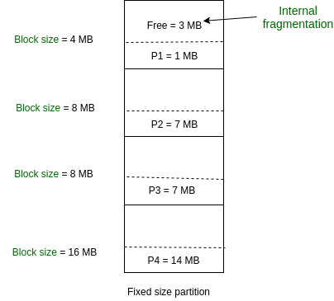
1. Fix-size Partitioning Method
Each process in this method of contiguous memory allocation is given a fixed-size continuous block in the main memory. This means that the entire memory will be partitioned into continuous blocks of fixed size, and each time a process enters the system, it will be given one of the available blocks.

Slide 6
1. Fix-size Partitioning Method (Cont.…)
Problems in Fixed Size Partitioning:
Internal Fragmentation
Limit on the size of the coming process
External Fragmentation

Slide 7
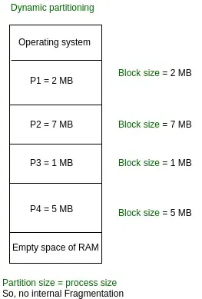
2. Variable-size Partitioning Method
Whenever the processes are coming into the RAM, only that time we will be allocating the space to them.
Space will be allocated on run time according to the process requirement so, there is no chance for internal fragmentation.

Slide 8
2. Variable-size Partitioning Method
What is fixed by the variable partitioning method
Internal Fragmentation
No limit on the process size
No limit on the number of processes
Problems:
External Fragmentation

Slide 9
Any Questions???

