Slide 1
Memory Management
(Paging in OS)
Lecture 43
Week 15
13/22/2024

Slide 2
What is Paging in the OS?
Paging is a storage mechanism used in OS to retrieve processes from secondary storage to the main memory as pages. The primary concept behind paging is to break each process into individual pages. Thus, the primary memory would also be separated into frames.

Slide 3
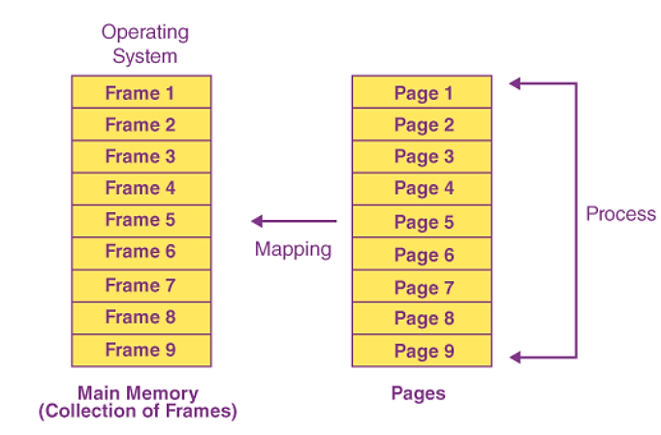
What is Paging in the OS?
One page of the process must be saved in one of the given memory frames. These pages can be stored in various memory locations, but finding contiguous frames is always the main goal.

Slide 4
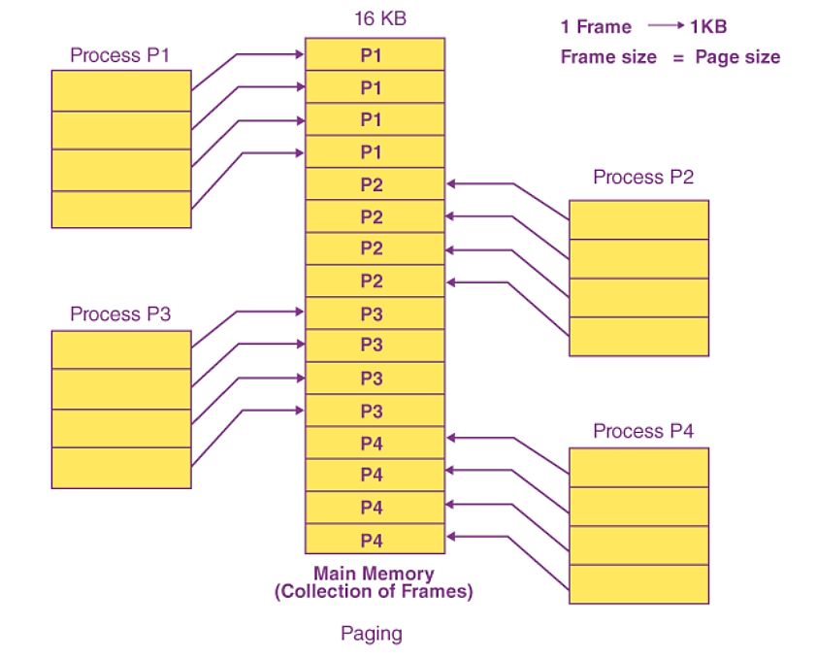
Example
Assuming that the main memory is 16 KB and the frame size is 1 KB, the main memory will be partitioned into a collection of 16 1 KB frames. P1, P2, P3, and P4 are the four processes in the system, each of which is 4 KB in size. Each process is separated into 1 KB pages, allowing one page to be saved in a single frame.

Slide 5
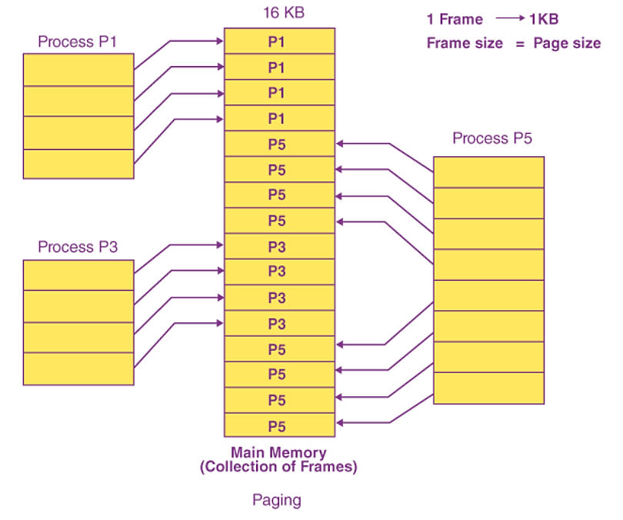
Example
Consider the case when P2 and P4 are shifted to the waiting state after a period of time. Eight frames are now empty, allowing other pages to be loaded in their stead. Inside the ready queue is the process P5, which is 8 KB (8 pages) in size.
Given that we have 8 noncontiguous frames accessible in memory, paging allows us to store the process in many locations. As a result, we can load the process P5 page instead of P2 and P4.

Slide 6










How CPU Access these Pages from Main memory?
0 1
2 3
0 1
3
5
7
9
11
13
14 15
Bytes
Bytes
Main Memory

Slide 7


If CPU Request for Byte#3?
0 1
2 3
0 1
3
5
7
9
11
13
14 15
Bytes
Page# 0
Bytes
Page# 1
CPU is asking for Byte “3”, but in MM it’s stored at byte “9”. How to access it???
Main Memory

Slide 8
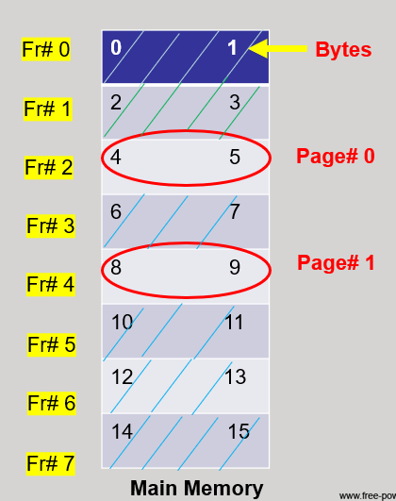





If CPU Request for Byte#3?
For this conversion, a Memory management Unit is used, that further uses a “Page Table”.
MMU
Frame#2
Frame#4
Page Table

Slide 9
But at which location that byte is stored in that Frame???
For this, Logical Addressing is used by the CPU.
Suppose, in our case, required data is “3”.
The binary of 3 is “11”.
So, we can write “1” in first and 2nd part.
Page Number | Page Offset (Value)

Slide 10


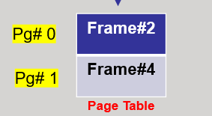
Logical Address to
Physical Address
For this, Logical Addressing is used by the CPU.
Pg# 1 | Pg Offset 1
0 1
2 3
1001 = 9
4B (Memory Size)
Physical Address
4 in Binary (100) | Frame Size 2B (1 Bit)

Slide 11
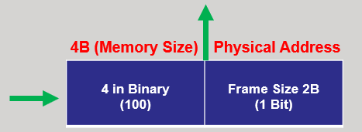
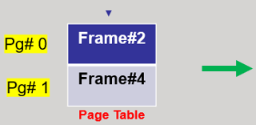
Physical Address
Conversion
1001 = 9
Suppose the main memory size is “16B”. Then if we write as 2^4=16. We will mention this power in first part, and then convert that power into “Binary”.
In second part, we will write the frame size, suppose its 2B, then 2^1=2. So, we will write “1” in second part.

Slide 12
Thank You!!!

