Slide 1

Chapter 2 Application Layer
Computer Networking: A Top-Down Approach 8th edition n Jim Kurose, Keith Ross Pearson, 2020
Notes:
Version History
8.1. Updates throughout, including a lot more animations. These are the ppt files used to make Chapter 2 online lectures in Sept. 2020.
8.0 (April 2020)
All slides reformatted for 16:9 aspect ratio
All slides updated to 8th edition material
Use of Calibri font, rather that Gill Sans MT
Add LOTS more animation throughout

Slide 2

Application Layer: Overview
P2P applications
video streaming and content distribution networks
Principles of network applications
Web and HTTP
E-mail, SMTP, IMAP
The Domain Name System DNS

Slide 3
DNS: Domain Name System
people: many identifiers:
SSN, name, passport #
Internet hosts, routers:
IP address (32 bit) - used for addressing datagrams
“name”, e.g., cs.umass.edu - used by humans
Q: how to map between IP address and name, and vice versa ?
Domain Name System (DNS):
distributed database implemented in hierarchy of many name servers
application-layer protocol: hosts, DNS servers communicate to resolve names (address/name translation)
note: core Internet function, implemented as application-layer protocol
complexity at network’s “edge”

Slide 4
DNS: services, structure
DNS services:
hostname-to-IP-address translation
host aliasing
canonical, alias names
mail server aliasing
load distribution
replicated Web servers: many IP addresses correspond to one name
Q: Why not centralize DNS?
single point of failure
traffic volume
distant centralized database
maintenance
A: doesn‘t scale!
Comcast DNS servers alone: 600B DNS queries/day
Akamai DNS servers alone: 2.2T DNS queries/day

Slide 5
DNS: a distributed, hierarchical database
Root DNS Servers
Root
…
…
.com DNS servers
.org DNS servers
.edu DNS servers
Top Level Domain
…
…
…
…
yahoo.com
DNS servers
amazon.com
DNS servers
pbs.org
DNS servers
nyu.edu
DNS servers
umass.edu
DNS servers
Authoritative
Client wants IP address for www.amazon.com; 1st approximation:
client queries root server to find .com DNS server
client queries .com DNS server to get amazon.com DNS server
client queries amazon.com DNS server to get IP address for www.amazon.com

Slide 6
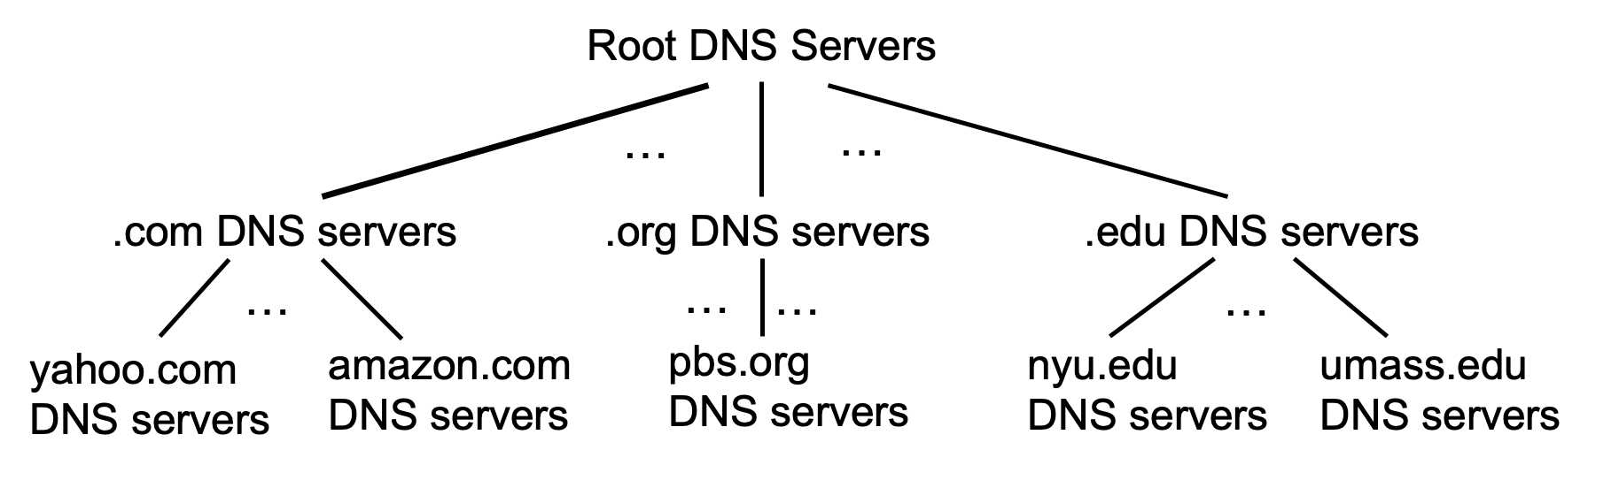
DNS: root name servers
official, contact-of-last-resort by name servers that can not resolve name

Slide 7
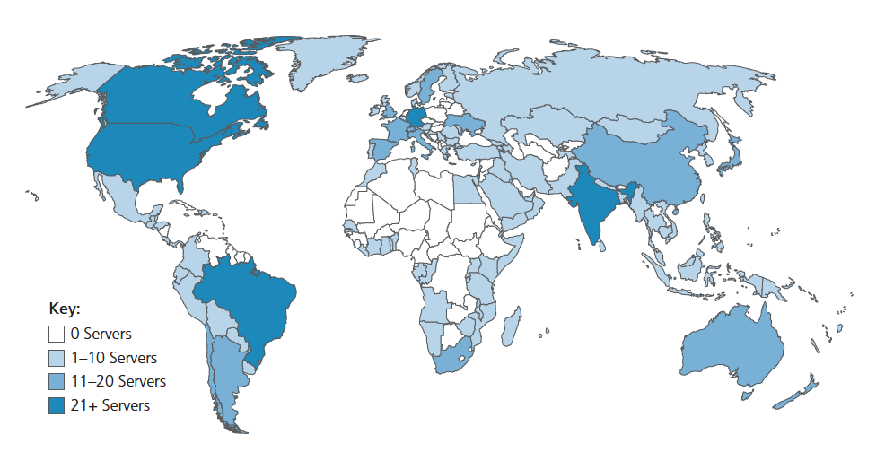
DNS: root name servers
official, contact-of-last-resort by name servers that can not resolve name
incredibly important Internet function
Internet couldn’t function without it!
DNSSEC – provides security (authentication, message integrity)
ICANN (Internet Corporation for Assigned Names and Numbers) manages root DNS domain
13 logical root name “servers” worldwide each “server” replicated many times (~200 servers in US)

Slide 8
Top-Level Domain, and authoritative servers
Top-Level Domain (TLD) servers:
responsible for .com, .org, .net, .edu, .aero, .jobs, .museums, and all top-level country domains, e.g.: .cn, .uk, .fr, .ca, .jp
Network Solutions: authoritative registry for .com, .net TLD
Educause: .edu TLD
authoritative DNS servers:
organization’s own DNS server(s), providing authoritative hostname to IP mappings for organization’s named hosts
can be maintained by organization or service provider

Slide 9
Local DNS name servers
when host makes DNS query, it is sent to its local DNS server
Local DNS server returns reply, answering:
from its local cache of recent name-to-address translation pairs (possibly out of date!)
forwarding request into DNS hierarchy for resolution
each ISP has local DNS name server; to find yours:
MacOS: % scutil --dns
Windows: >ipconfig /all
local DNS server doesn’t strictly belong to hierarchy

Slide 10

DNS name resolution: iterated query
root DNS server
Example: host at engineering.nyu.edu wants IP address for gaia.cs.umass.edu
2
3
TLD DNS server
Iterated query:
contacted server replies with name of server to contact
“I don’t know this name, but ask this server”
1
4
8
5
requesting host at
engineering.nyu.edu
local DNS server
dns.nyu.edu
gaia.cs.umass.edu
7
6
authoritative DNS server
dns.cs.umass.edu

Slide 11
DNS name resolution: recursive query
root DNS server
Example: host at engineering.nyu.edu wants IP address for gaia.cs.umass.edu
2
3
7
6
Recursive query:
puts burden of name resolution on contacted name server
heavy load at upper levels of hierarchy?
1
TLD DNS server
8
requesting host at
engineering.nyu.edu
local DNS server
dns.nyu.edu
5
4
gaia.cs.umass.edu
authoritative DNS server
dns.cs.umass.edu

Slide 12
Caching DNS Information
once (any) name server learns mapping, it caches mapping, and immediately returns a cached mapping in response to a query
caching improves response time
cache entries timeout (disappear) after some time (TTL)
TLD servers typically cached in local name servers
cached entries may be out-of-date
if named host changes IP address, may not be known Internet-wide until all TTLs expire!
best-effort name-to-address translation!

Slide 13
DNS records
DNS: distributed database storing resource records (RR)
RR format: (name, value, type, ttl)
type=A
name is hostname
value is IP address
type=CNAME
name is alias name for some “canonical” (the real) name
www.ibm.com is really servereast.backup2.ibm.com
value is canonical name
type=NS
name is domain (e.g., foo.com)
value is hostname of authoritative name server for this domain
type=MX
value is name of SMTP mail server associated with name

Slide 14
DNS protocol messages
DNS query and reply messages, both have same format:
2 bytes
2 bytes
message header:
identification: 16 bit # for query, reply to query uses same #
flags:
query or reply
recursion desired
recursion available
reply is authoritative
identification
flags
# questions
# answer RRs
# authority RRs
# additional RRs
questions (variable # of questions)
answers (variable # of RRs)
authority (variable # of RRs)
additional info (variable # of RRs)

Slide 15
DNS protocol messages
DNS query and reply messages, both have same format:
2 bytes
2 bytes
identification
flags
# questions
# answer RRs
# authority RRs
# additional RRs
name, type fields for a query
questions (variable # of questions)
RRs in response to query
answers (variable # of RRs)
records for authoritative servers
authority (variable # of RRs)
additional “ helpful” info that may be used
additional info (variable # of RRs)

Slide 16
Application Layer: Overview
P2P applications
video streaming and content distribution networks
socket programming with UDP and TCP
Principles of network applications
Web and HTTP
E-mail, SMTP, IMAP
The Domain Name System DNS

Slide 17








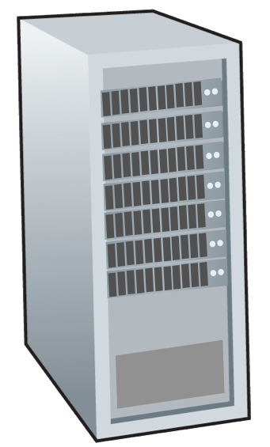







Peer-to-peer (P2P) architecture
no always-on server
arbitrary end systems directly communicate
peers request service from other peers, provide service in return to other peers
self scalability – new peers bring new service capacity, and new service demands
peers are intermittently connected and change IP addresses
complex management
examples: P2P file sharing (BitTorrent), streaming (KanKan), VoIP (Skype)
mobile network
national or global ISP
local or regional ISP
home network
content
provider
network
datacenter
network
enterprise
network

Slide 18
File distribution: client-server vs P2P
Q: how much time to distribute file (size F) from one server to N peers?
peer upload/download capacity is limited resource
u_{s}: server upload capacity
d_{i}: peer i download capacity
file, size F
u₁
d₁
u₂
u_{s}
d₂
server
d_{i}
u_{N}
network (with abundant
bandwidth)
u_{i}
d_{N}
u_{i}: peer i upload capacity

Slide 19
File distribution time: client-server
server transmission: must sequentially send (upload) N file copies:
time to send one copy: F/u_{s}
time to send N copies: NF/u_{s}
F
u_{s}
d_{i}
network
client: each client must download file copy
d_{min} = min client download rate
min client download time: F/d_{min}
u_{i}
time to distribute F
to N clients using
client-server approach
D_{c-s} > max{NF/u_{s,},F/d_{min}}
increases linearly in N

Slide 20
File distribution time: P2P
server transmission: must upload at least one copy:
time to send one copy: F/u_{s}
F
u_{s}
client: each client must download file copy
min client download time: F/d_{min}
d_{i}
network
u_{i}
clients: as aggregate must download NF bits
max upload rate (limiting max download rate) is u_{s} + Σu_{i}
time to distribute F
to N clients using
P2P approach
D_{P2P} > max{F/u_{s,},F/d_{min,},NF/(u_{s} + Σu_{i})}
increases linearly in N …
… but so does this, as each peer brings service capacity

Slide 21
Client-server vs. P2P: example
client upload rate = u, F/u = 1 hour, u_{s} = 10u, d_{min} ≥ u_{s}

Slide 22


P2P file distribution: BitTorrent
file divided into 256Kb chunks
peers in torrent send/receive file chunks
tracker: tracks peers
participating in torrent
torrent: group of peers exchanging chunks of a file
Alice arrives …
… obtains list
of peers from tracker
… and begins exchanging
file chunks with peers in torrent

Slide 23


P2P file distribution: BitTorrent
peer joining torrent:
has no chunks, but will accumulate them over time from other peers
registers with tracker to get list of peers, connects to subset of peers (“neighbors”)
while downloading, peer uploads chunks to other peers
peer may change peers with whom it exchanges chunks
churn: peers may come and go
once peer has entire file, it may (selfishly) leave or (altruistically) remain in torrent

Slide 24
BitTorrent: requesting, sending file chunks
Requesting chunks:
at any given time, different peers have different subsets of file chunks
periodically, Alice asks each peer for list of chunks that they have
Alice requests missing chunks from peers, rarest first
Sending chunks: tit-for-tat
Alice sends chunks to those four peers currently sending her chunks at highest rate
other peers are choked by Alice (do not receive chunks from her)
re-evaluate top 4 every10 secs
every 30 secs: randomly select another peer, starts sending chunks
“optimistically unchoke” this peer
newly chosen peer may join top 4

Slide 25

BitTorrent: tit-for-tat
(1) Alice “optimistically unchokes” Bob
(2) Alice becomes one of Bob’s top-four providers; Bob reciprocates
(3) Bob becomes one of Alice’s top-four providers
higher upload rate: find better trading partners, get file faster !

Slide 26
Chapter 2: Summary
our study of network application layer is now complete!
application architectures
client-server
P2P
application service requirements:
reliability, bandwidth, delay
Internet transport service model
connection-oriented, reliable: TCP
unreliable, datagrams: UDP
specific protocols:
HTTP
SMTP, IMAP
DNS
P2P: BitTorrent

Slide 27
Chapter 2: Summary
Most importantly: learned about protocols!
typical request/reply message exchange:
client requests info or service
server responds with data, status code
message formats:
headers: fields giving info about data
data: info(payload) being communicated
important themes:
centralized vs. decentralized
stateless vs. stateful
scalability
reliable vs. unreliable message transfer
“complexity at network edge”

