Slide 1

Chapter 3 Transport Layer
Computer Networking: A Top-Down Approach 8th edition Jim Kurose, Keith Ross Pearson, 2020
Notes:
Version History
8.0 (April 2020)
All slides reformatted for 16:9 aspect ratio
All slides updated to 8th edition material
Use of Calibri font, rather that Gill Sans MT
Add LOTS more animation throughout
added new 8th edition material on QUIC, CUBIC, delay-based congestion control
lighter header font
8.2 (July 2023): changes from 8.0
minor updates throughout, but not much changes from 8.0

Slide 2
Transport layer: overview
Our goal:
understand principles behind transport layer services:
multiplexing, demultiplexing
reliable data transfer
flow control
congestion control
learn about Internet transport layer protocols:
UDP: connectionless transport
TCP: connection-oriented reliable transport
TCP congestion control

Slide 3

Transport layer: roadmap
Transport-layer services
Multiplexing and demultiplexing
Connectionless transport: UDP
Principles of reliable data transfer
Connection-oriented transport: TCP
Principles of congestion control
TCP congestion control
Evolution of transport-layer functionality

Slide 4
Chapter 3: roadmap
Transport-layer services
Multiplexing and demultiplexing
Connectionless transport: UDP
Principles of reliable data transfer
Connection-oriented transport: TCP
segment structure
reliable data transfer
flow control
connection management
Principles of congestion control
TCP congestion control

Slide 5
TCP: overview RFCs: 793,1122, 2018, 5681, 7323
point-to-point:
one sender, one receiver
reliable, in-order byte steam:
no “message boundaries"
full duplex data:
bi-directional data flow in same connection
MSS: maximum segment size
cumulative ACKs
pipelining:
TCP congestion and flow control set window size
connection-oriented:
handshaking (exchange of control messages) initializes sender, receiver state before data exchange
flow controlled:
sender will not overwhelm receiver
Notes:
Typical MSS is 1460 bytes

Slide 6
TCP: Overview RFCs: 793,1122,1323, 2018, 2581
Three-way handshaking:
client first sends a special TCP segment; the server responds with a second special TCP segment; and finally the client responds again with a third special segment.
The first two segments carry no payload, that is, no application-layer data; the third of these segments may carry a payload
three segments are sent between the two hosts, this connection-establishment procedure is often referred to as a three-way handshake.

Slide 7
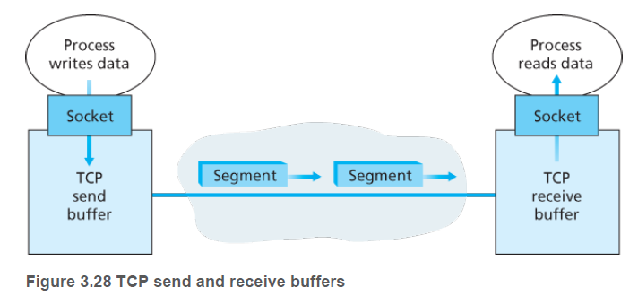
TCP: Overview RFCs: 793,1122,1323, 2018, 2581
TCP send and receive Buffers:
TCP connection consists of buffers, variables, and a socket connection to a process in one host, and another set of buffers, variables, and a socket connection to a process in another host.

Slide 8
TCP: Overview RFCs: 793,1122,1323, 2018, 2581
Maximum Segment Size (MSS):
Maximum amount of data that can be grabbed and placed in a segment is limited by MSS
Maximum amount of application layer data that can be placed in a segment, not the size of TCP segment
MSS is determined by (Maximum Transmission unit) MTU, length of largest link-layer frame that can be sent by local sending hist. Ethernet – 1500 bytes MTU

Slide 9
TCP segment structure
32 bits
source port #
dest port #
segment seq #: counting bytes of data into bytestream (not segments!)
ACK: seq # of next expected byte; A bit: this is an ACK
sequence number
acknowledgement number
length (of TCP header)
head
len
not
used
A
P
S
receive window
flow control: # bytes receiver willing to accept
C
E
U
R
F
Internet checksum
checksum
Urg data pointer
options (variable length)
C, E: congestion notification
TCP options
application
data
(variable length)
data sent by application into TCP socket
RST, SYN, FIN: connection management

Slide 10
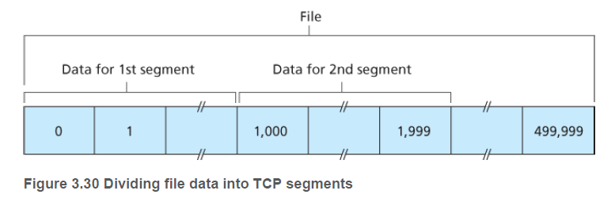
Sequence Numbers:
TCP views data as an unstructured, but ordered, stream of bytes.
The sequence number for a segment is therefore the byte-stream number of the first byte in the segment
Suppose that the data stream consists of a file consisting of 500,000 bytes, that the MSS is 1,000 bytes, and that the first byte of the data stream is numbered 0.
TCP constructs 500 segments out of the data stream
Each sequence number is inserted in the sequence number field in the header of the appropriate TCP segment.

Slide 11
TCP sequence numbers, ACKs
outgoing segment from sender
Sequence numbers:
byte stream “number” of first byte in segment’s data
source port #
dest port #
sequence number
acknowledgement number
rwnd
checksum
urg pointer
window size
N
Acknowledgements:
seq # of next byte expected from other side
cumulative ACK
sender sequence number space
sent
ACKed
sent, not-yet ACKed
(“in-flight”)
usable
but not
yet sent
not
usable
Q: how receiver handles out-of-order segments
A: TCP spec doesn’t say, - up to implementor
outgoing segment from receiver
source port #
dest port #
sequence number
acknowledgement number
A
rwnd
checksum
urg pointer

Slide 12

TCP sequence numbers, ACKs
Host A
Host B
User types‘C’
Seq=42, ACK=79, data = ‘C’
host ACKs receipt of‘C’, echoes back ‘C’
Seq=79, ACK=43, data = ‘C’
host ACKs receipt of echoed ‘C’
Seq=43, ACK=80
simple telnet scenario
Notes:
The key thing to note here is that the ACK number (43) on the B-to-A segment is one more than the sequence number (42) on the A-to-B segment that triggered that ACK
Similarly, the ACK number (80) on the last A-to-B segment is one more than the sequence number (79) on the B-to-A segment that triggered that ACK

Slide 13
TCP round trip time, timeout
Q: how to set TCP timeout value?
longer than RTT, but RTT varies!
too short: premature timeout, unnecessary retransmissions
too long: slow reaction to segment loss
Q: how to estimate RTT?
SampleRTT:measured time from segment transmission until ACK receipt
ignore retransmissions
SampleRTT will vary, want estimated RTT “smoother”
average several recent measurements, not just current SampleRTT

Slide 14
TCP round trip time, timeout
EstimatedRTT = (1- α)*EstimatedRTT + α*SampleRTT
exponential weighted moving average (EWMA)
influence of past sample decreases exponentially fast
typical value: α = 0.125
RTT: gaia.cs.umass.edu to fantasia.eurecom.fr
RTT (milliseconds)
sampleRTT
EstimatedRTT
time (seconds)
Notes:
This is how TCP re-computes the estimated RTT each time a new SampleRTT is taken.
The process is knows as an exponentially weighted moving average, shown by the equation here.
<say it>
Where alpha reflects the influence of the most recent measurements on the estimated RTT; a typical value of alpha used in implementations is .125
The graph at the bottom show measured RTTs between a host in the Massachusetts and a host in France, as well as the estimated, “smoothed” RTT

Slide 15

TCP round trip time, timeout
timeout interval: EstimatedRTT plus “safety margin”
large variation in EstimatedRTT: want a larger safety margin
TimeoutInterval = EstimatedRTT + 4*DevRTT
estimated RTT
“safety margin”
DevRTT: EWMA of SampleRTT deviation from EstimatedRTT:
DevRTT = (1-β)*DevRTT + β*|SampleRTT-EstimatedRTT|
(typically, β = 0.25)
* Check out the online interactive exercises for more examples: http://gaia.cs.umass.edu/kurose_ross/interactive/
Notes:
Given this value of the estimated RTT, TCP computes the timeout interval to be the estimated RTT plus a “safety margin”
And the intuition is that if we are seeing a large variation in SAMPLERTT – the RTT estimates are fluctuating a lot - then we’ll want a larger safety margin
So TCP computes the Timeout interval to be the Estimated RTT plus 4 times a measure of deviation in the RTT.
The deviation in the RTT is computed as the eWMA of the difference between the most recently measured SampleRTT from the Estimated RTT

Slide 16
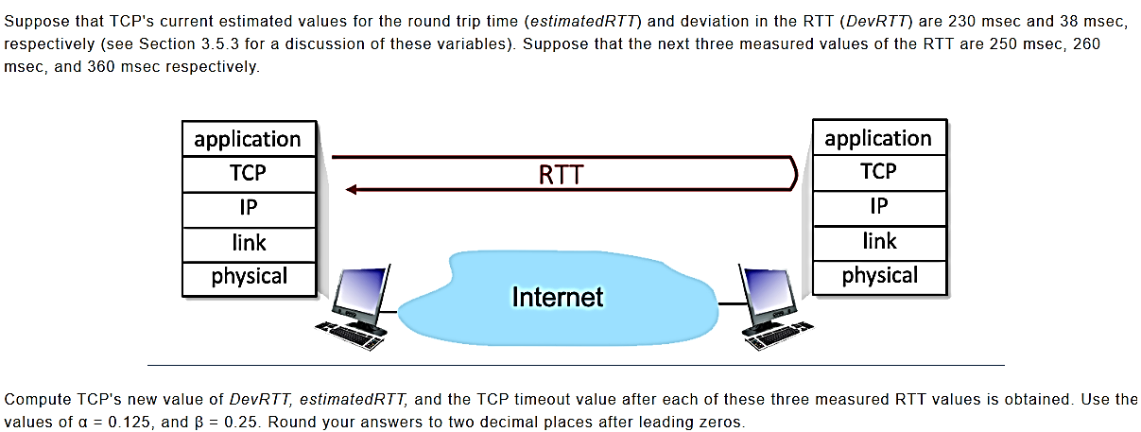
Computing TCP's RTT and timeout values

Slide 17
Question List
1. What is the estimatedRTT after the first RTT? 2. What is the RTT Deviation for the the first RTT? 3. What is the TCP timeout for the first RTT? 4. What is the estimatedRTT after the second RTT? 5. What is the RTT Deviation for the the second RTT? 6. What is the TCP timeout for the second RTT? 7. What is the estimatedRTT after the third RTT? 8. What is the RTT Deviation for the the third RTT? 9. What is the TCP timeout for the third RTT?

Slide 18
