Slide 1

Chapter 3 Transport Layer
Computer Networking: A Top-Down Approach 8th edition Jim Kurose, Keith Ross Pearson, 2020
Notes:
Version History
8.0 (April 2020)
All slides reformatted for 16:9 aspect ratio
All slides updated to 8th edition material
Use of Calibri font, rather that Gill Sans MT
Add LOTS more animation throughout
added new 8th edition material on QUIC, CUBIC, delay-based congestion control
lighter header font
8.2 (July 2023): changes from 8.0
minor updates throughout, but not much changes from 8.0

Slide 2
Transport layer: overview
Our goal:
understand principles behind transport layer services:
multiplexing, demultiplexing
reliable data transfer
flow control
congestion control
learn about Internet transport layer protocols:
UDP: connectionless transport
TCP: connection-oriented reliable transport
TCP congestion control

Slide 3

Chapter 3: roadmap
Transport-layer services
Multiplexing and demultiplexing
Connectionless transport: UDP
Principles of reliable data transfer
Connection-oriented transport: TCP
segment structure
reliable data transfer
flow control
connection management
Principles of congestion control
TCP congestion control

Slide 4
TCP reliable data transfer
TCP creates rdt service on top of IP’s unreliable service
pipelined segments
cumulative acks
retransmissions triggered by:
timeout events
duplicate acks
let’s initially consider simplified TCP sender:
ignore duplicate acks
ignore flow control, congestion control

Slide 5
TCP Sender (simplified)
event: data received from application
create segment with seq #
seq # is byte-stream number of first data byte in segment
start timer if not already running
think of timer as for oldest unACKed segment
expiration interval: TimeOutInterval
event: timeout
retransmit segment that caused timeout
restart timer
event: ACK received
if ACK acknowledges previously unACKed segments
update what is known to be ACKed
start timer if there are still unACKed segments
Notes:
Given these details of TCP sequence numbers, acks, and timers, we can now describe the big picture view of how the TCP sender and receiver operate
You can check out FSMs in book; let’s just give an English text description here and let’s start with the sender.

Slide 6

TCP: retransmission scenarios
Host A
Host B
Host A
Host B
SendBase=92
Seq=92, 8 bytes of data
Seq=92, 8 bytes of data
timeout
timeout
Seq=100, 20 bytes of data
ACK=100
X
ACK=100
ACK=120
Seq=92, 8 bytes of data
Seq=92, 8
bytes of data
SendBase=100
send cumulative
ACK for 120
SendBase=120
ACK=100
ACK=120
SendBase=120
lost ACK scenario
premature timeout
Notes:
To cement our understanding of TCP reliability, let’s look a a few retransmission scenarios
In the first case a TCP segments is transmitted and the ACK is lost, and the TCP timeout mechanism results in another copy of being transmitted and then re-ACKed a the sender
In the second example two segments are sent and acknowledged, but there is a premature timeout e for the first segment, which is retransmitted. Note that when this retransmitted segment is received, the receiver has already received the first two segments, and so resends a cumulative ACK for both segments received so far, rather than an ACK for just this fist segment.

Slide 7
TCP: retransmission scenarios
Host A
Host B
Seq=92, 8 bytes of data
Seq=100, 20 bytes of data
timeout
ACK=100
X
ACK=120
Seq=120, 15 bytes of data
cumulative ACK covers for earlier lost ACK
Notes:
And in this last example, two segments are again transmitted, the first ACK is lost but the second ACK, a cumulative ACK arrives at the sender, which then can transmit a third segment, knowing that the first two have arrived, even though the ACK for the first segment was lost

Slide 8

TCP fast retransmit
Host A
Host B
TCP fast retransmit
if sender receives 3 additional ACKs for same data (“triple duplicate ACKs”), resend unACKed segment with smallest seq #
likely that unACKed segment lost, so don’t wait for timeout
Seq=92, 8 bytes of data
Seq=100, 20 bytes of data
X
ACK=100
timeout
ACK=100
ACK=100
Receipt of three duplicate ACKs indicates 3 segments received after a missing segment – lost segment is likely. So retransmit!
ACK=100
Seq=100, 20 bytes of data
Notes:
Let’s wrap up our study of TCP reliability by discussing an optimization to the original TCP known as TCP fast retransmit,
Take a look at this example on the right where 5 segments are transmitted and the second segment is lost. In this case the TCP receiver sends an ACK 100 acknowledging the first received segment.
When the third segment arrives at the receiver, the TCP receiver sends another ACK 100 since the second segment has not arrived. And similarly for the 4th and 5th segments to arrive.
Now what does the sender see? The sender receives the first ACK 100 it has been hoping for, but then three additional duplicate ACK100s arrive. The sender knows that somethings’ wrong – it knows the first segment arrived at the receiver but three later arriving segments at the receiver – the ones that generated the three duplicate ACKs – we received correctly but were not in order. That is, that there was a missing segment at the receiver when each of the three duplicate ACK were generated.
With fast retransmit, the arrival of three duplicate ACK causes the sender to retransmit its oldest unACKed segment, without waiting for a timeout event. This allows TCP to recover more quickly from what is very likely a loss event
specifically that the second segment has been lost, since three higher -numbered segments were received

Slide 9
TCP Receiver: ACK generation [RFC 5681]
Event at receiver
arrival of in-order segment with
expected seq #. All data up to
expected seq # already ACKed
arrival of in-order segment with
expected seq #. One other
segment has ACK pending
arrival of out-of-order segment
higher-than-expect seq. # .
Gap detected
arrival of segment that
partially or completely fills gap
TCP receiver action
delayed ACK. Wait up to 500ms
for next segment. If no next segment,
send ACK
immediately send single cumulative
ACK, ACKing both in-order segments
immediately send duplicate ACK,
indicating seq. # of next expected byte
immediate send ACK, provided that
segment starts at lower end of gap
Notes:
Rather than immediately Acknowledging this segment, many TCP implementations will wait for half a second for another in-order segment to arrive, and then generate a single cumulative ACK for both segments – thus decreasing the amount of ACK traffic. The arrival of this second in-order segment and the cumulative ACK generation that covers both segments is the second row in this table.

Slide 10
Chapter 3: roadmap
Transport-layer services
Multiplexing and demultiplexing
Connectionless transport: UDP
Principles of reliable data transfer
Connection-oriented transport: TCP
segment structure
reliable data transfer
flow control
connection management
Principles of congestion control
TCP congestion control

Slide 11
TCP flow control
application
process
Q: What happens if network layer delivers data faster than application layer removes data from socket buffers?
Application removing data from TCP socket buffers
TCP socket
receiver buffers
TCP
code
Network layer delivering IP datagram payload into TCP socket buffers
IP
code
from sender
receiver protocol stack
Notes:
(Presuming an intro)
Before diving into the details of TCP flow control, let’s first get the general context and motivate the need for flow control.
This diagram show a typical transport-layer implementation
A segment is brought up the protocol stack to the transport layer, and the segment’s payload is removed from the segment and written INTO socket buffers.
How does data get taken OUT of socket buffers? By applications performing socket reads, as we learned in Chapter 2.
And so the question is “What happens if network layer delivers data faster than an application-layer process removes data from socket buffers?”
Let’s watch a video of what happens when things arrive way too fast to fast to be processed.
<video>. (I love that video). Another human analogy showing the need for flow control is the saying – to use some English slang - “no one can drink from a firehose”
Flow control is a mechanism to the calamity of a receiver being over-run by a sender that is sending too fast – it allows the RECEIVER to explicitly control the SENDER so sender won’t overflow receiver’s buffer by transmitting too much, too fast

Slide 12

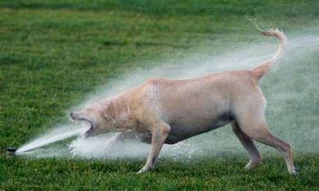
TCP flow control
application
process
Q: What happens if network layer delivers data faster than application layer removes data from socket buffers?
Application removing data from TCP socket buffers
TCP socket
receiver buffers
TCP
code
Network layer delivering IP datagram payload into TCP socket buffers
IP
code
from sender
receiver protocol stack
Notes:
(Presuming an intro)
Before diving into the details of TCP flow control, let’s first get the general context and motivate the need for flow control.
This diagram show a typical transport-layer implementation
A segment is brought up the protocol stack to the transport layer, and the segment’s payload is removed from the segment and written INTO socket buffers.
How does data get taken OUT of socket buffers? By applications performing socket reads, as we learned in Chapter 2.
And so the question is “What happens if network layer delivers data faster than an application-layer process removes data from socket buffers?”
Let’s watch a video of what happens when things arrive way too fast to fast to be processed.
<video>. (I love that video). Another human analogy showing the need for flow control is the saying – to use some English slang - “no one can drink from a firehose”
Flow control is a mechanism to the calamity of a receiver being over-run by a sender that is sending too fast – it allows the RECEIVER to explicitly control the SENDER so sender won’t overflow receiver’s buffer by transmitting too much, too fast

Slide 13
TCP flow control
application
process
Q: What happens if network layer delivers data faster than application layer removes data from socket buffers?
Application removing data from TCP socket buffers
TCP socket
receiver buffers
TCP
code
receive window
flow control: # bytes receiver willing to accept
IP
code
from sender
receiver protocol stack
Notes:
(Presuming an intro)
Before diving into the details of TCP flow control, let’s first get the general context and motivate the need for flow control.
This diagram show a typical transport-layer implementation
A segment is brought up the protocol stack to the transport layer, and the segment’s payload is removed from the segment and written INTO socket buffers.
How does data get taken OUT of socket buffers? By applications performing socket reads, as we learned in Chapter 2.
And so the question is “What happens if network layer delivers data faster than an application-layer process removes data from socket buffers?”
Let’s watch a video of what happens when things arrive way too fast to fast to be processed.
<video>. (I love that video). Another human analogy showing the need for flow control is the saying – to use some English slang - “no one can drink from a firehose”
Flow control is a mechanism to the calamity of a receiver being over-run by a sender that is sending too fast – it allows the RECEIVER to explicitly control the SENDER so sender won’t overflow receiver’s buffer by transmitting too much, too fast

Slide 14
TCP flow control
application
process
Q: What happens if network layer delivers data faster than application layer removes data from socket buffers?
Application removing data from TCP socket buffers
TCP socket
receiver buffers
TCP
code
flow control
receiver controls sender, so sender won’t overflow receiver’s buffer by transmitting too much, too fast
IP
code
from sender
receiver protocol stack
Notes:
(Presuming an intro)
Before diving into the details of TCP flow control, let’s first get the general context and motivate the need for flow control.
This diagram show a typical transport-layer implementation
A segment is brought up the protocol stack to the transport layer, and the segment’s payload is removed from the segment and written INTO socket buffers.
How does data get taken OUT of socket buffers? By applications performing socket reads, as we learned in Chapter 2.
And so the question is “What happens if network layer delivers data faster than an application-layer process removes data from socket buffers?”
Let’s watch a video of what happens when things arrive way too fast to fast to be processed.
<video>. (I love that video). Another human analogy showing the need for flow control is the saying – to use some English slang - “no one can drink from a firehose”
Flow control is a mechanism to the calamity of a receiver being over-run by a sender that is sending too fast – it allows the RECEIVER to explicitly control the SENDER so sender won’t overflow receiver’s buffer by transmitting too much, too fast

Slide 15
TCP flow control
TCP receiver “advertises” free buffer space in rwnd field in TCP header
RcvBuffer size set via socket options (typical default is 4096 bytes)
many operating systems auto-adjust RcvBuffer
sender limits amount of unACKed (“in-flight”) data to received rwnd
guarantees receive buffer will not overflow
to application process
RcvBuffer
buffered data
rwnd
free buffer space
TCP segment payloads
TCP receiver-side buffering
Notes:
Here’s how TCP implement flow control. The basic idea is simple – the receiver informs the sender how much free buffer space there is, and the sender is limited to send no more than this amount of data. That the value o RWND in the diagram to the right.
This information is carried from the receiver to the sender in the “receiver advertised window” (do a PIP of header) in the TCP header, and the value will change as the amount of free buffer space fluctuates over time.

Slide 16
TCP flow control
flow control: # bytes receiver willing to accept
TCP receiver “advertises” free buffer space in rwnd field in TCP header
RcvBuffer size set via socket options (typical default is 4096 bytes)
many operating systems auto-adjust RcvBuffer
sender limits amount of unACKed (“in-flight”) data to received rwnd
guarantees receive buffer will not overflow
receive window
TCP segment format
Notes:
Here’s how TCP implement flow control. The basic idea is simple – the receiver informs the sender how much free buffer space there is, and the sender is limited to send no more than this amount of data. That the value o RWND in the diagram to the right.
This information is carried from the receiver to the sender in the “receiver advertised window” (do a PIP of header) in the TCP header, and the value will change as the amount of free buffer space fluctuates over time.

Slide 17
Chapter 3: roadmap
Transport-layer services
Multiplexing and demultiplexing
Connectionless transport: UDP
Principles of reliable data transfer
Connection-oriented transport: TCP
Principles of congestion control
TCP congestion control

Slide 18
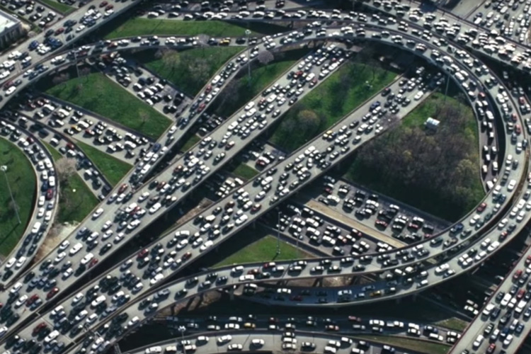
Principles of congestion control
Congestion:
informally: “too many sources sending too much data too fast for network to handle”
manifestations:
long delays (queueing in router buffers)
packet loss (buffer overflow at routers)
different from flow control!
congestion control: too many senders, sending too fast
a top-10 problem!
flow control: one sender too fast for one receiver

Slide 19
TCP congestion control: AIMD
approach: senders can increase sending rate until packet loss (congestion) occurs, then decrease sending rate on loss event
Additive Increase
Multiplicative Decrease
increase sending rate by 1 maximum segment size every RTT until loss detected
cut sending rate in half at each loss event
AIMD sawtooth
behavior: probing
for bandwidth
TCP sender Sending rate
time

