Slide 1

Chapter 4 Network Layer:
Data Plane
Computer Networking: A Top-Down Approach 8th edition Jim Kurose, Keith Ross Pearson, 2020
Notes:
Version History
8.0 (May 2020)
All slides reformatted for 16:9 aspect ratio
All slides updated to 8th edition material
Use of Calibri font, rather that Gill Sans MT
Add LOTS more animation throughout
added new 8th edition material on middleboxes (and Internet arch), Net neutrality, buffering …
lighter header font
8.2 (July 2023), changes from 8.0:
some minor updates (e.g., IPv6 stats updated) but not much has changed.

Slide 2
Network layer: our goals
understand principles behind network layer services, focusing on data plane:
network layer service models
forwarding versus routing
how a router works
addressing
generalized forwarding
Internet architecture
instantiation, implementation in the Internet
IP protocol
NAT

Slide 3

Network layer: “data plane” roadmap
Network layer: overview
data plane
control plane
What’s inside a router
input ports, switching, output ports
buffer management, scheduling
IP: the Internet Protocol
datagram format
addressing
network address translation
IPv6
Generalized Forwarding, SDN
Match+action
OpenFlow: match+action in action

Slide 4








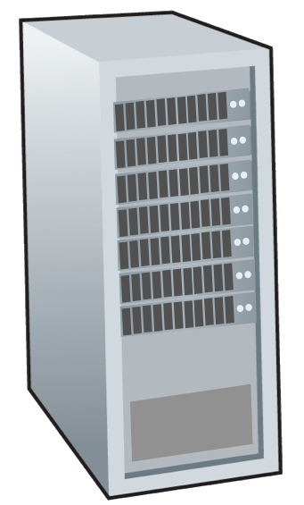







Network-layer services and protocols
transport segment from sending to receiving host
sender: encapsulates segments into datagrams, passes to link layer
receiver: delivers segments to transport layer protocol
network layer protocols in every Internet device: hosts, routers
routers:
examines header fields in all IP datagrams passing through it
moves datagrams from input ports to output ports to transfer datagrams along end-end path
mobile network
national or global ISP
application
transport
network
link
physical
network
link
physical
network
link
physical
network
link
physical
network
link
physical
network
link
physical
datacenter
network
application
transport
network
link
physical
enterprise
network

Slide 5

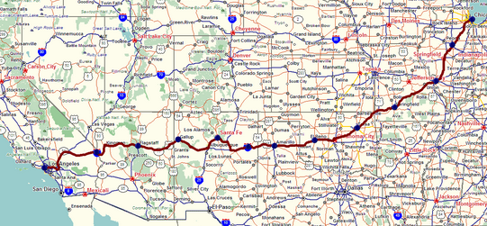
Two key network-layer functions
network-layer functions:
forwarding: move packets from a router’s input link to appropriate router output link
analogy: taking a trip
forwarding: process of getting through single interchange
routing: process of planning trip from source to destination
routing: determine route taken by packets from source to destination
routing algorithms
forwarding
routing

Slide 6
Network layer: data plane, control plane
Data plane:
local, per-router function
determines how datagram arriving on router input port is forwarded to router output port
Control plane
network-wide logic
determines how datagram is routed among routers along end-end path from source host to destination host
values in arriving
packet header
two control-plane approaches:
traditional routing algorithms: implemented in routers
software-defined networking (SDN): implemented in (remote) servers
0111
1
3
2

Slide 7

Per-router control plane
Individual routing algorithm components in each and every router interact in the control plane
Routing
Algorithm
control
plane
data
plane
values in arriving
packet header
0111
1
3
2

Slide 8
Software-Defined Networking (SDN) control plane
Remote controller computes, installs forwarding tables in routers
Remote Controller
control
plane
data
plane
CA
CA
CA
CA
CA
values in arriving
packet header
0111
1
3
2

Slide 9
Network service model
Q: What service model for “channel” transporting datagrams from sender to receiver?
example services for individual datagrams:
guaranteed delivery
guaranteed delivery with less than 40 msec delay
example services for a flow of datagrams:
in-order datagram delivery
guaranteed minimum bandwidth to flow
restrictions on changes in inter-packet spacing

Slide 10
Network-layer service model
Quality of Service (QoS) Guarantees ?
Network
Architecture
Internet
ATM
ATM
Internet
Internet
Service
Model
best effort
Constant Bit Rate
Available Bit Rate
Intserv Guaranteed
(RFC 1633)
Diffserv (RFC 2475)
Bandwidth
none
Constant rate
Guaranteed min
yes
possible
Loss
no
yes
no
yes
possibly
Order
no
yes
yes
yes
possibly
Timing
no
yes
no
yes
no
Internet “best effort” service model
No guarantees on:
successful datagram delivery to destination
timing or order of delivery
bandwidth available to end-end flow

Slide 11
Network-layer service model
Quality of Service (QoS) Guarantees ?
Network
Architecture
Internet
ATM
ATM
Internet
Internet
Service
Model
best effort
Constant Bit Rate
Available Bit Rate
Intserv Guaranteed
(RFC 1633)
Diffserv (RFC 2475)
Bandwidth
none
Constant rate
Guaranteed min
yes
possible
Loss
no
yes
no
yes
possibly
Order
no
yes
yes
yes
possibly
Timing
no
yes
no
yes
no

Slide 12
Reflections on best-effort service:
simplicity of mechanism has allowed Internet to be widely deployed adopted
sufficient provisioning of bandwidth allows performance of real-time applications (e.g., interactive voice, video) to be “good enough” for “most of the time”
replicated, application-layer distributed services (datacenters, content distribution networks) connecting close to clients’ networks, allow services to be provided from multiple locations
congestion control of “elastic” services helps
It’s hard to argue with success of best-effort service model

Slide 13
Network layer: “data plane” roadmap
Network layer: overview
data plane
control plane
What’s inside a router
input ports, switching, output ports
buffer management, scheduling
IP: the Internet Protocol
datagram format
addressing
network address translation
IPv6
Generalized Forwarding, SDN
Match+action
OpenFlow: match+action in action
Middleboxes

Slide 14
Router architecture overview
high-level view of generic router architecture:
routing, management
control plane (software)
operates in millisecond
time frame
routing
processor
forwarding data plane (hardware) operates in nanosecond timeframe
high-speed
switching
fabric
router input ports
router output ports

Slide 15


Input port functions
lookup,
forwarding
queueing
line
termination
link
layer
protocol
(receive)
switch
fabric
physical layer:
bit-level reception
Datagram
decentralized switching:
using header field values, lookup output port using forwarding table in input port memory (“match plus action”)
goal: complete input port processing at ‘line speed’
input port queuing: if datagrams arrive faster than forwarding rate into switch fabric
link layer:
e.g., Ethernet
(chapter 6)
Frame
Notes:
Green box is a physical layer responsible for receiving bit level transmission. Copper, fiber wireless.
Link layer in blue – bit assemble into Ethernet frame. We will discuss this in details in chapter 6.
But most critical one, is here. Lookup, forwarding function. Lookup and forward is “Match plus action” behavior.
GOAL – processing at “line speed”, otherwise, buffer will be full and packet will be lost

Slide 16
Input port functions
lookup,
forwarding
queueing
line
termination
link
layer
protocol
(receive)
switch
fabric
physical layer:
bit-level reception
decentralized switching:
using header field values, lookup output port using forwarding table in input port memory (“match plus action”)
destination-based forwarding: forward based only on destination IP address (traditional)
generalized forwarding: forward based on any set of header field values
link layer:
e.g., Ethernet
(chapter 6)

Slide 17
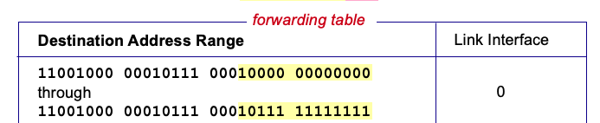

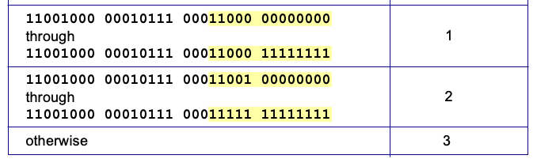
Destination-based forwarding
3
Q: but what happens if ranges don’t divide up so nicely?
Notes:
Text for this animation:
This all works out pretty nice and looks pretty simple!
But of course the devil is in the details, as the saying goes.
What happens, for example, when a subset of addresses say in this first range should go to say interface 3, rather than interface 0. Well, of course we could split the first address range into multiple pieces, and add in this new subrange with its new destination output port. But it turns out there’s a much simpler and elegant way to do this. Known as longest prefix matching.

Slide 18
Longest prefix matching
longest prefix match
when looking for forwarding table entry for given destination address, use longest address prefix that matches destination address.
Destination Address Range
11001000 00010111 00010
11001000 00010111 00011000
11001000 00010111 00011
otherwise
Link interface
0
1
2
3
***
********
********
***
********
examples:
11001000 00010111 00010110 10100001
which interface?
11001000 00010111 00011000 10101010
which interface?

Slide 19
Longest prefix matching
longest prefix match
when looking for forwarding table entry for given destination address, use longest address prefix that matches destination address.
Destination Address Range
11001000 00010111 00010
11001000 00010111 00011000
11001000 00010111 00011
otherwise
Link interface
0
1
2
3
***
********
********
match!
***
********
examples:
11001000 00010111 00010110 10100001
which interface?
11001000 00010111 00011000 10101010
which interface?

Slide 20
Longest prefix matching
longest prefix match
when looking for forwarding table entry for given destination address, use longest address prefix that matches destination address.
Destination Address Range
11001000 00010111 00010
11001000 00010111 00011000
11001000 00010111 00011
otherwise
Link interface
0
1
2
3
***
********
********
***
********
match!
examples:
11001000 00010111 00010110 10100001
which interface?
11001000 00010111 00011000 10101010
which interface?

Slide 21
Longest prefix matching
longest prefix match
when looking for forwarding table entry for given destination address, use longest address prefix that matches destination address.
Destination Address Range
11001000 00010111 00010
11001000 00010111 00011000
11001000 00010111 00011
otherwise
Link interface
0
1
2
3
***
********
********
***
********
match!
examples:
11001000 00010111 00010110 10100001
which interface?
11001000 00010111 00011000 10101010
which interface?

