Slide 1

Chapter 4
Network Layer:
Data Plane
Computer Networking: A Top-Down Approach
8th edition
Jim Kurose, Keith Ross
Pearson, 2020
Notes:
Version History
8.0 (May 2020)
All slides reformatted for 16:9 aspect ratio
All slides updated to 8th edition material
Use of Calibri font, rather that Gill Sans MT
Add LOTS more animation throughout
added new 8th edition material on middleboxes (and Internet arch), Net neutrality, buffering …
lighter header font
8.2 (July 2023), changes from 8.0:
some minor updates (e.g., IPv6 stats updated) but not much has changed.

Slide 2
Network layer: our goals
understand principles behind network layer services, focusing on data plane:
  network layer service models
  forwarding versus routing
  how a router works
  addressing
  generalized forwarding
  Internet architecture
instantiation, implementation in the Internet
  IP protocol
  NAT, middleboxes

Slide 3
IP addresses: how to get one?
That’s actually two questions:
Q: How does a host get IP address within its network (host part of address)?
Q: How does a network get IP address for itself (network part of address)
How does host get IP address?
hard-coded by sysadmin in config file (e.g., /etc/rc.config in UNIX)
DHCP: Dynamic Host Configuration Protocol: dynamically get address from as server
  “plug-and-play”

Slide 4
DHCP: Dynamic Host Configuration Protocol
goal: host dynamically obtains IP address from network server when it “joins” network
  can renew its lease on address in use
  allows reuse of addresses (only hold address while connected/on)
  support for mobile users who join/leave network
DHCP overview:
  host broadcasts DHCP discover msg [optional]
  DHCP server responds with DHCP offer msg [optional]
  host requests IP address: DHCP request msg
  DHCP server sends address: DHCP ack msg

Slide 5





DHCP client-server scenario
Typically, DHCP server will be co-located in router, serving all subnets to which router is attached
DHCP server
223.1.1.1
223.1.2.1
223.1.2.5
223.1.1.2
223.1.1.4
223.1.2.9
223.1.1.3
223.1.3.27
arriving DHCP client needs
address in this network
223.1.2.2
223.1.3.1
223.1.3.2

Slide 6


DHCP client-server scenario
DHCP server: 223.1.2.5
DHCP discover
Arriving client
src : 0.0.0.0, 68
dest.: 255.255.255.255,67
yiaddr: 0.0.0.0
transaction ID: 654
Broadcast: is there a DHCP server out there?
DHCP offer
src: 223.1.2.5, 67
dest: 255.255.255.255, 68
yiaddr: 223.1.2.4
transaction ID: 654
lifetime: 3600 secs
Broadcast: I’m a DHCP server! Here’s an IP address you can use
The two steps above can be skipped “if a client remembers and wishes to reuse a previously allocated network address” [RFC 2131]
DHCP request
src: 0.0.0.0, 68
dest:: 255.255.255.255, 67
yiaddr: 223.1.2.4
transaction ID: 655
lifetime: 3600 secs
Broadcast: OK. I would like to use this IP address!
DHCP ACK
src: 223.1.2.5, 67
dest: 255.255.255.255, 68
yiaddr: 223.1.2.4
transaction ID: 655
lifetime: 3600 secs
Broadcast: OK. You’ve got that IP address!

Slide 7
DHCP: more than IP addresses
DHCP can return more than just allocated IP address on subnet:
  address of first-hop router for client
  name and IP address of DNS sever
  network mask (indicating network versus host portion of address)

Slide 8


DHCP: example
DHCP
DHCP
UDP
IP
Eth
Phy
Connecting laptop will use DHCP to get IP address, address of first-hop router, address of DNS server.
DHCP
DHCP
DHCP
DHCP
DHCP REQUEST message encapsulated in UDP, encapsulated in IP, encapsulated in Ethernet
DHCP
DHCP
UDP
IP
Eth
Phy
168.1.1.1
DHCP
DHCP
DHCP
Ethernet frame broadcast (dest: FFFFFFFFFFFF) on LAN, received at router running DHCP server
DHCP
router with DHCP
server built into
router
Ethernet de-mux’ed to IP de-mux’ed, UDP de-mux’ed to DHCP

Slide 9
DHCP: example
DHCP
UDP
IP
Eth
Phy
DCP server formulates DHCP ACK containing client’s IP address, IP address of first-hop router for client, name & IP address of DNS server
DHCP
DHCP
DHCP
DHCP
encapsulated DHCP server reply forwarded to client, de-muxing up to DHCP at client
DHCP
DHCP
UDP
IP
Eth
Phy
DHCP
DHCP
DHCP
router with DHCP
server built into
router
client now knows its IP address, name and IP address of DNS server, IP address of its first-hop router
DHCP

Slide 10
IP addresses: how to get one?
Q: how does network get subnet part of IP address?
A: gets allocated portion of its provider ISP’s address space
ISP's block 11001000 00010111 00010000 00000000 200.23.16.0/20
ISP can then allocate out its address space in 8 blocks:
Organization 0 11001000 00010111 00010000 00000000 200.23.16.0/23
Organization 1 11001000 00010111 00010010 00000000 200.23.18.0/23
Organization 2 11001000 00010111 00010100 00000000 200.23.20.0/23
... ….. …. ….
Organization 7 11001000 00010111 00011110 00000000 200.23.30.0/23

Slide 11
IP addressing: last words ...
Q: how does an ISP get block of addresses?
A: ICANN: Internet Corporation for Assigned Names and Numbers http://www.icann.org/
  allocates IP addresses, through 5 regional registries (RRs) (who may then allocate to local registries)
  manages DNS root zone, including delegation of individual TLD (.com, .edu , …) management
Q: are there enough 32-bit IP addresses?
ICANN allocated last chunk of IPv4 addresses to RRs in 2011
NAT (next) helps IPv4 address space exhaustion
IPv6 has 128-bit address space
"Who the hell knew how much address space we needed?" Vint Cerf (reflecting on decision to make IPv4 address 32 bits long)

Slide 12

Network layer: “data plane” roadmap
Network layer: overview
  data plane
  control plane
What’s inside a router
  input ports, switching, output ports
  buffer management, scheduling
IP: the Internet Protocol
  datagram format
  addressing
  network address translation
  IPv6
Generalized Forwarding, SDN
  match+action
  OpenFlow: match+action in action
Middleboxes

Slide 13
NAT: network address translation
NAT: all devices in local network share just one IPv4 address as far as outside world is concerned
rest of
Internet
local network (e.g., home network) 10.0.0/24
10.0.0.1
138.76.29.7
10.0.0.4
10.0.0.2
10.0.0.3
all datagrams leaving local network have same source NAT IP address: 138.76.29.7, but different source port numbers
datagrams with source or destination in this network have 10.0.0/24 address for source, destination (as usual)

Slide 14
NAT: network address translation
  all devices in local network have 32-bit addresses in a “private” IP address space (10/8, 172.16/12, 192.168/16 prefixes) that can only be used in local network
  advantages:
    just one IP address needed from provider ISP for all devices
    can change addresses of host in local network without notifying outside world
    can change ISP without changing addresses of devices in local network
    security: devices inside local net not directly addressable, visible by outside world

Slide 15
NAT: network address translation
implementation: NAT router must (transparently):
  outgoing datagrams: replace (source IP address, port #) of every outgoing datagram to (NAT IP address, new port #)
      remote clients/servers will respond using (NAT IP address, new port #) as destination address
  remember (in NAT translation table) every (source IP address, port #) to (NAT IP address, new port #) translation pair
  incoming datagrams: replace (NAT IP address, new port #) in destination fields of every incoming datagram with corresponding (source IP address, port #) stored in NAT table

Slide 16
NAT: network address translation
NAT translation table
WAN side addr LAN side addr
2: NAT router changes datagram source address from 10.0.0.1, 3345 to 138.76.29.7, 5001,
updates table
1: host 10.0.0.1 sends datagram to 128.119.40.186, 80
138.76.29.7, 5001 10.0.0.1, 3345
…… ……
S: 10.0.0.1, 3345
D: 128.119.40.186, 80
10.0.0.1
1
2
S: 138.76.29.7, 5001
D: 128.119.40.186, 80
10.0.0.4
10.0.0.2
138.76.29.7
S: 128.119.40.186, 80
D: 10.0.0.1, 3345
4
S: 128.119.40.186, 80
D: 138.76.29.7, 5001
3
10.0.0.3
3: reply arrives, destination address: 138.76.29.7, 5001

Slide 17
NAT: network address translation
NAT has been controversial:
  routers “should” only process up to layer 3
  address “shortage” should be solved by IPv6
  violates end-to-end argument (port # manipulation by network-layer device)
  NAT traversal: what if client wants to connect to server behind NAT?
but NAT is here to stay:
  extensively used in home and institutional nets, 4G/5G cellular nets

Slide 18
IPv6: motivation
initial motivation: 32-bit IPv4 address space would be completely allocated
additional motivation:
  speed processing/forwarding: 40-byte fixed length header
  enable different network-layer treatment of “flows”

Slide 19
IPv6 datagram format
flow label: identify datagrams in same "flow.” (concept of “flow” not well defined).
32 bits
priority: identify priority among datagrams in flow
ver
pri
flow label
payload len
next hdr
hop limit
source address
(128 bits)
128-bit
IPv6 addresses
destination address
(128 bits)
payload (data)
What’s missing (compared with IPv4):
no checksum (to speed processing at routers)
no fragmentation/reassembly
no options (available as upper-layer, next-header protocol at router)

Slide 20
Transition from IPv4 to IPv6
not all routers can be upgraded simultaneously
  no “flag days”
  how will network operate with mixed IPv4 and IPv6 routers?
tunneling: IPv6 datagram carried as payload in IPv4 datagram among IPv4 routers (“packet within a packet”)
  tunneling used extensively in other contexts (4G/5G)
IPv4 header fields
IPv6 header fields
IPv4 payload
IPv4 source, dest addr
IPv6 source dest addr
UDP/TCP payload
IPv6 datagram
IPv4 datagram

Slide 21
Tunneling and encapsulation
Ethernet connecting two IPv6 routers:
A
B
Ethernet connects two IPv6 routers
E
F
IPv6
IPv6
IPv6
IPv6
IPv6 datagram
Link-layer frame
The usual: datagram as payload in link-layer frame
IPv4 network connecting two IPv6 routers
A
B
E
F
IPv6
IPv6/v4
IPv6/v4
IPv6
IPv4 network

Slide 22
Tunneling and encapsulation
Ethernet connecting two IPv6 routers:
A
B
Ethernet connects two IPv6 routers
E
F
IPv6
IPv6
IPv6
IPv6
IPv6 datagram
Link-layer frame
The usual: datagram as payload in link-layer frame
IPv4 tunnel connecting two IPv6 routers
A
B
IPv4 tunnel
connecting IPv6 routers
E
F
IPv6
IPv6/v4
IPv6/v4
IPv6
IPv6 datagram
IPv4 datagram
tunneling: IPv6 datagram as payload in a IPv4 datagram

Slide 23
Tunneling
A
B
IPv4 tunnel
connecting IPv6 routers
E
F
logical view:
IPv6
IPv6/v4
IPv6/v4
IPv6
A
B
C
D
E
F
physical view:
IPv6
IPv6/v4
IPv4
IPv4
IPv6/v4
IPv6
flow: X
src: A
dest: F
data
src:B
dest: E
src:B
dest: E
src:B
dest: E
flow: X
src: A
dest: F
data
Flow: X
Src: A
Dest: F
data
Flow: X
Src: A
Dest: F
data
Flow: X
Src: A
Dest: F
data
Note source and destination addresses!
A-to-B:
IPv6
B-to-C:
IPv6 inside
IPv4
B-to-C:
IPv6 inside
IPv4
B-to-C:
IPv6 inside
IPv4
E-to-F:
IPv6

Slide 24
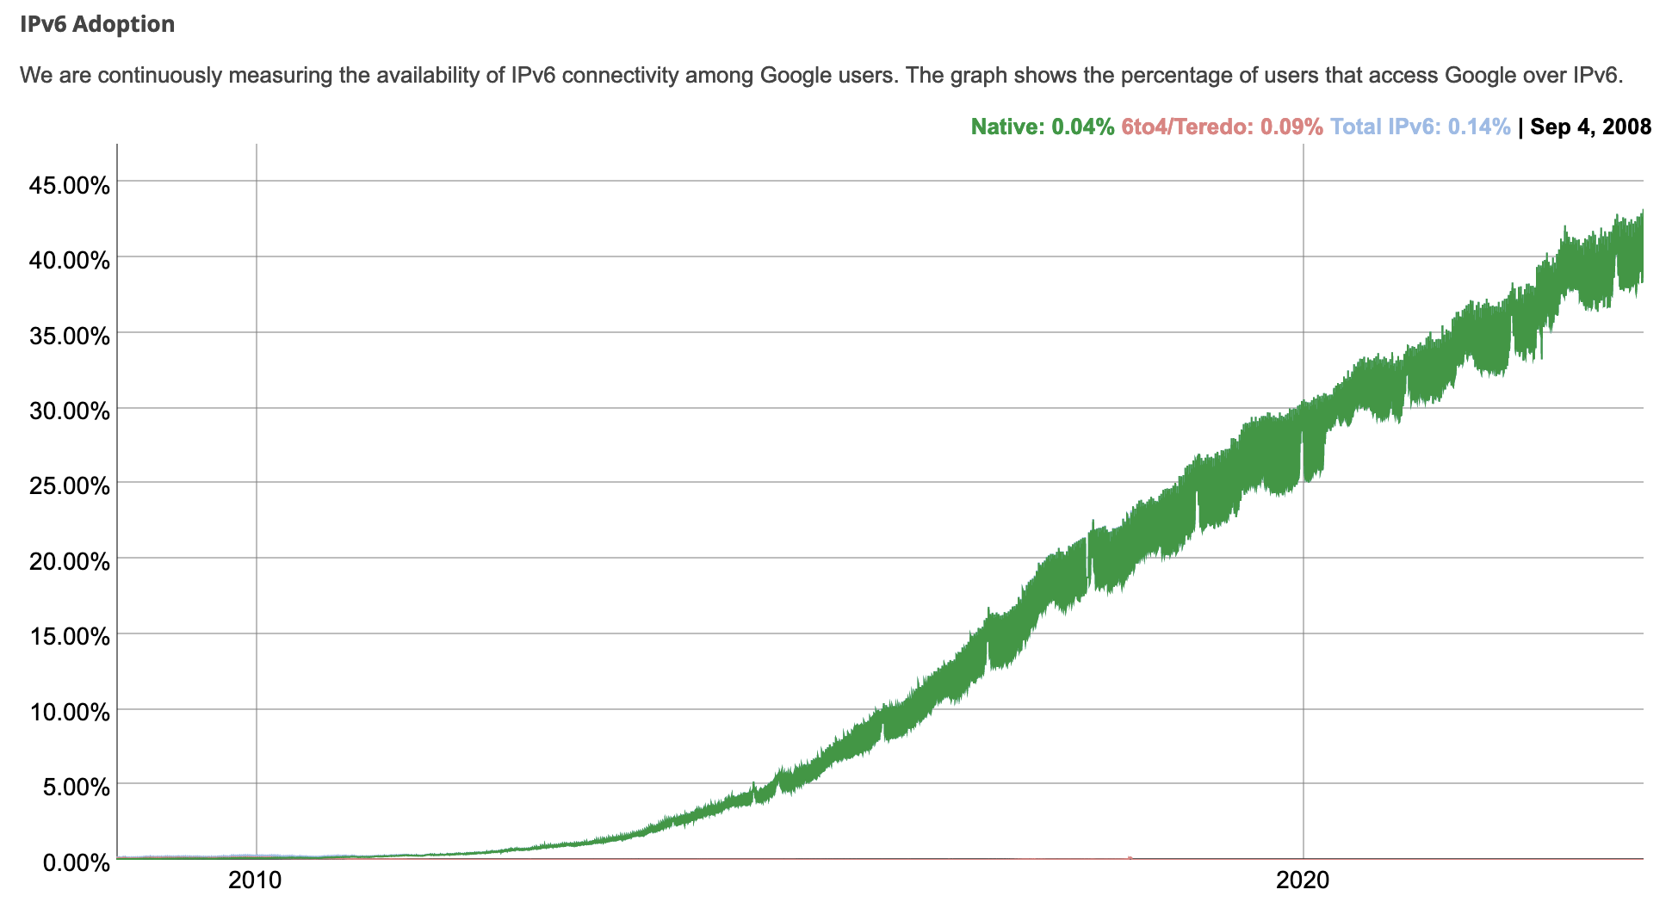
IPv6: adoption
Google¹: ~ 40% of clients access services via IPv6 (2023)
NIST: 1/3 of all US government domains are IPv6 capable

Slide 25
IPv6: adoption
Google¹: ~ 40% of clients access services via IPv6 (2023)
NIST: 1/3 of all US government domains are IPv6 capable
Long (long!) time for deployment, use
  25 years and counting!
  think of application-level changes in last 25 years: WWW, social media, streaming media, gaming, telepresence, …
  Why?
¹ https://www.google.com/intl/en/ipv6/statistics.html

Slide 26
Middleboxes
Middlebox (RFC 3234)
“any intermediary box performing functions apart from normal, standard functions of an IP router on the data path between a source host and destination host”

Slide 27












Middleboxes everywhere!
Firewalls, IDS: corporate, institutional, service providers, ISPs
national or global ISP
NAT: home, cellular, institutional
Load balancers: corporate, service provider, data center, mobile nets
Application-specific: service providers, institutional, CDN
datacenter
network
Caches: service provider, mobile, CDNs
enterprise
network

Slide 28
Middleboxes
initially: proprietary (closed) hardware solutions
move towards “whitebox” hardware implementing open API
  move away from proprietary hardware solutions
  programmable local actions via match+action
  move towards innovation/differentiation in software
SDN: (logically) centralized control and configuration management often in private/public cloud
network functions virtualization (NFV): programmable services over white box networking, computation, storage

Slide 29




Where’s the intelligence?
20th century phone net:
intelligence/computing at network switches
Internet (pre-2005)
intelligence, computing at edge
Internet (post-2005)
programmable network devices
intelligence, computing, massive application-level infrastructure at edge
Notes:
The 20th century phone network had dumb network endpoints, really by definition. The end points were rotary phones that maybe only your parents and grandparents remember; they weren’t computers. They really were dumb devices, and therefore the phone network had programmable switches that were quite smart. All functionality – well, all of the intelligence - was implemented within the network. It HAD to be. The end systems could not do anything more than send digits and send audio signals.
When the Internet came along, the endpoints and the switches were both programmable computers. So where to put the complexity? RFC 1958 – the architectural principles of the Internet RFC - that says “intelligence is end to end rather than hidden in the network.” That puts the intelligence clearly at the edge, like we see here. And that’s possible because the edge devices are smart; they’re programmable. Well that’s the diagram as I remember it 20 years ago.
And in the 20 years since, as we see the rise of middleboxes and SDN, we’re now seeing intelligence (in software) layered on top of “dumb” whiteboxes within the network. So I might add a brain here today. And with datacenters and content distribution networks, we see even smarter and more sophisticated application-level infrastructure being connected at points within the network. So now there are clearly much much bigger, much more computationally intensive and complex, endpoints if you will in today’s Internet

Slide 30
Chapter 4: done!
Network layer: overview
What’s inside a router
IP: the Internet Protocol
Generalized Forwarding, SDN
Middleboxes
Question: how are forwarding tables (destination-based forwarding) or flow tables (generalized forwarding) computed?
Answer: by the control plane (next chapter)

Slide 31
Additional Chapter 4 slides

Slide 32
IP fragmentation/reassembly
network links have MTU (max. transfer size) - largest possible link-level frame
  different link types, different MTUs
large IP datagram divided (“fragmented”) within net
  one datagram becomes several datagrams
  “reassembled” only at destination
  IP header bits used to identify, order related fragments
…
fragmentation:
in: one large datagram
out: 3 smaller datagrams
reassembly
…

Slide 33
IP fragmentation/reassembly
example:
4000 byte datagram
MTU = 1500 bytes
length
=4000
ID
=x
fragflag
=0
offset
=0
one large datagram becomes
several smaller datagrams
1480 bytes in
data field
length
=1500
ID
=x
fragflag
=1
offset
=0
offset =
1480/8
length
=1500
ID
=x
fragflag
=1
offset
=185
length
=1040
ID
=x
fragflag
=0
offset
=370

