Slide 1

Chapter 5
Network Layer:
Control Plane
Computer Networking: A Top-Down Approach
8th edition
Jim Kurose, Keith Ross
Pearson, 2020
Notes:
Version History
8.0 (May 2020)
All slides reformatted for 16:9 aspect ratio
All slides updated to 8th edition material
Use of Calibri font, rather that Gill Sans MT
Add LOTS more animation throughout
lighter header font
Re-do of network management slides; redo of Bellman-Ford slides
8.2 (changes over 8.0)
improved animations of Dijkstra’s algorithm and Bellman Ford
various improvements to BGP
SDN: added Google Orion (2021 Google network SDN control plane)

Slide 2
Network layer control plane: our goals
understand principles behind network control plane:
  traditional routing algorithms
  SDN controllers
  network management, configuration
instantiation, implementation in the Internet:
  OSPF, BGP
  OpenFlow, ODL and ONOS controllers
  Internet Control Message Protocol: ICMP
  SNMP, YANG/NETCONF

Slide 3

Network layer: “control plane” roadmap
introduction
routing protocols
  link state
  distance vector
intra-ISP routing: OSPF
routing among ISPs: BGP
SDN control plane
Internet Control Message Protocol
network management, configuration
  SNMP
  NETCONF/YANG

Slide 4
Network-layer functions
forwarding: move packets from router’s input to appropriate router output
data plane
routing: determine route taken by packets from source to destination
control plane
Two approaches to structuring network control plane:
per-router control (traditional)
logically centralized control (software defined networking)

Slide 5

Per-router control plane
Individual routing algorithm components in each and every router interact in the control plane
Routing
Algorithm
control
plane
data
plane
values in arriving
packet header
0111
1
3
2

Slide 6
Software-Defined Networking (SDN) control plane
Remote controller computes, installs forwarding tables in routers
Remote Controller
control
plane
data
plane
CA
CA
CA
CA
CA
values in arriving
packet header
0111
1
3
2

Slide 7
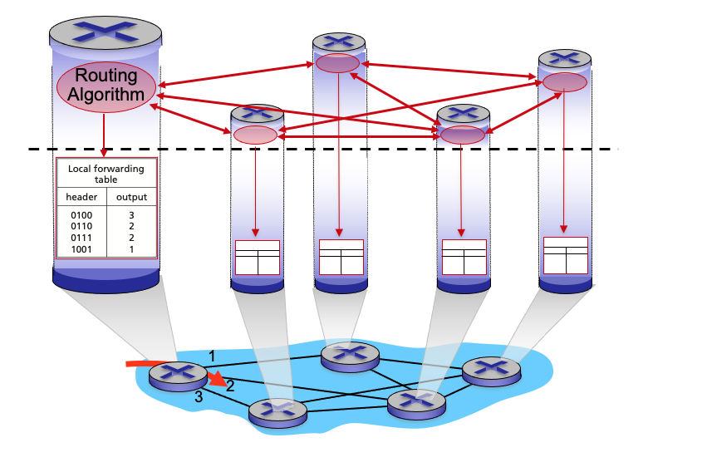
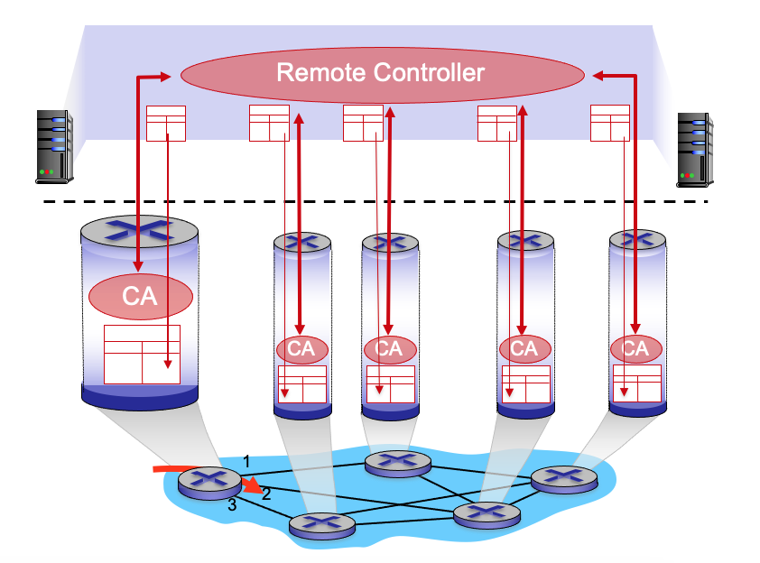
Per-router control plane
SDN control plane

Slide 8
Network layer: “control plane” roadmap
introduction
routing protocols
  link state
  distance vector
intra-ISP routing: OSPF
routing among ISPs: BGP
SDN control plane
Internet Control Message Protocol
network management, configuration
  SNMP
  NETCONF/YANG

Slide 9
















Routing protocols
mobile network
Routing protocol goal: determine “good” paths (equivalently, routes), from sending hosts to receiving host, through network of routers
path: sequence of routers packets traverse from given initial source host to final destination host
“good”: least “cost”, “fastest”, “least congested”
routing: a “top-10” networking challenge!
national or global ISP
application
transport
network
link
physical
network
link
physical
network
link
physical
network
link
physical
network
link
physical
network
link
physical
datacenter
network
application
transport
network
link
physical
enterprise
network

Slide 10
Graph abstraction: link costs
5
c_{a,b}: cost of direct link connecting a and b
e.g., c_{w,z} = 5, c_{u,z} = ∞
  cost defined by network operator: could always be 1, or inversely related to bandwidth, or inversely related to congestion
v
3
w
2
5
u
2
1
z
3
1
2
x
y
1
graph: G = (N,E)
N: set of routers = { u, v, w, x, y, z }
E: set of links ={ (u,v), (u,x), (v,x), (v,w), (x,w), (x,y), (w,y), (w,z), (y,z) }

Slide 11
Routing algorithm classification
global: all routers have complete topology, link cost info
“link state” algorithms
dynamic: routes change more quickly
  periodic updates or in response to link cost changes
How fast do routes change?
static: routes change slowly over time
decentralized: iterative process of computation, exchange of info with neighbors
routers initially only know link costs to attached neighbors
“distance vector” algorithms
global or decentralized information?

Slide 12
Network layer: “control plane” roadmap
introduction
routing protocols
  link state
  distance vector
intra-ISP routing: OSPF
routing among ISPs: BGP
SDN control plane
Internet Control Message Protocol
network management, configuration
  SNMP
  NETCONF/YANG

Slide 13
Dijkstra’s link-state routing algorithm
centralized: network topology, link costs known to all nodes
  accomplished via “link state broadcast”
  all nodes have same info
computes least cost paths from one node (“source”) to all other nodes
  gives forwarding table for that node
iterative: after k iterations, know least cost path to k destinations
notation
c_{x,y}: direct link cost from node x to y; = ∞ if not direct neighbors
D(v): current estimate of cost of least-cost-path from source to destination v
p(v): predecessor node along path from source to v
N': set of nodes whose least-cost-path definitively known

Slide 14
Dijkstra’s link-state routing algorithm
1 Initialization:
2 N' = {u} /* compute least cost path from u to all other nodes */
3 for all nodes v
4 if v adjacent to u /* u initially knows direct-path-cost only to direct neighbors */
5 then D(v) = c_{u,v} /* but may not be minimum cost! */
6 else D(v) = ∞
7
8 Loop
9
10
11
12
13
14
15 until all nodes in N'
find w not in N' such that D(w) is a minimum
add w to N'
update D(v) for all v adjacent to w and not in N' :
D(v) = min ( D(v), D(w) + c_{w,v} )
/* new least-path-cost to v is either old least-cost-path to v or known
least-cost-path to w plus direct-cost from w to v */

Slide 15
Dijkstra’s algorithm: an example
v
w
x
y
z
Step
0
1
2
3
4
5
N'
D(v),p(v)
D(w),p(w)
D(x),p(x)
D(y),p(y)
D(z),p(z)
u
2,u
5,u
1,u
∞
∞
D(w),p(w)
5,u
4,x
3,y
3,y
5
Initialization (step 0):
For all a: if a adjacent to u then D(a) = c_{u,a}
v
3
w
2
5
u
2
1
z
3
1
2
x
y
1

Slide 16
Dijkstra’s algorithm: an example
v
w
x
y
z
Step
0
1
2
3
4
5
N'
D(v),p(v)
D(w),p(w)
D(x),p(x)
D(y),p(y)
D(z),p(z)
u
2,u
5,u
1,u
∞
∞
ux
D(w),p(w)
5,u
4,x
3,y
3,y
8 Loop
9
10
find a not in N' such that D(a) is a minimum
add a to N'
5
v
3
w
2
5
u
2
1
z
3
1
2
x
y
1

Slide 17

Dijkstra’s algorithm: an example
v
w
x
y
z
Step
0
1
2
3
4
5
N'
D(v),p(v)
D(w),p(w)
D(x),p(x)
D(y),p(y)
D(z),p(z)
u
2,u
5,u
1,u
∞
∞
ux
2,u
4,x
2,x
∞
D(w),p(w)
5,u
4,x
3,y
3,y
8 Loop
9
10
11
find a not in N' such that D(a) is a minimum
add a to N'
5
v
3
w
2
5
update D(b) for all b adjacent to a and not in N' :
D(b) = min ( D(b), D(a) + c_{a,b} )
u
2
1
z
3
1
2
D(v) = min ( D(v), D(x) + c_{x,v} ) = min(2, 1+2) = 2
x
y
1
D(w) = min ( D(w), D(x) + c_{x,w} ) = min (5, 1+3) = 4
D(y) = min ( D(y), D(x) + c_{x,y} ) = min(inf,1+1) = 2

Slide 18
Dijkstra’s algorithm: an example
v
w
x
y
z
Step
0
1
2
3
4
5
N'
D(v),p(v)
D(w),p(w)
D(x),p(x)
D(y),p(y)
D(z),p(z)
u
2,u
5,u
1,u
∞
∞
ux
2,u
4,x
2,x
∞
uxy
D(w),p(w)
5,u
4,x
3,y
3,y
8 Loop
9
10
find a not in N' such that D(a) is a minimum
add a to N'
5
v
3
w
2
5
u
2
1
z
3
1
2
x
y
1

Slide 19
Dijkstra’s algorithm: an example
v
w
x
y
z
Step
0
1
2
3
4
5
N'
D(v),p(v)
D(w),p(w)
D(x),p(x)
D(y),p(y)
D(z),p(z)
u
2,u
5,u
1,u
∞
∞
ux
2,u
4,x
2,x
∞
uxy
2,u
3,y
4,y
8 Loop
9
10
11
find a not in N' such that D(a) is a minimum
add a to N'
5
v
3
w
2
5
update D(b) for all b adjacent to a and not in N' :
D(b) = min ( D(b), D(a) + c_{a,b} )
u
2
1
z
3
1
2
D(w) = min ( D(w), D(y) + c_{y,w} ) = min (4, 2+1) = 3
x
y
1
D(z) = min ( D(z), D(y) + c_{y,z} ) = min(inf,2+2) = 4

Slide 20
Dijkstra’s algorithm: an example
v
w
x
y
z
Step
0
1
2
3
4
5
N'
D(v),p(v)
D(w),p(w)
D(x),p(x)
D(y),p(y)
D(z),p(z)
u
2,u
5,u
1,u
∞
∞
ux
2,u
4,x
2,x
∞
uxy
2,u
3,y
4,y
uxyv
8 Loop
9
10
find a not in N' such that D(a) is a minimum
add a to N'
5
v
3
w
2
5
u
2
1
z
3
1
2
x
y
1

Slide 21
Dijkstra’s algorithm: an example
v
w
x
y
z
Step
0
1
2
3
4
5
N'
D(v),p(v)
D(w),p(w)
D(x),p(x)
D(y),p(y)
D(z),p(z)
u
2,u
5,u
1,u
∞
∞
ux
2,u
4,x
2,x
∞
uxy
2,u
3,y
4,y
uxyv
3,y
4,y
8 Loop
9
10
11
find a not in N' such that D(a) is a minimum
add a to N'
5
v
3
w
2
5
update D(b) for all b adjacent to a and not in N' :
D(b) = min ( D(b), D(a) + c_{a,b} )
u
2
1
z
3
1
2
D(w) = min ( D(w), D(v) + c_{v,w} ) = min (3, 2+3) = 3
x
y
1

Slide 22
Dijkstra’s algorithm: an example
v
w
x
y
z
Step
0
1
2
3
4
5
N'
D(v),p(v)
D(w),p(w)
D(x),p(x)
D(y),p(y)
D(z),p(z)
u
2,u
5,u
1,u
∞
∞
ux
2,u
4,x
2,x
∞
uxy
2,u
3,y
4,y
uxyv
3,y
4,y
uxyvw
8 Loop
9
10
find a not in N' such that D(a) is a minimum
add a to N'
5
v
3
w
2
5
u
2
1
z
3
1
2
x
y
1

Slide 23
Dijkstra’s algorithm: an example
v
w
x
y
z
Step
0
1
2
3
4
5
N'
D(v),p(v)
D(w),p(w)
D(x),p(x)
D(y),p(y)
D(z),p(z)
u
2,u
5,u
1,u
∞
∞
ux
2,u
4,x
2,x
∞
uxy
2,u
3,y
4,y
uxyv
3,y
4,y
uxyvw
4,y
8 Loop
9
10
11
find a not in N' such that D(a) is a minimum
add a to N'
5
v
3
w
2
5
update D(b) for all b adjacent to a and not in N' :
D(b) = min ( D(b), D(a) + c_{a,b} )
u
2
1
z
3
1
2
D(z) = min ( D(z), D(w) + c_{w,z} ) = min (4, 3+5) = 4
x
y
1

Slide 24
Dijkstra’s algorithm: an example
v
w
x
y
z
Step
0
1
2
3
4
5
N'
D(v),p(v)
D(w),p(w)
D(x),p(x)
D(y),p(y)
D(z),p(z)
u
2,u
5,u
1,u
∞
∞
ux
2,u
4,x
2,x
∞
uxy
2,u
3,y
4,y
uxyv
3,y
4,y
uxyvw
4,y
uxyvwz
8 Loop
9
10
find a not in N' such that D(a) is a minimum
add a to N'
5
v
3
w
2
5
u
2
1
z
3
1
2
x
y
1

Slide 25
Dijkstra’s algorithm: an example
v
w
x
y
z
Step
0
1
2
3
4
5
N'
D(v),p(v)
D(w),p(w)
D(x),p(x)
D(y),p(y)
D(z),p(z)
u
2,u
5,u
1,u
∞
∞
ux
2,u
4,x
2,x
∞
uxy
2,u
3,y
4,y
uxyv
3,y
4,y
uxyvw
4,y
uxyvwz
8 Loop
9
10
11
find a not in N' such that D(a) is a minimum
add a to N'
5
v
3
w
2
5
update D(b) for all b adjacent to a and not in N' :
D(b) = min ( D(b), D(a) + c_{a,b} )
u
2
1
z
3
1
2
x
y
1

Slide 26
Dijkstra’s algorithm: an example
v
w
x
y
z
Step
0
1
2
3
4
5
N'
D(v),p(v)
D(w),p(w)
D(x),p(x)
D(y),p(y)
D(z),p(z)
u
2,u
5,u
1,u
∞
∞
ux
2,u
4,x
2,x
∞
uxy
2,u
3,y
4,y
uxyv
3,y
4,y
D(w),p(w)
5,u
4,x
3,y
3,y
uxyvw
4,y
uxyvwz
Initialization (step 0): For all a: if a adjacent to then D(a) = c_{u,a}
5
find a not in N' such that D(a) is a minimum
add a to N'
update D(b) for all b adjacent to a and not in N' :
D(b) = min ( D(b), D(a) + c_{a,b} )
v
3
w
2
5
u
2
1
z
3
1
2
x
y
1

Slide 27
Dijkstra’s algorithm: an example
5
v
3
w
2
5
u
2
1
z
3
1
2
D(w),p(w)
5,u
4,x
3,y
3,y
x
y
1
resulting least-cost-path tree from u:
resulting forwarding table in u:
v
w
destination
outgoing link
v
x
y
w
x
(u,v)
(u,x)
(u,x)
(u,x)
(u,x)
route from u to v directly
u
z
x
route from u to all other destinations via x
y

Slide 28
Dijkstra’s algorithm: another example
v
w
x
y
z
x
D(v),
p(v)
D(w),
p(w)
D(x),
p(x)
D(y),
p(y)
D(z),
p(z)
9
Step
N'
0
u
7,u
3,u
5,u
∞
∞
5
7
4
1
uw
6,w
5,u
11,w
∞
8
2
uwx
6,w
11,w
14,x
u
3
w
y
z
2
3
uwxv
10,v
14,x
3
4
uwxvy
12,y
7
4
5
uwxvyz
v
notes:
construct least-cost-path tree by tracing predecessor nodes
ties can exist (can be broken arbitrarily)

Slide 29
Network layer: “control plane” roadmap
introduction
routing protocols
  link state
  distance vector
intra-ISP routing: OSPF
routing among ISPs: BGP
SDN control plane
Internet Control Message Protocol
network management, configuration
  SNMP
  NETCONF/YANG

Slide 30
Network layer: “control plane” roadmap
introduction
routing protocols
intra-ISP routing: OSPF
routing among ISPs: BGP
SDN control plane
Internet Control Message Protocol
network management, configuration
  SNMP
  NETCONF/YANG

Slide 31
Making routing scalable
our routing study thus far - idealized
all routers identical
network “flat”
… not true in practice
scale: billions of destinations:
can’t store all destinations in routing tables!
routing table exchange would swamp links!
administrative autonomy:
Internet: a network of networks
each network admin may want to control routing in its own network

Slide 32
Internet approach to scalable routing
aggregate routers into regions known as “autonomous systems” (AS) (a.k.a. “domains”)
intra-AS (aka “intra-domain”): routing among routers within same AS (“network”)
all routers in AS must run same intra-domain protocol
routers in different AS can run different intra-domain routing protocols
gateway router: at “edge” of its own AS, has link(s) to router(s) in other AS’es
inter-AS (aka “inter-domain”): routing among AS’es
gateways perform inter-domain routing (as well as intra-domain routing)

Slide 33
Interconnected ASes
forwarding table configured by intra- and inter-AS routing algorithms
Intra-AS
Routing
Inter-AS
Routing
  intra-AS routing determine entries for destinations within AS
forwarding
table
  inter-AS & intra-AS determine entries for external destinations
intra-AS
routing
3c
3a
inter-AS routing
2c
3b
2a
intra-AS
routing
1c
2b
AS3
intra-AS
routing
1a
1b
AS2
1d
AS1

Slide 34
Intra-AS routing: routing within an AS
most common intra-AS routing protocols:
RIP: Routing Information Protocol [RFC 1723]
  classic DV: DVs exchanged every 30 secs
  no longer widely used
EIGRP: Enhanced Interior Gateway Routing Protocol
  DV based
  formerly Cisco-proprietary for decades (became open in 2013 [RFC 7868])
OSPF: Open Shortest Path First [RFC 2328]
  link-state routing
  IS-IS protocol (ISO standard, not RFC standard) essentially same as OSPF

Slide 35
OSPF (Open Shortest Path First) routing
“open”: publicly available
classic link-state
  each router floods OSPF link-state advertisements (directly over IP rather than using TCP/UDP) to all other routers in entire AS
  multiple link costs metrics possible: bandwidth, delay
  each router has full topology, uses Dijkstra’s algorithm to compute forwarding table
security: all OSPF messages authenticated (to prevent malicious intrusion)

Slide 36
Network layer: “control plane” roadmap
introduction
routing protocols
intra-ISP routing: OSPF
routing among ISPs: BGP
SDN control plane
Internet Control Message Protocol
network management, configuration
  SNMP
  NETCONF/YANG

Slide 37

Interconnected ASes
intra-AS
routing
3c
3a
inter-AS routing
2c
3b
2a
intra-AS
routing
1c
2b
AS3
intra-AS
routing
1a
1b
AS2
1d
AS1
intra-AS (aka “intra-domain”): routing among routers within same AS (“network”)
inter-AS (aka “inter-domain”): routing among AS’es
Notes:
Each router then locally runs Dijkstra’s shortest-path algorithm to determine a shortest-path tree to all subnets, with itself as the root node.

Slide 38
Internet inter-AS routing: BGP
BGP (Border Gateway Protocol): the de facto inter-domain routing protocol
  “glue that holds the Internet together”
allows subnet to advertise its existence, and the destinations it can reach, to rest of Internet: “I am here, here is who I can reach, and how”
BGP provides each AS a means to:
  obtain destination network reachability info from neighboring ASes (eBGP)
  determine routes to other networks based on reachability information and policy
  propagate reachability information to all AS-internal routers (iBGP)
  advertise (to neighboring networks) destination reachability info
Notes:
Since an inter-AS routing protocol involves coordination among multiple ASs, communicating ASs must run the same inter-AS routing protocol. In fact, in the Internet, all ASs run the same inter-AS routing protocol, called the Border Gateway Protocol, more commonly known as BGP

