Slide 1

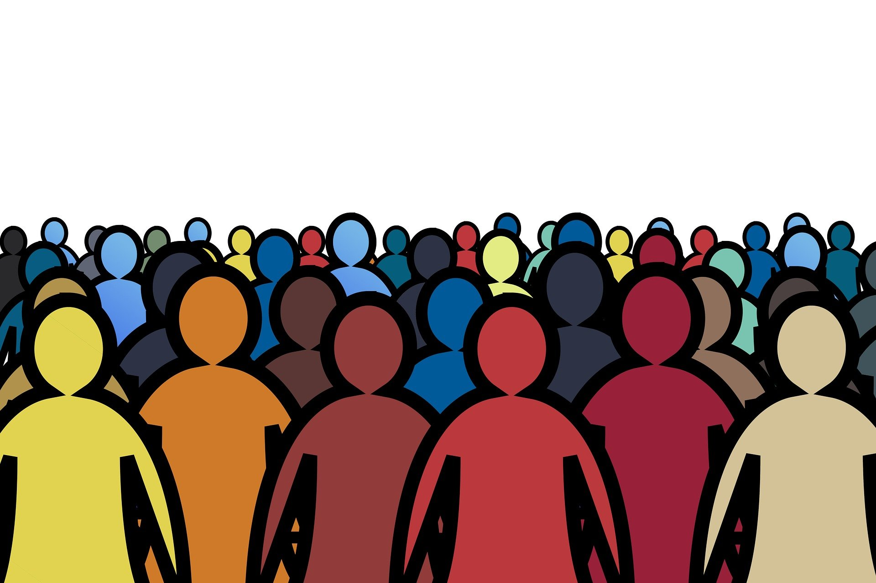
Social Change

Slide 2
Topics
Understanding Social Change
Key Drivers of Social Change
Exploring Theories of Social Change
Processes of Social Change
Approaches to Social Movements
Consequences and Impacts of Social Change

Slide 3
Understanding Social Change
Social change refers to significant and lasting shifts in the structures, practices, relationships, and cultural values that define a society. It encompasses transformations in the way people think, behave, interact, and organize themselves, often leading to enduring modifications in social institutions (such as the family, education, government, and religion), social norms (widely accepted behaviors and values), and overall societal frameworks. These changes may arise from various sources, including technological advancements, shifts in cultural beliefs, demographic changes, or external influences like globalization. Ultimately, social change modifies the foundational aspects of social life, impacting how people relate to each other and to the institutions that govern social order.

Slide 4
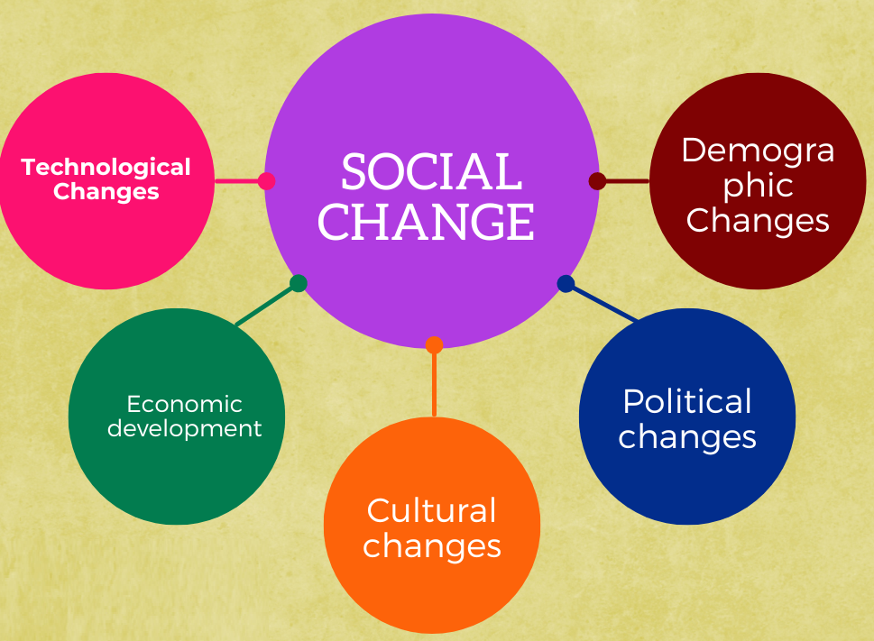
Key Drivers of Social Change
Various factors contribute to social change, including technological advancements, economic shifts, political changes, cultural transformations, and demographic trends.

Slide 5

Technology
Technological innovation is a major driver of social change.
Examples include the invention of the wheel, the printing press, the internet, and digital technologies.

Slide 6

Economy
Economic factors such as industrialization, globalization, and changes in labor markets significantly impact social structures and relationships.
Economic crises can also catalyze social change.

Slide 7
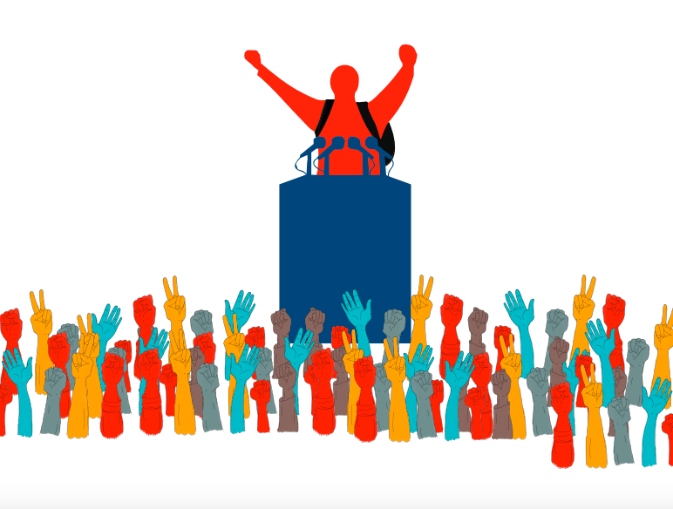
Politics
Political changes, including revolutions, policy reforms, and shifts in governance, play a critical role in shaping society.
Examples include the fall of communism, the establishment of democracies, and civil rights legislation.

Slide 8

Culture
Cultural values, beliefs, and practices influence social behavior and societal norms.
Cultural diffusion, or the spread of cultural elements, contributes to social change.

Slide 9
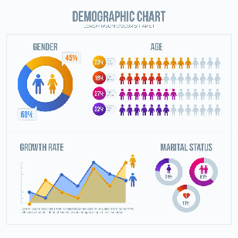
Demographics
Changes in population size, age structure, migration patterns, and life expectancy affect social dynamics.
Demographic shifts can lead to changes in family structures, labor markets, and social policies.

Slide 10

Exploring Theories of Social Change
Different sociological theories explain the mechanisms and processes driving social change.
Major theories include Evolutionary, Conflict, Functionalist, and Cyclical theories.

Slide 11
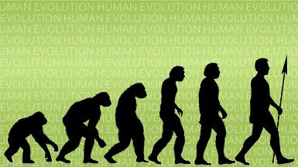
Evolutionary Theory
The evolutionary theory of social change suggests that societies develop progressively, transitioning from simple to more complex forms over time. This perspective is influenced by Charles Darwin's theory of biological evolution, which emphasizes adaptation and gradual change.
Gradual Development: Societies evolve incrementally, with each stage building on the achievements of the previous one.
Progress and Complexity: Over time, societies move toward higher levels of complexity, specialization, and organization.
Survival and Adaptation: Similar to biological evolution, societies adapt to their environments to survive, with successful adaptations leading to growth and advancement.

Slide 12
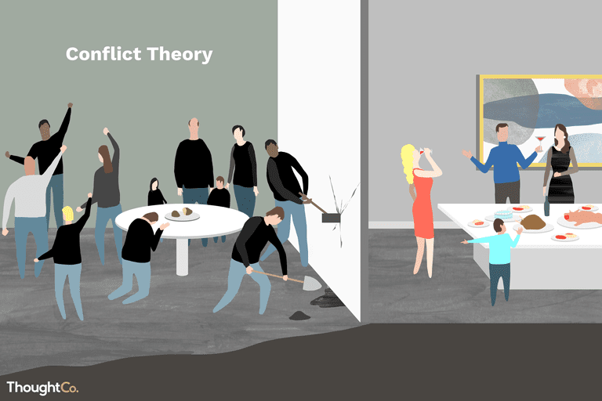
Conflict Theory
Proposed by Karl Marx.
Argues that social change is driven by conflict between different social classes.
Focuses on issues of power, inequality, and social justice.

Slide 13

Functionalist Theory
Views society as a complex system whose parts work together to promote solidarity and stability.
Change occurs to maintain equilibrium and adapt to new conditions.
Emphasizes the role of social institutions in fostering change.

Slide 14
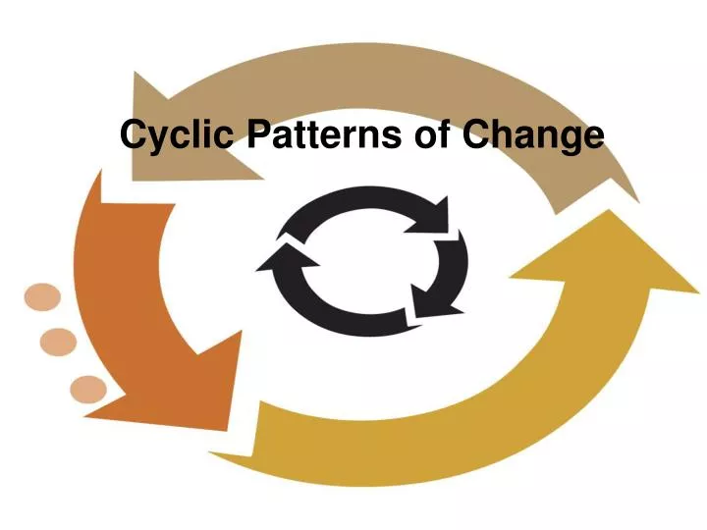
Cyclical Theory
The cyclical theory of social change posits that societies undergo recurring cycles of growth, decline, and eventual fall. This perspective, influenced by historians such as Oswald Spengler and Arnold Toynbee, views history as repetitive and non-linear, with civilizations rising to prominence, facing challenges, and eventually succumbing to decline.
Oswald Spengler in The Decline of the West, Spengler argued that civilizations are like living organisms, with distinct life cycles of birth, growth, maturity, and decay. He believed that Western civilization was in its final stage of decline, marked by cultural stagnation and loss of vitality.
Arnold Toynbee in A Study of History, proposed that civilizations rise by responding creatively to challenges. Decline occurs when societies fail to adapt to new challenges, leading to disintegration and eventual collapse.
History follows a cyclical pattern, with periods of growth followed by inevitable decline. Societies are shaped by internal dynamics (e.g., culture, values) and external challenges (e.g., invasions, environmental factors).No society remains dominant indefinitely; all are subject to the cyclical laws of history.

Slide 15
Processes of Social Change
Social change occurs through various processes, including diffusion, innovation, social movements, and globalization.

Slide 16

Innovation
Innovations cause social change by introducing new technologies, ideas, or methods that transform how people live, work, and interact. They disrupt existing norms, improve efficiency, and address societal challenges, leading to shifts in behavior, culture, and institutions. For example, the invention of the automobile revolutionized transportation, urban development, and global trade, demonstrating how innovations reshape society.

Slide 17

Diffusion
Diffusion leads to social change by spreading ideas, innovations, and cultural practices across societies, challenging traditions and introducing new ways of thinking and acting. This process fosters global interconnectedness, inspires local adaptations, and accelerates shifts in norms, behaviors, and systems. Examples include the spread of democracy, industrial technologies, and healthcare advancements, all of which transform societies over time.

Slide 18
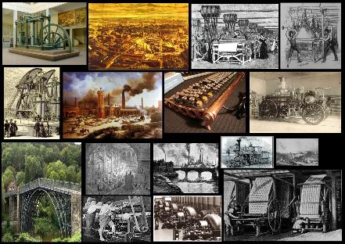
Industrial Revolution
A period of rapid industrialization in the 18th and 19th centuries.
Led to urbanization, changes in labor, and technological advancements.

Slide 19

Globalization
Globalization causes social change by increasing interconnectedness and the exchange of ideas, cultures, and resources across borders. This process influences economic systems, social norms, and cultural identities, leading to both integration and transformation. For example, global trade has integrated economies, while platforms like social media have amplified global social movements, driving change in perspectives and policies worldwide.

Slide 20
Social Movements
Social movements refer to collective activities designed to bring about or resist primary changes in an existing society or group.
Examples of social movements
• Civil rights movement in the United States
• Environmental movement
• Labor movement
• Anti-globalization movement
• Vegetarian movement
• Feminist movement

Slide 21
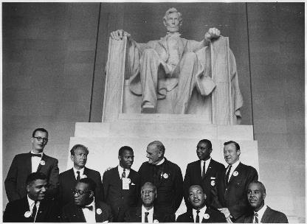
Civil Rights Movement
The Civil Rights Movement caused social change by challenging systemic racism, promoting equality, and transforming laws and social norms in society.
Legal Reforms: Landmark legislation like the Civil Rights Act (1964) and Voting Rights Act (1965) outlawed racial segregation and discrimination.
Cultural Shifts: The movement reshaped societal attitudes toward race, fostering greater inclusion and awareness of racial inequality.
Empowerment: It inspired marginalized groups worldwide to fight for their rights, influencing movements for gender equality, LGBTQ+ rights, and more.
Education and Awareness: Increased focus on civil rights in education and public discourse challenged prejudice and promoted social justice.
The movement not only advanced racial equality in the U.S. but also set a precedent for peaceful activism as a tool for societal transformation

Slide 22

Digital Revolution
The shift from analog to digital technology in the late 20th and early 21st centuries.
Enhanced Communication
Access to Information
Economic Growth
Efficiency
.Globalization
Convenience
Empowerment

Slide 23
Approaches to Social Movements
Resource mobilization
Economic deprivation
Structural strain
Fields of action

Slide 24
Resource Mobilization Approach
The Resource Mobilization approach views social change as a product of the ability of a movement to effectively gather and utilize resources, rather than being solely a response to deprivation or inequality. This theory emphasizes that social movements require specific resources—such as money, leadership, organizational skills, and access to media—to be successful.
This approach shifts focus from the grievances alone to the organizational strategies and external support that facilitate the movement’s objectives. It underscores that resource-rich groups may more effectively sustain collective action over time.

Slide 25
Economic deprivation Approach
The Economic Deprivation approach, associated with Marxist theory, suggests that social change is driven by economic inequality and class conflict. When economic inequalities become severe, and one class (often the working class) experiences deprivation compared to wealthier groups, this disparity can lead to social tension and ultimately, to revolutionary or transformative social change.
This approach assumes that economic grievances are a primary driver of social mobilization and collective action. However, critics argue that it may overlook cultural, ideological, or psychological factors that can also play important roles in social change.

Slide 26
Structural Strain Approach
The Structural Strain approach suggests that social change emerges from specific structural conditions or strains within society. According to this theory, certain structural conditions, such as economic inequality, political conflict, or cultural shifts, create strains that increase the likelihood of collective action and social change.
The Structural Strain approach offers a detailed framework for understanding how specific societal pressures can lead to social change, often by creating a sense of urgency and collective identity among affected groups.

Slide 27
Field of Action Approach
The "Fields of Action" approach to social change emphasizes the interactions between social movements and established institutions. It highlights the agency of social actors who engage, compete, and negotiate within specific arenas to influence societal outcomes. According to Touraine, social change results from the purposeful actions of organized groups within a social context, balancing the role of both structure and agency, rather than solely from structural pressures or economic forces.

Slide 28
Comparison
Approach | Focus of Change | Primary drivers | Key Elements | Example
Economic Deprivation | Economic inequalities | Class conflict | Economic disparity deprivation | Labor movements revolution
Resource Mobilization | Organizational capacity | Access to resources | Funding, leadership, social networks | Civil rights movement
Structural Strain | Social and structural tension | Structural conditions | Social strain, precipitating events | French Revolution
Fields of Action | Interactions within social arenas | Agency of social actors | Social movements, institutional arenas, negotiation | Environmental movement vs. policy
Each of these approaches provides a unique perspective on social change, offering insights into how different factors—economic deprivation, access to resources, or structural strains—contribute to transformative shifts within societies. These approaches are complementary rather than mutually exclusive, as economic grievances, organizational resources, and structural conditions often intersect in real-world social movements.

Slide 29
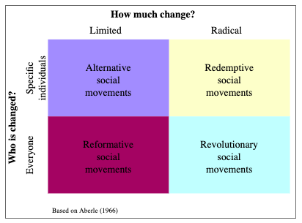
Types of Social Movements
David Aberle identified these four types of social movements, with some types of movements targeting either specific individuals or everyone, while some want limited changes, and others are more radical.

Slide 30
Types of Social Movements
1) Alternative social movement: Movements that target a small group of people and a specific behavior, and attempt to change the behavior of individual people in relation to that issue. For example, Mothers Against Drunk Driving (MADD): Aims to encourage safe driving by advocating against drunk driving. Similarly, Plastic-Free Initiatives: Encourages individuals to reduce plastic use for environmental protection.
2) Redemptive social movement: Movements seeking total change in the behavior of specific individuals. For instance, Alcoholics Anonymous (AA) helps individuals recover from alcohol addiction and transform their lives. Likewise, religious conversion movements groups promoting spiritual rebirth or a return to faith, like evangelical revival movements.

Slide 31
Types of Social Movements
3). Reformative social movements: Social movements that advocate for limited social change across an entire society. E.g. Civil Rights Movement (1960s): Sought racial equality and justice through legal and societal reforms. Similarly, Environmental Movements do Advocacy for laws and policies to combat climate change or promote renewable energy.
4) Revolutionary social movements: These movements are deeply dissatisfied with the social order and work for radical change. They advocate replacing the entire existing structure. Russian Revolution (1917): Overthrew the monarchy and established a communist government. Likewise, Arab Spring (2010–2012) aimed to overthrow authoritarian regimes in the Middle East and North Africa.

Slide 32
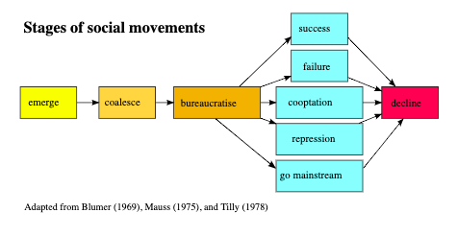
Stages of Social Movements

Slide 33
Stages of Social Movements
1. Emerge: Social movements typically begin when individuals recognize a problem within their society that needs to be addressed. This realization may stem from dissatisfaction with current conditions or an increased awareness of an issue through information and knowledge.
In this emergent stage, also referred to as the evolutionary stage, the movement is still in its formative phase. The focus is on identifying and defining the problem that the movement seeks to address. At this point, dissatisfaction is often personal and unorganized, with individuals acting independently rather than collectively. The unrest remains largely internal or esoteric, with participants feeling unhappy about a situation but not yet mobilized for collective action.
For example, in the early 1950s during the initial phase of the Civil Rights Movement, there was widespread dissatisfaction among African Americans about racial segregation and discrimination. However, at this stage, most efforts to address these issues were isolated and individual rather than part of an organized, collective movement. It was only later, as awareness and shared commitment grew, that the movement transitioned into more coordinated and visible action.

Slide 34
Stages of Social Movements
2. The coalesce stage, also referred to as the popular stage, occurs when individual dissatisfaction transforms into collective action. At this stage, people move beyond isolated complaints and begin to organize around a shared sense of injustice. The unrest shifts from being esoteric (internal and individual) to exoteric (external and collective). This means that dissatisfaction is no longer confined to personal grievances; it is widely recognized and focused on a common goal.
In this stage, social movements overcome initial obstacles such as fragmentation and lack of coordination. They develop a more defined identity, set objectives, and start mobilizing resources and participants. The discontent becomes unified and focalized, creating a foundation for organized action.
For example, the Montgomery Bus Boycott in 1955, sparked by Rosa Parks' refusal to give up her seat to a white passenger, marked a critical moment in the Civil Rights Movement. It transformed widespread individual frustration with racial segregation into a coordinated and collective effort. The boycott galvanized community members, brought leaders together, and demonstrated the power of collective action in challenging systemic injustice

Slide 35
Stages of Social Movements
3. The bureaucratization stage, also known as the formalization stage, marks the third phase in the life cycle of a social movement. At this stage, the movement becomes more structured and organized, transitioning from grassroots activism to a more institutionalized form. Volunteer efforts are often supplemented or replaced by paid staff and professional leaders, creating clear lines of authority and division of labor. Additionally, fundraising becomes a significant focus to sustain operations.
An SMO (Social Movement Organization) is typically established during this phase. The SMO serves as the operational arm of the social movement, relying on trained staff to carry out essential functions such as planning campaigns, managing resources, and maintaining momentum. This bureaucratic structure is necessary for the movement to survive and achieve its long-term goals, as reliance on inspirational leaders and spontaneous mass rallies is no longer sufficient.
For example, the Student Nonviolent Coordinating Committee (SNCC) was formed during the Civil Rights Movement to provide a formal structure for organizing protests, training activists, and supporting nonviolent resistance. The SNCC’s establishment ensured that the movement could sustain its efforts, coordinate activities effectively, and expand its reach across communities.

Slide 36
Stages of Social Movements
4. Decline: The fourth stage of the social movement life cycle is known as decline. Social movements eventually decline for one or more reasons. For example, leaders may not run things properly, or there may be conflicts inside the organization. However, sometimes they achieve their goals and naturally cease to exist because there is no reason to continue. For example, the abolitionist movement became irrelevant with the passing of the Thirteenth Amendment, ending slavery.
A social movement can decline in the following five ways.
Success
Cooptation
Repression
Go mainstream
Failure

Slide 37
Stages of Social Movements
Success: When the goals are achieved.
Cooptation: When movement leaders are offered rewards by movements’ opponents.
Repression: When authorities control or destroy a social movement.
Go mainstream: The goals of the movement are adopted by the mainstream.
Failure: There are two reasons of failure:
Factionalism
Encapsulation

Slide 38
Stages of Social Movements
Factionalism refers to internal divisions and conflicts within a social movement caused by differing ideas, strategies, or goals among its members or groups. These disagreements can weaken the movement’s unity, dilute its focus, and reduce its ability to achieve its objectives. In the Civil Rights Movement, divisions sometimes arose between groups like the Student Nonviolent Coordinating Committee (SNCC) and the Southern Christian Leadership Conference (SCLC) over strategies for achieving racial equality.
Encapsulation occurs when a social movement becomes insular, with its pioneers or early members creating barriers that discourage new followers from joining. This often stems from rigid control or exclusivity. The movement stagnates due to its inability to attract fresh ideas, resources, or participants, limiting its growth and effectiveness. A grassroots environmental movement may struggle to expand if its founding members resist adopting new approaches or integrating younger activists with diverse perspectives.

Slide 39
Impacts of Social Change
Social change has both positive and negative impacts on societies.
Positive Impacts:
Economic growth, improved living standards, technological advancements, and greater social equality.
Increased access to education, healthcare, and information.
Negative Impacts:
Social disruption, loss of cultural heritage, environmental degradation, and increased inequality.
Challenges such as unemployment, social isolation, and mental health issues.

