Slide 1
Management of sofware development
Automation of the business processes and code industrialisation
02b Code analysis
(the good, the bad and the ugly)
17 janvier 2007

Slide 2
Creating testable code I
Program 1 : image converter
  Use TiffImageConverter
  User stories :
      Add 2 new conversions gif and bmp
      Enhance the interface to be able to do it simply
  Time issue : the code should be delivered and clean by September 24th 12h45
17 janvier 2007

Slide 3
Constraints
Group of 2 peoples imposed (but 1)
  Put the full zipped project on Cyberlearn
use «good coding» principles
  Justify your choices
  Use the course support
  Use references on internet
17 janvier 2007

Slide 4
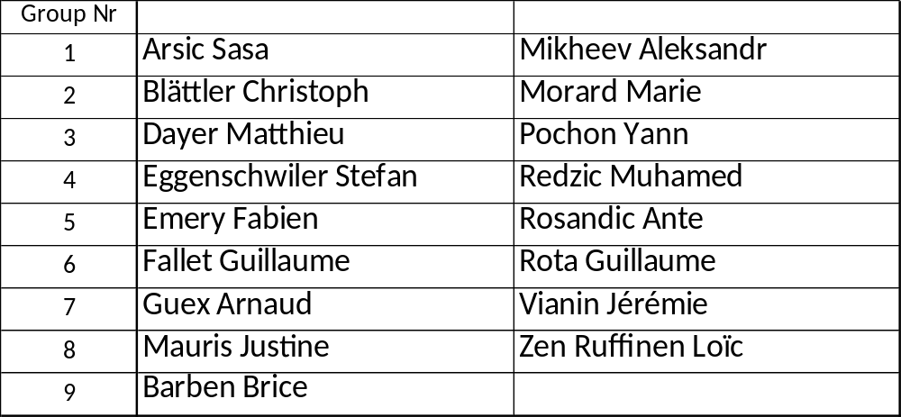
Groups
17 janvier 2007

