Slide 1
raytrace and pyflate: Benchmark Optimization and Hardware Acceleration
Performance analysis, software optimization and a ray-sphere accelerator in SystemVerilog
Muhameed Mhameed · Ahmad Maatouq
HW/SW Co-design · Course 00460882
Notes:
Introduce the team and the plan: two pyperformance benchmarks, software optimization for both, and a ray-sphere accelerator for raytrace.

Slide 2
Project at a glance
Benchmark | Main bottleneck | Software change | Speedup | Hardware
raytrace | Object and call overhead in the interpreter | __slots__, remove no-op checks, inline math | 1.52x | Proposed
pyflate | Linear Huffman search, byte-at-a-time loops | Lookup table, bit buffer, faster MTF and RLE | 3.32x | No
1
Measure
2
Locate
3
Optimize
4
Accelerate
pyperf, perf, flame graphs
Connect C frames to Python code
Change code, verify the output
RTL, simulation, Amdahl estimate
Both benchmarks spend their time on work around the computation, not on the computation.
2
Notes:
One slide with the whole story. raytrace: object overhead, 1.52x, and a hardware proposal. pyflate: an algorithmic Huffman scan and byte-level loops.

Slide 3
Method: how every number was measured
commands, run inside the VM
Two environments
perf record -F 999 -g -- python3-dbg run_benchmark.py \
--values 1 -w 0
perf script | stackcollapse-perf.pl | flamegraph.pl
python3 run_benchmark.py --values 3 -w 1 -o out.json
python3 -m pyperf compare_to orig.json opt.json
Times and profiles: QEMU VM
The VM has no hardware counters
perf stat counters: tangerine host
Tool | What it gives us | Limit
pyperf | Mean and spread with python3 | VM spread reached 16-20% on raytrace
perf + FlameGraph | Profiles with python3-dbg | Debug build changes the percentages
perf stat | Instructions, cycles, IPC on the host | Different machine from the VM timing
Icarus Verilog | Simulation of the RTL | No synthesis, so timing is an assumption
3
Notes:
Timing and profiles ran in the course QEMU VM with Python 3.10. The VM uses software emulation, so runs are slow and noisy, and it does not support hardware counters. Those were measured separately on the tangerine host, also with Python 3.10.

Slide 4
raytrace
PART A
A pure-Python ray tracer
Notes:
Part A covers the raytrace benchmark and its hardware proposal.

Slide 5
What raytrace does
For each pixel
Cast a ray
Test all objects
Pick nearest hit
Shade and reflect
Scene
Data structures
Libraries
100 x 100 pixels
7 spheres and a checkerboard half-space
2 lights, with reflections
Vector and Point: x, y, z
Ray: point and vector
Sphere, Halfspace, Scene, Canvas
math.sqrt
pyperf for timing
No numeric library: all arithmetic is Python objects
Part A · raytrace
5
Notes:
The scene has 7 spheres and a checkerboard floor at 100 by 100 pixels. Every pixel casts a ray, tests every object, then shades with shadow and reflection rays. Vector and Point are small Python objects.

Slide 6
Profiling: where the self-time goes
Self % | Symbol | Category
20.83 | _PyEval_EvalFrameDefault | Interpreter
2.80 | _PyEval_MakeFrameVector | Calls and frames
2.31 | frame_dealloc | Calls and frames
1.98 | binary_op1 | Arithmetic
1.95 | PyTuple_GetItem | Tuple access
1.90 | _PyObject_GetMethod | Attributes and dicts
1.71 | call_function | Calls and frames
1.68 | PyFloat_FromDouble | Float objects
20.8%
Interpreter loop
13.2%
Calls and frames, by symbol name
17.8%
Attributes and dicts, by symbol name
perf report --stdio, python3-dbg, original code, 1,270,226 samples
Part A · raytrace
6
Notes:
Self time from perf report on the original code. The interpreter loop is about a third. The rest is spread over many small costs from calls, frames, attributes and dictionaries.

Slide 7
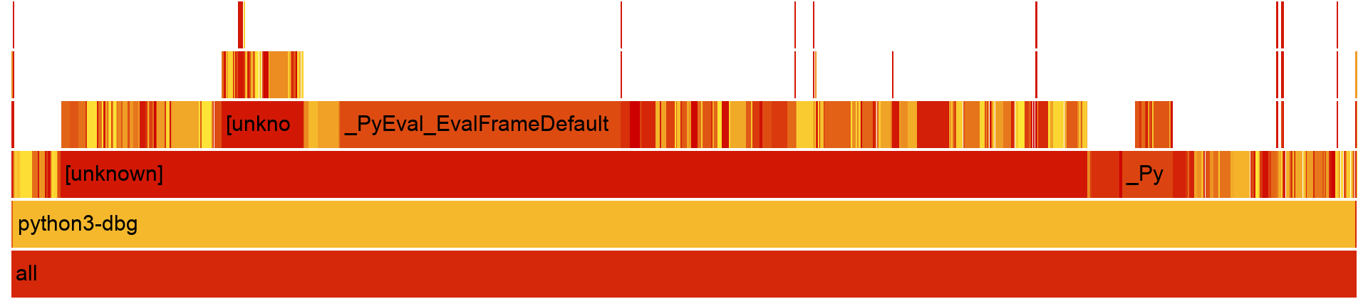
Profiling: flame graph of the original run
How to read it
Limit of this profile
Width is share of samples, not time order
No single wide function except the interpreter loop
This points to many small costs
Many stacks still pass through [unknown]
Python function names are not visible
The Python mapping comes from reading the source
Part A · raytrace
7
Notes:
Bottom rows of raytrace_orig.svg. Width is the share of samples. The profile is flat apart from the interpreter loop. Many stacks still pass through unknown frames, and it shows CPython C functions only, so we read the code to map this to Python.

Slide 8
Bottlenecks: the code behind the hotspots
bm_raytrace/run_benchmark.py · Vector
dict per object
bm_raytrace/run_benchmark.py · dot
no-op call
22 class Vector(object):
24 def __init__(self, initx, inity, initz):
25 self.x = initx # __dict__ write
26 self.y = inity
27 self.z = initz
51 def dot(self, other):
52 other.mustBeVector()
53 return self.x*other.x + ...
76 def mustBeVector(self):
77 return self
bm_raytrace/run_benchmark.py · Sphere.intersectionTime
179,457 calls per render
142 def intersectionTime(self, ray):
143 cp = self.centre - ray.point
144 v = cp.dot(ray.vector)
145 discriminant = (self.radius * self.radius) - (cp.dot(cp) - v * v)
146 if discriminant < 0:
147 return None
148 else:
Part A · raytrace
8
Notes:
Three sources of work. Each operation creates a Vector with a dictionary. mustBeVector just returns self, so it is a pure call cost. intersectionTime runs for every ray-sphere pair and builds a temporary. The conclusion: the arithmetic is cheap, and the cost is the Python objects around it.

Slide 9
Optimization: three targeted changes
# | Change | What it removes | Expected in profile
1 | __slots__ on Vector, Point, Ray | Per-object dictionary | insertdict, dict_dealloc
2 | Remove mustBeVector() in hot methods | No-op Python calls | Frames, method lookup
3 | Inline math in Sphere.intersectionTime | Temporary Vector and dot() calls | Allocation, frames
original · lines 143-145
objects and calls
optimized
local floats
143 cp = self.centre - ray.point
144 v = cp.dot(ray.vector)
145 disc = r*r - (cp.dot(cp) - v*v)
cpx = c.x - p.x # same for y, z
v = cpx*d.x + cpy*d.y + cpz*d.z
cp2 = cpx*cpx + cpy*cpy + cpz*cpz
disc = r*r - (cp2 - v*v)
Part A · raytrace
9
Notes:
Each change maps to a cost from the profile. Output stayed byte-identical on a 60 by 60 render of the benchmark scene.

Slide 10
Results: raytrace runs 1.52x faster
Measure | Original | Optimized | Change
Mean time | 17.5 s | 11.6 s | 34% less
perf samples | 1,270,226 | 768,333 | 40% fewer
Frame creation | 2.80% | 2.40% | lower
Dict writes | 1.17% | 0.15% | lower
Frame cleanup | 2.31% | 2.19% | lower
Method lookup | 1.90% | 1.29% | lower
Mean ± std dev (pyperf)
17.5 s
original, ± 2.8 s
11.6 s
optimized, ± 2.3 s
Output stayed byte-identical, and the gain is far above the 7% target.
Part A · raytrace
10
Notes:
Official pyperf comparison, 60 values each. The spread is large because of the VM, but the gain is well above it and far above the 7 percent target. perf sample count fell by 28 percent, consistent with the time saved.

Slide 11
Results: hardware counters for raytrace
Counter | Original | Optimized | Change
Instructions | 50.72 G | 33.82 G | 1.50x fewer
Cycles | 18.67 G | 12.47 G | 1.50x fewer
IPC | 2.72 | 2.71 | same
Branches | 9.77 G | 6.34 G | 1.54x fewer
Cache-miss rate | 1.64% | 1.71% | about the same
Branch-miss rate | 0.27% | 0.36% | higher
How it was measured
tangerine host, Xeon E5-2690 v4
perf stat -r 5, 10 loops
Pinned to one core
Not in the VM
IPC did not change: the speedup comes from executing fewer instructions.
Part A · raytrace
11
Notes:
The VM does not support hardware counters, so these come from perf stat directly on the tangerine host, with 5 repeats of 10 loops pinned to one core. IPC stays the same, so the speedup comes from executing fewer instructions. Times on the other slides are from the VM, so do not mix the two.

Slide 12
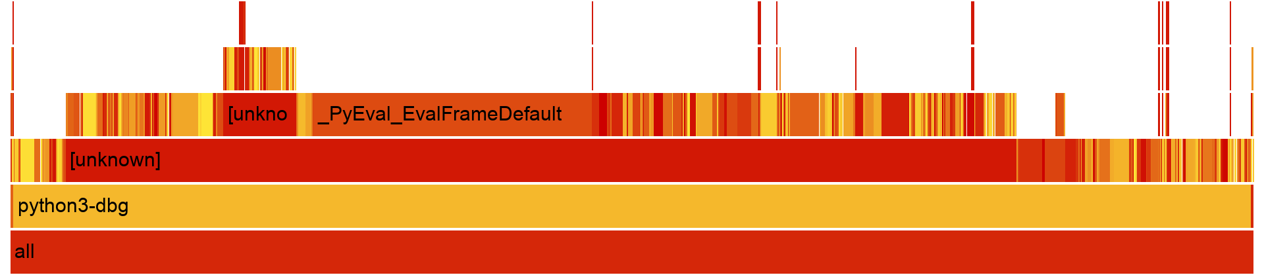
Results: flame graphs before and after
Before: 1,270,226 samples
After: 768,333 samples
Share | Frame
20.86% | _PyEval_EvalFrameDefault
2.12% | _PyEval_MakeFrameVector
1.17% | insertdict
Share | Frame
22.39% | _PyEval_EvalFrameDefault
1.85% | _PyEval_MakeFrameVector
0.15% | insertdict
The interpreter share rises because other work shrank. Compare shape and sample count, not raw width.
Part A · raytrace
12
Notes:
Same shape, less work. The percentages are shares of a shorter run, so compare the shape and the sample counts, not raw widths.

Slide 13
Hardware: why ray-sphere intersection
the computation
Worked example (Test 1)
cp = c - p
v = cp . d
disc = r^2 - (cp.cp - v^2)
disc < 0 : miss
t = v - sqrt(disc)
Sphere at (0, 0, 10), r = 2
Ray from origin along +z
v = 10, cp.cp = 100, disc = 4
t = 10 - 2 = 8
179,457
0.50 / 0.285
Q16.16
calls per 100x100 render
share of runtime, original / optimized
32-bit signed fixed point
Part A · raytrace
13
Notes:
This function is fixed arithmetic with no data-dependent memory access, and it runs 179,457 times per render. Worked example is Test 1 in the testbench. d must be a unit vector.

Slide 14
Hardware: accelerator block diagram
Software (CPU)
ray_sphere_intersect (SystemVerilog)
Sphere.intersectionTime
Python
Input regs
c, r, p, d
Subtract
cp = c - p
Multiply-add
v, cp.cp, r^2
C extension and driver
float to Q16.16, batching
t = v - sqrt(disc)
output register
q16_sqrt
restoring, 24 cycles
disc and sign
r^2 - (cp.cp - v^2)
MMIO registers / DMA
descriptor list of pairs
Control FSM: IDLE, CALC_DOT, CALC_DISC, SQRT_WAIT, EMIT
A start bit drives in_valid. Results return with hit and t_hit.
disc < 0: skip q16_sqrt and go straight to EMIT with hit = 0.
valid/ready handshake on both the input and output sides.
Part A · raytrace
14
Notes:
Left is software: Python calls a driver that converts floats to Q16.16 and moves data by MMIO or DMA. Right is the block: one multi-cycle datapath, a square root unit, and an FSM. A miss skips the square root.

Slide 15
Hardware: interface and FSM latency
Signal | Bits | Meaning
cx, cy, cz, radius | 32 each | Sphere, Q16.16
px, py, pz | 32 each | Ray origin
dx, dy, dz | 32 each | Unit direction
in_valid / in_ready | 1 each | Input handshake
out_valid / out_ready | 1 each | Output handshake
hit | 1 | Sphere was hit
t_hit | 32 | Distance, 0 on miss
State | Work | Cycles
IDLE | Capture cp = c - p | 1
CALC_DOT | v, cp.cp, r^2 | 1
CALC_DISC | Scale, disc, sign | 1
SQRT_WAIT | 24 root bits + handoff | 26
EMIT | Hold until ready | 1
30
4
cycles, hit
cycles, miss
At an assumed 200 MHz: 150 ns per hit, 20 ns per miss. One request at a time, not a pipeline.
Part A · raytrace
15
Notes:
All data is signed Q16.16. Latency is measured in simulation: 30 cycles for a hit and 4 for a miss. The 200 MHz clock is an assumption since we did not synthesize.

Slide 16
Hardware: verification found a real bug
ray_sphere_intersect.sv · before
same cycle
ray_sphere_intersect.sv · after
hold until transfer
EMIT: begin
out_valid <= 1'b1;
if (out_ready) begin
out_valid <= 1'b0; // wins
EMIT: begin
out_valid <= 1'b1;
if (out_valid && out_ready) begin
out_valid <= 1'b0;
Testbench run | Result | Why
Old testbench, old RTL | PASS | @(posedge out_valid) saw a glitch
New testbench, old RTL | FAIL, timeout | out_valid never settles high
New testbench, fixed RTL | PASS: t = 8.0, miss detected | Real handshake
Not tested yet: out_ready held low, tangent rays, negative t.
Part A · raytrace
16
Notes:
Two nonblocking assignments in one cycle meant out_valid never held a high value. The old testbench caught a zero-width glitch, so it passed. The new testbench samples a settled level. The old RTL fails it. Not tested yet: out_ready low, tangent rays, negative t.

Slide 17
Hardware: estimated benefit (Amdahl's law)
S = 1 / ((1 - f) + f / s)
Transfers decide the outcome
tangerine, Python 3.10 | Original | Optimized
Render time | 0.710 s | 0.465 s
Cost per call | 2.00 us | 0.74 us
f | 0.50 | 0.285
The 1.29x excludes transfer and conversion
A Python-to-device round trip can cost as much as the 0.74 us it replaces
So calls must be sent in batches
What makes it pay off
Batch ray-sphere pairs over DMA
Pipeline the datapath for throughput
Part A · raytrace
17
Notes:
f and the per-call cost were measured on the tangerine host with Python 3.10, by replaying the real calls of one render. Against the optimized code the ceiling is 1.40x. With 0.74 microseconds in software and 150 nanoseconds in hardware at the 200 MHz target, s is 4.9, giving 1.29x before transfer costs. A device round trip from Python can take as long as the call it replaces, so batching is needed.

Slide 18
Hardware: performance, area and power trade-offs
Aspect | Current design | Alternative and cost
Area | 8 multipliers of 32x32 | One shared multiplier: smaller, about 6 extra cycles
Frequency | Three products summed in one cycle | More stages: higher clock, longer latency
Throughput | One result per 30 cycles | Pipelined root: one per cycle, about 24 register stages
Precision | Q16.16, squares below 32768 | Floating point: more range, much more logic
Power | Fixed point, misses skip the root | More parallel lanes raise power and throughput
Integration | MMIO or DMA, C extension | Tighter CPU coupling lowers call cost, harder to build
The largest open choice is batching and pipelining, because transfer cost sets the real speedup.
Part A · raytrace
18
Notes:
These are design estimates. We did not run synthesis, so area and frequency numbers are not measured.

Slide 19
pyflate
PART B
bzip2 decompression in pure Python
Notes:
Part B covers pyflate. Here the bottleneck is algorithmic, so the software change has more room.

Slide 20
What pyflate does
Huffman decode
Move-to-front
Expand runs
Reverse BWT
Final RLE
Input and check
Data structures
Libraries
interpreter.tar.bz2, 67,562 bytes
MD5 checked on every run
RBitfield: bit reader
HuffmanTable: list of codes
Python lists and bytes
hashlib, struct, pyperf
No compression library in the decoder
Part B · pyflate
20
Notes:
pyflate decodes a bzip2 file with no compression library and checks an MD5 on every run. Bits are read through a Python class, and each stage is written in pure Python.

Slide 21
Profiling: where the self-time goes
Self % | Symbol | Category
21.08 | _PyEval_EvalFrameDefault | Interpreter
3.35 | __memset_sse2_unaligned_erms | Debug build
2.58 | _PyMem_DebugCheckAddress | Debug build
2.14 | _PyMem_DebugRawFree | Debug build
1.97 | PyGILState_Check | Debug build
1.62 | read_size_t | Debug build
1.61 | _PyMem_DebugRawAlloc | Debug build
1.59 | PyTuple_GetItem | Tuple access
What stands out
Interpreter loop: 21.1%
Debug-build allocator costs are large
List frees fall from 1.47% to 0.19% after the fix
perf report --stdio, python3-dbg, original code, 1,380,705 samples
Part B · pyflate
21
Notes:
Self time from perf report on the original pyflate code.

Slide 22
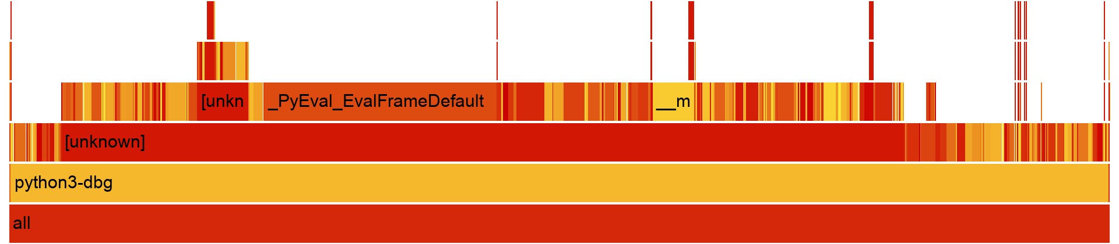
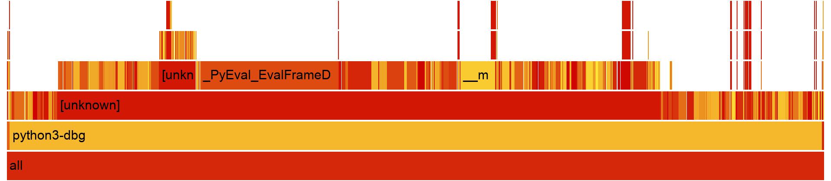
Profiling: flame graphs before and after
Before: 1,380,705 samples
After: 539,715 samples
Share | Frame
21.08% | _PyEval_EvalFrameDefault
1.47% | list_dealloc
0.88% | list_ass_slice
Share | Frame
16.89% | _PyEval_EvalFrameDefault
0.19% | list_dealloc
0.30% | list_ass_slice
Part B · pyflate
22
Notes:
Bottom rows of the pyflate flame graphs. Samples fall by 61 percent. List slicing and list frees shrink, which matches removing the scan and the list rebuild. In the optimized run re and memory-copy functions appear, as expected.

Slide 23
Bottlenecks: the code behind the hotspots
bm_pyflate/run_benchmark.py · find_next_symbol
linear scan per symbol
move_to_front
224 def find_next_symbol(self, field, reversed=True):
225 cached_length = -1
226 cached = None
227 for x in self.table:
228 if cached_length != x.bits:
229 cached = field.snoopbits(x.bits)
230 cached_length = x.bits
231 if ... x.symbol == cached:
232 field.readbits(x.bits)
288 def move_to_front(l, c):
289 l[:] = l[c:c+1] + l[0:c] + ...
Root causes
Algorithmic: search cost grows with table size
Bit reader pulls one byte at a time
Byte-level Python loops create many objects
bm_pyflate/run_benchmark.py · final RLE
one object per byte
449 while i < len(nearly_there):
454 else:
455 out.append(nearly_there[i:i + 1])
456 i += 1
Part B · pyflate
23
Notes:
find_next_symbol runs once per decoded symbol and scans the code table. move_to_front builds a new list each time. The RLE loop creates one small bytes object per output byte.

Slide 24
Optimization: four changes, still pure Python
# | Change | What it removes | Cost addressed
1 | Huffman lookup table | Scan over the code table | Algorithmic
2 | 8-byte refill, local bit state | Per-byte reads, method calls | Call overhead
3 | move_to_front with pop and insert | New list per symbol | Allocation
4 | RLE with re, copy slices | One bytes object per output byte | Allocation, loop cost
opt_pyflate/run_benchmark.py · main decode loop
one list lookup
464 width = t.fast_bits
465 entry = t.fast[(bitfield >> (nbits - width)) & ((1 << width) - 1)]
466 if entry:
467 r = entry >> 5
468 nbits -= entry & 31
Part B · pyflate
24
Notes:
We kept the decoder in Python. We did not replace it with the bz2 module, because that would remove the code under study. Each change maps to a root cause on the previous slide.

Slide 25
How the lookup table works
Symbol | Code | Length
A | 0 | 1
B | 10 | 2
C | 110 | 3
D | 111 | 3
000
001
010
011
100
101
110
111
A
len 1
A
len 1
A
len 1
A
len 1
B
len 2
B
len 2
C
len 3
D
len 3
Next bits 101... index 5: B, consume 2 bits. One step, no scan.
Toy example, 3-bit table
In our decoder
Why it is safe near the end
Width: min(longest code, 10 bits)
Entry: (symbol << 5) | code length
Longer codes: one dict per length
Longest code is 20 bits
At least 80 bits follow every block
So peeking cannot pass the end of the stream
Part B · pyflate
25
Notes:
Toy example with four codes and a 3-bit table. Every index that begins with a code stores that symbol and its length. The next 3 bits index directly: no scan. Our table uses 10 bits, and longer codes use one dict per length.

Slide 26
Results: pyflate runs 3.32x faster
Check | Result
Speedup | 3.32x
Runtime reduction | 70%
perf samples, python3-dbg | 1,380,705 to 539,715
Target | At least 7%
MD5 of the output | Passes on every run
bz2 cross-check | 14 of 14 inputs match
Mean ± std dev (pyperf)
18.5 s
original, ± 1.6 s
5.6 s
optimized, ± 1.2 s
An algorithmic change gives more room than removing interpreter overhead alone.
Part B · pyflate
26
Notes:
Official pyperf comparison in the VM. MD5 passes on every run. The optimized decoder also matched the bz2 module on 14 test inputs, including multi-block files.

Slide 27
Results: hardware counters for pyflate
Counter | Original | Optimized | Change
Instructions | 21.42 G | 7.05 G | 3.04x fewer
Cycles | 8.06 G | 2.64 G | 3.06x fewer
IPC | 2.66 | 2.67 | same
Branches | 4.27 G | 1.33 G | 3.21x fewer
Cache-miss rate | 4.68% | 0.95% | lower, noisy
Branch-miss rate | 0.34% | 0.48% | higher
How it was measured
tangerine host, Xeon E5-2690 v4
perf stat -r 5, 3 loops
Pinned to one core
Not in the VM
IPC did not change: the speedup comes from executing fewer instructions.
Part B · pyflate
27
Notes:
The VM does not support hardware counters, so these come from perf stat directly on the tangerine host, with 5 repeats of 3 loops pinned to one core. IPC stays the same, so the speedup comes from executing fewer instructions. Times on the other slides are from the VM, so do not mix the two.

Slide 28
Conclusions
Measure first
Software first
Transfers decide
Profiles showed where the extra work was, and reading the code linked it to Python.
Removing work gave 1.52x on raytrace and 3.32x on pyflate, with no new hardware.
An accelerator needs batching: the upper bound is 1.40x after optimization.
Open limits
Repository
200 MHz is a design target: no synthesis
Back-pressure is not tested
Transfer costs are not measured
github.com/muhameedm/hw-sw-codesign-project
Thank you. Questions?
Notes:
Close with the three lessons and the open limits, then take questions.

