Slide 1

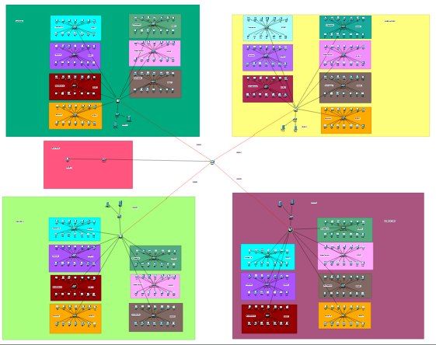
Inter-campus Network Communication
CCN Lab Fall 2024: CEA Final Presentation
Department of Electrical Engineering, B-SEAS
1

Slide 2


Meet our Team
Muhammad
Shahnoor Shahzad
Configuration and Website development
Network Design and
Logical Planning
Department of Electrical Engineering, B-SEAS
2

Slide 3
Table of Contents
Part 1
Problem Statement
Part 2
Objectives
Part 3
Block Diagram
Part 5
Flowchart
Part 6
Simulations
Part 7
Hardware Design
Part 8
Timeline
Department of Electrical Engineering, B-SEAS
3

Slide 4
Problem Statement
Bahria University has multiple campuses in Karachi, Lahore, E-8, and H-11.
No current scalable network supports this across Karachi, Lahore, E-8, and H-11.
Lack of strict access control risks unauthorized lab access.
No campus-specific websites exist for localized services.
Project aims to build a secure network with controlled lab communication and dedicated websites for each campus
Department of Electrical Engineering, B-SEAS
4

Slide 5

Objectives:
Objective 1
Objective 2
Rector's Computer
Routing Configuration
(RIP)
Department of Electrical Engineering, B-SEAS
Objective 3
Campus-specific Websites
Objective 4
VLAN Or ACL Implementation
5

Slide 6
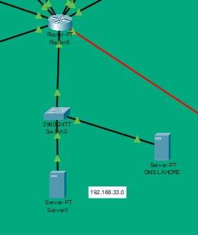
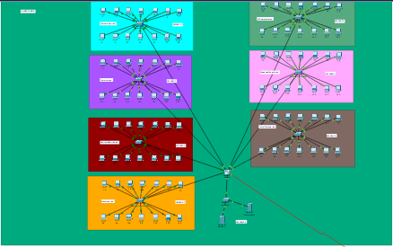
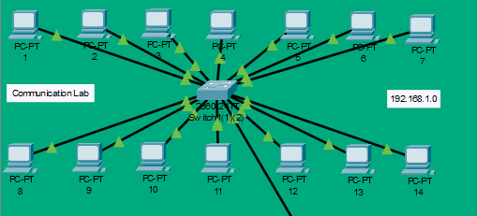
Block Diagram
Department of Electrical Engineering, B-SEAS
6

Slide 7
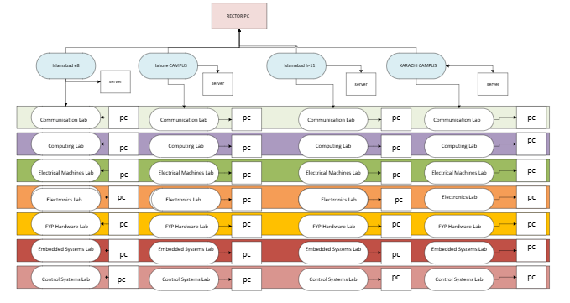
Flowchart
Department of Electrical Engineering, B-SEAS
7

Slide 8
Process Flow
Inter-Campus Routing via OSPF/RIP:
Centralized Administration (Rector’s PC):
Campus-Specific Web Services:
Access Control Enforcement (ACLs):
Routers at each campus exchange routing information using OSPF or RIP protocols. This dynamic routing enables efficient path selection and connectivity between campuses while adapting to network changes.
A dedicated Rector’s computer is connected with administrative privileges, enabling it to access and manage all labs across all campuses. This central point facilitates network monitoring, troubleshooting, and policy enforcement
Each campus hosts its own localized website accessible only within its VLAN and subnet. This ensures students and staff receive tailored information and services relevant to their campus without exposure to other campuses’ networks.
ACLs are configured on routers to strictly control traffic flow, allowing communication only between identical labs across different campuses. Unauthorized cross-lab traffic is blocked to maintain security and data integrity.
Department of Electrical Engineering, B-SEAS
8

Slide 9
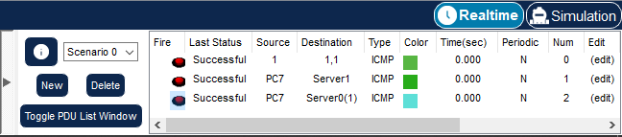
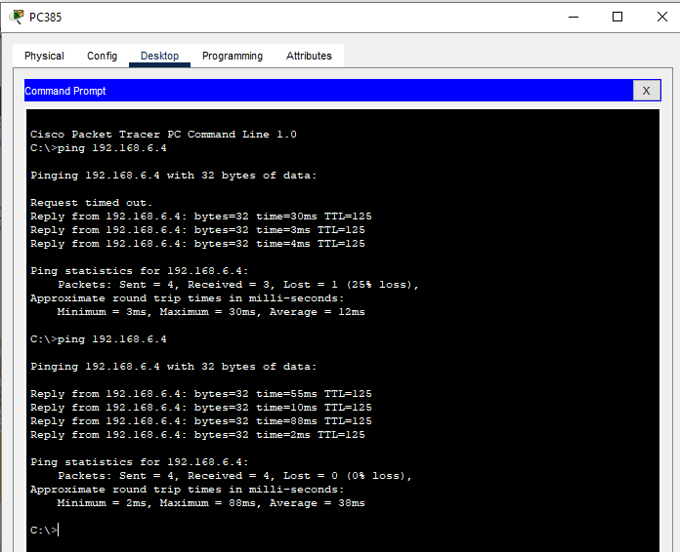
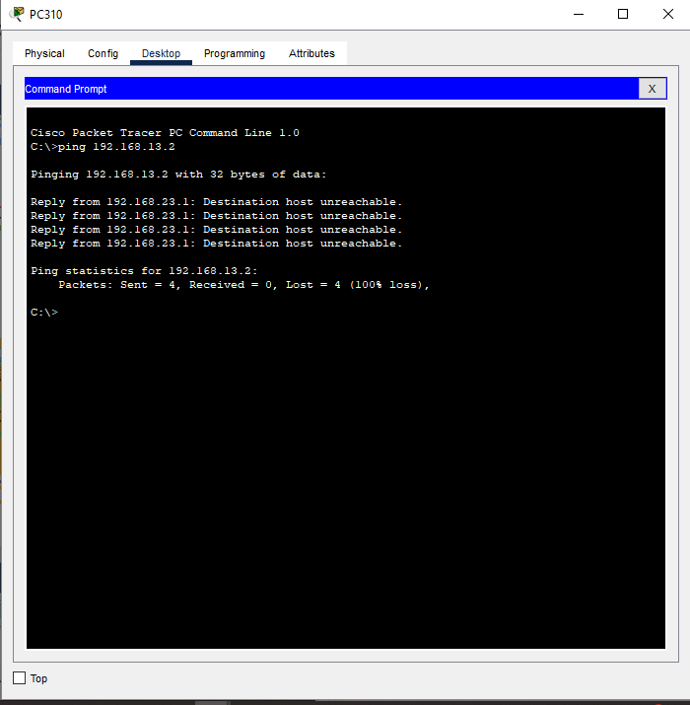
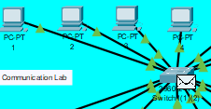
Results: -
Fig 1: Ping Results of Same Type of Lab PCs
Fig 2: Ping Results of Different Type of Lab PCs
Department of Electrical Engineering, B-SEAS
9

Slide 10
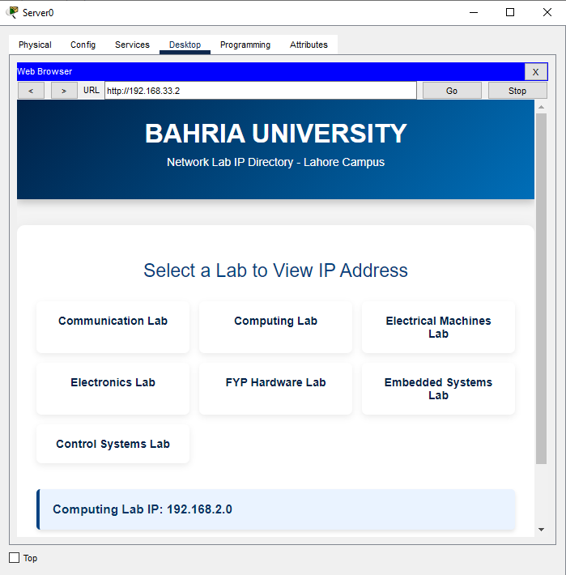

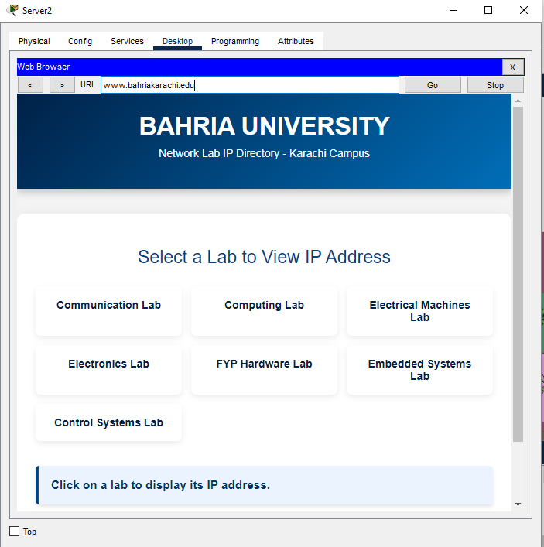
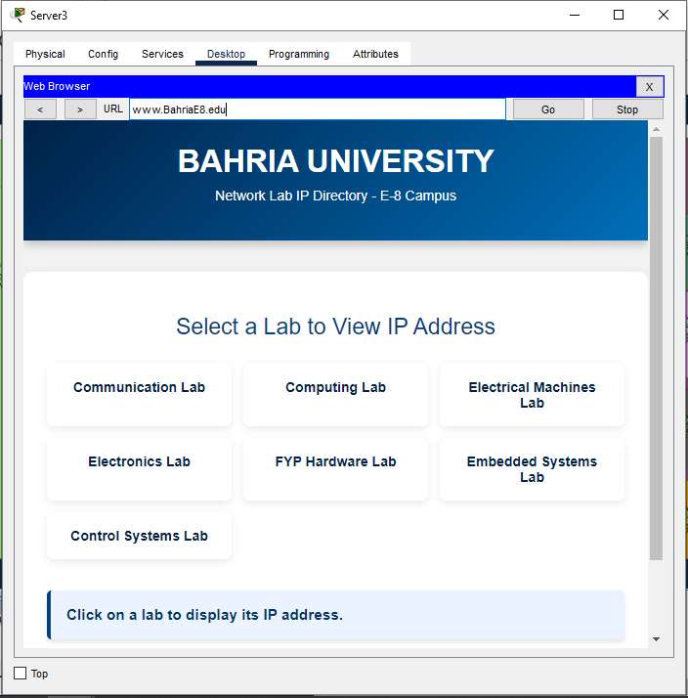
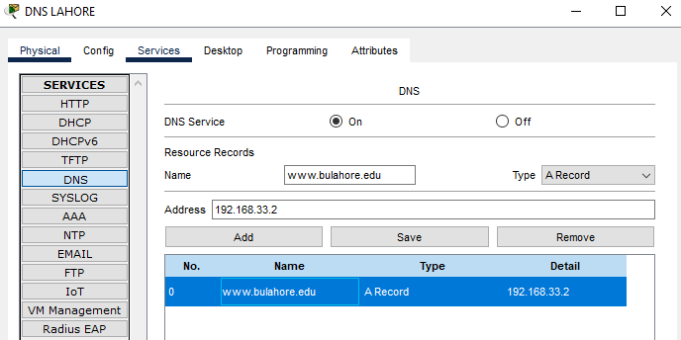
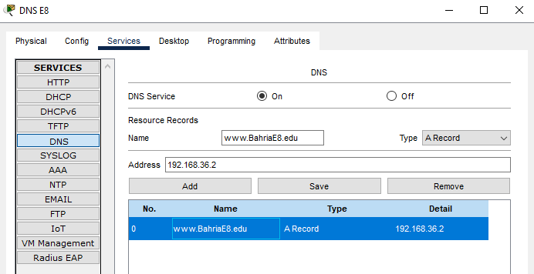
Website
Lahore , H-11 , E-8 , Karachi
DNS SERVER
Department of Electrical Engineering, B-SEAS
10

Slide 11
Labs
🔗 Interconnection (Serial Links)
Serial Link | IP Address Range
Serial 1 | 192.168.29.0
Serial 2 | 192.168.30.0
Serial 3 | 192.168.31.0
Serial 4 | 192.168.32.0
🧮 Lab-Wise IP Address Table for All Campuses
Lab Name | Color Box | Campus 1 (E-8) | Campus 2 (H-11) | Campus 3 (Lahore) | Campus 4 (Karachi)
Communication Lab | Sky Blue | 192.168.1.0 (1.1) | 192.168.8.0 (8.1) | 192.168.15.0 (15.1) | 192.168.22.0 (22.0)
Computing Lab | Purple | 192.168.2.0 (2.1) | 192.168.9.0 (9.1) | 192.168.16.0 (16.1) | 192.168.23.0 (23.0)
Electrical Machines Lab | Red | 192.168.3.0 (3.1) | 192.168.10.0 (10.1) | 192.168.17.0 (17.1) | 192.168.24.0 (24.0)
Electronics Lab | Yellow | 192.168.4.0 (4.1) | 192.168.11.0 (11.1) | 192.168.18.0 (18.1) | 192.168.25.0 (25.0)
FYP Hardware Lab | Green | 192.168.5.0 (5.1) | 192.168.12.0 (12.1) | 192.168.19.0 (19.1) | 192.168.26.0 (26.1)
Embedded Systems Lab | Pink | 192.168.6.0 (6.1) | 192.168.13.0 (13.1) | 192.168.20.0 (20.1) | 192.168.27.0 (27.1)
Control Systems Lab | Brown | 192.168.7.0 (7.1) | 192.168.14.0 (14.1) | 192.168.21.0 (21.1) | 192.168.28.0 (28.1)
🌐 Server Switch Subnets
Server Location | IP Address Range
Server 1 | 192.168.33.0
Server 2 | 192.168.34.0
Server 3 | 192.168.35.0
Server 4 | 192.168.36.0
🧑‍💼 Rector’s PC
Device | IP Address
Rector’s PC | 192.168.37.2
Department of Electrical Engineering, B-SEAS
11

Slide 12
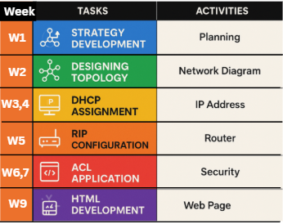
Project Timeline: -
Department of Electrical Engineering, B-SEAS
12

Slide 13
Thank you: Question & Answer Session
Muhammad
Shahnoor shahzad
Department of Electrical Engineering, B-SEAS

