Slide 1
SignVision AI
Sign-language image classification with deep learning
[YOUR NAME] · [UNIVERSITY NAME]

Slide 2



PROJECT OVERVIEW
SignVision AI turns hand signs into predictions
A computer-vision system recognizes sign-language gestures from images and returns a predicted class.
Focus
Core stack
Accessible, real-time sign recognition.
MobileNetV2, FastAPI, and a lightweight frontend.

Slide 3



WHY THIS MATTERS
Communication barriers make sign recognition worth solving
When manual interpretation is unavailable, assistive vision can support faster interaction and learning.
Reduce friction
Lower the barrier to experimentation
Clearer paths between signers and non-signers.
Make sign-language AI easier to explore and learn from.

Slide 4

SCOPE
The project targets focused recognition, not full language translation
The system answers a narrower question: which one of 29 known classes appears in this image?
OBJECTIVE
SCOPE
LIMITS
Classify one image
Image-based prediction
Bounded vocabulary
Map a hand-sign image to one of 29 classes.
Run predictions through a simple web interface.
Fixed classes, image-quality dependence, and no sentence-level translation.

Slide 5
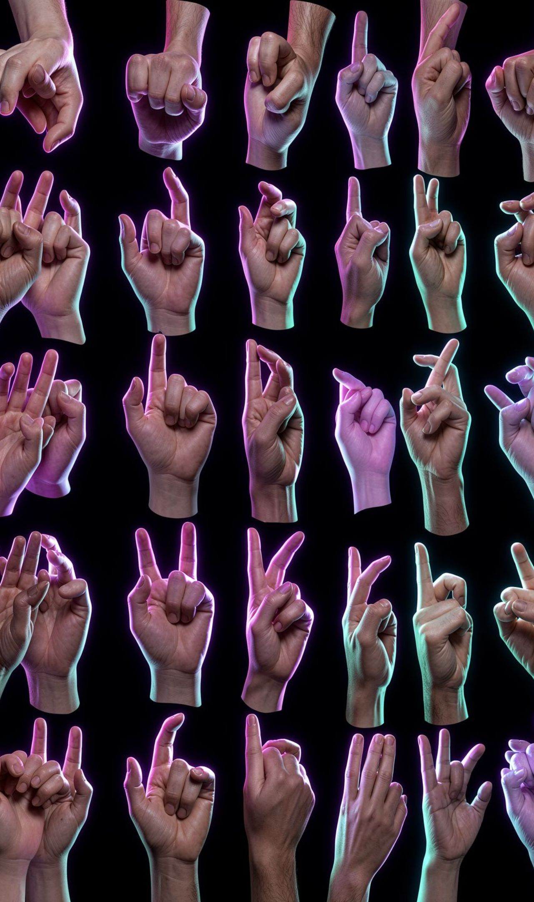


DATASET
87,000 images support 29 gesture classes
A large labeled image dataset supports supervised classification across the project’s 29-class vocabulary.
87,000
29
labeled images
gesture classes
Used to train, validate, and test the recognition pipeline.
Dataset split details: [train / validation / test split]

Slide 6
METHODOLOGY
The workflow moves from image input to class prediction
01
02
03
04
05
Collect
Prepare
Train
Validate
Predict
Gather and label gesture images.
Preprocess and resize each input.
Fit the classifier on the dataset.
Measure performance and export the model.
Send a new image through the API.

Slide 7






MODEL DESIGN
MobileNetV2 extracts features before classification
The efficient convolutional backbone turns image pixels into a useful feature representation. A classification head then maps that representation to the 29 target classes.
Input image
MobileNetV2
Classification head
Resized gesture image.
Pretrained convolutional feature extractor.
Pooling, regularization, and final class probabilities.
Design goal: strong accuracy with practical inference cost.

Slide 8



SYSTEM DESIGN
The system connects a simple frontend to a FastAPI inference layer
FRONTEND
BACKEND
MODEL
Upload & display
FastAPI inference
MobileNetV2 classifier
Accepts the image and sends a request; shows prediction and confidence in the interface.
FastAPI endpoint loads the trained model for inference.
Trained model classifies the uploaded image.

Slide 9

IMPLEMENTATION
The implementation keeps training and deployment modular
1
2
3
4
5
Prepare data
Train model
Save artifacts
Expose API
Serve results
Training code builds, fine-tunes, and evaluates the model.
FastAPI service exposes prediction endpoints.
Data and preprocessing scripts prepare the images.
Saved model artifacts power inference.
Frontend handles the user interaction.
Technologies: Python, TensorFlow/Keras, FastAPI, and frontend web tools. · GitHub repository: [GitHub Repository URL]

Slide 10
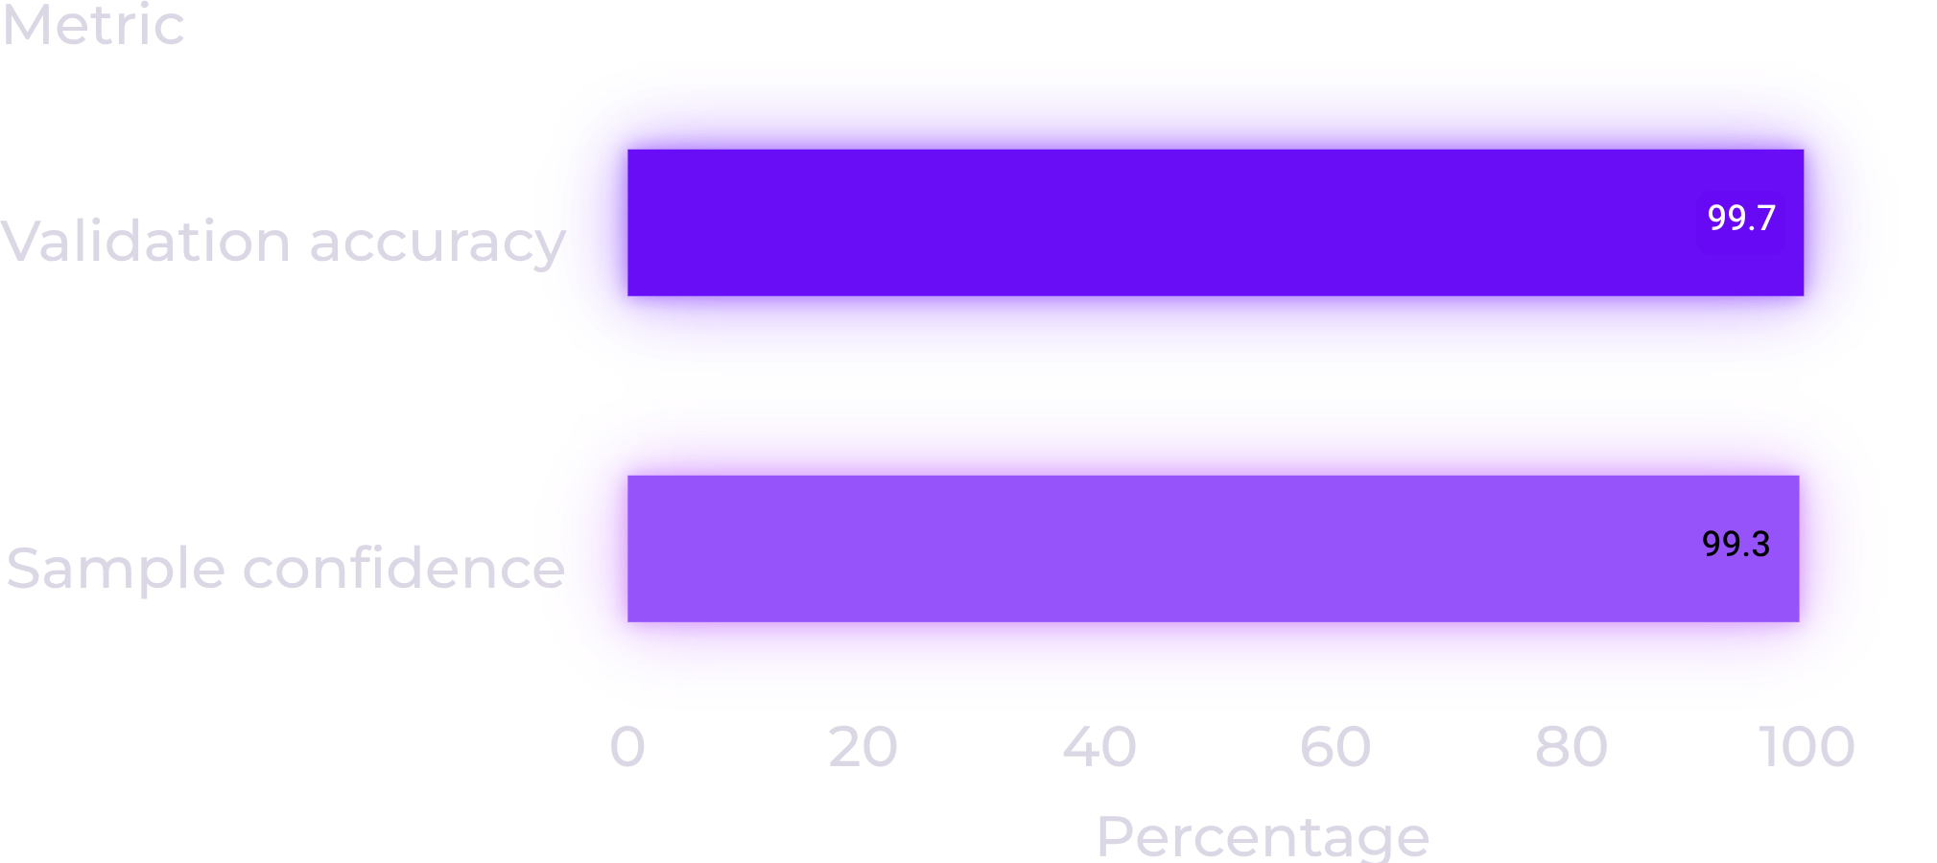
EVALUATION
The model reached 99.67% validation accuracy
99.67%
Validation accuracy
The current pipeline shows strong performance on the evaluated data.
99.28% sample prediction confidence
Reference URLs: [Reference URLs]

