Slide 1

This Photo by Unknown Author is licensed under CC BY-SA-NC

Slide 2

Salary Calculation System
Group members
1. Talha Sheikh
2. Furqan Waseem
3. Zafar Qureshi
4. Syed Muzamil Ali Kazmi

Slide 3
Introduction
In this “Salary Calculation System” ,we used login system so no one can access our system expect the one who has access of using that system and than our system is taking basic info. of all the designations in the company and calculating the bonus,tax deduction and net salary of the requied designation.

Slide 4
Header files
There are four header file used in this program :
1. #include <iostream>
This is used for taking input/output from the user.
2. #include <fstream>
This header file is used for reading and writing purpose from the text file.
3. #include <stdio.h>
This header file is used for clearing the screen.
4. #include <windows.h>
This is used for invoking sleep function.

Slide 5
Login system
Only CEO has access to enter in the system.
First of all it will ask the user to enter password and than program will read the password from the password.txt from the back end of the program.
If the user enters the wrong password at first then it will ask the user to enter the password again. And there is four chances left and if the user enters password all time wrong than it will display reset Screen and you have to wait for five second

Slide 6
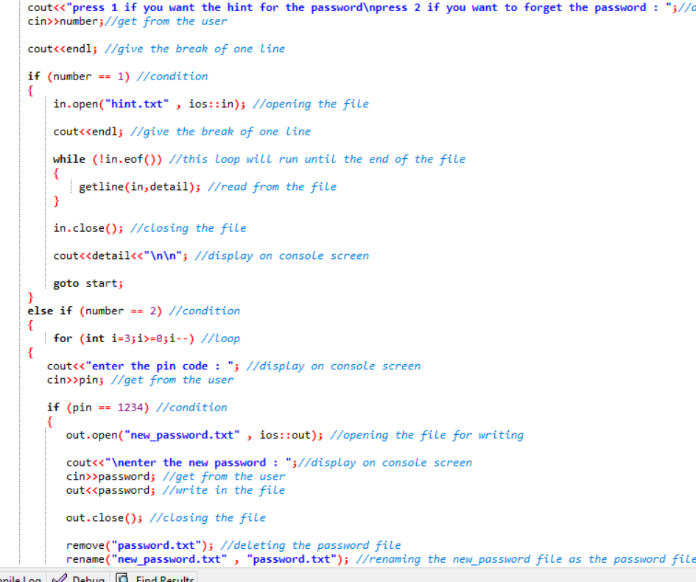
Wrong Pin
If user enters the 1 it will ask the pin code.
If user enters the wrong pin it will displays that you have 3 chances left.
It will show that the system is locked
If user enters the correct pin code It will ask the user to enter the new password and displays to restart the program.

Slide 7
Classes and Functions
We used two classes in the program:
class Desiginfo
class Salaryinfo
Member functions of the classes:
1. void setname ()
2. void getname()
3. void setcity()
4. void getcity()
5. void setCnic()
6. void getCnic()
7. void calcsalary()

Slide 8
Variables
String type variables:
ceo_name, asst_name, hr_name, clerk_name, recpt_name, prob_name;
ceo_city, asst_city, hr_city, clerk_city, recpt_city, prob_city, ceo_cnic;
Float type variables:
bonus_ceo, bonus_asst, bonus_hr, bonus_clerk, bonus_recpt , bonus_prob, ceo_tax, asst_tax,
hr_tax,clerk_tax,recpt_tax,prob_tax, net_sal_ceo, net_sal_asst, net_sal_hr, net_sal_clerk, net_sal_recpt,
net_sal_prob;
Int type variables:
choice, bsal_ceo,int bsal_asst, int bsal_hr, bsal_clerk, bsal_recpt, bsal_prob;

Slide 9
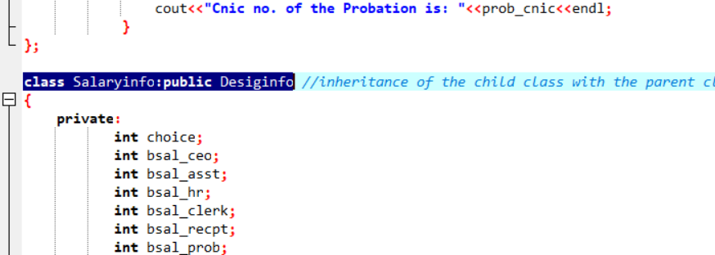
Inheritance
Syntax for inheritance:
class Salaryinfo:public Desiginfo
Here we did inheritance of the child class with the parent class,for increasing the reuseability of the program.

Slide 10
Designations
CEO
Assistant
HR
Clerk
5. Receptionist
6. Probation

Slide 11
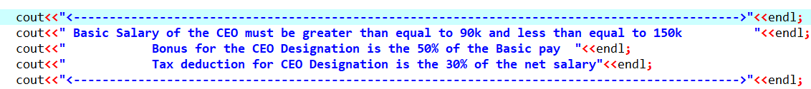
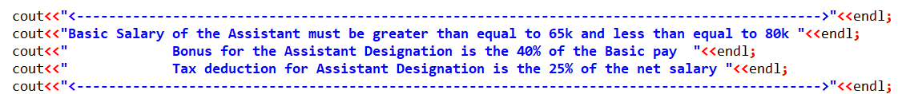
Salary Scenario of Designations
Salary Scenario of the CEO:
Salary Scenario of the Assistant:

Slide 12
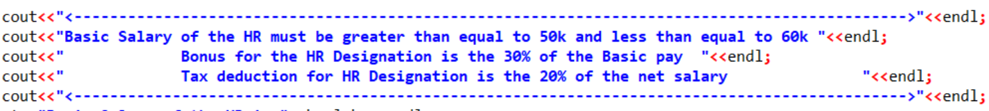
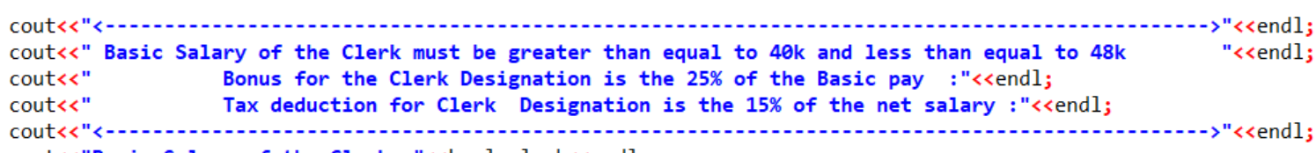
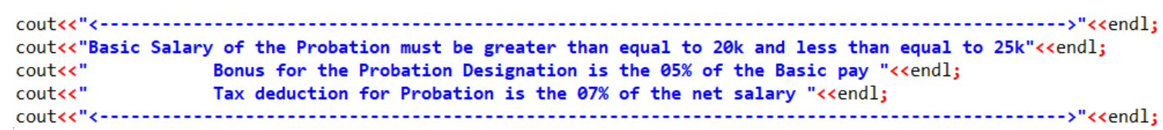
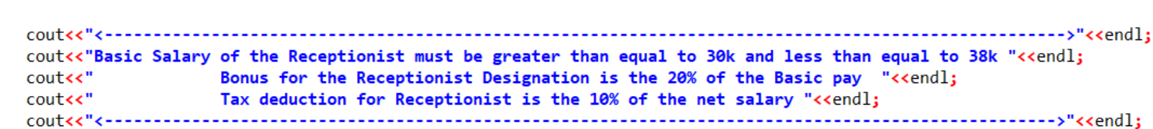
Salary Scenario of the HR:
Salary scenario of clerk :
Salary scenario of probation :
Salary scenario of receptionist :

Slide 13
Thank you
Any question ?

