Slide 1

FCFS Scheduler

Slide 2
Group Members
Muhammad Furqan Waseem (28)
Syed Muzamil Ali Kazmi (30)
Syed Hamza Ilyas (32)
Muhammad Talha Sheikh (44)

Slide 3
Introduction
Scheduler
Scheduler is the system software which handles the process handling. The main purpose of the scheduler is to select which process to run. There are three types of schedulers.
Short term scheduler
Middle term scheduler
Long term scheduler
Algorithm
There are multiple types of scheduler algorithms.
FCFS (First Come First Serve)
SJN (Short Job Next) Scheduling
Priority Scheduling

Slide 4
FCFS (First Come First Serve)
This algorithm will create the queue and store the processes in the queue than executes them turn wise. This will store the starting of the process. This is the simplest and easiest scheduler algorithm. See table (3.3) for the understanding of FCFS.
Processes | Burst Time | Waiting Time | Turn Around Time
P1 | 33 | 0 | 33
P2 | 5 | 33 | 38
P3 | 1 | 38 | 39
P4 | 55 | 39 | 94

Slide 5
FCFS (First Come First Serve)
Working
Algorithm
In this a queue is created and processes are stored in it. CPU calculates the burst time. Waiting time of the first process is 0 than waiting time of all the processes are the sum of the waiting and burst time of the previous process. Turn around time is the sum of current burst and waiting time.
Insert burst time of all processes
The waiting time of first process is zero
Find the waiting time of all the processes
waitingTime[i] = burstTimep[i – 1] + waitingTime[i – 1]
Find the turn Around Time
turnAroundTime[i] = waitingTime[i] + burstTimep[i]
Find average waiting time
Average = totalWaitingTime/No.OfProcesses
Find the average turn around Time
Average = totalTurnAroundTime/No.OfProcesses

Slide 6
Class diagram
Our project mainly based on the working of FCFS. We created two classes.
Student
Algorithm
Student
-read : ifstream -write : ofstream -name : string - grade : string -readData : string -marks : float -counter : int -store : int -flag : int -rollNumber : int -deleteCounter : int
+Student() +insertStudentData() : void +readStudentData() : void +deleteStudentData() : void +searchStudent() : void +getFlag() : int +numberOfLine() : int
Algorithm
-processes[100] : string -waitingTime[100] : double -burstTime[100] : double -turnAroundTime[100] : double -length : int
+Algorithm() : void +getBurstTimeAndProcess() : void +fcfsWorking() : void +display() : void +getLength() : int

Slide 7
FCFS (First Come First Serve)
Libraries
Class Student
In this project we used following libraries
Iostream (For Input & Output)
Fstream (For File Handling)
Chrono (For Time Handling)
Stdlib.h (For Clearing Screen)
Algorithm (For Count Function)
Student class contains 6 functions
Insert Student Data
Read Student Data
Delete Student Data
Search for Student Data
Number of lines
Get Flag

Slide 8
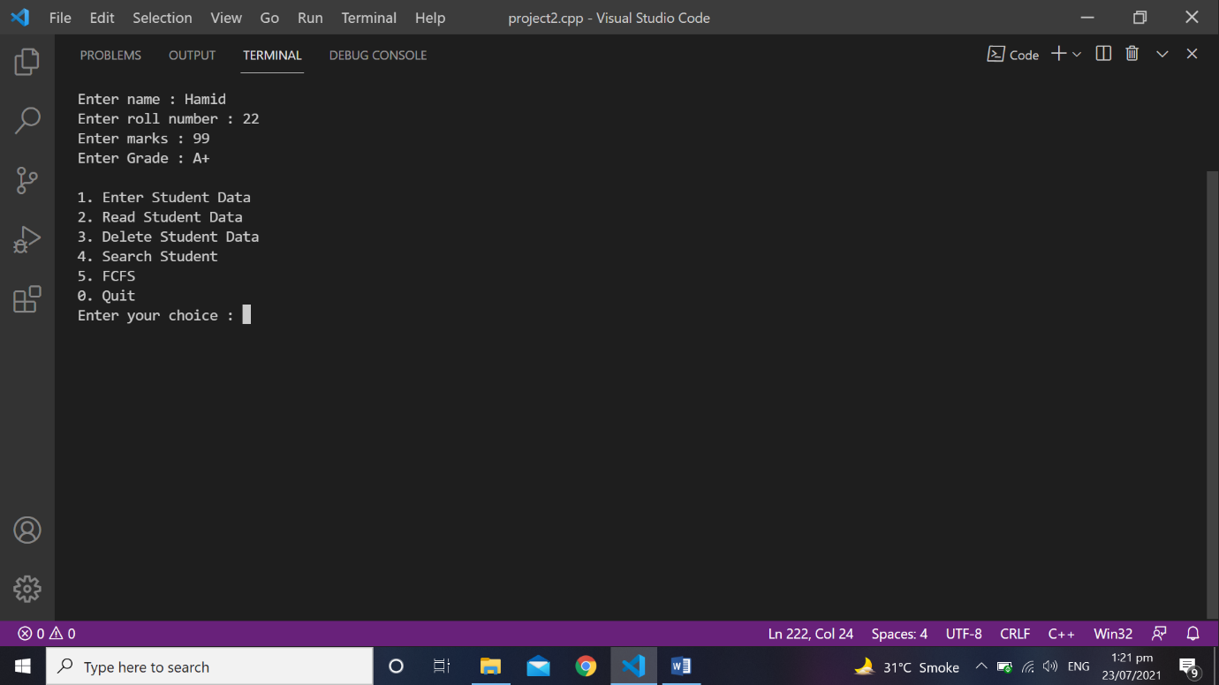
Insert Student Data
Code
Output
void insertStudentData (string Name , string Grade , float Marks , int RollNumber)
{
name = Name;
grade = Grade;
marks = Marks;
rollNumber = RollNumber;
write.open("studentData.txt" , ios::app);
write << name << endl;
write << grade << endl;
write << marks << endl;
write << rollNumber << endl;
write.close();
}

Slide 9
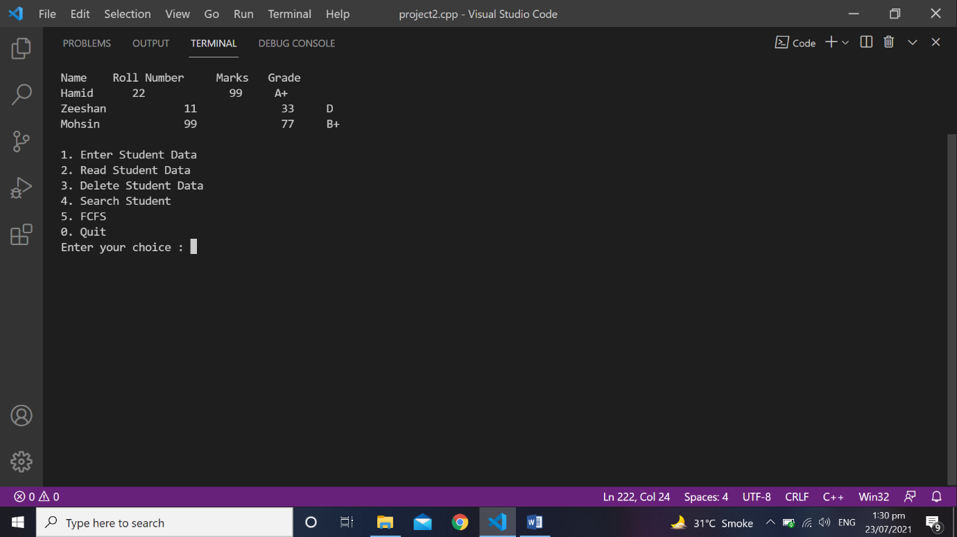
Read Student Data
Code
Output
void readStudentData()
{ store = numberOfLine()/4;
if(store ==
{ cout << "File is empty" << endl;
return; }
read.open("studentData.txt");
cout << "Name" << "\t" << "Roll Number" << "\t" << "Marks" << "\t" << "Grade" << endl;
for(int i = 1 ; i <= store ; i++)
{ read >> name;
read >> grade;
read >> marks;
read >> rollNumber;
cout << name << " \t " << rollNumber << " \t " << marks << " \t " << grade << endl;}
read.close(); }

Slide 10
Delete Student Data
Code
void deleteStudentData(int RollNumber)
{ flag = 0;
store = numberOfLine()/4;
if(store == 0)
{ cout << "File is empty" << endl;
return }
read.open("studentData.txt");
write.open("temp.txt" , ios::app);
for(int i = 1 ; i <= store ; i++)
{ read >> name;
read >> grade;
read >> marks;
read >> rollNumber;
if(RollNumber == rollNumber)
{ cout << endl;
cout << name << endl;
cout << rollNumber << endl;
cout << marks << endl;
cout << grade << endl;
cout << "***********************************" << endl;
cout << "* Above student record is deleted *" << endl;
cout << "***********************************" << endl;
flag = 1; }
else
{ write << name << endl;
write << grade << endl;
write << marks << endl;
write << rollNumber << endl;} }
read.close();
write.close();
remove("studentData.txt");
rename("temp.txt" , "studentData.txt") }

Slide 11
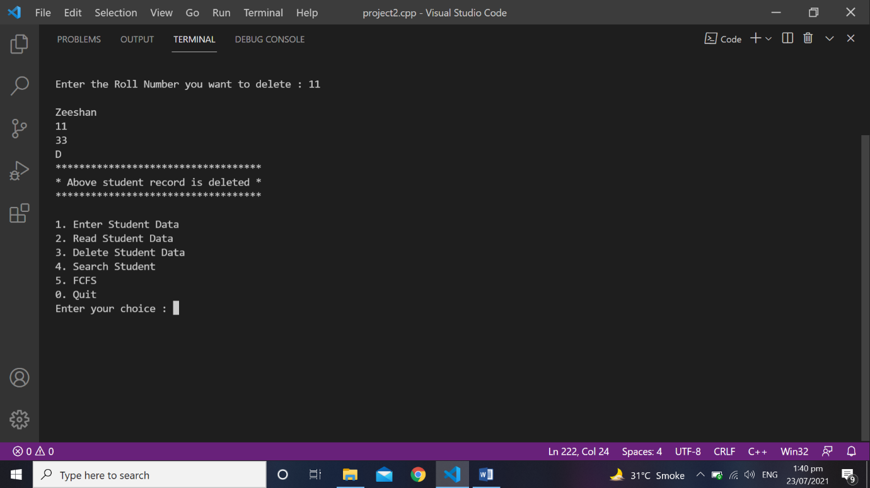

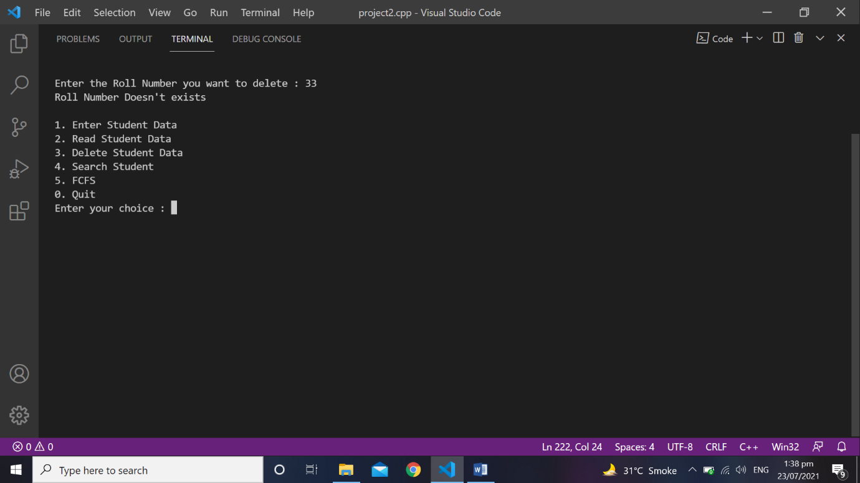
Delete Student Data
Output

Slide 12
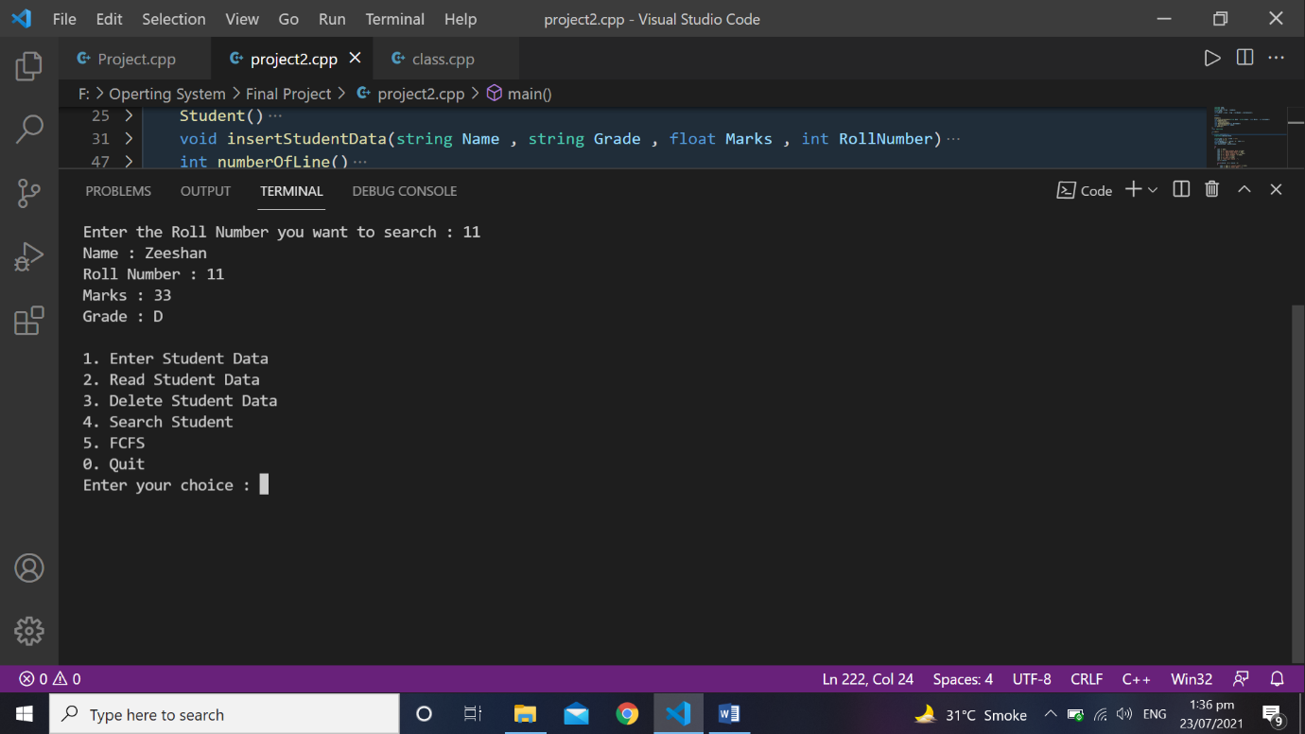

Search Student Data
Code
Output
void searchStudent(int index)
{ flag = 0;
read.open("studentData.txt");
while(!read.eof())
{ read >> name;
read >> grade;
read >> marks;
read >> rollNumber;
if(rollNumber == index)
{ cout << "Name : " << name<< endl;
cout << "Roll Number : " << rollNumber << endl;
cout << "Marks : " << marks << endl;
cout << "Grade : " << grade << endl;
flag = 1;
break; } }
read.close(); }

Slide 13
number of lines & get flag
Number of Lines
Get Flag
This function calculates the total number of lines stored in the file and return that total number of lines which are further used in read and delete function.
Code
int numberOfLine()
{ counter = 0;
read.open("studentData.txt");
while(getline(read , readData))
{ counter++; }
read.close();
return counter; }
This function returns the value of flag.
Code
int getFlag()
{
return flag;
}

Slide 14
Algorithm
This class is used for FCFS scheduler. It contains 4 functions.
Get burst time and processes
FCFS working
Display
Get Length

Slide 15
Algorithm
Get burst time and processes
Get Length
This function takes the processes and time taken by the process as the parameters and store the processes in the process array and time in the burst time array.
Code
void getBurstTimeAndProcess(string process , double time)
{
++length;
processes[length] = process;
burstTime[length] = time; }
This function returns the length. Length is the total number of entries done in the array.
Code
int getLength()
{
return length;
}

Slide 16
Algorithm
FCFS Working
Display
In this function main working of FCFS (First Come first Serve) is done. This function take the total number of entries as the parameters.
Code
void fcfsWorking(int size)
{
waitingTime[0] = 0.0;
for(int i = 1 ; i < size ; i++)
{
waitingTime[i] = burstTime[i - 1] + waitingTime[i - 1];
}
for(int i = 0 ; i < size ; i++)
{
turnAroundTime[i] = waitingTime[i] + burstTime[i];
}
}
Code
void display(int size)
{
double average = 0.0 , sum = 0.0;
cout << "Process Burst Time\t Waiting Time \t Turn Around Time" << endl << endl;
for(int i = 0 ; i < size ; i++)
{
cout << processes[i] << "\t\t" << burstTime[i] << "\t\t" << waitingTime[i] << "\t\t" << turnAroundTime[i] << endl;
}
for(int i = 0 ; i < size ; i++)
{
sum = waitingTime[i] + sum;
}
average = sum / size;
cout << "Average waiting time is : " << average << endl;
average = 0.0;
sum = 0.0;
for(int i = 0 ; i < size ; i++)
{
sum = turnAroundTime[i] + sum;
}
average = sum / size;
cout << "Average turn around time is : " << average << endl;
}

Slide 17
Int main
This is the main body of the program where objects of the algorithm and student class is created and their functions are called. Our main possesses a menu with 5 choices which we discuss above.
Code
int main()
{
Student objStudent;
Algorithum objAlgorithum;
string name = "\0" , grade = "\0";
float marks = 0.0;
int rollNumber = 0 , choice = 0 , index = 0;
double storedTime = 0.0;
char nextPortion , nextPortion1;
do
{
cout << endl;
cout << "1. Enter Student Data" << endl;
cout << "2. Read Student Data" << endl;
cout << "3. Delete Student Data" << endl;
cout << "4. Search Student " << endl;
cout << "5. FCFS" << endl;
cout << "0. Quit" << endl;
cout << "Enter your choice : ";
cin >> choice;
while(choice < 0 || choice > 5)
{
cout << endl << "Invalid input" << endl;
cout << endl << "Enter Again : ";
cin >> choice;
}
system("CLS");
if(choice == 1)
{
auto starting = high_resolution_clock::now();
cout << "Enter name : ";
cin >> name;
cout << "Enter roll number : ";
cin >> rollNumber;
cout << "Enter marks : ";
cin >> marks;
cout << "Enter Grade : ";
cin >> grade;
objStudent.insertStudentData(name , grade , marks , rollNumber);
auto ending = high_resolution_clock::now();
auto duration = duration_cast<milliseconds>(ending - starting);
storedTime = duration.count();
objAlgorithum.getBurstTimeAndProcess("Insert" , storedTime);
}

Slide 18
Int main
else if(choice == 2)
{
auto starting = high_resolution_clock::now();
objStudent.readStudentData();
auto ending = high_resolution_clock::now();
auto duration = duration_cast<milliseconds>(ending - starting);
storedTime = duration.count();
objAlgorithum.getBurstTimeAndProcess("Read" , storedTime);
}
else if(choice == 3)
{
auto starting = high_resolution_clock::now();
if(objStudent.numberOfLine() == 0)
{
cout << "File is empty" << endl;
goto nextPortion;
}
cout << "Enter the Roll Number you want to delete : ";
cin >> index;
objStudent.deleteStudentData(index);
if(objStudent.getFlag() == 0)
{
cout << "Roll Number Doesn't exists" << endl;
}
nextPortion:;
auto ending = high_resolution_clock::now();
auto duration = duration_cast<milliseconds>(ending - starting);
storedTime = duration.count();
objAlgorithum.getBurstTimeAndProcess("Delete" , storedTime);
}
else if(choice == 4)
{
auto starting = high_resolution_clock::now();
if(objStudent.numberOfLine() == 0)
{
cout << "File is empty" << endl;
goto nextPortion1;
}
cout << "Enter the Roll Number you want to search : ";
cin >> index;
objStudent.searchStudent(index);
if(objStudent.getFlag() == 0)
{
cout << "Roll Number Doesn't exists" << endl;
}
nextPortion1:;
auto ending = high_resolution_clock::now();
auto duration = duration_cast<milliseconds>(ending - starting);
storedTime = duration.count();
objAlgorithum.getBurstTimeAndProcess("Search" , storedTime);
}
else if(choice == 5)
{
objAlgorithum.fcfsWorking(objAlgorithum.getLength() + 1);
objAlgorithum.display(objAlgorithum.getLength() + 1);
}
} while(choice != 0);

Slide 19

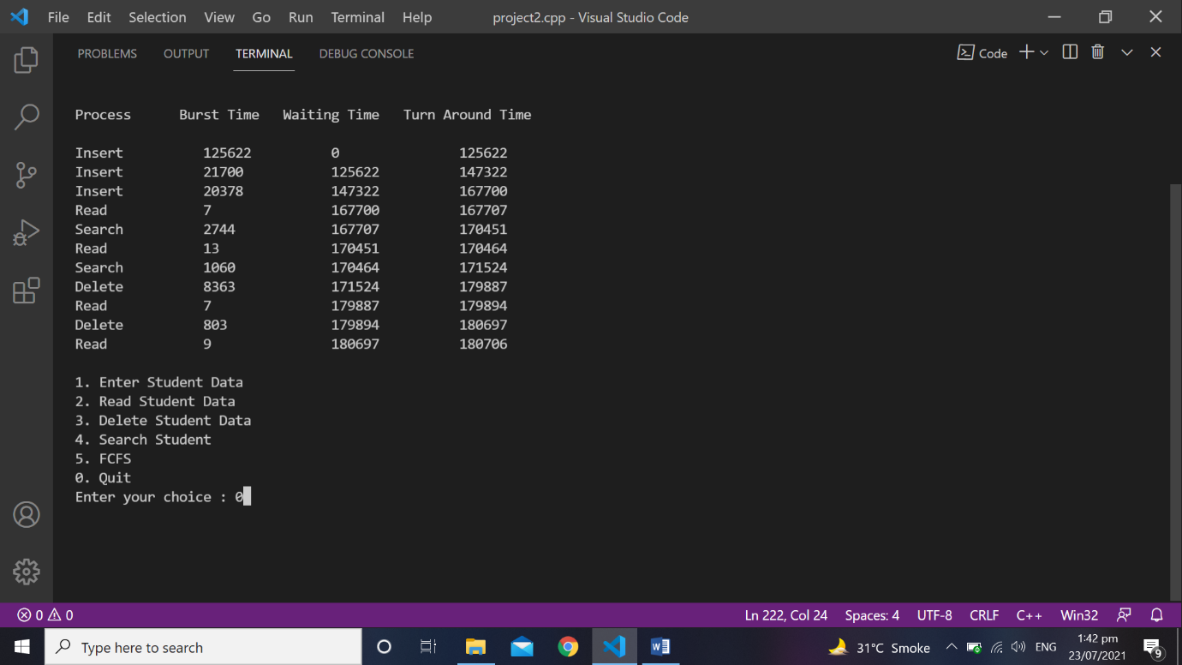
Int main
Output

Slide 20
Summary & references
Summary:
We are working on this project since 16th of July, 2021. This project mainly based on the working of the FCFS (First Come First Serve) scheduler algorithm. There are total 4 processes in this project which are insert, read, delete and search. This project calculates the total time taken (time are calculated in milliseconds) by each process and tells the average waiting time and turn around time.
References:
https://www.tutorialspoint.com/operating_system/os_process_scheduling.htm
https://www.tutorialspoint.com/operating_system/os_process_scheduling_algorithms.htm
https://www.geeksforgeeks.org/program-for-fcfs-cpu-scheduling-set-1/
https://www.programiz.com/cpp-programming/library-function/iostream#:~:text=The%20C%2B%2B%20header%20file,%2C%20cout%2C%20clog%2C%20etc.
https://www.tutorialspoint.com/cplusplus/cpp_files_streams.htm
https://www.geeksforgeeks.org/measure-execution-time-function-cpp/

Slide 21

Thank You

