Slide 1
Design and Verification of a
2-Way Set-Associative Cache Controller
Verilog RTL Project
2-Way Set Associative • LRU • Write-Through • No-Write-Allocate
Cache
Controller
CPU Interface
Cache Store

Slide 2
Project Objective & Scope
Assigned cache configuration
Goal
Implemented Parameters
Design and verify a modular Verilog cache controller that demonstrates hit/miss detection, LRU replacement, Write-Through behavior, and No-Write-Allocate handling.
16 bits
Address width
Cache lines
8 total
Organization
4 sets × 2 ways
Directed simulation only
Clear PASS/FAIL reporting
Simple main memory; FSM only in cache controller
Data per line
32 bits
Replacement
LRU
Write policy
Write-Through
Write miss
No-Write-Allocate
Cache Controller | Verilog RTL | 2/12

Slide 3
Cache Organization
Address mapping and storage
Address Breakdown
4 sets × 2 ways
TAG [15:2]
14 bits
INDEX
[1:0]
Set 0
Way 0
Tag | Data | V
Way 1
Tag | Data | V
Hit condition: valid way + matching tag
Set 1
Way 0
Tag | Data | V
Way 1
Tag | Data | V
Set 2
Way 0
Tag | Data | V
Way 1
Tag | Data | V
Set 3
Way 0
Tag | Data | V
Way 1
Tag | Data | V
1 LRU bit per set
selects replacement victim
No dirty bit
Write-Through policy
Cache Controller | Verilog RTL | 3/12

Slide 4
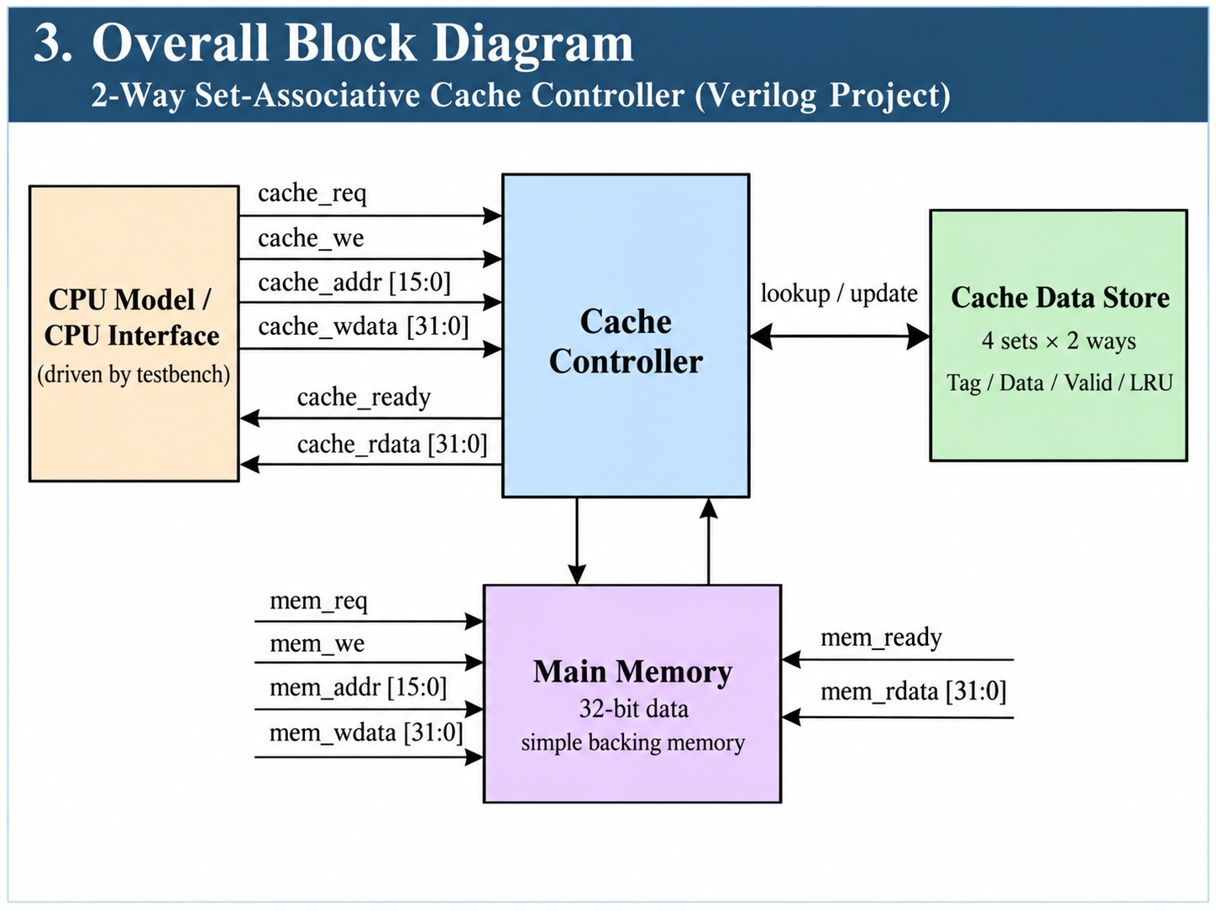
Overall Architecture
Top-level data/control flow
Testbench → CPU model → cache controller → main memory
Cache Controller | Verilog RTL | 4/12

Slide 5
Module Breakdown
What each file does
cpu_model.v
cache_controller.v
main_memory.v
cache_system_top.v
CPU-side adapter
request_sent flag
one cache_req pulse
Core cache logic
hit/miss + LRU
4-state FSM
Backing memory
combinational read
synchronous write
Integration module
connects internal signals
Design decision
Cache controller is the only FSM
Main memory stays simple
Testbench uses read_test() and write_test() tasks
Synthesizable RTL modules:
cpu_model.v, cache_controller.v, main_memory.v, cache_system_top.v
Cache Controller | Verilog RTL | 5/12

Slide 6
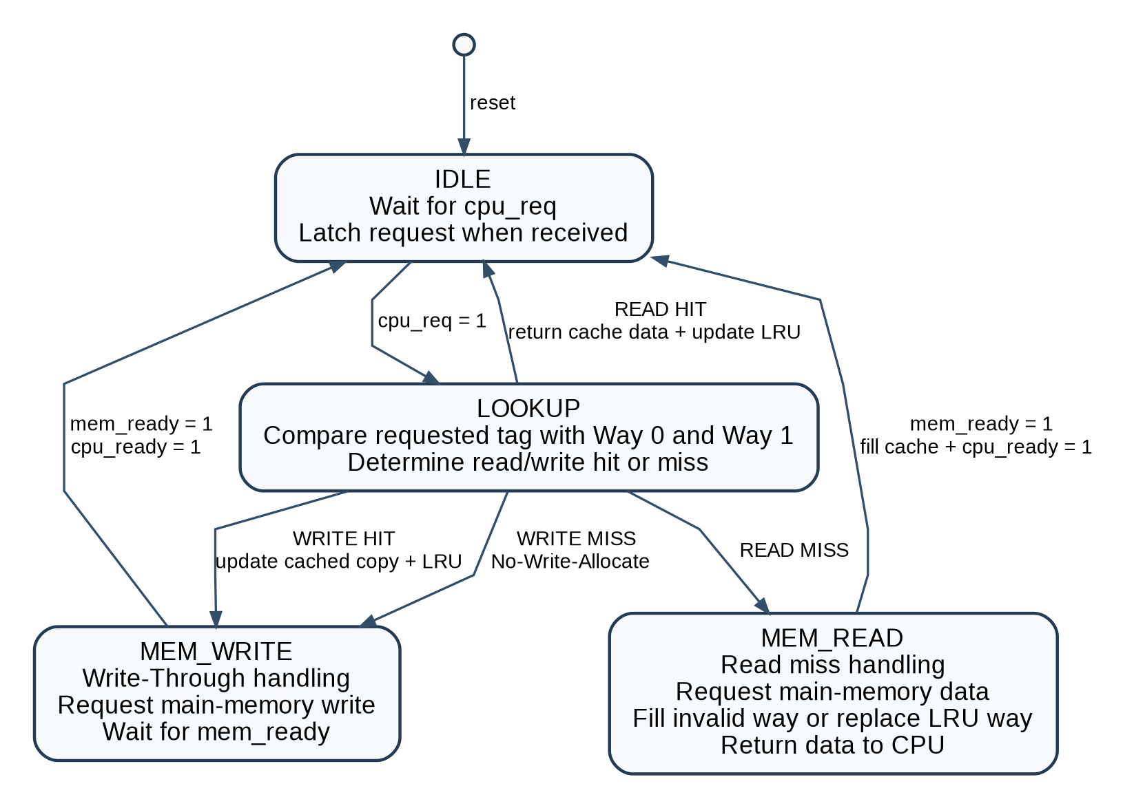
Cache Controller FSM
Four-state control flow
State roles
IDLE: wait for request
LOOKUP: compare both ways
MEM_READ: service read miss
MEM_WRITE: write-through to memory
Write hit and miss both use MEM_WRITE
Only read miss allocates cache line
Cache Controller | Verilog RTL | 6/12

Slide 7
Read Operation
Hit vs miss behavior
READ HIT
READ MISS
Tag matches
valid way
No valid tag
match
Cache data
returned to CPU
Enter MEM_READ
mem_req=1, mem_we=0
Update LRU
No memory read
Fill invalid way
or replace LRU
Return memory data
to CPU
Key check: read hit must produce Memory Read = 0
Key check: read miss must produce Memory Read = 1
Cache Controller | Verilog RTL | 7/12

Slide 8
Write Policy
Write-Through + No-Write-Allocate
Same MEM_WRITE state, different cache action before it.
WRITE HIT
WRITE MISS
Address found in cache
Update cached copy
Update LRU
Enter MEM_WRITE
Main memory updated
Address not cached
Do not update cache
No cache allocation
Enter MEM_WRITE
Main memory updated
CPU never writes memory directly — cache controller forwards mem_addr and mem_wdata.
Cache Controller | Verilog RTL | 8/12

Slide 9
LRU Replacement Example
Set 0 pressure test
Addresses 0x1000, 0x2000, and 0x3000 all map to Set 0.
Read 0x1000
Read 0x2000
Read 0x1000
Read 0x3000
Read 0x2000
MISS
Way filled
MISS
Second way filled
HIT
0x1000 becomes MRU
MISS
Replace LRU = 0x2000
MISS
Eviction confirmed
What this proves
Both ways are used before replacement
LRU metadata changes on a hit
Full set replaces least recently used line
2-way cache needs only one LRU bit per set
Cache Controller | Verilog RTL | 9/12

Slide 10
Verification Strategy
Directed tests with compact reporting
The testbench focuses on observable behavior, not random coverage.
Read tests
LRU tests
miss → hit
multiple hits
read-after-write
second-way fill
hit updates LRU
evicted line misses
Write tests
Miss policy
write hit
multiple write hits
write-through
write miss
no allocation
read after miss
Memory access counters prove:
Read hit → 0 memory reads
Read miss → 1 memory read
Every write → 1 memory write
Cache Controller | Verilog RTL | 10/12

Slide 11
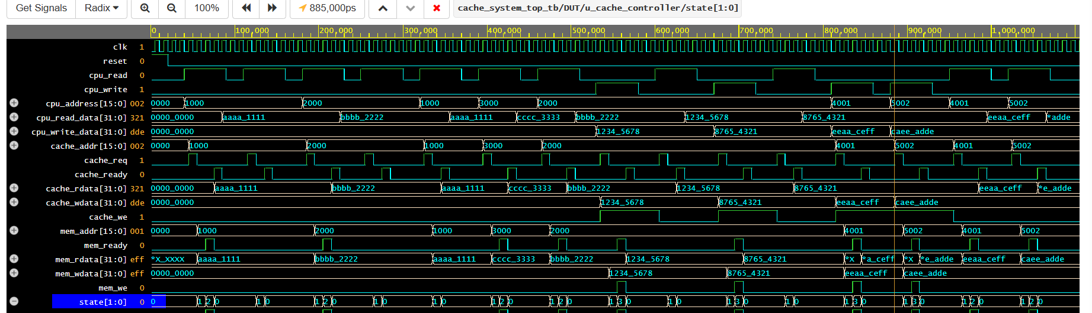
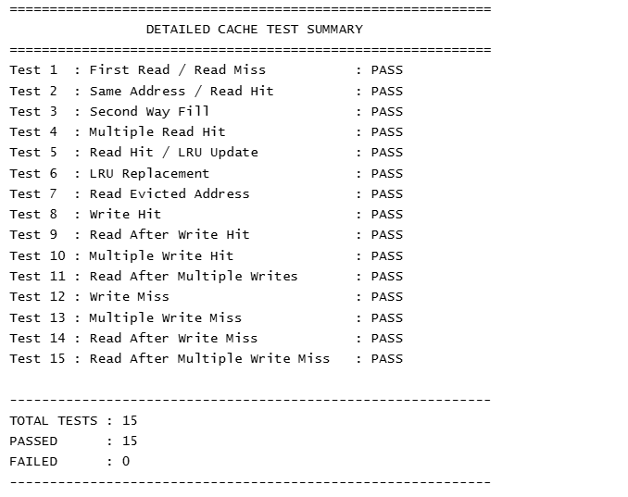
Simulation Evidence
EPWave and console summary
EPWave shows CPU requests, cache request/ready behavior, memory transactions, returned data, and FSM state transitions.
15 / 15 directed tests passed
FSM states visible: IDLE, LOOKUP, MEM_READ, MEM_WRITE
Cache Controller | Verilog RTL | 11/12

Slide 12
Conclusion
What the project demonstrates
Implemented successfully
2-way set-associative cache controller in Verilog
LRU replacement verified using Set-0 pressure tests
Write-Through verified on write hits and write misses
No-Write-Allocate verified by read-after-write-miss behavior
Final Check
15 directed tests
0 failed checks
Synthesizable RTL design
Ready for project review and waveform explanation
Cache Controller | Verilog RTL | 12/12

