Slide 1
THE WEBMCP CHALLENGE • INTERACTIVE MULTI-MODAL TUTOR
OmniLab MCP: 3D Interactive STEM & Code Learning Studio
Transforming chat threads from passive text into live 3D physics playgrounds, Web Audio synthesizers, and algorithmic voxel simulations with deterministic verification.
13 MCP Tools | 6 Generative UI Widgets | Three.js PBR | Cannon-es Physics | Web Audio API | Gemini AI

Slide 2
CHALLENGE & PARADIGM SHIFT
Why Conventional AI Assistants Fall Short in STEM & Coding
Bridging the gap between static text hallucinations and experiential physical understanding.
❌ Current AI Chat Limitations
• Wall of Static Text: Students glaze over long prose without building spatial or mechanical mental models.
• Hallucinated Grading (Sycophancy): LLMs often tell students their broken code is correct, reinforcing critical misunderstandings.
• Zero Sensory Feedback: Concepts like acoustics, wave harmonics, torque, and Big-O sorting remain abstract symbols on paper.
• Passive Consumption: Students read answers instead of experimenting with variables and discovering principles actively.
✓ The OmniLab MCP Paradigm
• Generative 3D UI in Chat: Renders live Three.js PBR viewports, Cannon-es physics, and audio synths directly inside the chat thread.
• Deterministic Trust Boundary: Grading is strictly handled by isolated Python subprocesses and math engines—never left to AI hallucinations.
• Socratic Scaffolding: Gemini inspects ground-truth unit test diffs to ask targeted guiding questions rather than giving away answers.
• In-Scene Scientific Explanations: Every 3D simulation includes live embedded concept cards with exact formulas and principles.

Slide 3
ENGINEERING & ARCHITECTURE
How OmniLab Works: Protocol & Technologies
A robust decoupling of AI proposal, protocol messaging, and deterministic execution.
MCP Streamable-HTTP Protocol
Standardized Model Context Protocol transport on port 3000 handling JSON-RPC tool dispatch and UI resource resolution.
Ext-Apps Generative UI
Client-side iframe protocol (@modelcontextprotocol/ext-apps) enabling bidirectional state exchange and zero-install client rendering.
Google Gemini Multi-Model AI
Leverages gemini-flash-lite-latest with fallback to generate 3D spatial scene specifications and Socratic tutoring hints.
Three.js WebGL (PBR Shaders)
Physically-Based Rendering with ACESFilmic tone mapping, PCF soft shadows, MeshPhysicalMaterial clearcoat, and procedural maps.
Cannon-es 3D Rigid Physics
60 Hz continuous collision dynamics engine computing linear momentum, impulse, torque, and variable gravity presets.
Deterministic Python Sandbox
Subprocess execution (python -I) with 5s timeout; checks real assertions before progress_store.py awards verified mastery.

Slide 4
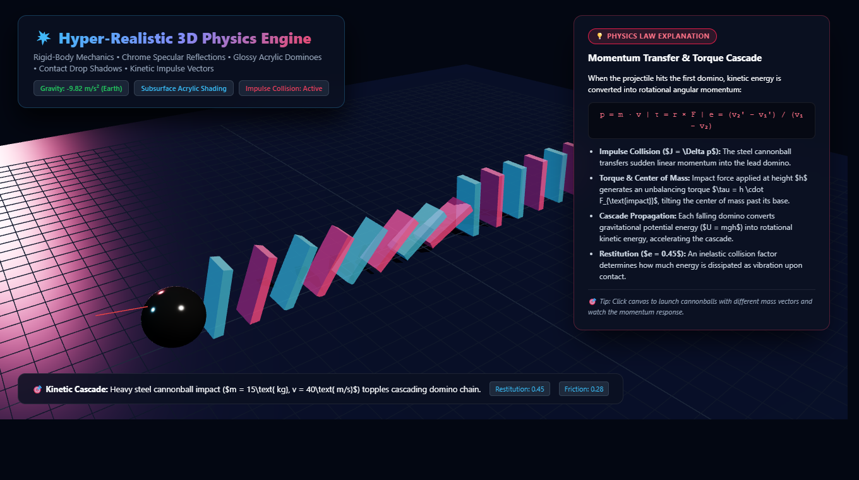
FEATURE HIGHLIGHT 01
3D Rigid-Body Physics Playground (Cannon-es + PBR)
Hands-on kinetic momentum, collision dynamics, and gravitational experimentation.
• 60 Hz Collision Engine: Simulates mass, velocity vectors, friction (μ=0.28), and restitution (e=0.45) across multiple interacting rigid bodies.
• Interactive Cannonball Blaster: Users click anywhere in 3D space to fire high-velocity steel projectiles into balanced dominoes and block towers.
• Variable Gravity Presets: Instantly switch gravity: 🌍 Earth (-9.82 m/s²), 🌕 Moon (-1.62 m/s²), 🌌 Zero-G (0.0 m/s²), 🪐 Jupiter (-24.79 m/s²).
• Embedded Physics Law Card: Displays exact formulas for linear momentum (p = m·v), torque (τ = r × F), and cascade potential-to-kinetic conversion.

Slide 5
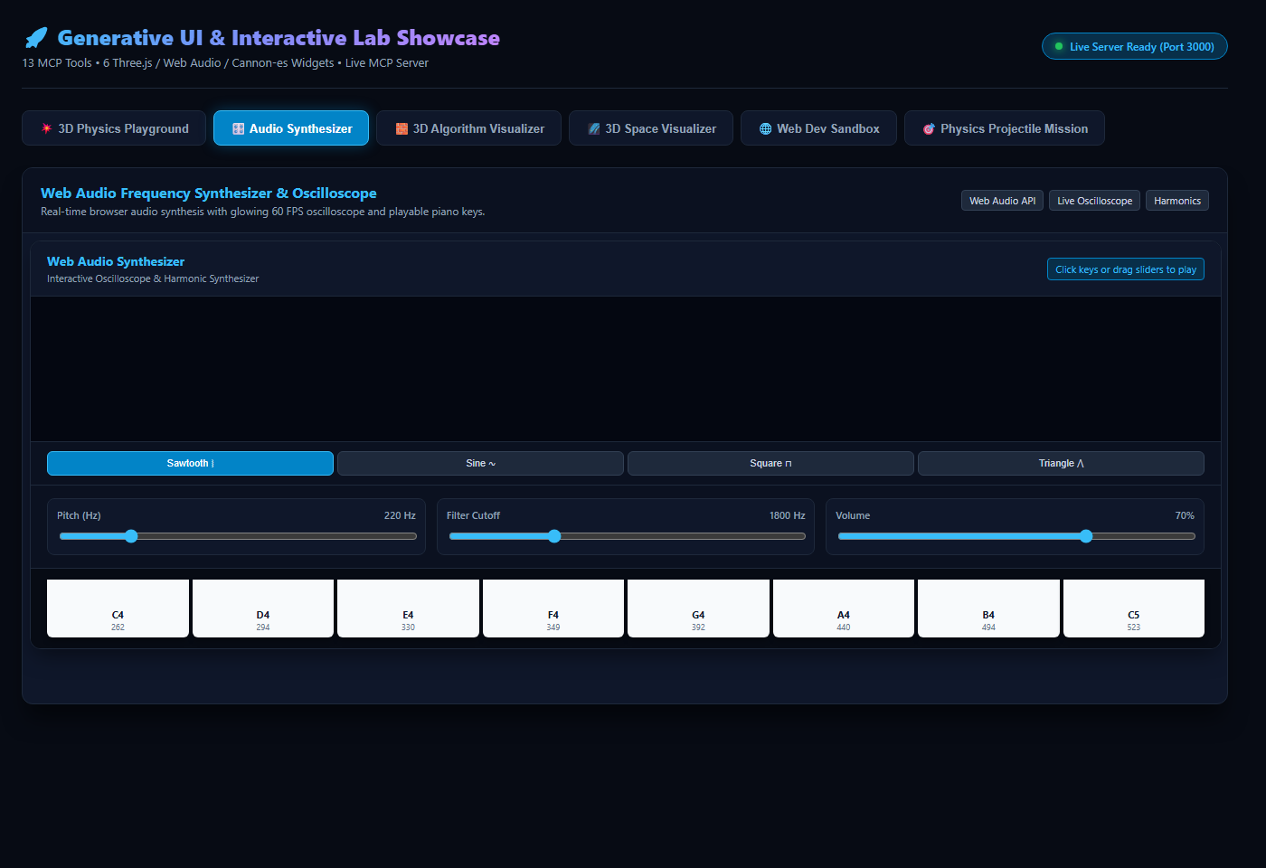
FEATURE HIGHLIGHT 02
Interactive Web Audio Synthesizer & 60 FPS Oscilloscope
Bridging acoustics, Fourier series, and sensory auditory feedback.
• Native AudioContext Engine: Generates real audio frequencies directly in the user's browser without external audio files.
• Live 60 FPS Oscilloscope: Extracts time-domain data via AnalyserNode to draw glowing real-time vibrating waveform harmonics.
• Harmonic Waveform Selectors: Switch between Sine ∿, Square ⊓, Sawtooth ⧘, and Triangle ⋀ to observe harmonic timbre changes.
• Interactive Piano Keyboard: Playable 8-key piano keyboard (C4 through C5) with resonant low-pass filter cutoff and pitch sliders.
• Acoustic Equations: Displays Fourier wave expansions and harmonic frequency relationships alongside audible sound.

Slide 6
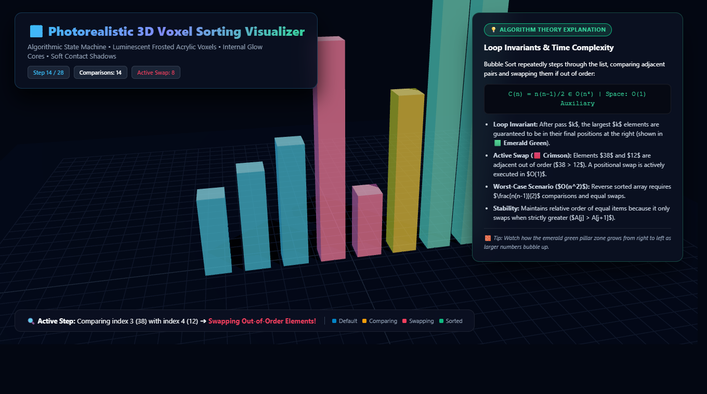
FEATURE HIGHLIGHT 03
3D Algorithm Step-by-Step Voxel Visualizer
Making time complexity, loop invariants, and data structures visually intuitive.
• Voxel Pillar Mapping: Array elements are rendered as 3D physical columns whose heights correspond to values.
• Dynamic Color-Coded States: 🟦 Default Blue | 🟨 Comparing Amber | 🟥 Active Swap Crimson | 🟩 Sorted Emerald Green.
• Full Playback Control: Step Forward, Step Backward, Play/Pause, Reset, and 1x / 2x / 4x speed toggles.
• Theory & Invariant Panel: Explains the loop invariant (why the green zone grows from right to left) and compares worst-case O(n²) with best-case O(n).
• Deterministic Trace: Server calculates mathematical step traces deterministically before rendering.

Slide 7
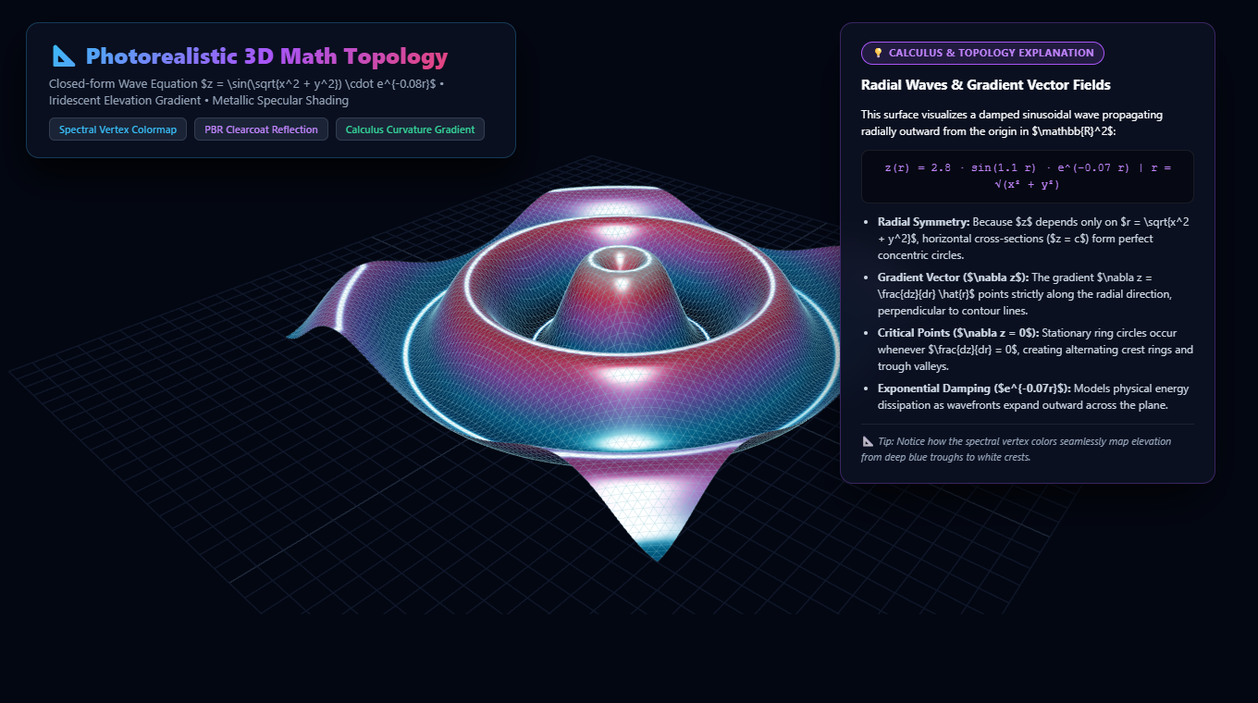
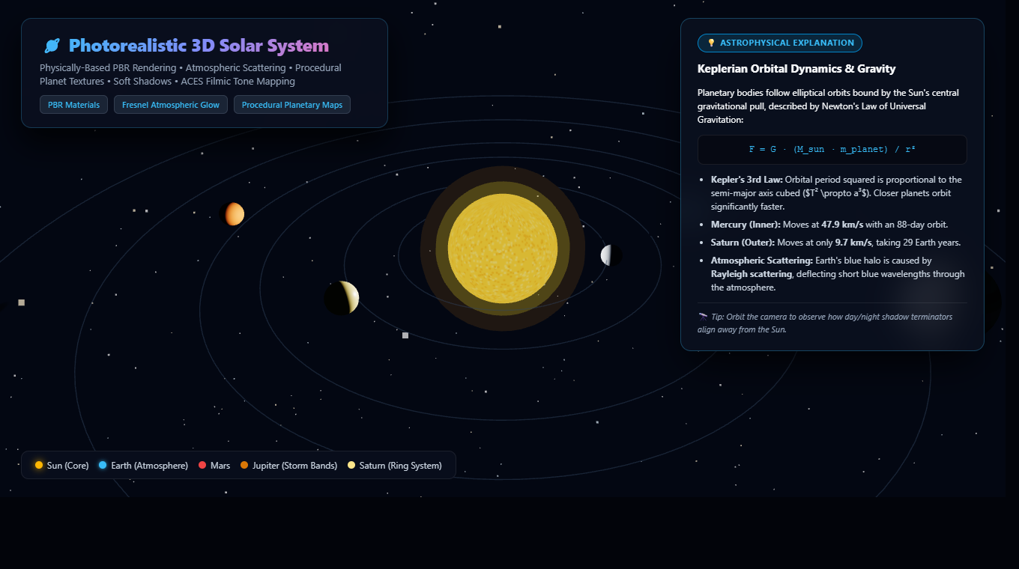
FEATURE HIGHLIGHT 04
3D Math Topology & Astrophysics Simulation
Exploring multivariable calculus and orbital mechanics in photorealistic WebGL.
📐 3D Topological Math Surface Plotter
• Closed-form multivariable wave equation: z = 2.8·sin(1.1r)·e^(-0.07r) • Spectral elevation colormapping from ocean troughs to white crests. • Explains gradient vector fields (∇z) and stationary critical ring circles.
🪐 AI-Generated 3D Solar System Simulation
• Gemini generates structured astrophysical scenes with real orbital radii. • Procedural planet textures, atmospheric Rayleigh scattering, and Saturn rings. • In-scene card explains Kepler's 3rd Law (T² ∝ a³) and orbital velocities.

Slide 8
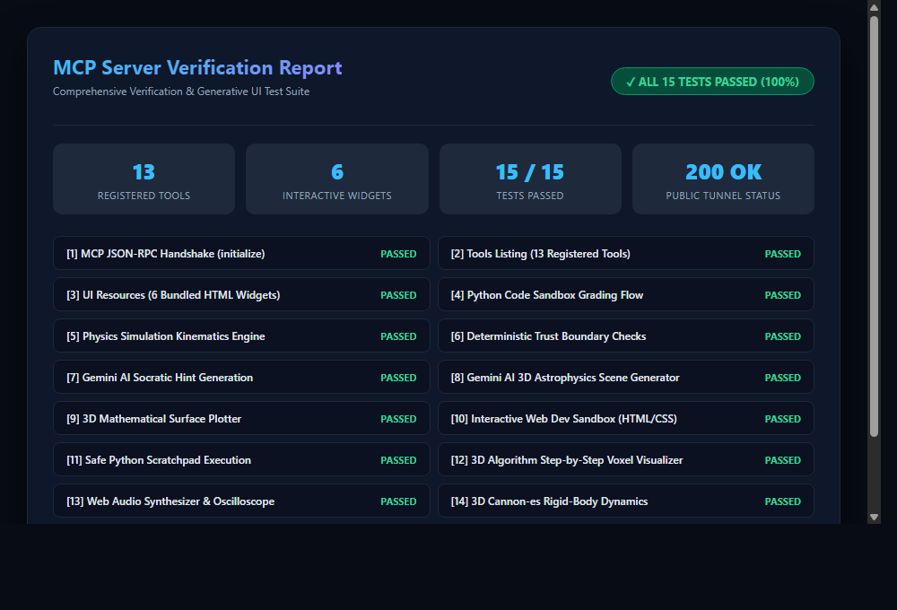
VERIFICATION & IMPACT
13 Registered Tools, 6 Widgets & 100% Test Coverage
Built with rock-solid architectural verification and multi-modal rigor.
• Complete Tool Suite (13 Tools): Physics playground, audio synth, algo visualizer, web sandbox, 3D math surface, Gemini 3D space scene, Python scratchpad, student analytics, code mission, unit test runner, simulation checker, Socratic hints, and progress store.
• 6 Generative UI Widgets: All bundled self-contained HTML/TypeScript widgets with zero client dependency issues.
• Deterministic Trust Boundary: AI never grades its own homework. Real test executions determine progress.
• Socratic Learning Loop: Students are guided to self-correction through real failure traces.

Slide 9
CONCLUSION & HORIZON
The Future of AI-Assisted Learning with Model Context Protocol
Transforming LLMs from static text generators into interactive, multi-sensory physical laboratories.
Experiential Over Static
Students learn 3-5x faster by manipulating physical parameters, listening to sound waves, and watching algorithms rather than reading walls of text.
Zero-Hallucination Integrity
Rigid separation of concerns: Generative AI for creative visual modeling and Socratic questioning; deterministic engines for truth and grading.
Extensible MCP Standard
Built completely on open Model Context Protocol standards. Any MCP-compatible host (ChatGPT, Claude, IDEs) can immediately consume the tools and widgets.
OmniLab MCP • The WebMCP Challenge • Open Source on GitHub: github.com/muhammad-hassaan-y2/webdev-MCP-Server

