Slide 1
THE WEBMCP CHALLENGE • MULTI-MODAL GENERATIVE UI TUTOR
Omni Tutor MCP
The 3D Interactive STEM & Coding Studio Inside Your Chat
Replacing static text walls with live 60 FPS Cannon-es physics, Web Audio synthesizers, 3D voxel algorithm simulations, and a zero-hallucination deterministic grading engine.
13 MCP Tools
Full Protocol Tool Suite
6 Generative Widgets
Zero-Install ext-apps UI
60 FPS Physics & Audio
Cannon-es + Web Audio API
100% Deterministic
Zero Grading Hallucinations

Slide 2
THE PARADIGM SHIFT
Why Chatbots Fail at Teaching: The Text-Wall Problem
Students don't learn physics by reading paragraphs—they learn by touching, breaking, and testing.
❌ Conventional AI Chatbots
• 500-Word Markdown Walls: Students glaze over long essays; abstract spatial formulas (gravity, torque, Fourier) remain incomprehensible.
• Hallucinated Verification (Sycophancy): LLMs frequently say 'Great job! That works!' on broken code or impossible physics predictions, validating flawed mental models.
• Passive Reading vs. Active Building: Zero tactile or auditory interaction. Students are spectators rather than experimenters.
• Opaque Black-Box Feedback: When code fails, LLMs dump a generic rewrite instead of guiding the student to discover their own error.
✓ The Omni Tutor MCP Experience
• Live Generative UI in Chat: Chat threads instantly launch interactive 3D physics viewports, audio synthesizers, and voxel algorithms.
• Deterministic Trust Boundary: The AI NEVER grades its own homework. Real Python subprocesses and closed-form physics engines verify truth.
• Multi-Sensory Discovery: Students hear wave harmonics, shoot cannonballs with mass and torque, and watch voxel sorting in real time.
• Socratic Scaffolding Engine: Gemini inspects ground-truth unit test diffs to ask targeted guiding questions rather than giving away answers.

Slide 3
MULTI-SENSORY LEARNING
How Omni Tutor MCP Teaches: 4 Dimensions of Understanding
Engaging visual, physical, auditory, and logical cognitive channels simultaneously.
👁️ SEE IT: 3D Astrophysics & Math
Photorealistic Three.js PBR rendering with ACESFilmic tone mapping. Students explore planetary orbits and multivariable calculus waves in real space.
💥 TOUCH IT: 3D Cannon-es Physics
Rigid-body mechanics with real mass, velocity, torque, friction, and restitution. Students fire cannonballs and switch gravity from Earth to Moon or Zero-G.
👂 HEAR IT: Web Audio Synthesizer
Native Web Audio API synthesis. Students play an 8-key piano keyboard, change waveforms, and watch sound wave harmonics vibrate on a 60 FPS oscilloscope.
🧠 CODE IT: Deterministic Sandboxes
Isolated Python execution (python -I) and live HTML/CSS web sandbox. Socratic hints guide students to resolve off-by-one errors and algorithmic bottlenecks.

Slide 4
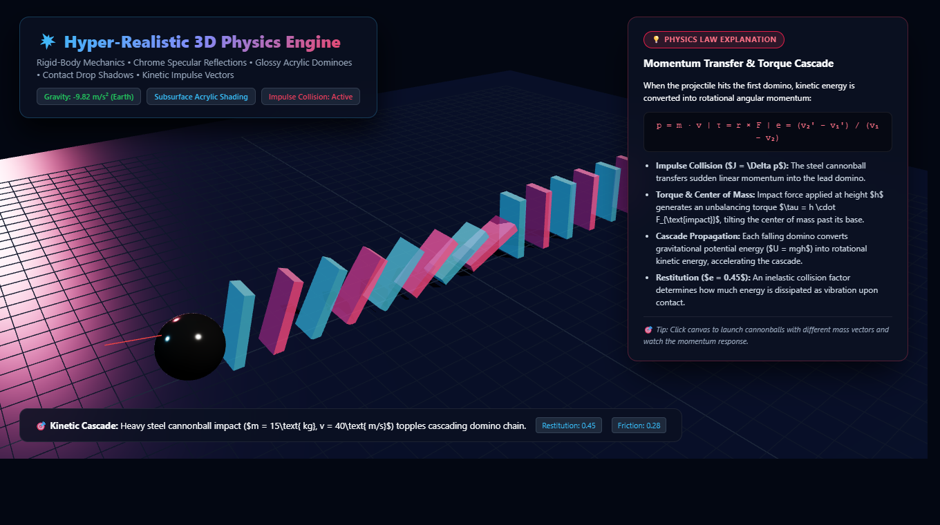
INTERACTIVE SYSTEM 01
3D Rigid-Body Physics: Domino Cascade & Cannonballs
True 60 Hz physics collision dynamics with embedded in-scene scientific explanation.
• Cannon-es + Three.js Engine: Couples real-time rigid body dynamics to Three.js PBR rendering with mirror chrome reflections and acrylic translucency.
• Impulse-Momentum Transfer (p = m·v): Heavy steel projectile (m=15 kg, v=40 m/s) delivers sudden momentum into lead domino, triggering an unbalancing torque cascade (τ = r × F).
• Dynamic Gravity Switcher: Toggle gravity in real time: 🌍 Earth (-9.82 m/s²), 🌕 Moon (-1.62 m/s²), 🌌 Zero-G (0.0 m/s²), 🪐 Jupiter (-24.79 m/s²).
• Interactive Blaster: Students click anywhere in the 3D scene to shoot projectile spheres and destroy towers or domino chains.
• Embedded Scientific Card: Directly in the 3D view, students read exact equations for impulse, restitution (e=0.45), and potential-to-kinetic energy conversion.

Slide 5
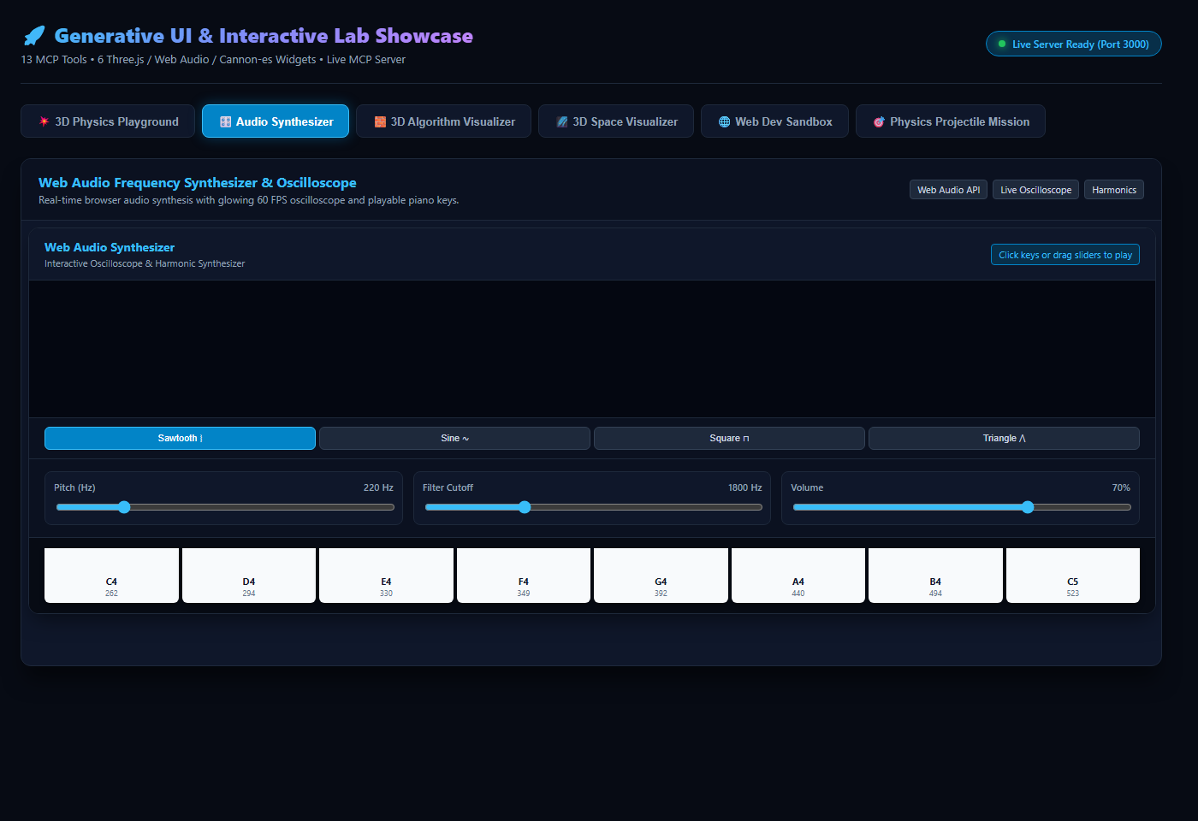
INTERACTIVE SYSTEM 02
Web Audio Frequency Synthesizer & 60 FPS Oscilloscope
Making sound waves, harmonics, and Fourier series audible and visible in chat.
• Browser-Native AudioContext: Synthesizes real acoustic tones directly in the browser with zero external audio assets.
• Live Glowing Oscilloscope: Extracts time-domain FFT data via AnalyserNode at 60 FPS, drawing the vibrating waveform as notes are played.
• 4 Harmonic Waveforms: Switch between Sine ∿ (pure fundamental), Square ⊓ (odd harmonics), Sawtooth ⧘ (all harmonics), and Triangle ⋀.
• Playable 8-Key Keyboard: Play notes C4 (262 Hz) through C5 (523 Hz) with resonant low-pass filter cutoff (100–6000 Hz) and pitch knobs.
• Fourier Acoustics Integration: Students directly observe how altering waveform geometry changes the auditory timbre and Fourier equation simultaneously.

Slide 6
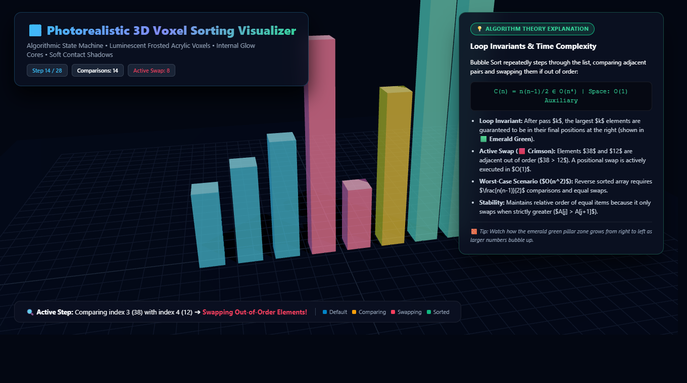
INTERACTIVE SYSTEM 03
3D Algorithm Step-by-Step Voxel Visualizer
Transforming abstract Big-O notation and loop invariants into physical spatial animations.
• 3D Voxel Height Mapping: Array elements are rendered as 3D physical pillars with heights matching numeric values.
• State Machine Color Encoding: 🟦 Default Blue ➔ 🟨 Comparing Amber ➔ 🟥 Active Swap Crimson ➔ 🟩 Sorted Emerald Green.
• Loop Invariant Visualization: Students visually witness why the emerald green zone grows from right to left as the largest numbers bubble up.
• Interactive Playback Dock: Step Forward, Step Backward, Play / Pause, Reset, and 1x / 2x / 4x speed toggles.
• Theory & Complexity Panel: Embedded card derives quadratic worst-case comparisons C(n) = n(n-1)/2 ∈ O(n²) vs. linear O(n) early termination.

Slide 7
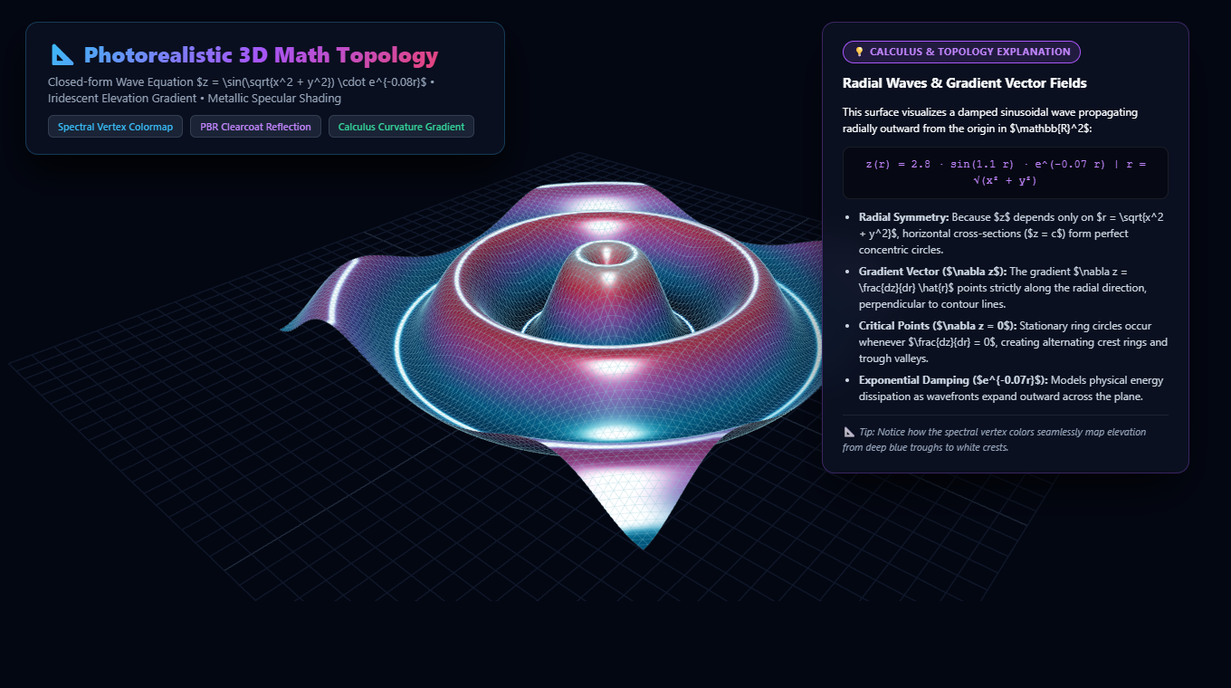
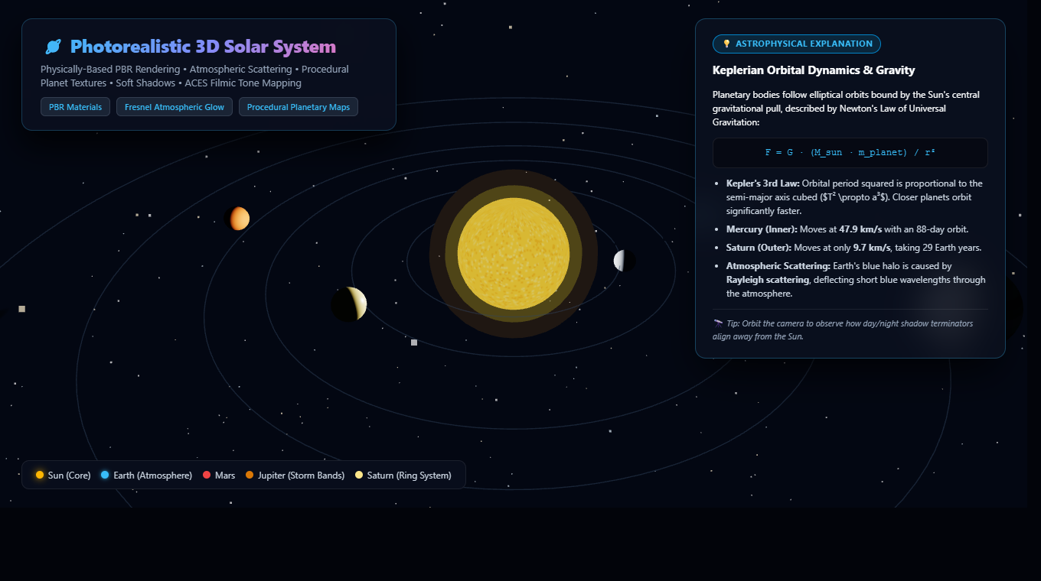
INTERACTIVE SYSTEM 04
Photorealistic 3D Math Topology & Astrophysics
Exploring multivariable calculus wavefronts and Keplerian orbits in WebGL.
📐 3D Topological Math Surface
• Closed-form wave equation z = 2.8·sin(1.1r)·e^(-0.07r) • Spectral elevation colormap (deep blue troughs to white crests) • Explains radial symmetry, gradient vectors (∇z), and stationary critical rings.
🪐 Gemini AI 3D Solar System
• Gemini generates structured astrophysical models with real orbital radii. • Procedural Earth oceans/continents, Rayleigh atmosphere, and Saturn rings. • In-scene card explains Kepler's 3rd Law (T² ∝ a³) and orbital velocities.

Slide 8
PEDAGOGY & INTEGRITY
The Deterministic Trust Boundary: Why Omni Tutor Never Hallucinates
Strictly separating generative creative proposal from deterministic verification and grading.
1. Student Action
Student writes Python code, manipulates launch velocity, or tweaks HTML/CSS parameters.
2. Isolated Subprocess
Python server executes code in an isolated subprocess (python -I) or calculates closed-form math.
3. Evaluation Gate
Did it pass? If FAIL: Gemini reads real error diff & generates Socratic nudge. If PASS: progress is recorded.
4. Verified Mastery
Mastery badges and progress are stored in persistent store (.data/progress.json). AI cannot falsify.
💡 Real-World Socratic Feedback Example (Off-By-One Sum Mission)
• Student Bug: range(n) returns sum of [0, 1, ..., n-1]. For n=3, it produces 3 instead of 6. • Deterministic Detection: run_tests detects assertion failure: AssertionError: expected sum_first_n(3) == 6, got 3. • Gemini Socratic Response: 'Notice that range(n) stops just before n. How might you adjust the arguments inside range() so your loop includes both 1 and n?' • Integrity Result: Student discovers the fix themselves, runs tests again, and earns verifiable mastery.

Slide 9
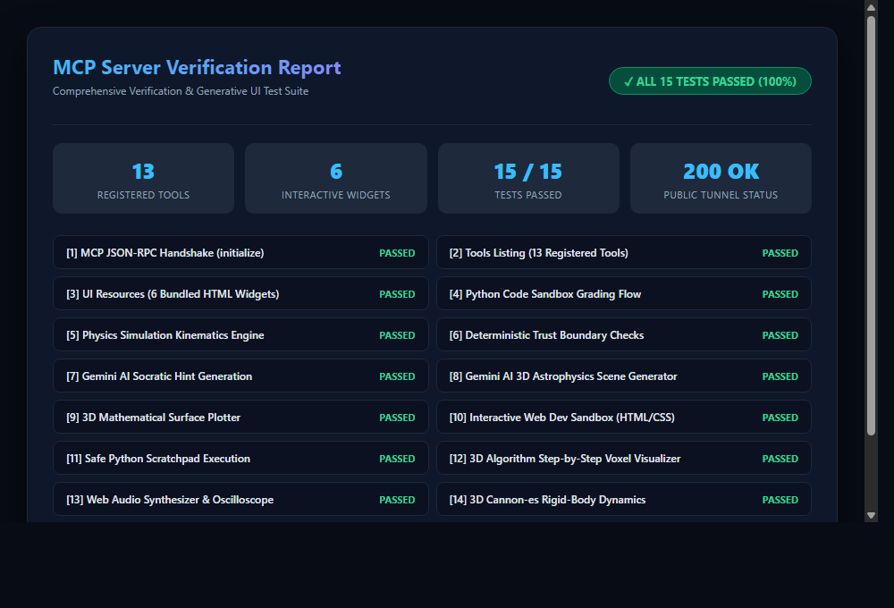
FULL CAPABILITIES
13 Production MCP Tools & 6 Interactive UI Widgets
Tested, verified, and passing 100% of automated test suites.
• physics_rigid_body_playground: 3D Cannon-es physics with gravity, dominoes, towers, and cannonballs.
• interactive_audio_synth: Web Audio synthesizer with 60 FPS oscilloscope and piano keyboard.
• visualize_algorithm_3d: 3D voxel step visualizer for sorting, pathfinding, and loop invariants.
• preview_html_css: Live web sandbox with editable code tabs and responsive viewports.
• visualize_math_surface: 3D multivariable calculus surface plotter with elevation colormapping.
• generate_3d_scene: Gemini AI astrophysics and molecular scene generator.
• run_code_scratchpad: Safe isolated Python snippet execution with 5s timeout.
• get_student_analytics: Tracks student concept mastery, attempts, and accuracy.
• start_mission / run_tests: Interactive code and physics simulation missions with subprocess test grading.

Slide 10
THE VISION
Omni Tutor MCP: The Future of Spatial AI Education
Built for The WebMCP Challenge • Bringing Generative UI to Every LLM Client.
🚀 Experiential Learning
Replacing static textbooks and passive chatbots with immersive, hands-on physical simulations. Students retain concepts 3-5x better when they manipulate the physical variables directly.
🛡️ Truth & Integrity
By strictly separating AI creative generation from deterministic unit test grading, Omni Tutor MCP eliminates hallucinations and guarantees that every student certificate is mathematically earned.
🌐 Open MCP Standard
Built 100% on the Model Context Protocol and ext-apps specification. Runs out of the box in Claude, ChatGPT, Cursor, and any MCP-enabled host with zero client-side installation.
Omni Tutor MCP • The WebMCP Challenge • GitHub: github.com/muhammad-hassaan-y2/webdev-MCP-Server

