Slide 1
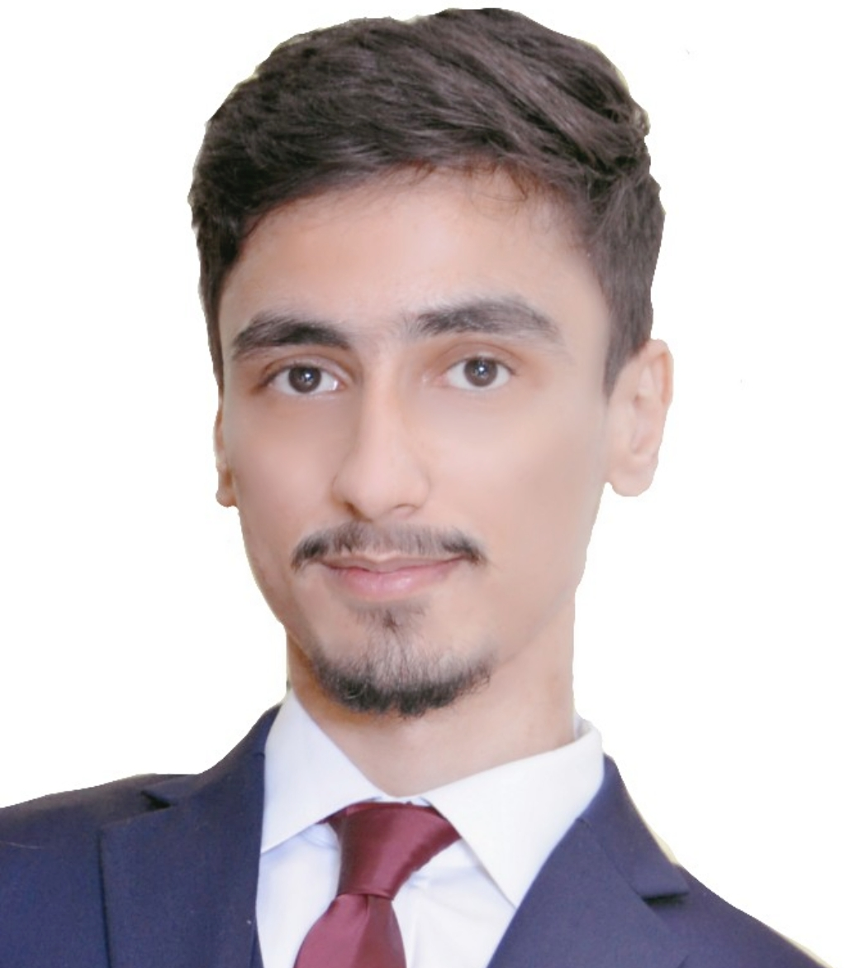
Hussain Mohamed Albasri
Seeking a challenging entry level position in the works field where I may be able to utilize and expand my data, leverage , and develop into a new kind of work.
Personal information
Education and trainning
Date of birth: 10/5/1995
CPR: 950502561
Place of Birth: MANAMA
Nationality: BAHRAINI
Marital Status: Married
Passport: 2107633
Bahrain – Hamad town
H1679/ R1629/ B1216
973 37700549 - 36160690
HussainAlbasri1995@gmail.com
------------------------------------------------.
2011 – 2014, Al-Jabrya Secondary School Completed my secondary studies in Advance Industrial Studies with a degree in Electricity and Machines filed with score 89% from the Year
2014; I have completed The Entrepreneurship Orientation Program in Bahrain Development Bank
The program was under Directorate of Technical and Vocational Education and Ministry of Education.
Our responsibly was in the project how to Planning and training on Projects Management.
2017; Licensed as Wireman from Electricity and Water Authority with Certificate of Competence Cineco; Bahrain Cinema in December 2016 – :Usher; Cinema Guide Support
-----------------------------------------------------------------------
Personal skills
1.Lead under pressure 2.Strong planning
3.time management
4.Customer services
5.Solving Problems
6.Sales Ability
7.cummincation skills
------------------------------------------------.
Personal Experience:
Carriage food delivery, I worked as driver in October 2017.
Project company, Electric buildings in the electricity supply, in February 2018.
Alshaya company, Solaris shop as sales associates June 2018 until April 2019.
Language
English
Arabic
Very good command of spoken and written.
Typing fast in both.
Thank you for giving me of your valuable time to read my CURRIULUM VITTEA

