Slide 1
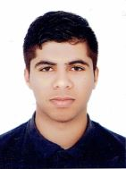
CURRICULUM VITAE
PERSONAL DETAILS
Name
Date of birth
Nationality
Social status
CPR Number
Address
Mobile
E-mail
Jasim Baqer Jasim
30/12/1999
Bahraini
Single
991210336
629 road 6212 Block 362
34656755
Jasimbaqer-1999@hotmail.com
EDUCATION
Qualification received
High school in commerce
Institute/School
Graduation year
Shaikh Abdul Aziz Bin Mohammed secondary school
2017
SKILLS
Languages
Computer skills
Interpersonal skills
Speak-Read-Write: English and Arabic
MS office windows(Word, Excel, Access, Front page, Publisher)
Working under pressure
Good communication skills
Good time management skills
Experience
- Worked for 3 month in “Bahrain bride”
- Worked for one year in “New style aluminum & automatic system”
(Referent : 17625293)
(Referent : 33390788)

