Slide 1
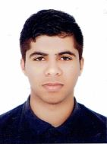
CURRICULUM VITAE
PERSONAL DETAILS
Name
Date of birth
Nationality
Social status
CPR Number
Address
Mobile
Jasim Baqer Jasim
30/12/1999
Bahraini
Single
991210336
629 road 6212 Block 362
34656755
EDUCATION
Qualification received
High school in commerce
Institute/School
Graduation year
Shaikh Abdul Aziz Bin Mohammed secondary school
2017
Experience
-
SKILLS
Languages
Computer skills
Interpersonal skills
Speak-Read-Write: English and Arabic
MS office windows(Word, Excel, Access, Front page, Publisher)
Working under pressure
Good communication skills
Good time management skills
INTRESTS
-Internet , football
OBJECTIVE
TO work in challenging environment where I can use, improve and develop my skills .

